Slide 1
Chapter 7
Linear Approximation

Slide 2
Outline
Review of Linear Approximation for Nonlinear Terms
A Case Study
  Renewable Sensor Networks with Wireless Energy Transfer

Slide 3
Linear Approximation
Motivation
  Nonlinear optimization is difficult
  Linear programming is easy to solve with many efficient tools available
Basic idea: Replacing nonlinear terms by some linear approximation approach
  Demonstrating piecewise linear approximation in this chapter

Slide 4
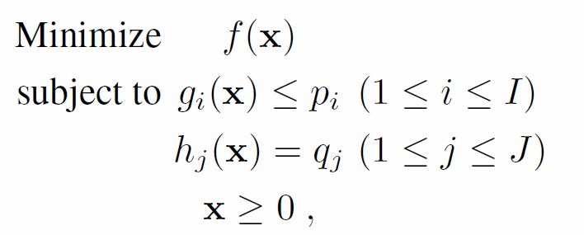


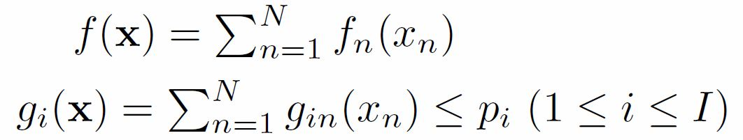



Separable Problem
Objective function and constraint functions are additively separable
Constraint functions are linear
and are constants

Slide 5



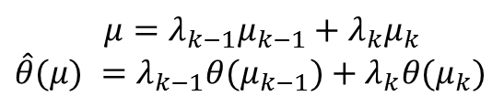










Piecewise Linear Approximation
$θ$(·)
$$μ=λ_{k−1}μ_{k−1}+λ_{k}μ_{k}$$
$$\hat{θ}(μ) =λ_{k−1}θ(μ_{k−1})+λ_{k}θ(μ_{k})$$
$\hat{θ}$(·)
$\hat{θ}(μ)$
$$θ(μ)$$
$$μ_{0}=a$$
$$μ_{1}$$
$$μ_{2}$$
$$μ_{k−1}$$
$$μ$$
$$μ_{k}$$
$μ_{m}=b$
: A continuous nonlinear function
: A linear approximation of
Notes:
Note that \lambda_{k-1} and \lambda_{k} is nonnegative, and their sum is 1.

Slide 6



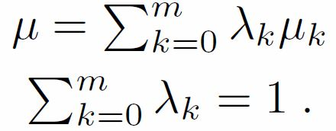



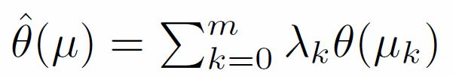
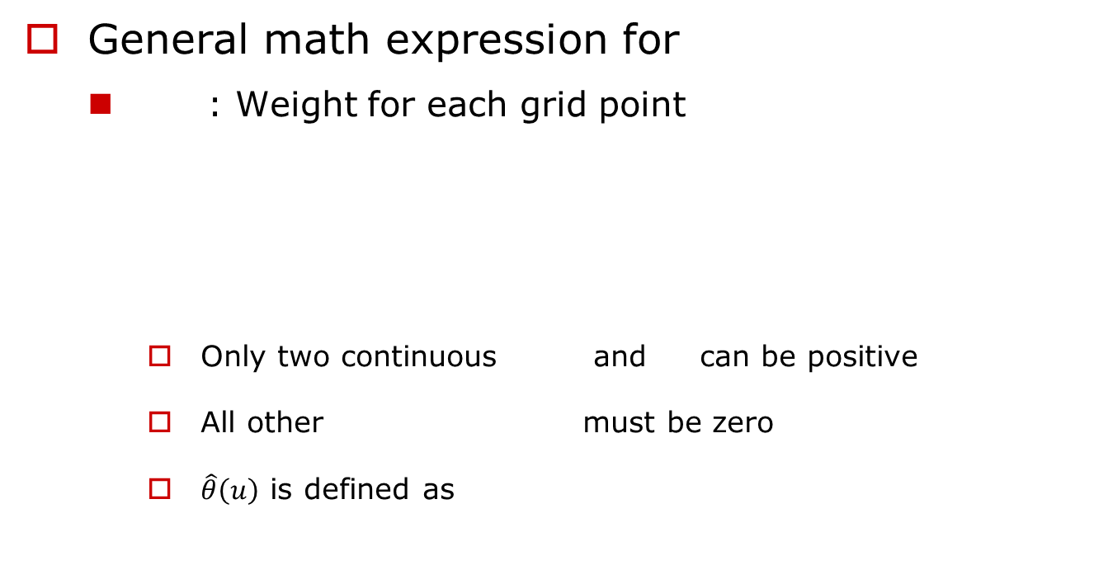
Piecewise Linear Approximation (cont’d)
General math expression for
  : Weight for each grid point
    Only two continuous and can be positive
    All other must be zero
    $\hat{θ}\left(u\right)$ is defined as

Slide 7



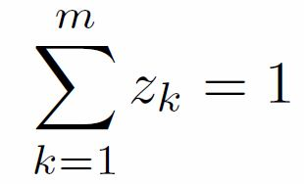
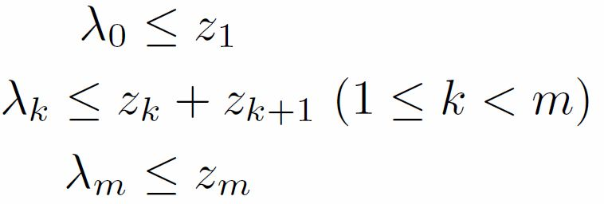
Piecewise Linear Approximation (cont’d)
  : A binary variable indicates whether falls within the k-th segment
  Relationship between and
Notes:
u can only falls in one of the m segments.
Three inequations mean
\lambda_0 >0 only if z_1 = 1
\lambda_k>0 only if z_k = 1 or z_k+1 = 1
\lambda_m >0 only if z_m = 1

Slide 8


Piecewise Linear Approximation (cont’d)
Back to the separable problem
  Replacing each nonlinear function and by its piecewise linear approximation
The solution to the linear approximating problem may or may not be feasible to the original separable problem
  Feasible: Accuracy/complexity vs. number of grid points
  Infeasible: Construct a feasible solution by local search
Notes:
The accuracy of piecewise linear approximation is closely related with the number of grid points used in approximation.
For each variable, we can expect that the performance of solution improves as the number of grid points increases.
However, as the grid number increases, the number of variables in the linear approximating problem also increases, which leads to a higher complexity.

Slide 9
Outline
Review of Linear Approximation for Nonlinear Terms
A Case Study
  Renewable Sensor Networks with Wireless Energy Transfer

Slide 10
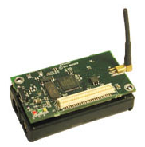
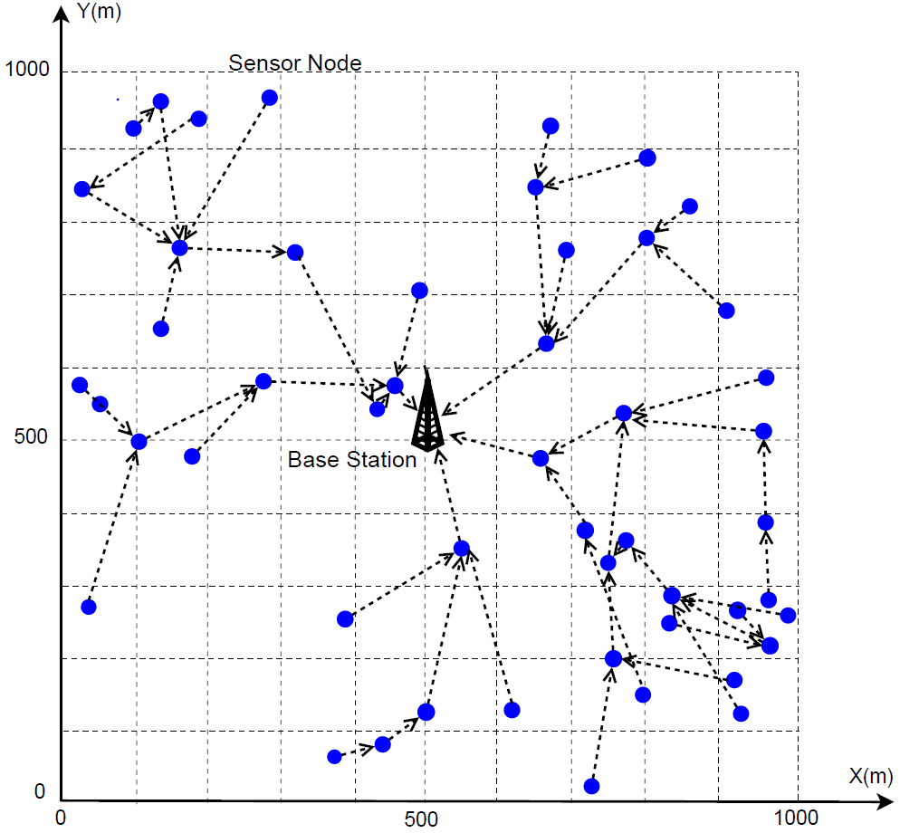
Wireless Sensor Networks (WSNs)
Sensor nodes
  Sensing multi-media (video, audio etc.) and scalar data (temperature, pressure, light etc. )
  Transmitting data to the base station via multi-hop
  Battery-powered
Network lifetime
  Limited by battery outage
  Tremendous research efforts
  Energy-harvesting
Notes:
In academia and industries, there are tremendous research efforts to maximize or prolong the network lifetime, for example, energy-efficient routing.
Energy-harvesting techniques have been proposed to extract energy from the environment, their success remains limited in practice.
This is because
1) the proper operations of any energy-harvesting technique is highly dependent on the environment.
2) the size of an energy-harvesting device may pose a concern in deployment, particular
when the size of such device is of much larger scale than the sensor node it is attempting to power.

Slide 11
WSNs (cont’d)
But lifetime remains a major performance bottleneck
Our objective
  Remove the fundamental performance bottleneck
  Motivated by the recent breakthrough in wireless energy transfer

Slide 12
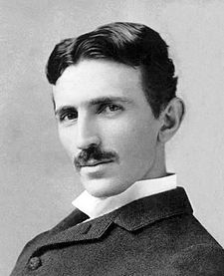
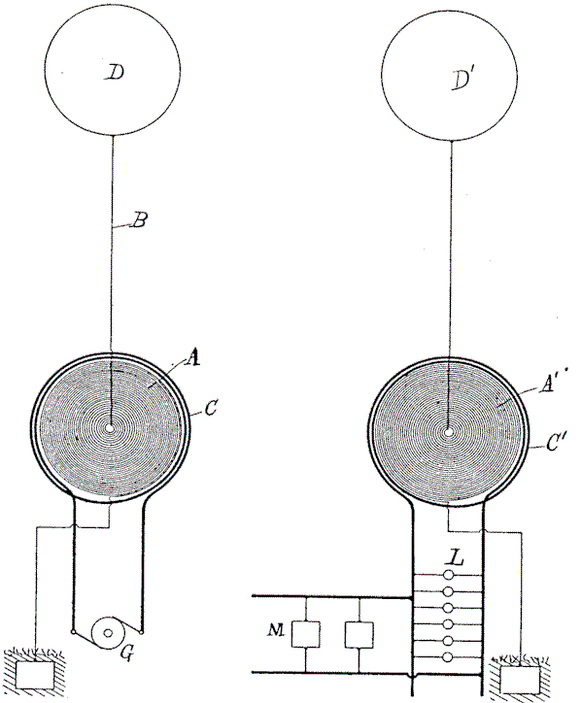
Wireless Energy Transfer
Dated back to the early 1900s by Nikola Tesla
Radiative mode by omni-directional antennas
  Low efficiency
  Never put into practice use
Notes:
A vast majority of energy is wasted into free space.
Not suitable for large scale wireless power distribution.

Slide 13

Wireless Energy Transfer (cont’d)
Little progress over nearly a century
In early 1990, the critical need of
wireless power transfer re-emerged
  Example: electric toothbrush
Limited applications due to
stringent requirements
  Omni-directional antennas: close in contact
  Uni-directional antennas: accurate alignment in charging direction, uninterrupted line of sight

Slide 14
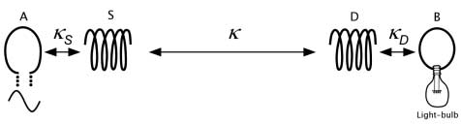
Wireless Energy Transfer (cont’d)
A breakthrough technology: Magnetic resonance
  Published in Science 2007
  Non-radiative, based on resonant coupling
Omni-directional, mid-range (up to 2 meters) and efficient energy transfer
A 60-W light bulb is lighted up from a distance of 2 meters away (by Kurs et al.)
Notes:
Using the novel technology, the wireless energy transfer is efficient, which make the wireless energy transfer not only possible, but practical.

Slide 15
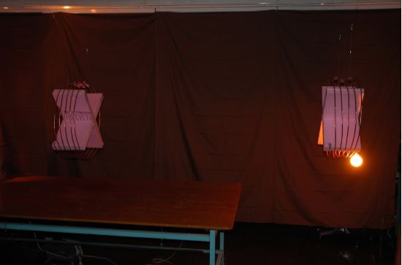
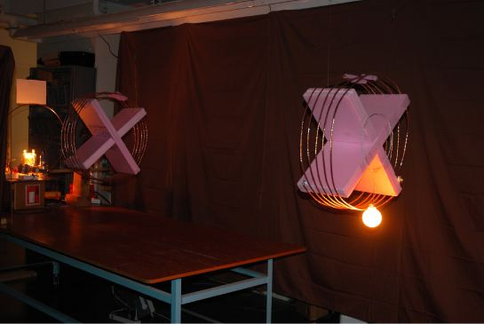
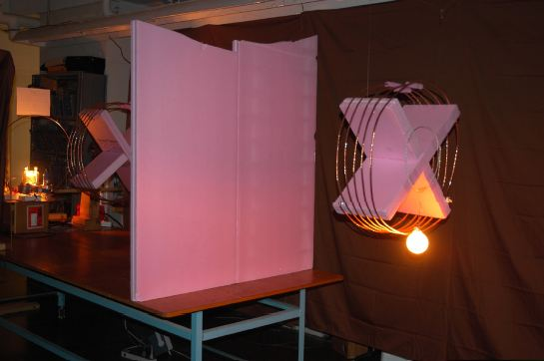
Experiment Setting
Notes:
Using the novel technology, the wireless energy transfer is efficient, which make the wireless energy transfer not only possible, but practical.

Slide 16
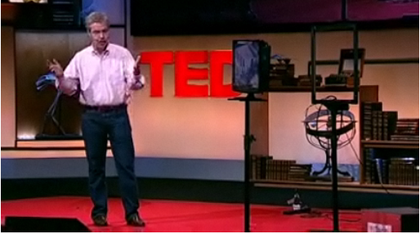


Wireless Energy Transfer (cont’d)
The emerging technology
comes to reality!
Wireless power consortium is setting the international standard for interoperable wireless charging
Demonstrated in 2009 TED Global
Revolutionize how energy is exchanged in the near future!
The first No-tail TV was released at 2010 International CES
Notes:
1) The emerging technology was demonstrated at the TED Global Conference held in Oxford in July 2009.
In this demonstration, A WiTricity power unit is shown to power a television as well as three different cell phones.
2) no-video cable, audio cable, signal cable, network cable, power line
3) Recently, wireless Power Consortium was established to set the international standard for interperable wireless charging.

Slide 17



Problem Description
Mobile Wireless
Charging Vehicle (WCV)
Objective:
Make sensor network work forever
Maximize the percentage of vacation time
Service
Station
Sensor Node
Base Station
Notes:
To recharge the battery at each sensor node, a mobile wireless charging vehicle is employed in the network.
It starts at a service station, visits sensor node one by one.
When it arrives at a sensor node, it will spend some time to charge the sensor node’s battery wirelessly via non-radiative energy transfer.
After the mobile WCV visits all sensor nodes, it will return to the service station to be serviced.
Some maintenance can be done in the service station, for example, replacing or recharging the battery in the vehicle.
The resting period is named vacation time.
After this vacation, the WCV will get ready and go out for its next trip.
A number of questions can be raised for such re-chargeable sensor network.
First and the most important one is: is it possible that every sensor node never run out of its battery?
If so, can we maximize the percentage of vacation time during a trip, equivalently, minimize the percentage of time that the WCV need to work?

Slide 18
Three Basic Components
Traveling path (including direction) for WCV
Charging schedule at each node
Multi-hop data routing

Slide 19
Outline of Case Study
A Solution Procedure
  Renewable energy cycle
  The optimal traveling path for WCV
  The optimal charging schedule and multi-hop data routing
Numerical Results

Slide 20








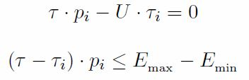
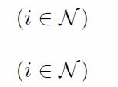
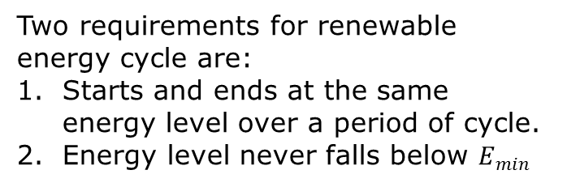
Renewable Energy Cycle
Sensor Energy Behavior
i
Vacation
Time
Arrival
time
Departure time
Two requirements for renewable energy cycle are:
Starts and ends at the same energy level over a period of cycle.
Energy level never falls below $E_{min}^{}$
Notes:
Three phases: 1) the charging vehicle leaves the service station but haven’t arrived at the target sensor node. During this period, the sensor node purely consumes energy because of data transmission.
2) The charging vehicle recharges the sensor node while the sensor consumes energy. Overall, the energy level goes up.
3) The charging vehicle leaves the sensor node, goes back to the service station and has vacation. The same as the first phase, the sensor energy level goes down for pure energy consumption.

Slide 21
Optimal Traveling Path
In an optimal solution, the WCV must move along the shortest Hamiltonian cycle that crosses all sensor nodes and the service station
  Obtained by solving the Traveling Salesman Problem (TSP)
The shortest cycle may not be unique
WCV can follow either direction
Any shortest path can achieve the same optimal objective
Notes:
One way is to throw everything into an optimization problem and attempt to solve it.
However, there is a better way. We can deduce the optimal traveling path before we solve the complete optimization problem.

Slide 22

Charging Schedule and Data Routing
Traveling path for WCV
Charging schedule at each node
Multi-hop data routing
Notes:
In short, data routing and charging schedule cannot be de-coupled.

Slide 23
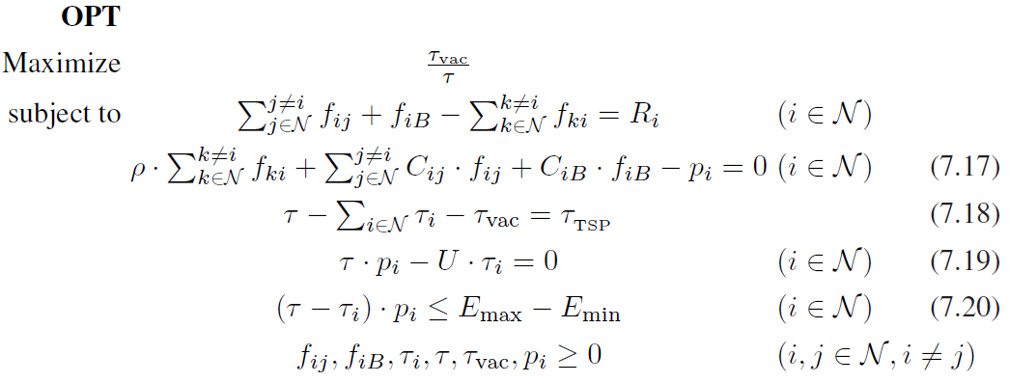

Optimization Problem
The ratio of the WCV’s vacation time to a cycle time
Routing constraint
Energy consumption
Time constraint
Cycle constraints
Data routing
Charging schedule
Consumed energy
Nonlinear optimization problem: NP-hard in general.

Slide 24

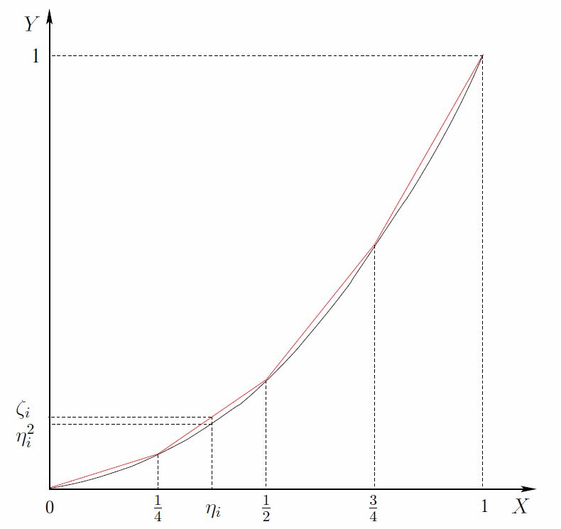
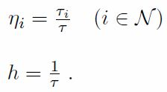
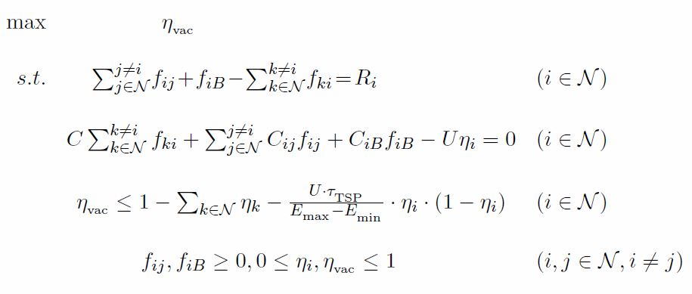

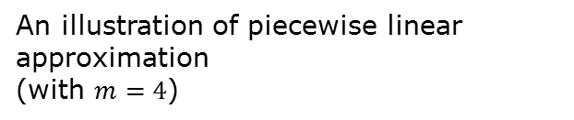

A Near-Optimal Solution
Problem OPT
Change-of-variable technique
Change-of-variable technique
Now only a nonlinear term $η_{i}^{2}$ exists for each $i$
Problem OPT-R
OPT-R
Piecewise linear approximation
Piecewise linear approximation
Linear relaxed formulation
Problem OPT-L
An illustration of piecewise linear approximation
(with $m=4$)
The approximation error $ζ_{i}−η_{i}^{2}≤\frac{1}{4m^{2}}$

Slide 25
Performance Gap vs. Segment Number
UB
An upper bound is obtained
by linear relaxation OPT-L
Estimated
performance
gap
Unknown optimal objective
value of problem OPT
Performance
gap
LB
A lower bound is obtained by
feasible solution construction
Estimated performance gap is a decreasing function of m (the number of segments in approximation)

Slide 26

Choosing Segment Number
Estimated
performance
gap < є
UB
An upper bound by linear relaxation
Unknown optimal objective value
Target
performance
gap є
A feasible solution is constructed
LB
Given an arbitrarily small performance gap $ϵ$
2) Choose an appropriate $m$ (a function of $ϵ$)
3) Construct a provable near-optimal solution

Slide 27
Summary of Solution Approach
Traveling path for WCV
Charging schedule at each node
Multi-hop data routing
The performance gap is no more than requirement є

Slide 28


Sensor Energy Behavior
- Complete Process
Initial transient cycle
1st renewable
energy cycle
2nd renewable
energy cycle
0
The first renewable energy cycle starts.
The first renewable energy cycle ends, i.e.,
the second renewable energy cycle starts.
Notes:
Construction of Initial Transient Cycle
By now, we skipped discussion on how to construct the initial transient cycle before the first renewable cycle.
Unlike a renewable energy cycle at node i, which starts and ends with the same energy level E_i,
the initial transient starts with E_max and ends with E_i.

Slide 29
Outline of Case Study
A Solution Procedure
  Renewable energy cycle
  The optimal traveling path for WCV
  The optimal charging schedule and multi-hop data routing
Numerical Results

Slide 30
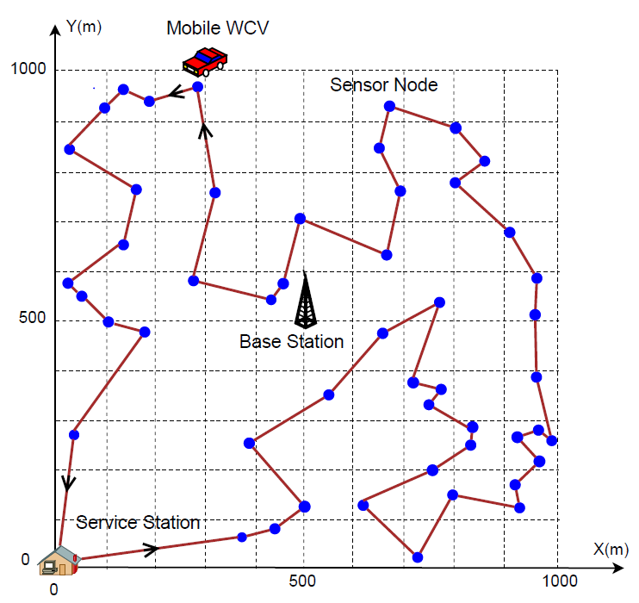
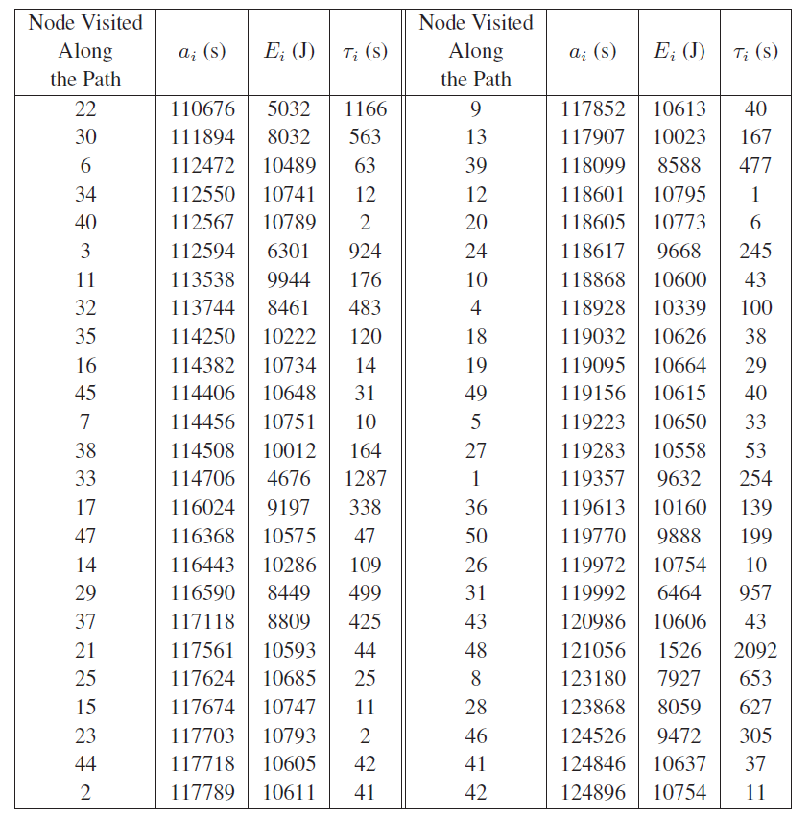
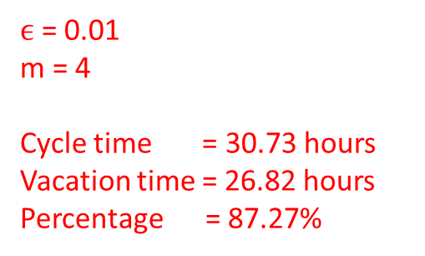
A 50-node Network
$ϵ$= 0.01
m = 4
Cycle time = 30.73 hours
Vacation time = 26.82 hours
Percentage = 87.27%
Optimal traveling path
Charging schedule
Notes:
Show results of this particular node under different directions in next slide.

Slide 31
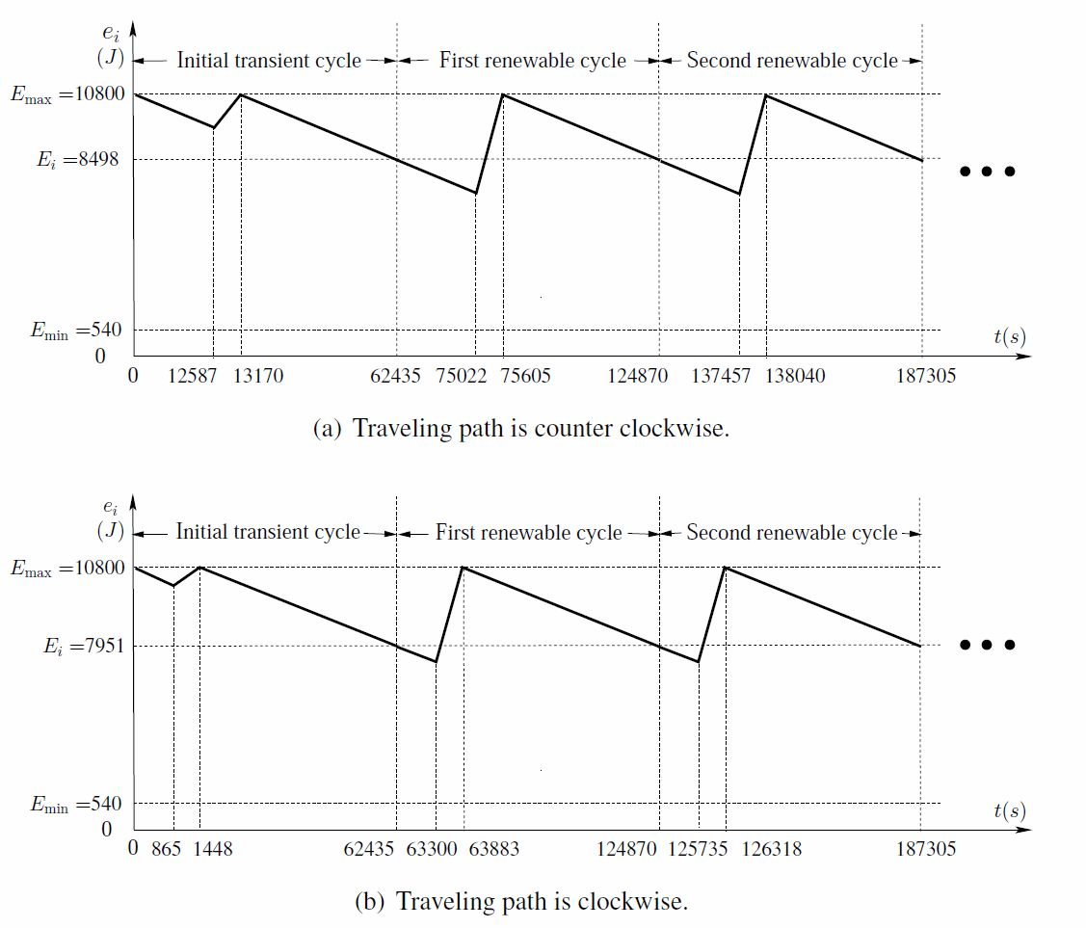
Results under Different Directions
Identical charging schedule and flow routing
Different arrival time and renewable cycle starting energy

Slide 32
Bottleneck Node
Provably show the existence of at least one “bottleneck” node in an optimal solution
Bottleneck node
Notes:
“bottleneck” node in the network is the node where the energy level at this node drops exactly to E_min when the WCV arrives and starts to charge this node’s battery.

Slide 33
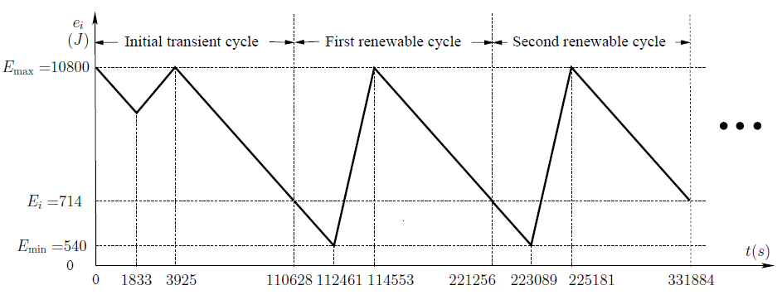
Bottleneck Node (cont’d)
The energy behavior of the bottleneck node

Slide 34
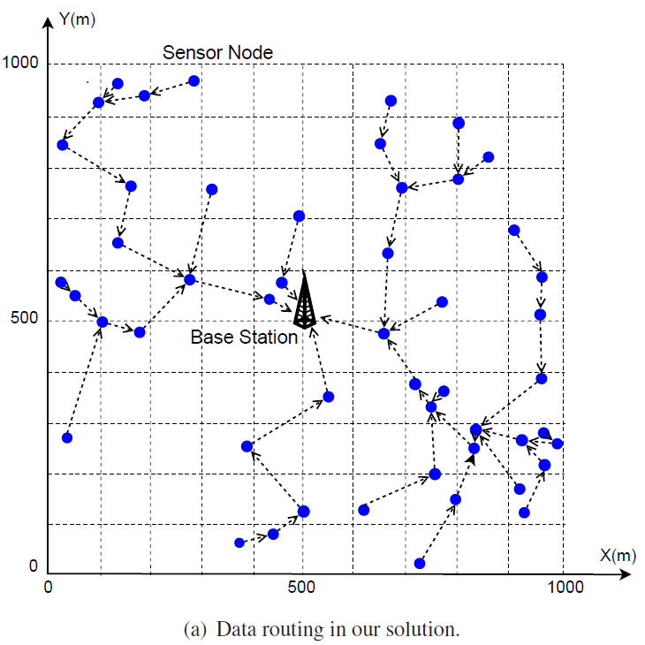
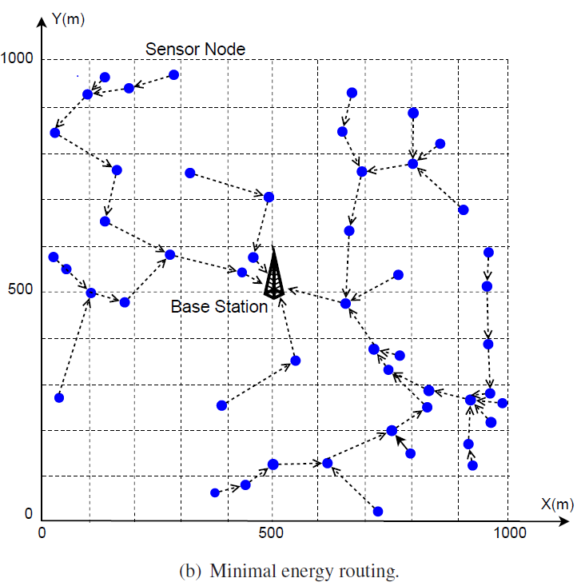
Multi-hop Data Routing

Slide 35
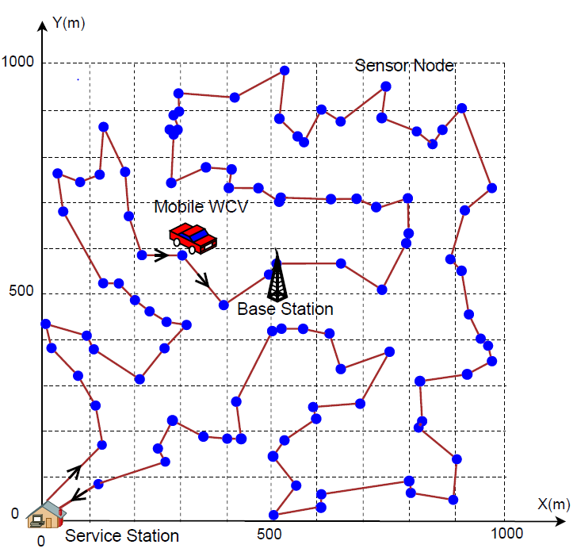
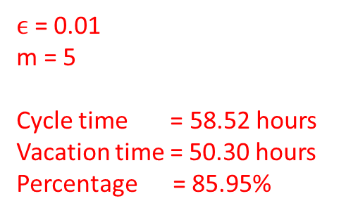
A 100-node network
$ϵ$= 0.01
m = 5
Cycle time = 58.52 hours
Vacation time = 50.30 hours
Percentage = 85.95%

Slide 36
Summary
Review of Linear Approximation for Nonlinear Terms
A case study
  Exploited recent breakthrough in wireless energy transfer technology for a WSN
  Showed that a WSN can remain operational forever!
  Studied a practical optimization problem
    Objective: Maximizing the ratio of the WCV’s vacation time over the cycle time
    Proved that the optimal traveling path is the shortest Hamiltonian cycle
    Developed a provable near-optimal solution for both charging schedule and flow routing
36

