Slide 1


Slide 2
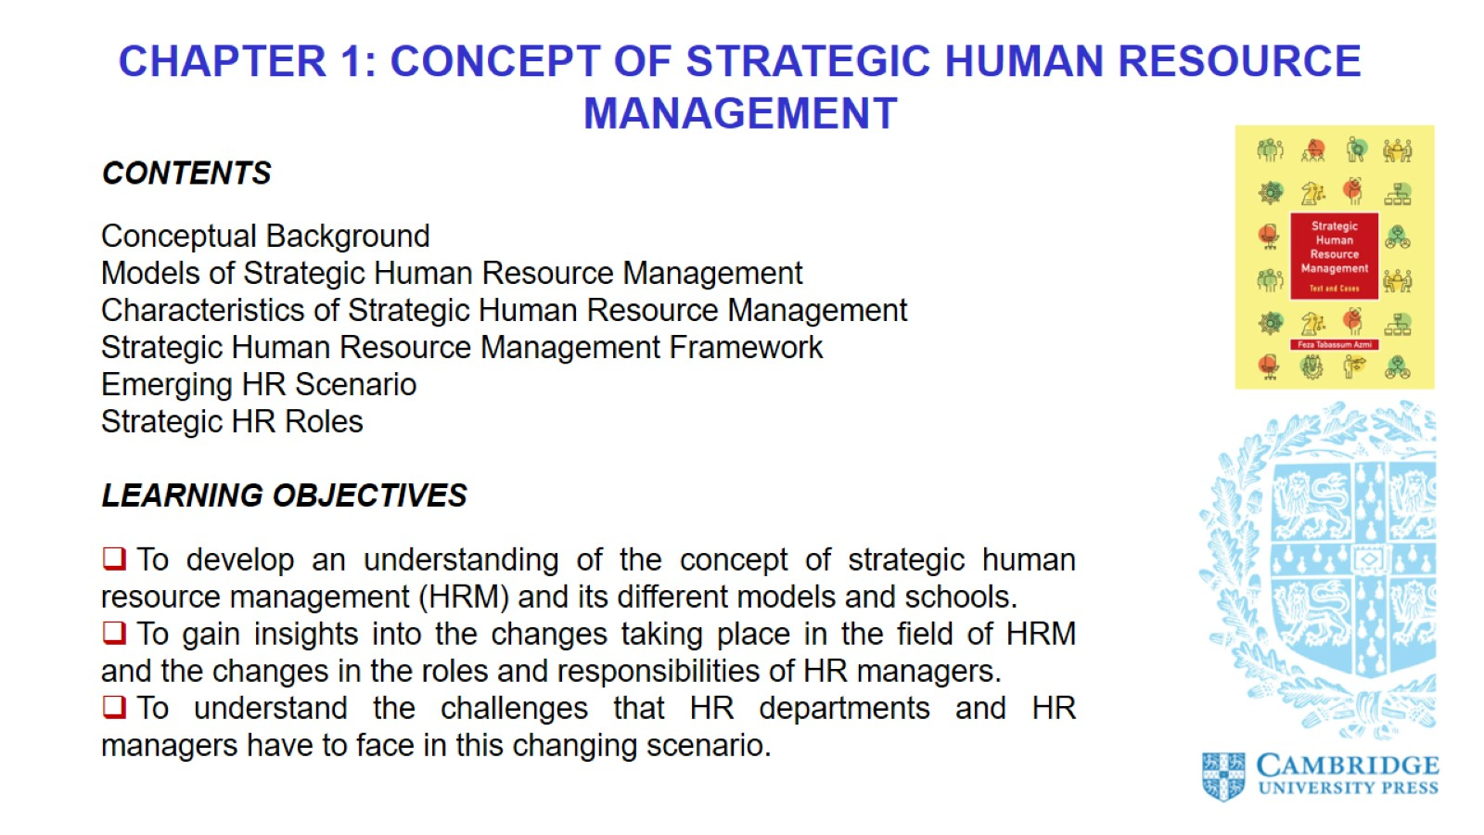

Slide 3
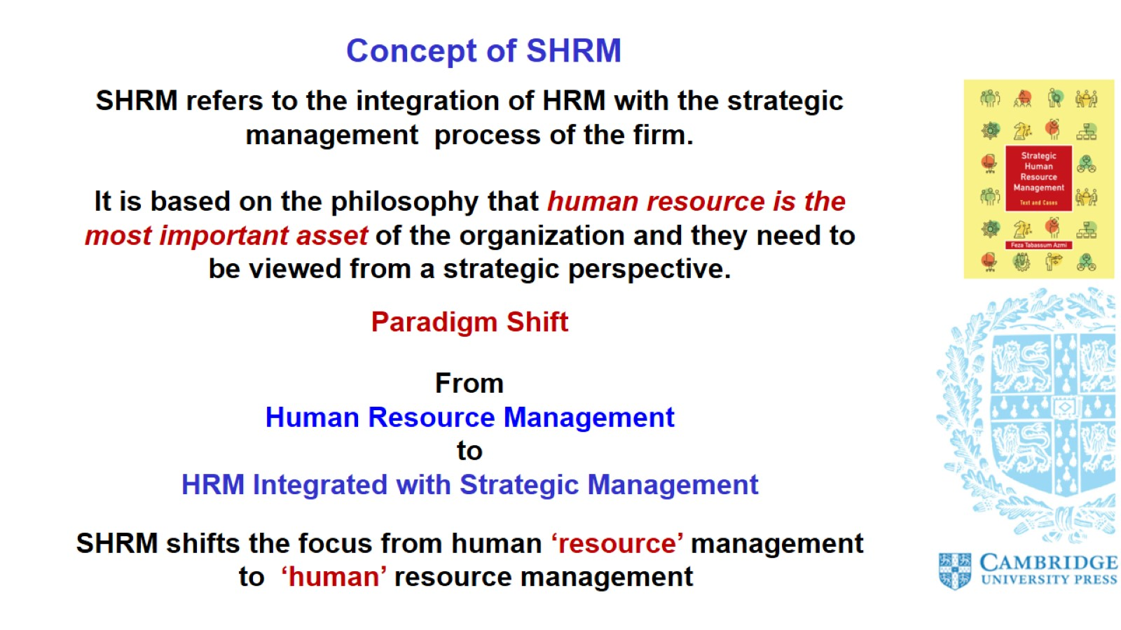
Concept of SHRM

Slide 4
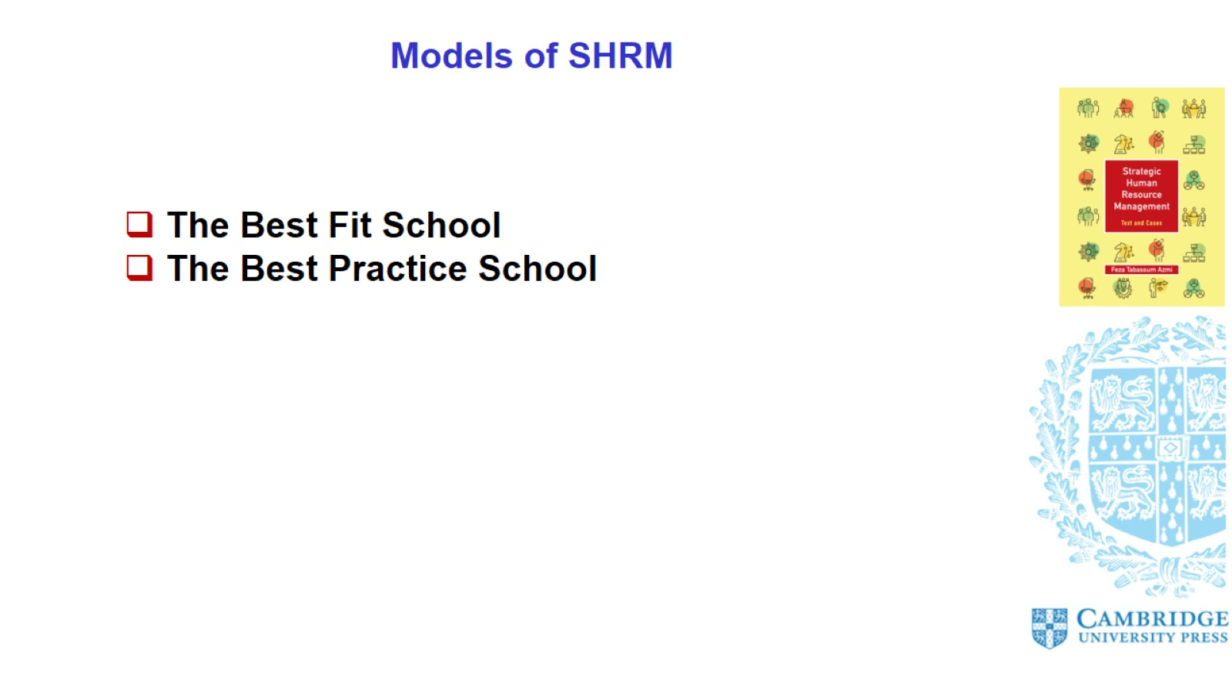
Models of SHRM

Slide 5
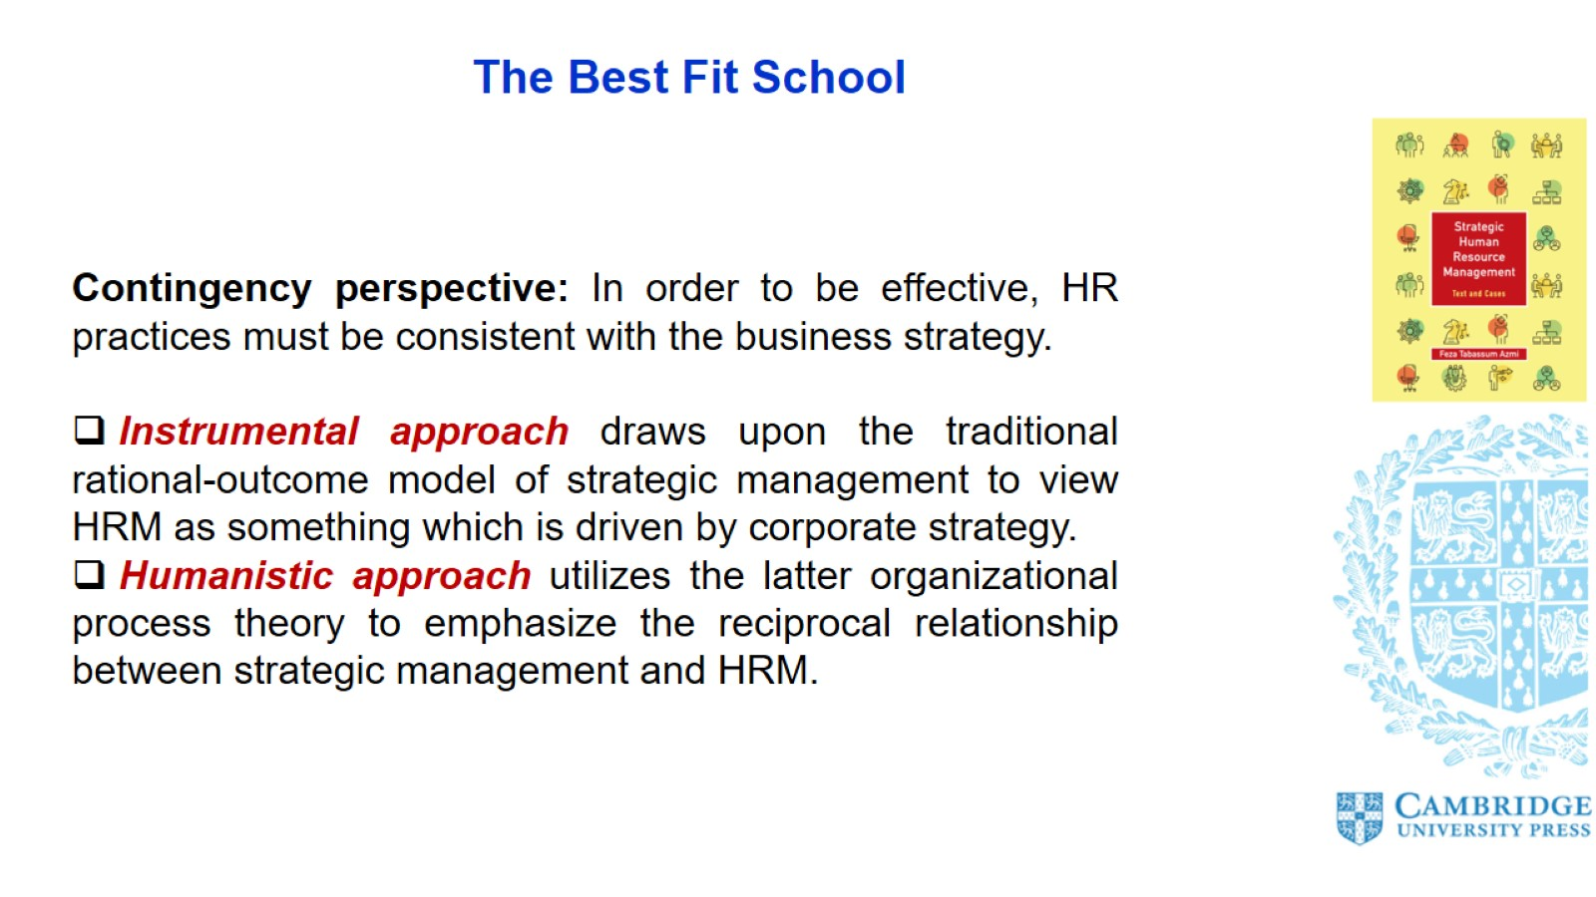
The Best Fit School

Slide 6
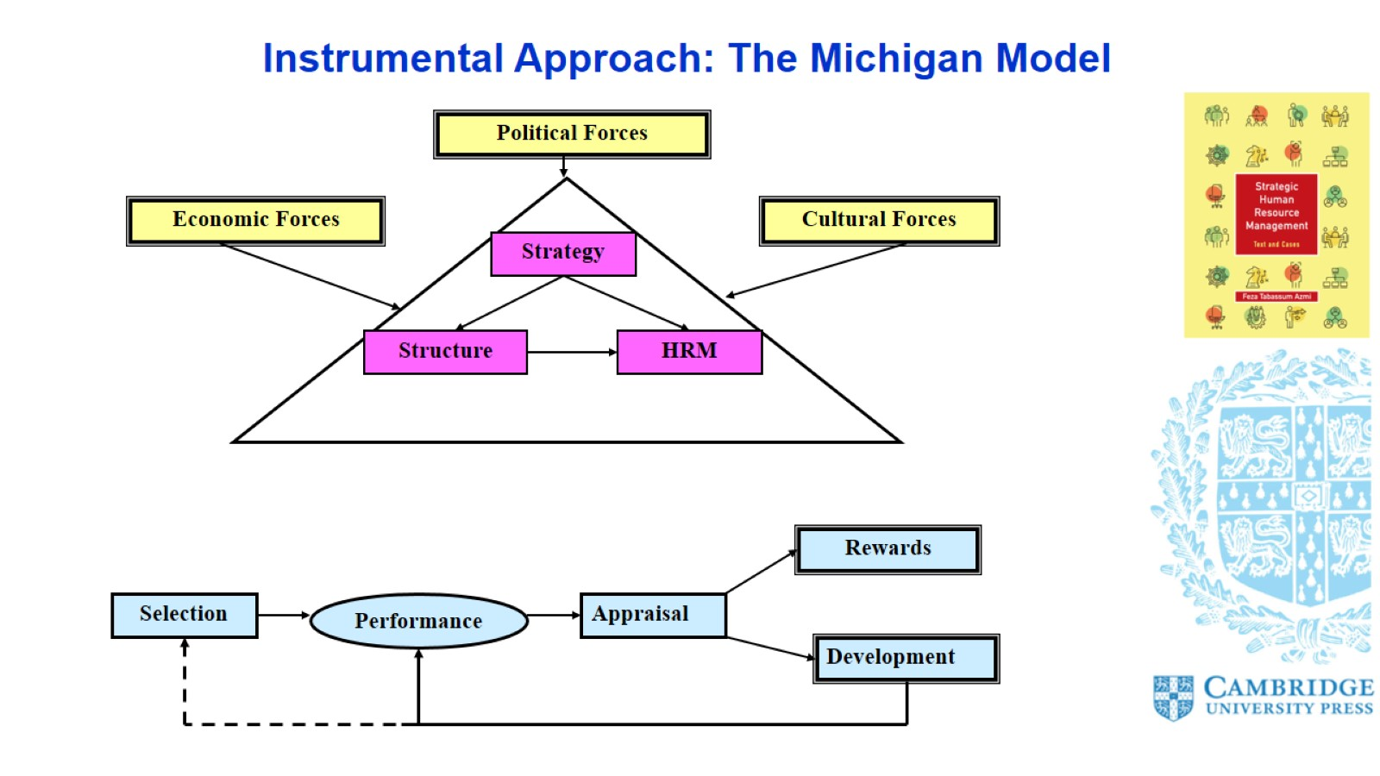
Instrumental Approach: The Michigan Model

Slide 7
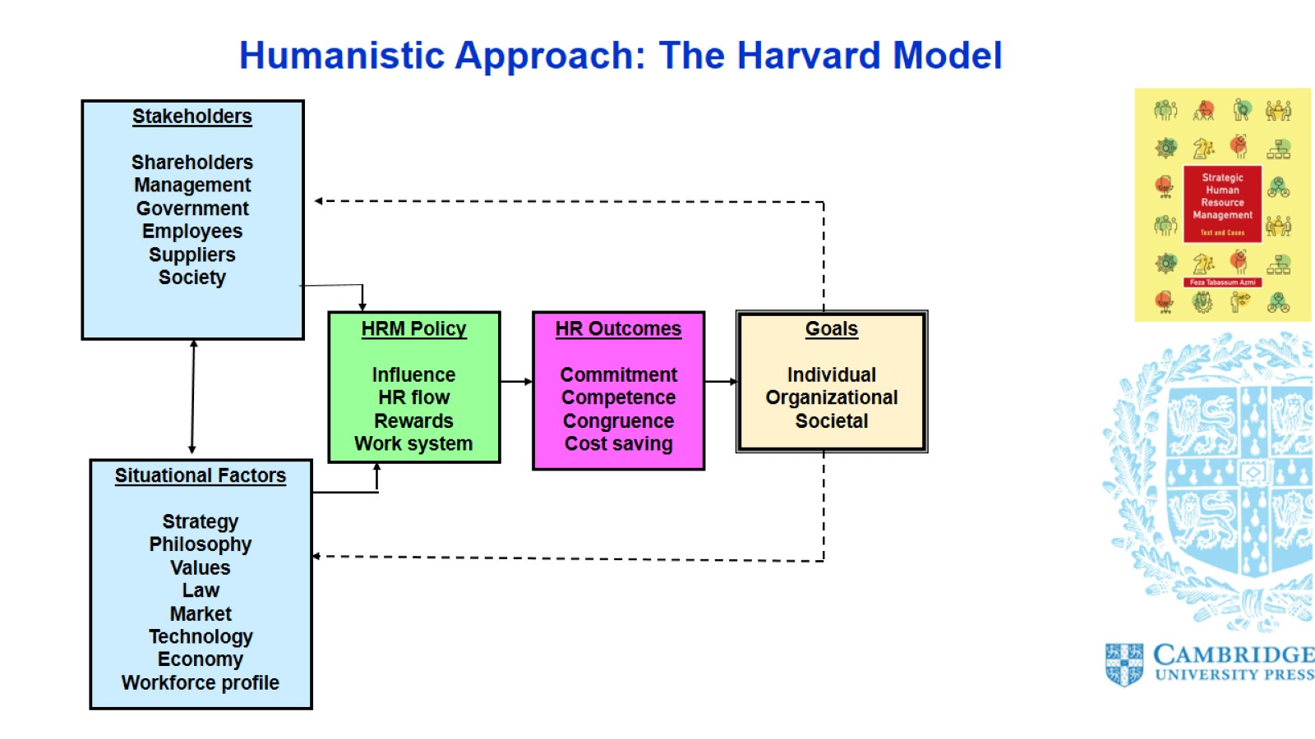
Humanistic Approach: The Harvard Model

Slide 8
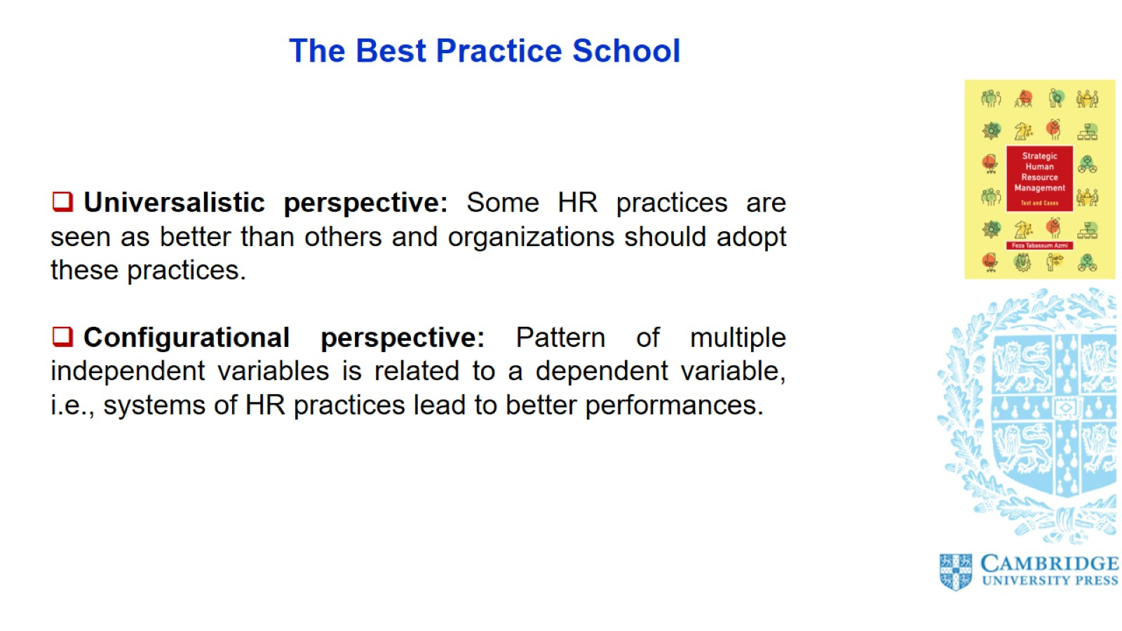
The Best Practice School

Slide 9
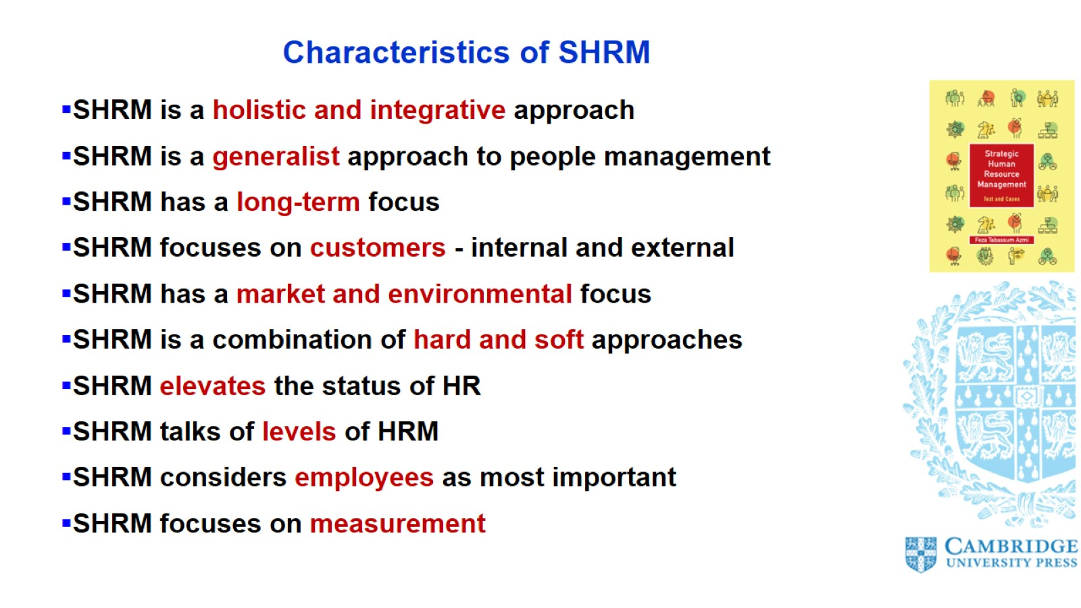
Characteristics of SHRM

Slide 10
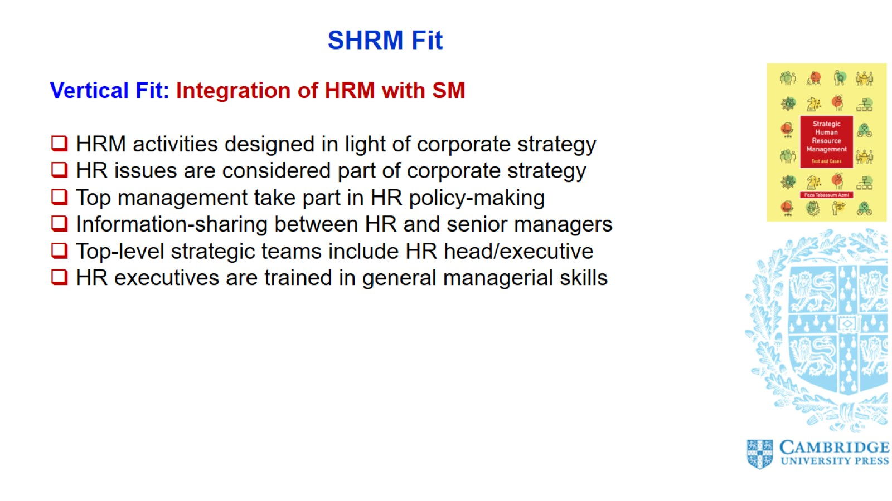
SHRM Fit

Slide 11
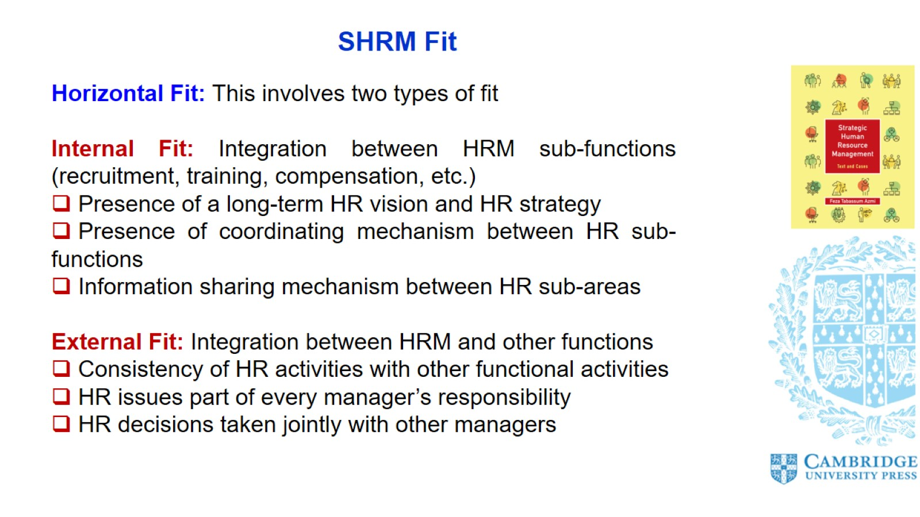
SHRM Fit

Slide 12
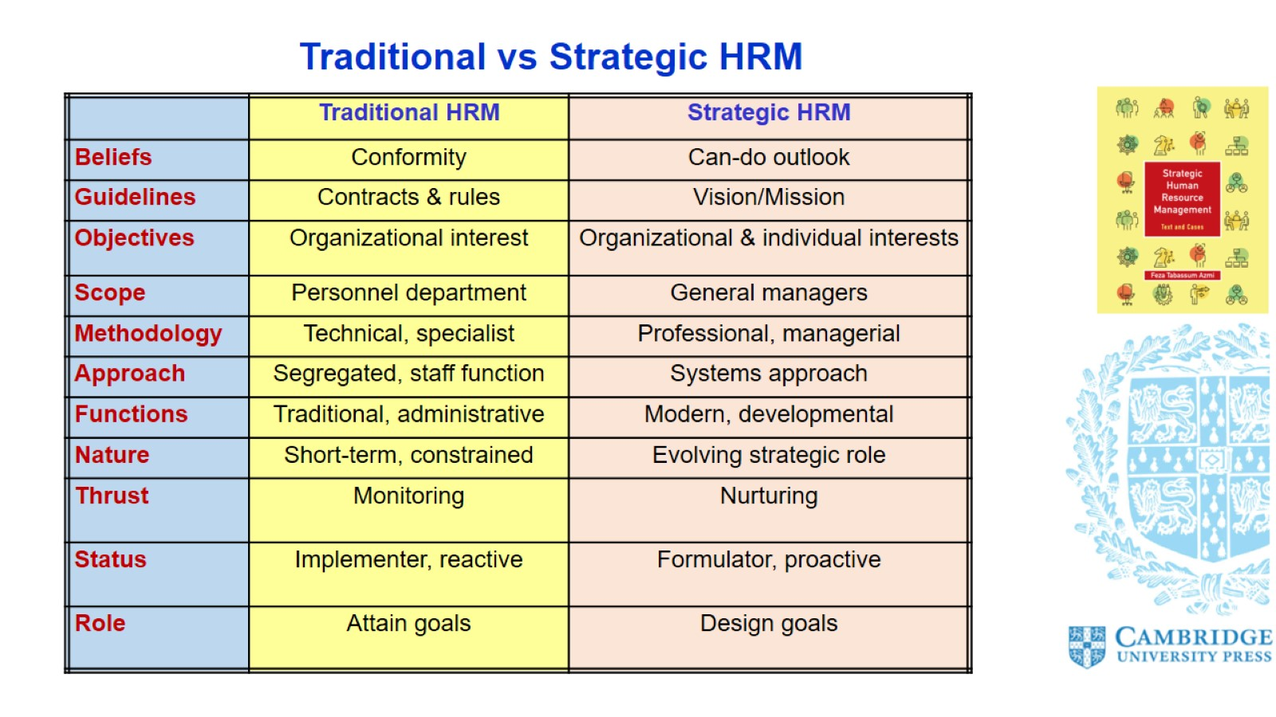
Traditional vs Strategic HRM

Slide 13
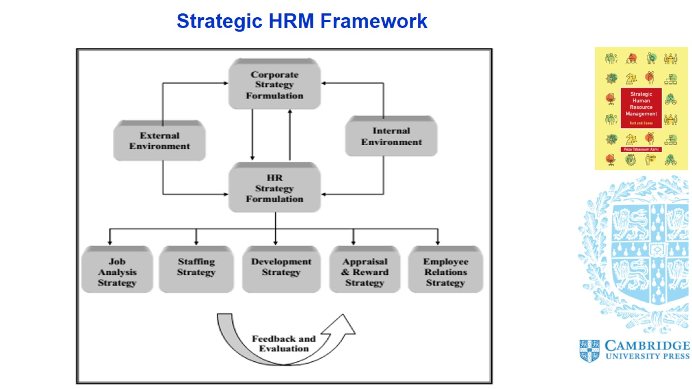
Strategic HRM Framework

Slide 14
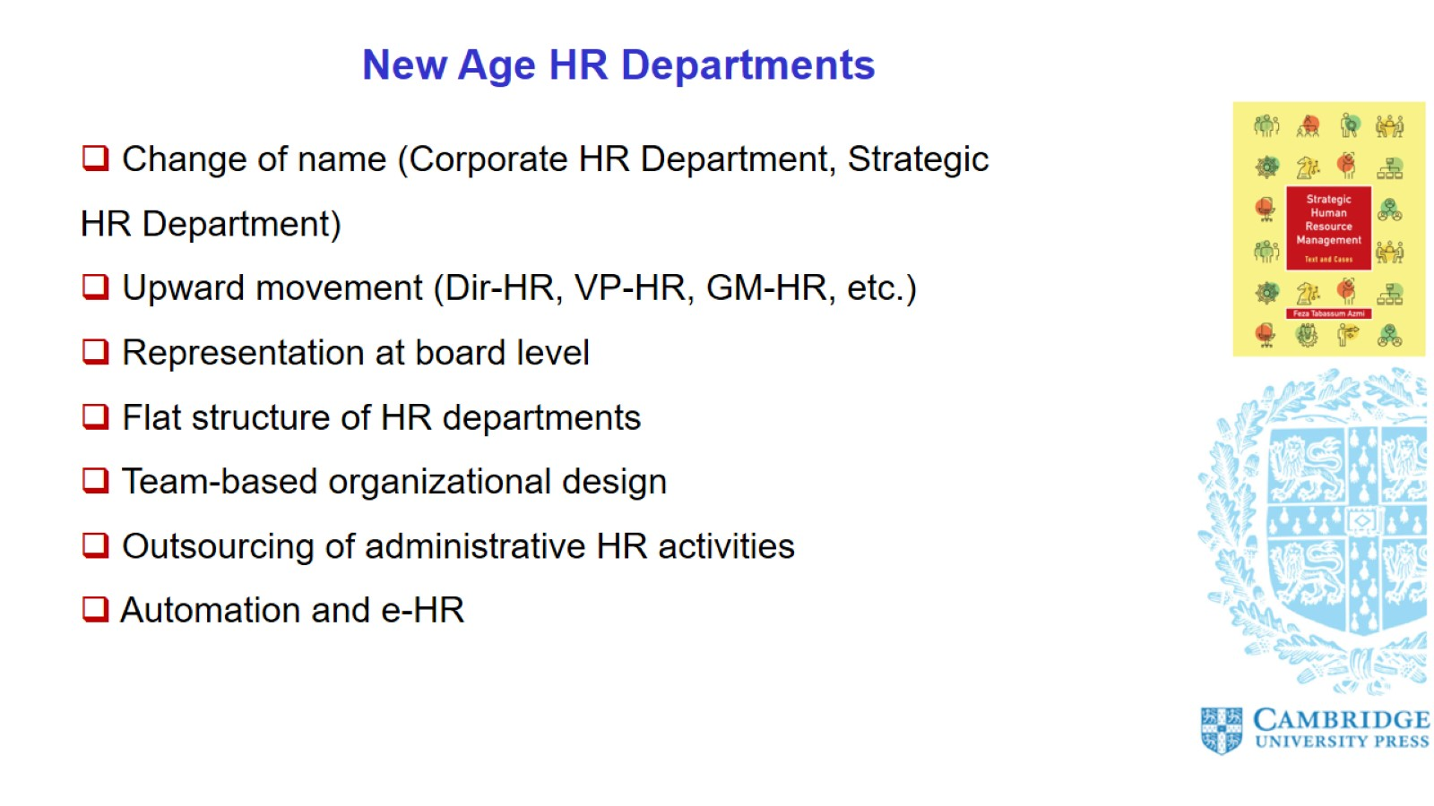
New Age HR Departments

Slide 15
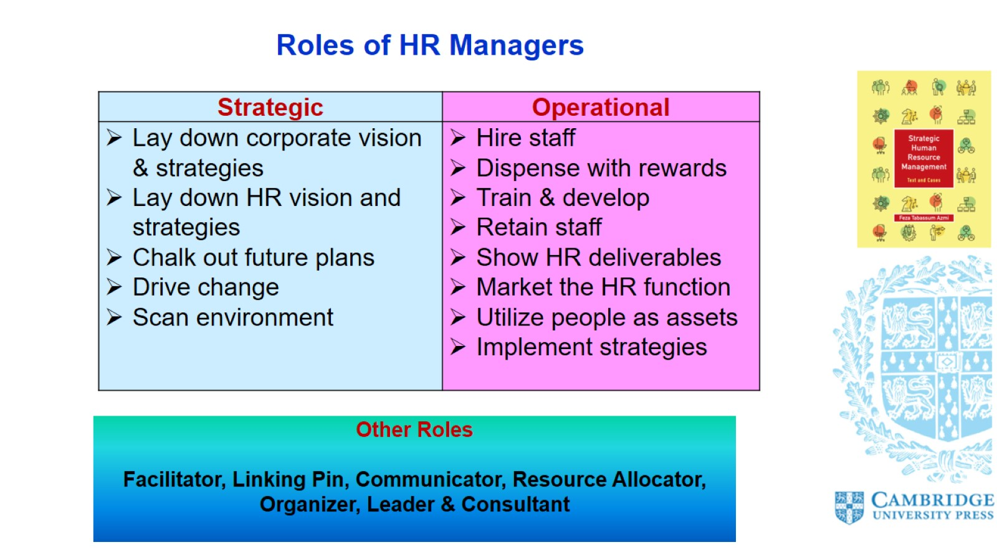
Roles of HR Managers

Slide 16
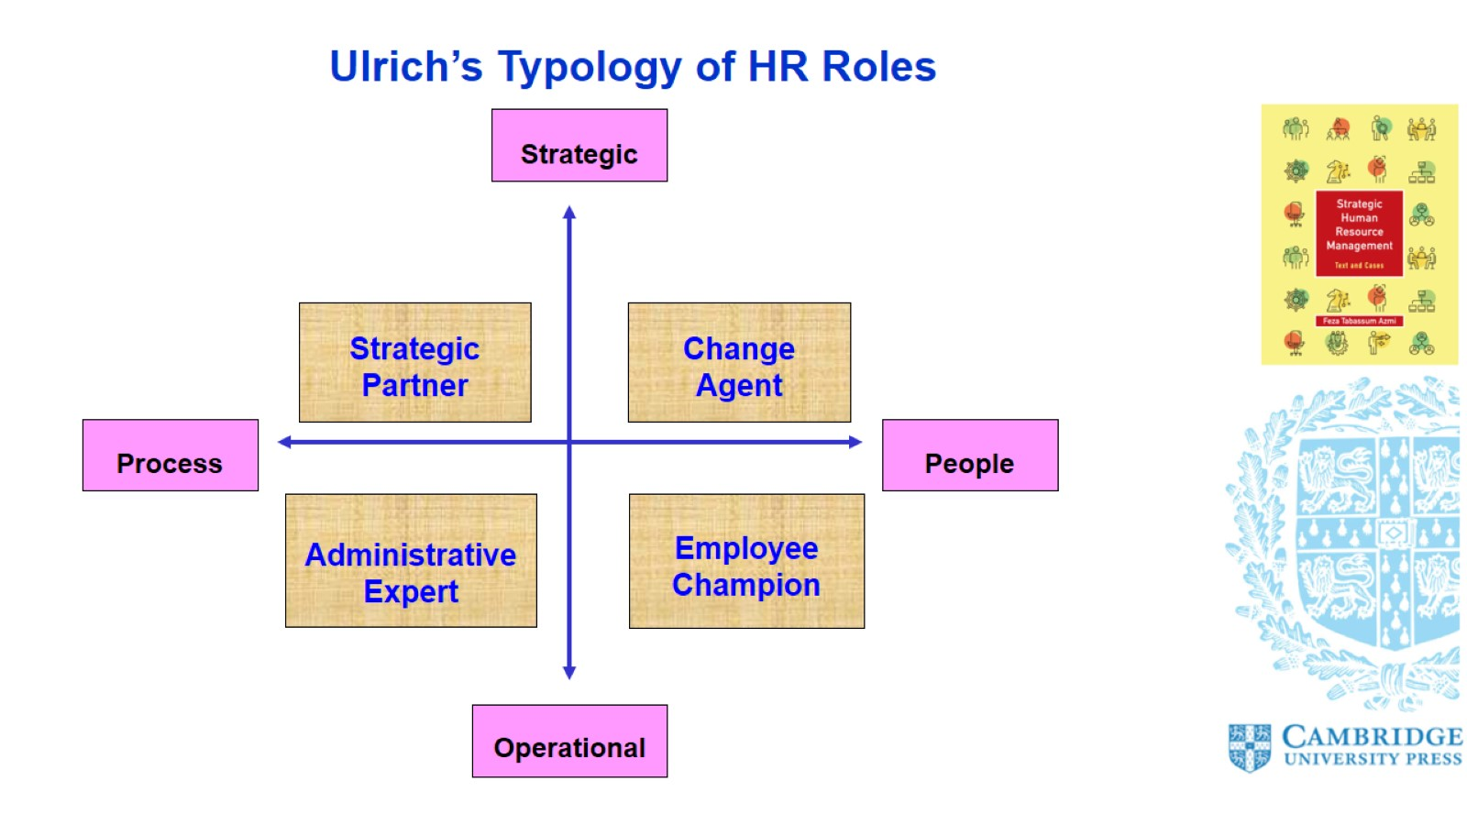
Ulrich’s Typology of HR Roles

Slide 17
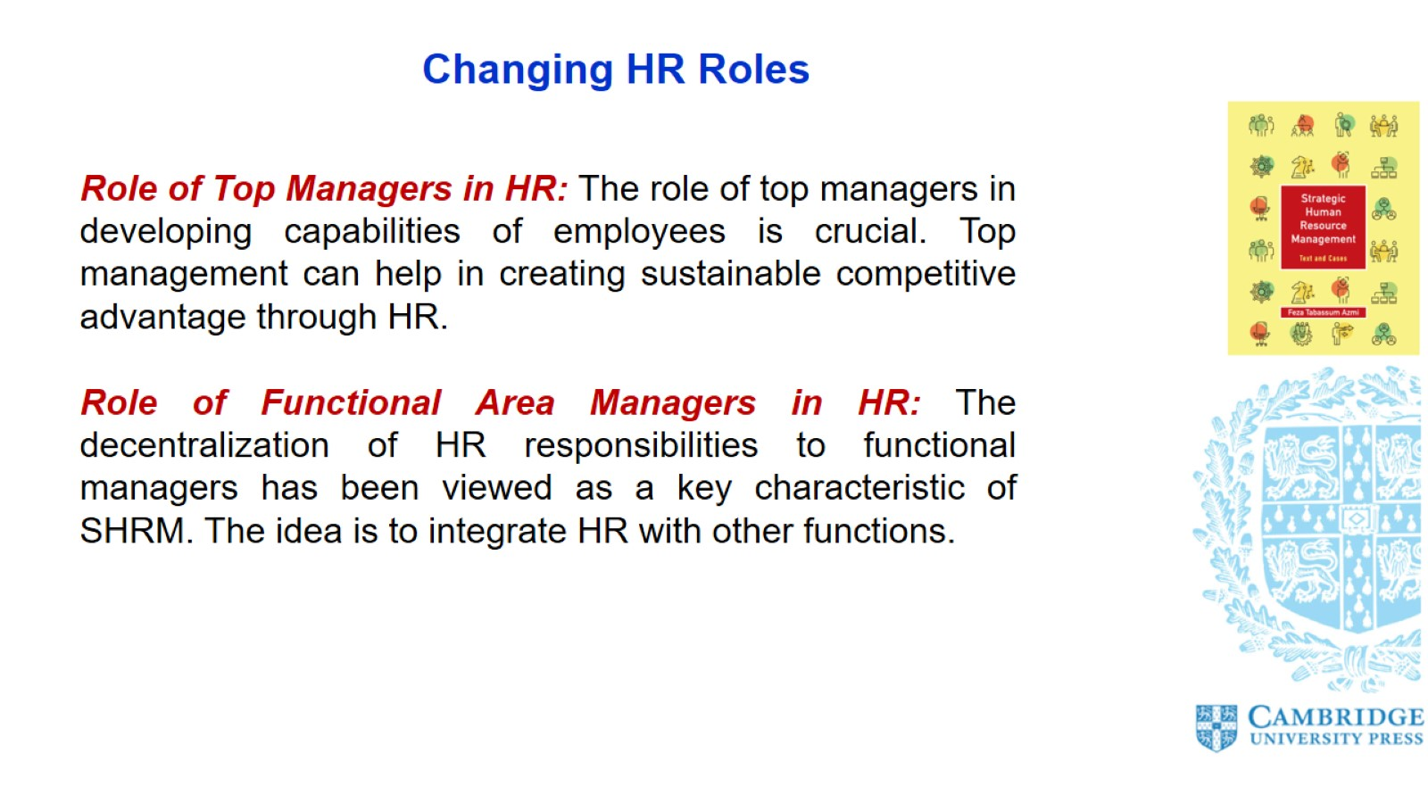
Changing HR Roles

Slide 18
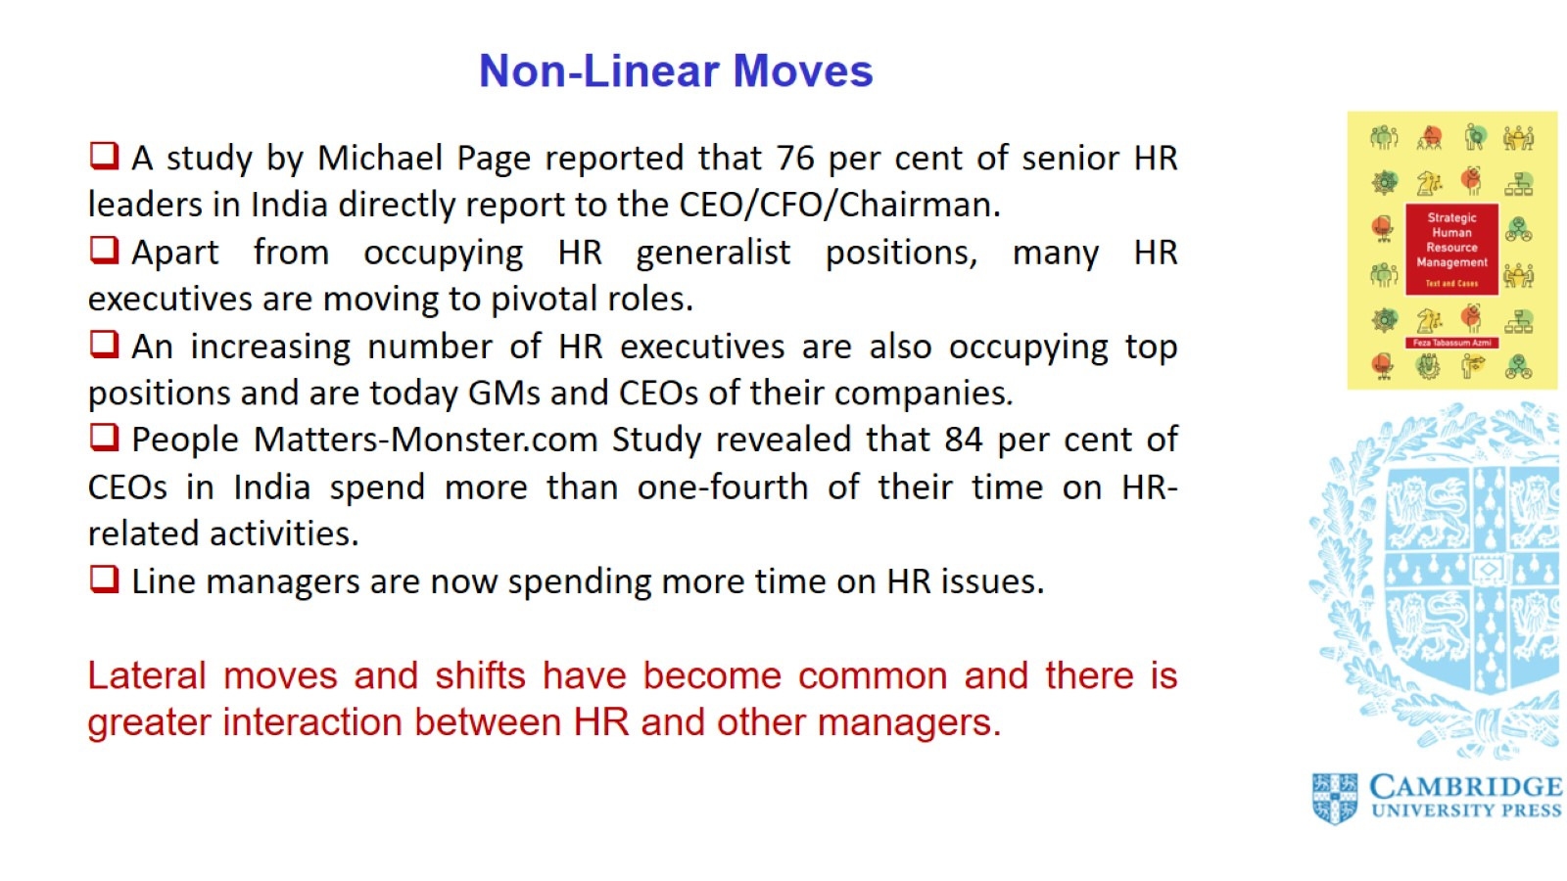
Non-Linear Moves

Slide 19
