Slide 1


Slide 2
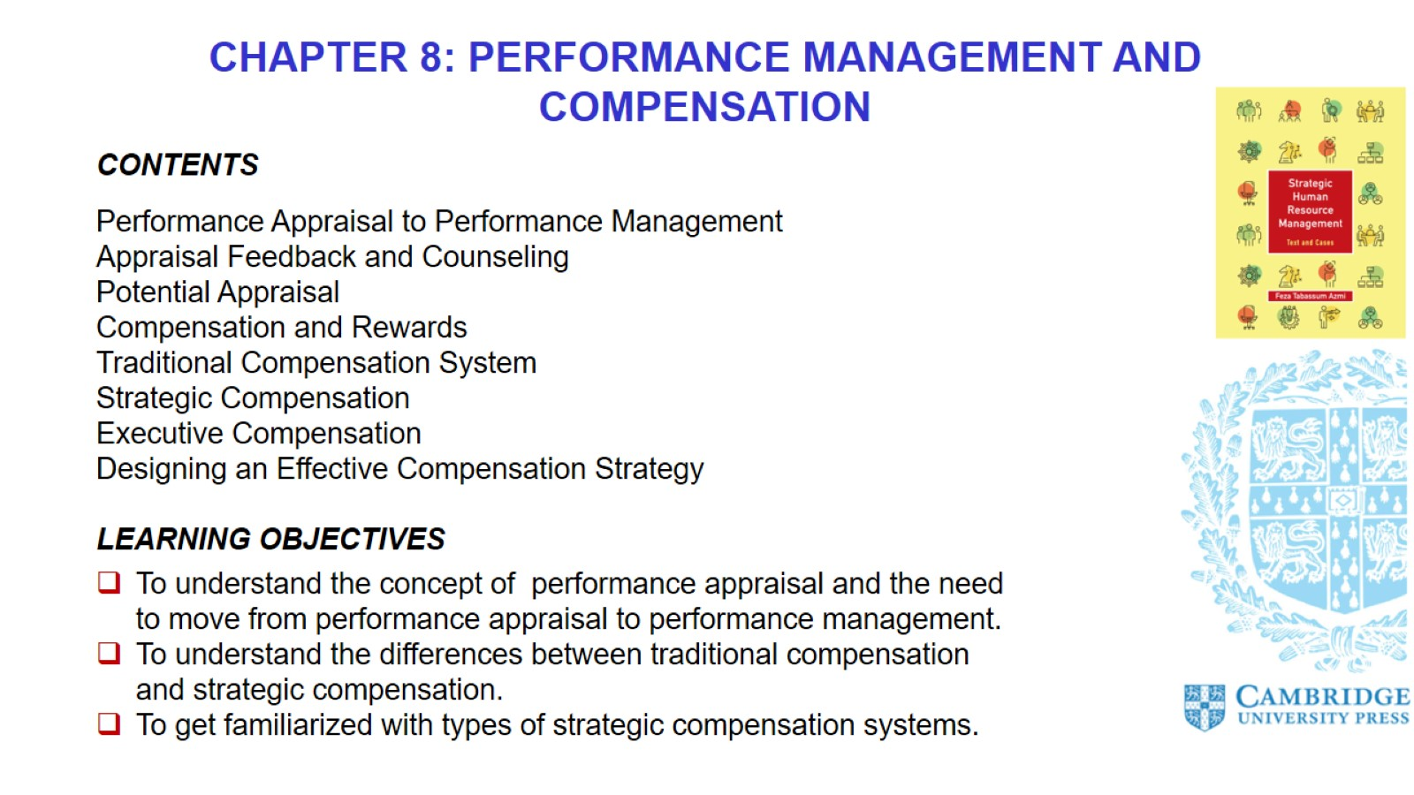

Slide 3
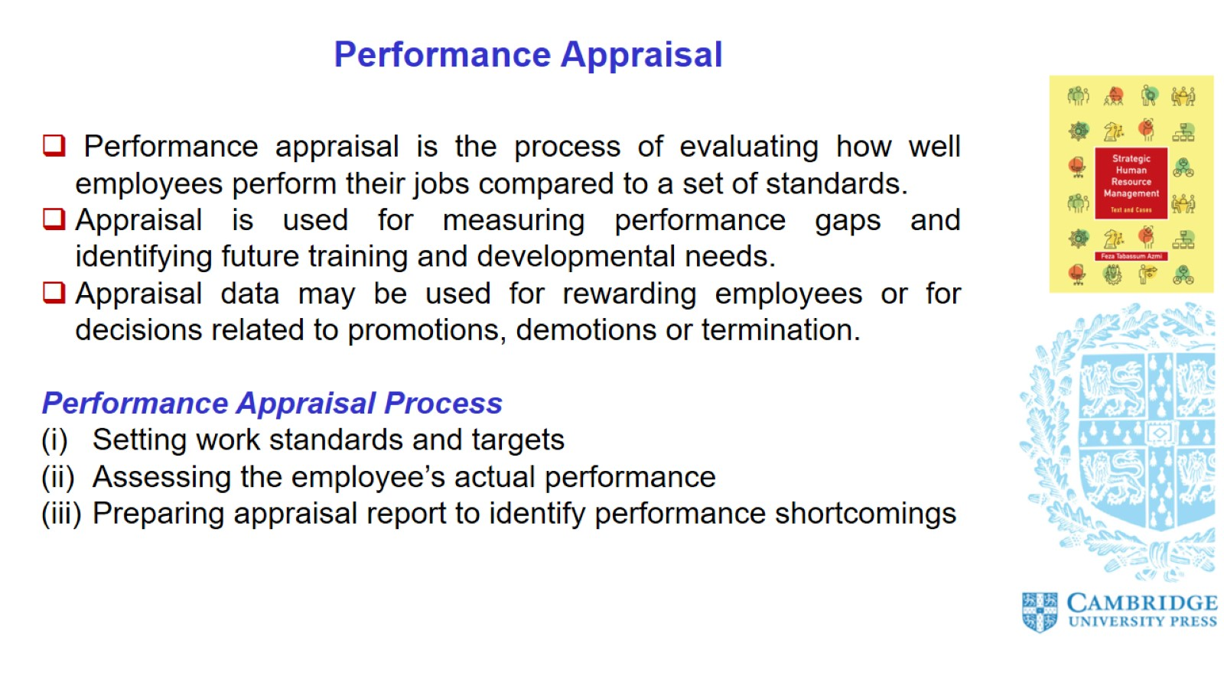
Performance Appraisal

Slide 4
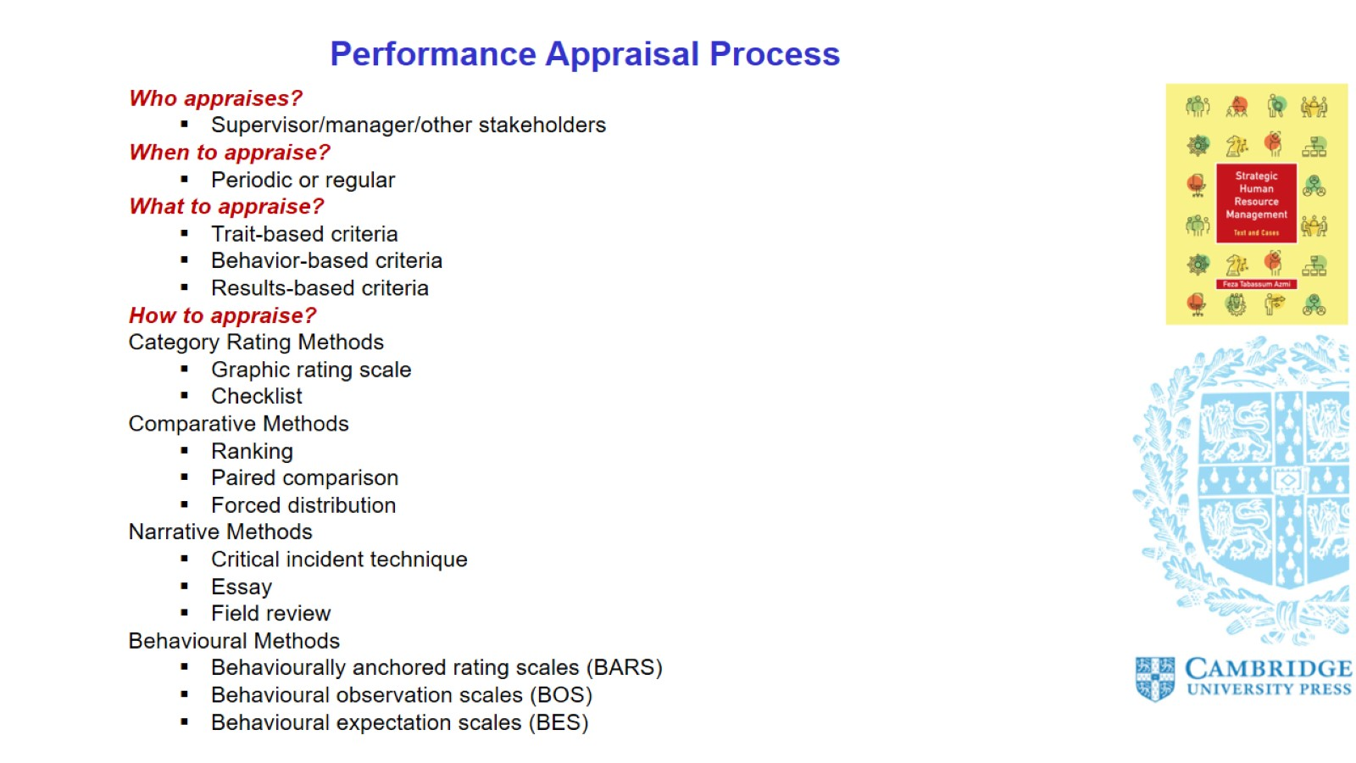
Performance Appraisal Process

Slide 5
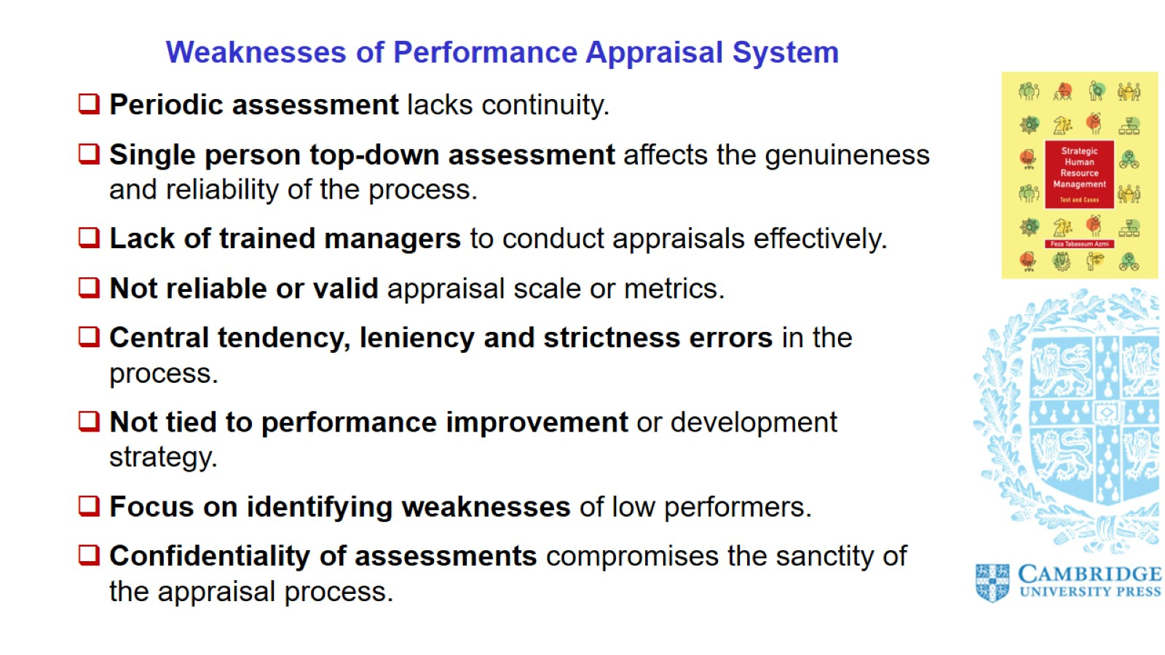
Weaknesses of Performance Appraisal System

Slide 6
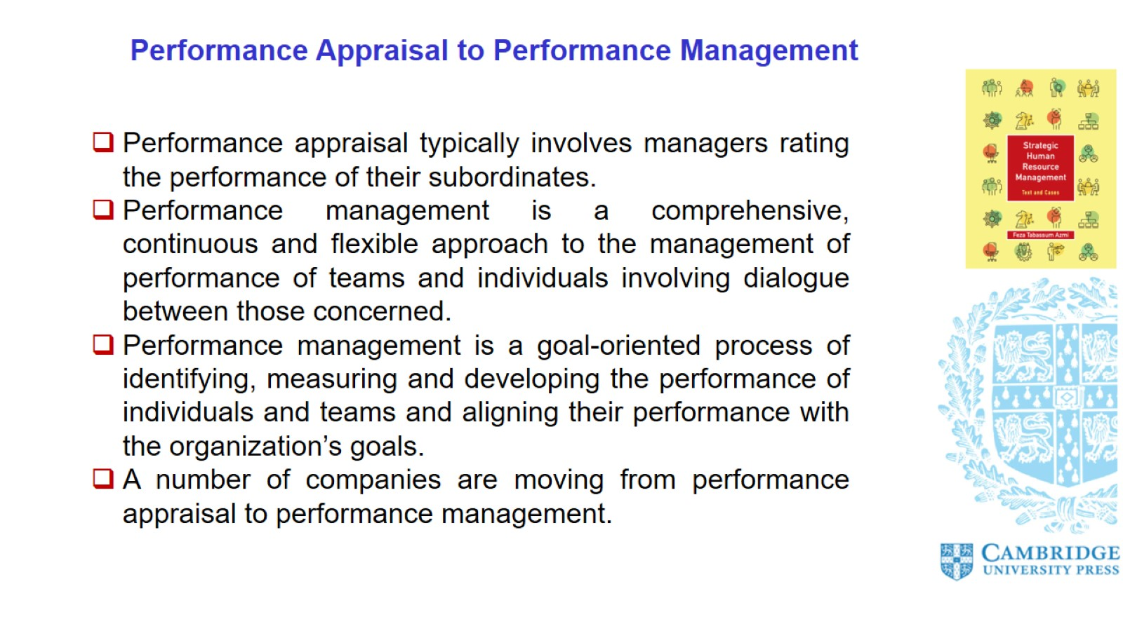
Performance Appraisal to Performance Management

Slide 7
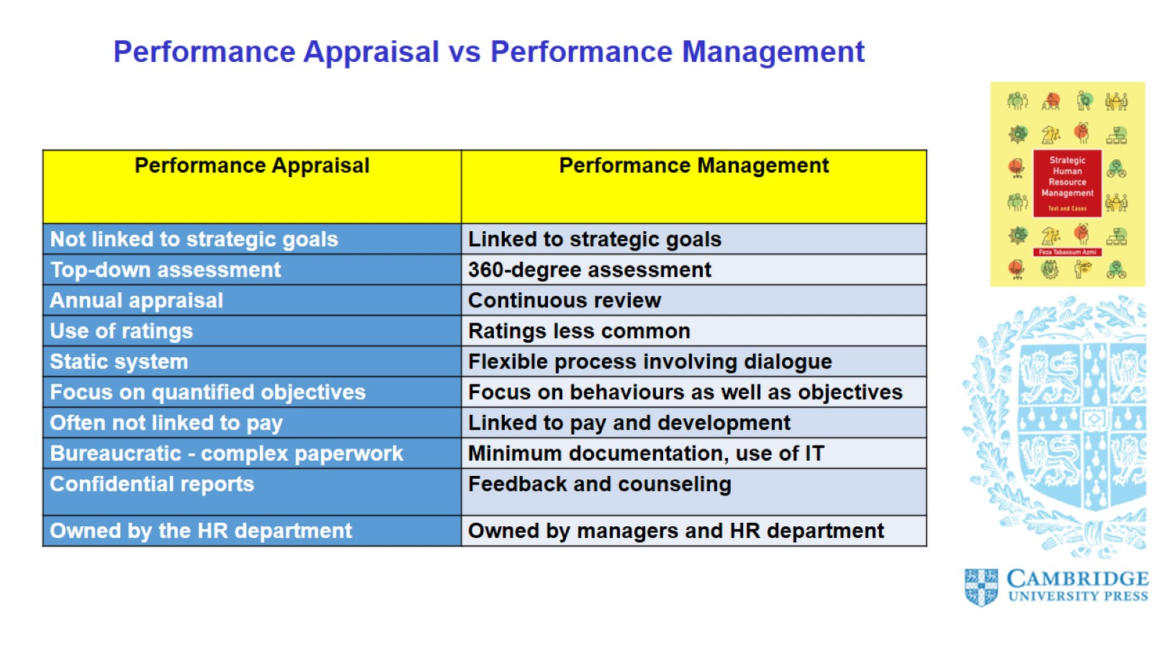
Performance Appraisal vs Performance Management

Slide 8
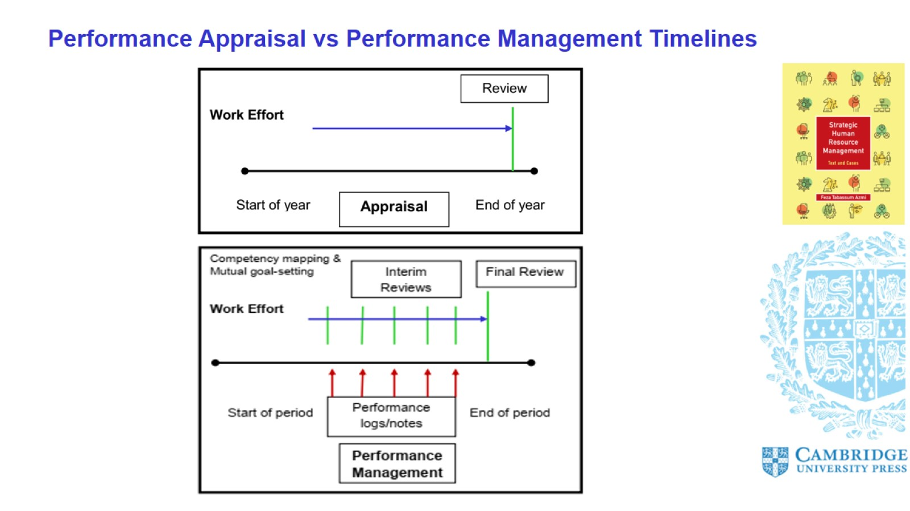
Performance Appraisal vs Performance Management Timelines

Slide 9
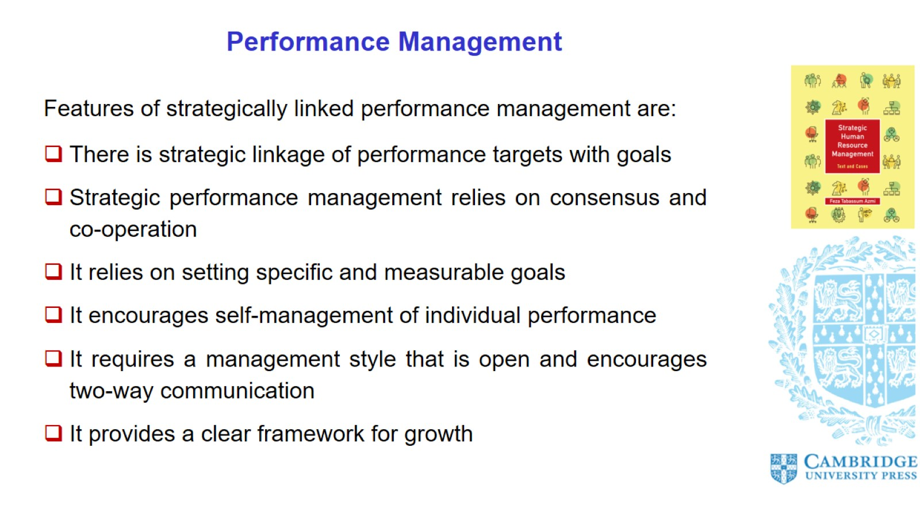
Performance Management

Slide 10
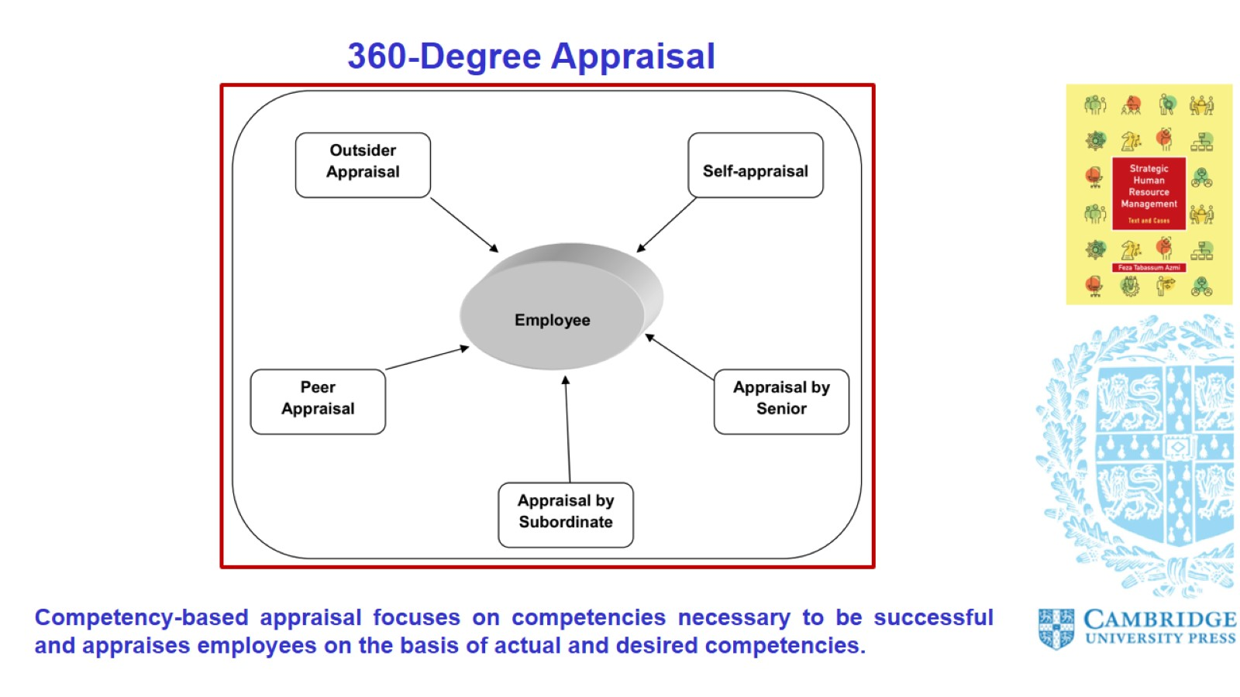
360-Degree Appraisal

Slide 11
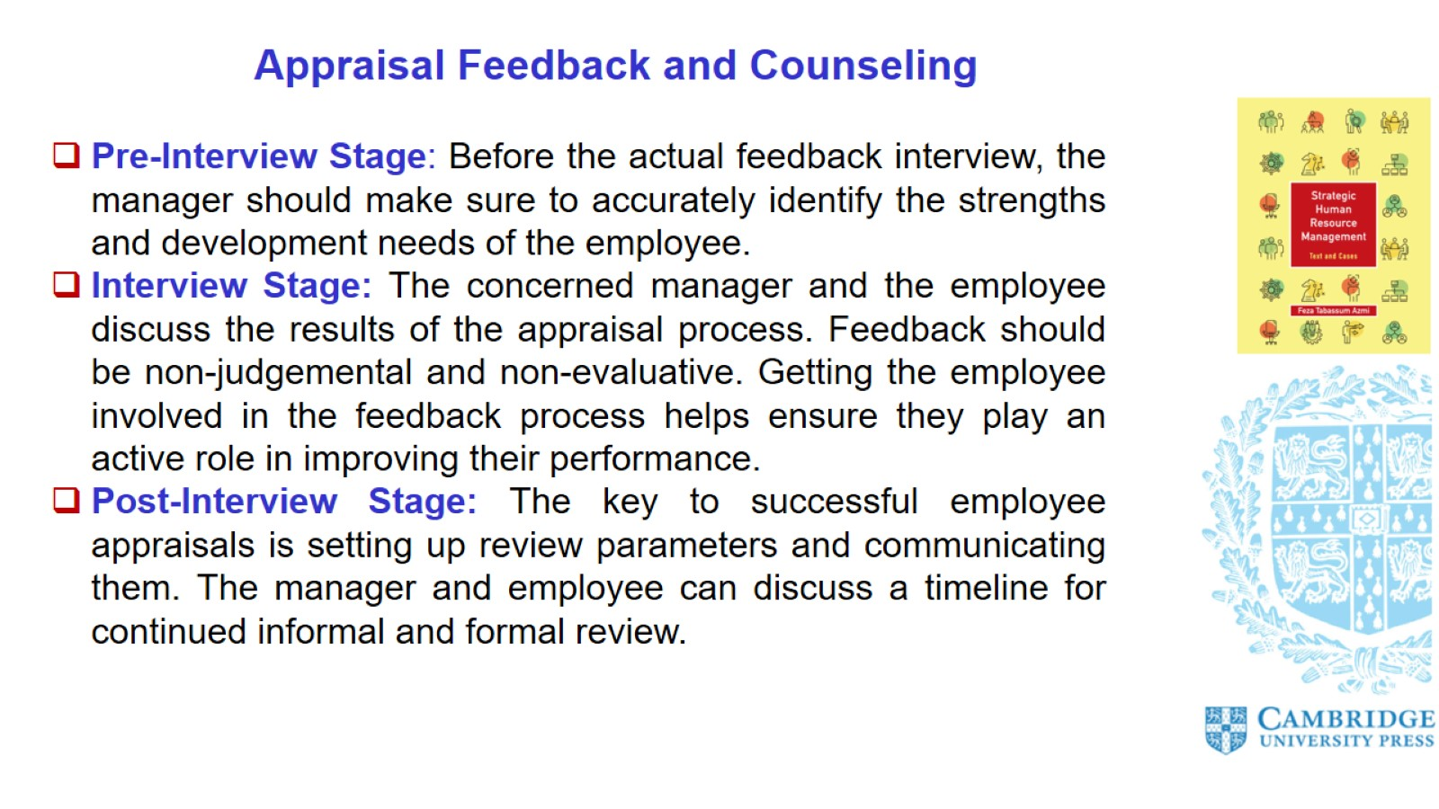
Appraisal Feedback and Counseling

Slide 12
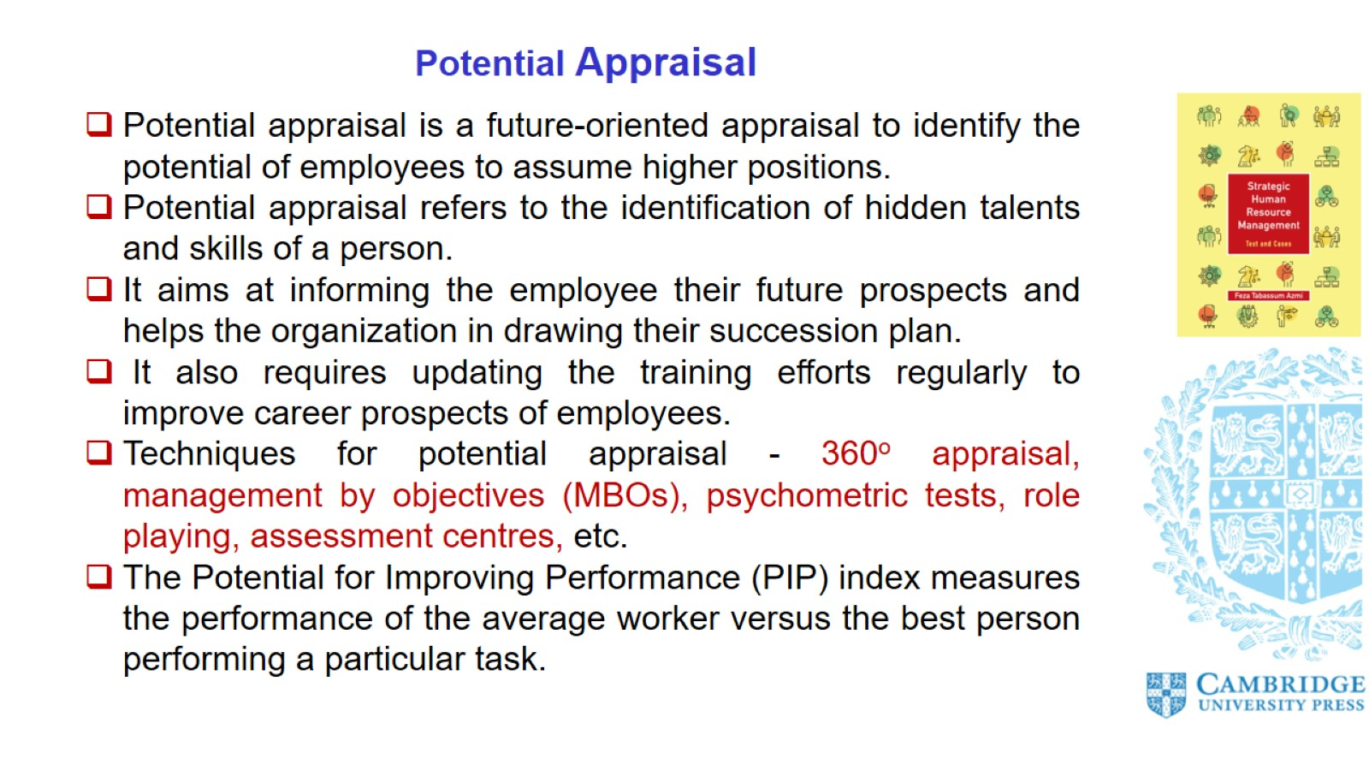
Potential Appraisal

Slide 13
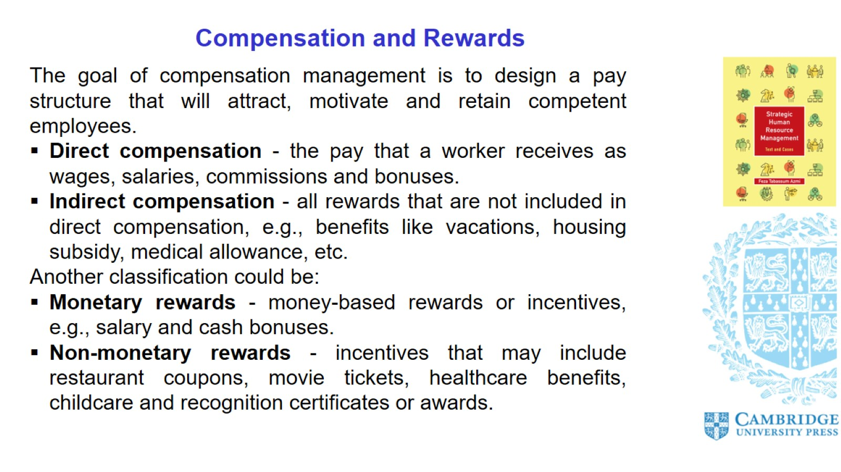
Compensation and Rewards

Slide 14
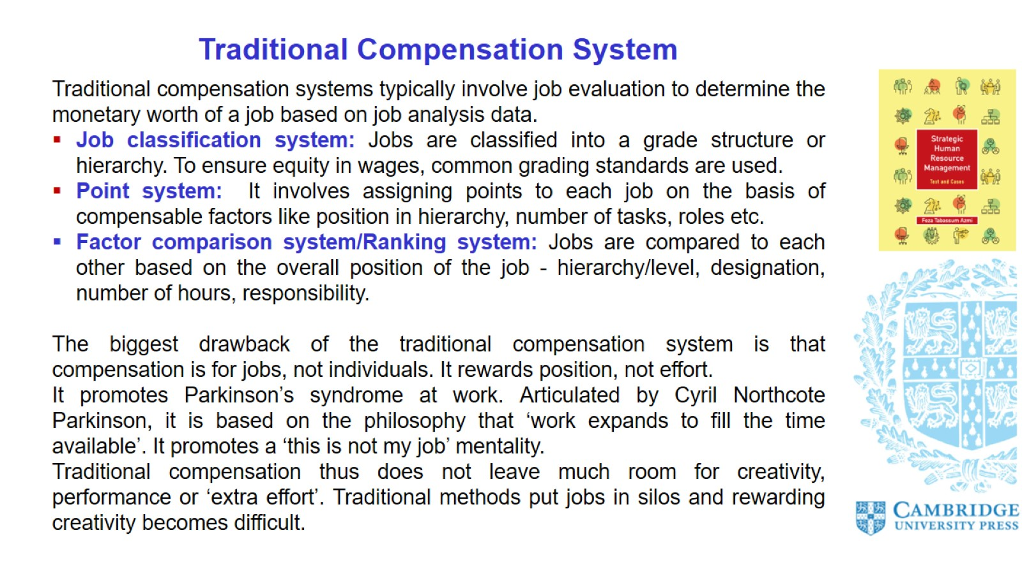
Traditional Compensation System

Slide 15
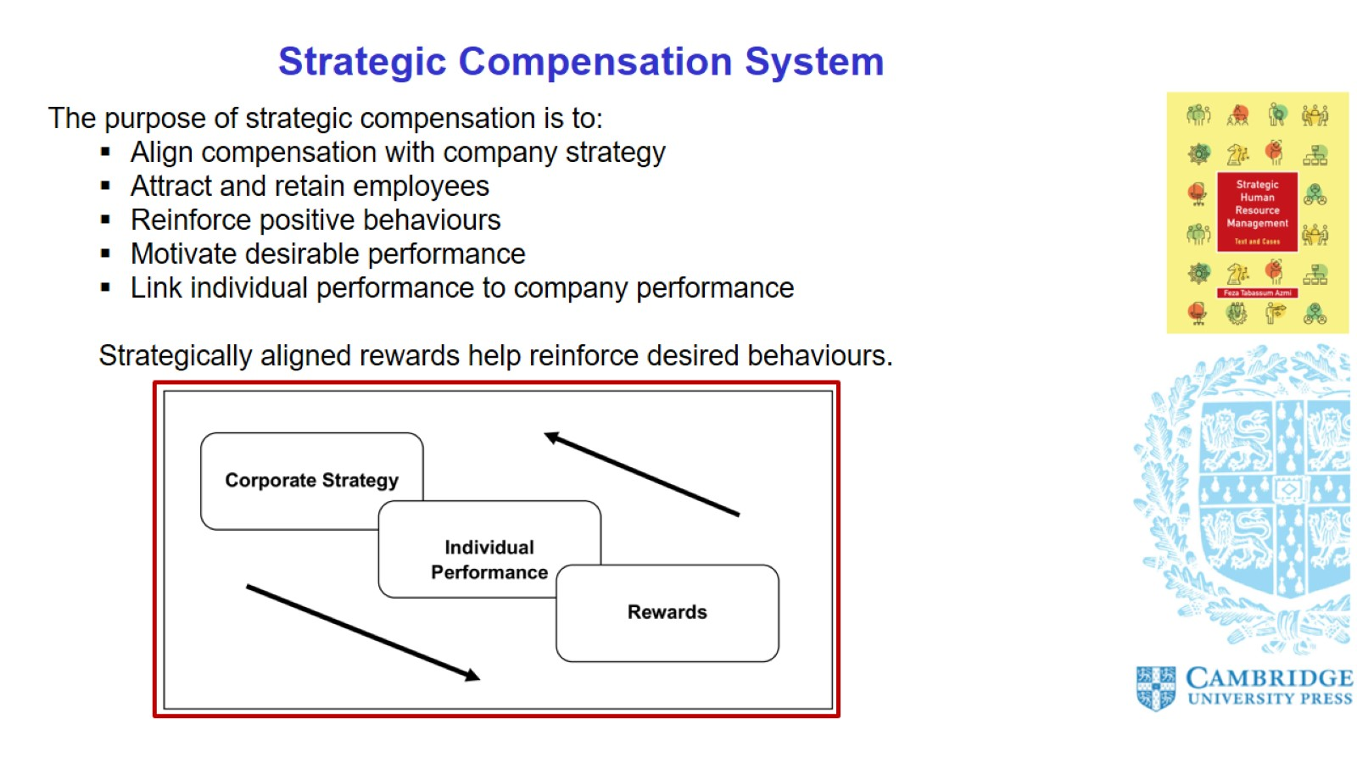
Strategic Compensation System

Slide 16
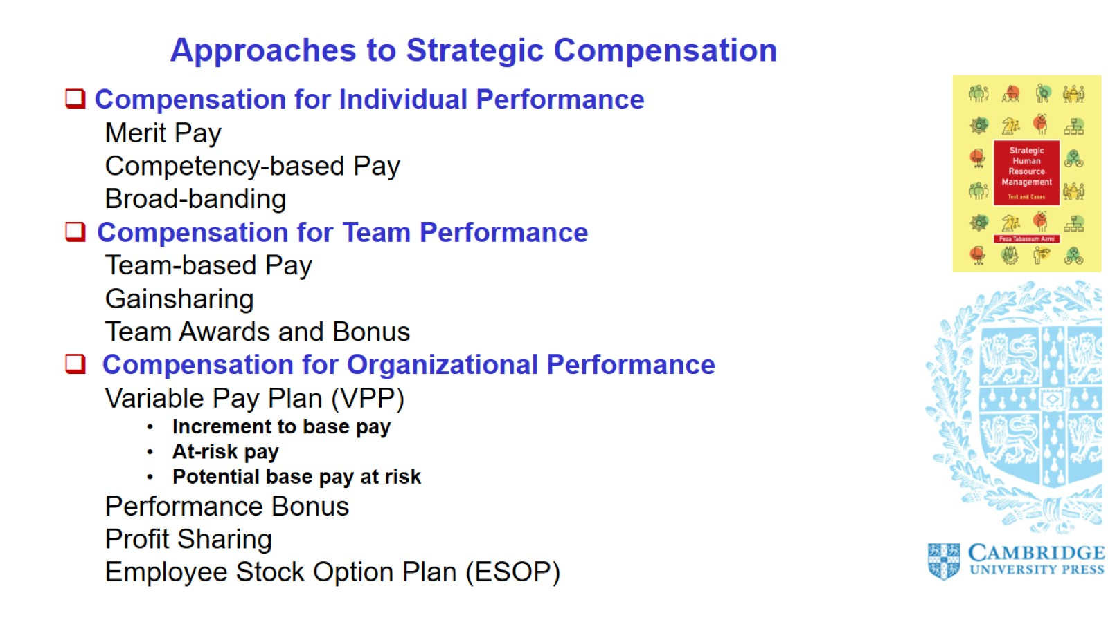
Approaches to Strategic Compensation

Slide 17
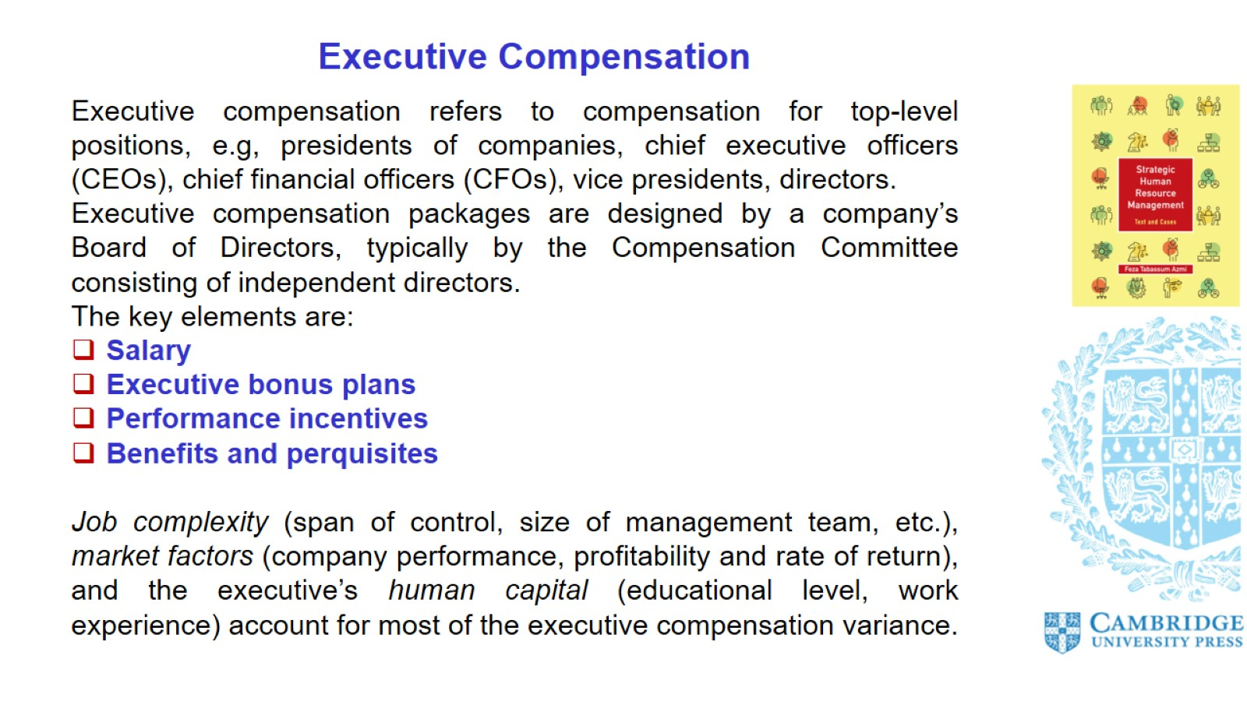
Executive Compensation

Slide 18
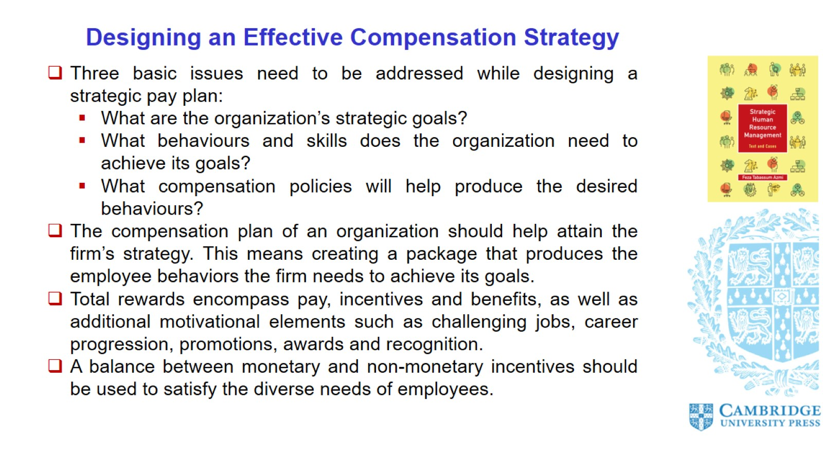
Designing an Effective Compensation Strategy

Slide 19
