Slide 1
Chapter 9
Approximation algorithm and its applications
Part 2

Slide 2
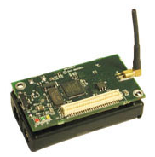
Network Setting
Sensor nodes
  Small. Collects data and forwards to a base station
  Tightly embedded in the environment
Wireless Sensor Network (WSN)
  Formed by a large number of sensor nodes through wireless communications
  Monitor and collect real-time in-situ information over an area

Slide 3
Mobile Base Station (MBS) Problem
Problem description
  The base station is allowed to move around in the WSN to collect data
Motivation
  Fact: Fixed base station location not optimal for sensor network lifetime
  Alleviate the traffic burden for some node
  Exploit mobile base station to maximize lifetime
  No solution yet with provable performance guarantee

Slide 4

Mobile Base Station (MBS) Problem
Objective: maximize network lifetime
  Time until a sensor uses up it energy
  Optimize
    Base station movement path
    Multi-hop data routing
Notes:
The maximize network lifetime is defined as the time until any node uses up its energy.

Slide 5




Problem Setting
A set of sensor node deployed over a two-dimensional area
Each sensor generates data at rate
Data is transmitted to the base station via multi-hop
Initial energy at sensor node is
Base station B collects data from all nodes

Slide 6


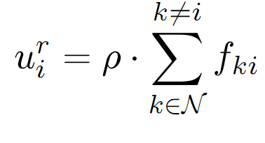
Energy Consumption Modeling
Communication power is the dominant part of energy consumption
Transmission power modeling
where
Receiving power modeling
Notes:
fij is data rate that node i transmits to node j when base station B is at point p.
Cij is the cost associated with link i -> j.
beta_1 and beta_2 are constant coefficients
Alpha is path loss index
dij is the physical distance between sensor node i and j
Rho is a constant coefficient

Slide 7

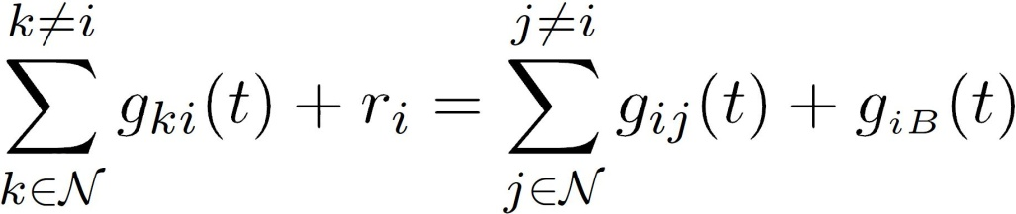




Flow Conservation Constraints
Flow conservation for node at any time
where and represent the data rates from node to node and B at time , respectively
Notes:
For node i, the sum of total incoming flow rates plus self-generated data rate is equal to the total outgoing flow rates at time t.
Note that in our problem, data generated at each node should be transmitted to the base station in real time.

Slide 8

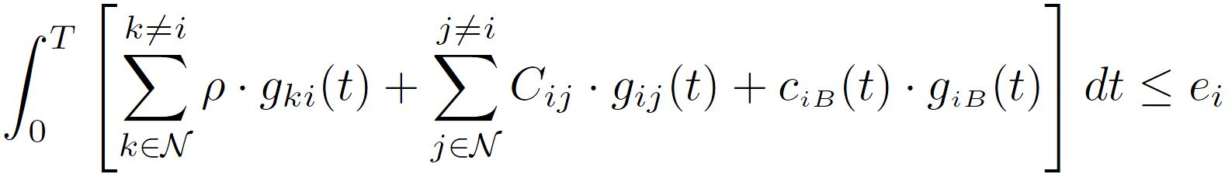


Energy Consumption Constraints
The energy constraint for each node in [0, T] is
We have
where is the location of node
Notes:
The total consumed energy due to reception and transmission over time T cannot exceed its initial energy.

Slide 9
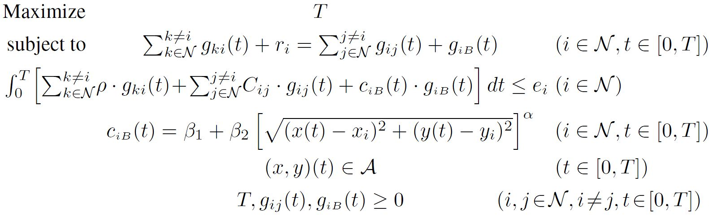
Problem Formulation
Non-linear Program
Notes:
$\mathcal A$ is the movement region for the base station, which can be narrowed down to the SED for all nodes in the network, as we have shown in chapter 8.

Slide 10

Basic Idea of Our Approach
Transform original problem from time domain to space domain
  Show that “when” the base station visits a particular point is not important, only the total sojourn time at that point affects lifetime
  Data routing only depends on base station; not time
  For lifetime maximization, sufficient to study a location-dependent problem
Change infinite search space to finite search space with optimality guarantee
Notes:
The methods for changing infinite search space to finite search space is the same as in last chapter.

Slide 11
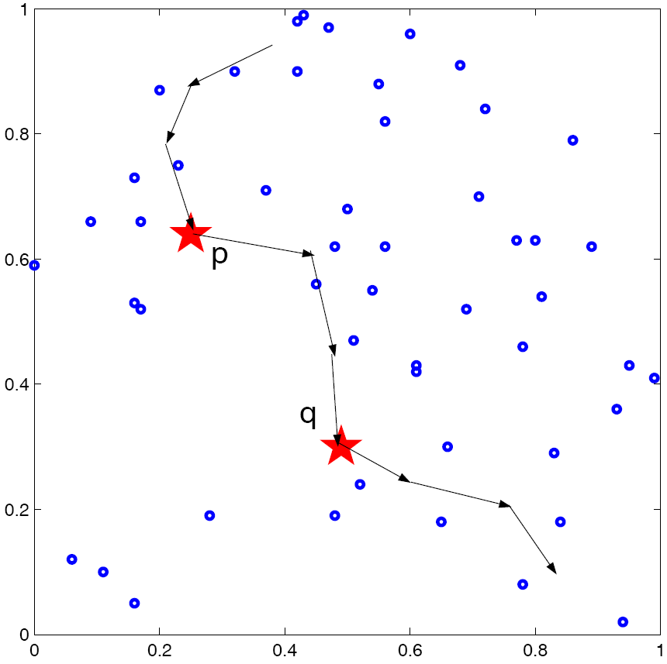
From time Domain to Space Domain
Base station movement path can be re-ordered without affecting network lifetime
  Base station moves from bottom to the top (visit q before p), instead of moving from the top to the bottom (visits p before q)
  Keep the total sojourn time at each point unchanged
“When” the base station visits a point is not important
  Only the total sojourn time at that point affects lifetime
Notes:
We only need to determine the total sojourn time w(p) for each point p visited by the base station

Slide 12


From time Domain to Space Domain (cont’d)
Theorem 9.1. The optimal location-dependent solution can achieve the same maximum network lifetime as the optimal time-dependent solution
  The proof is based on the following two lemmas
Lemma 9.1. Given a feasible time-dependent solution, we can construct a location-dependent solution with the same network lifetime
Proof:
  Given time-dependent solution
  We construct location-dependent solution
Notes:
T is network lifetime for the given solution
$\mathcal P$ is the path for base station,
g_{ij}(t) and g_{iB}(t) are flow routing for each sensor node i and j

Slide 13


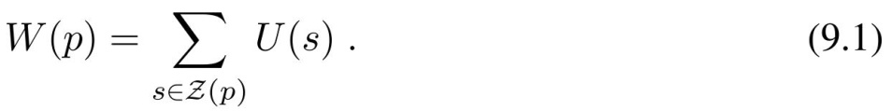




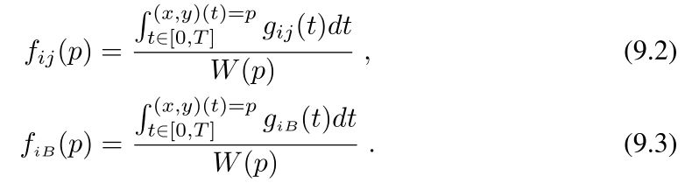
From time Domain to Space Domain (cont’d)
  The base station following same path and for each point
  We compute the total sojourn time at a point p
  For , we construct location-dependent flow rates and for each point as follows,
    If Base station dwells at p at least once ( ), then
Notes:
s is the distance traversed by the base station.
Since the base station may visit the same point multiple times, the multiple distances may corresponding to the same point.
Denote Z(p) as the set of such distances that correspond to the same p
Define the location-dependent flow rates f_{ij}(p) and f_{iB}(p) for each point p \in $\mathcal P$ by average of g_{ij}(t) and g_{iB}(t) over all visits to p during [0, T] as follows.

Slide 14

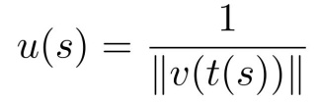

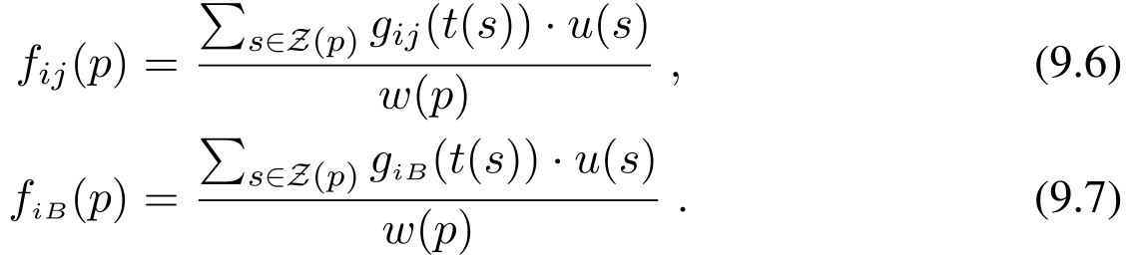
From time Domain to Space Domain (cont’d)
    If base station traverse p but never dwells, then this is a unique time corresponding to each ,. Define
    and , then
  Now, we show the constructed solution has the same network lifetime and with routing and feasible
    We first prove the routing is feasible and then prove the network lifetime is same
    We prove (i): when base station visits each point, flow conservation holds at this node
Notes:
To show the data routing scheme with f_{ij}(p) and f_{iB}(p) is feasible and the constructed solution has the same network lifetime T,
we need to prove (i) when the base station visits each point p\in $\mathcal P$, flow conservation holds at this node,
and (ii) at time T, the energy consumption at each node is the same as that in time-dependent solution

Slide 15
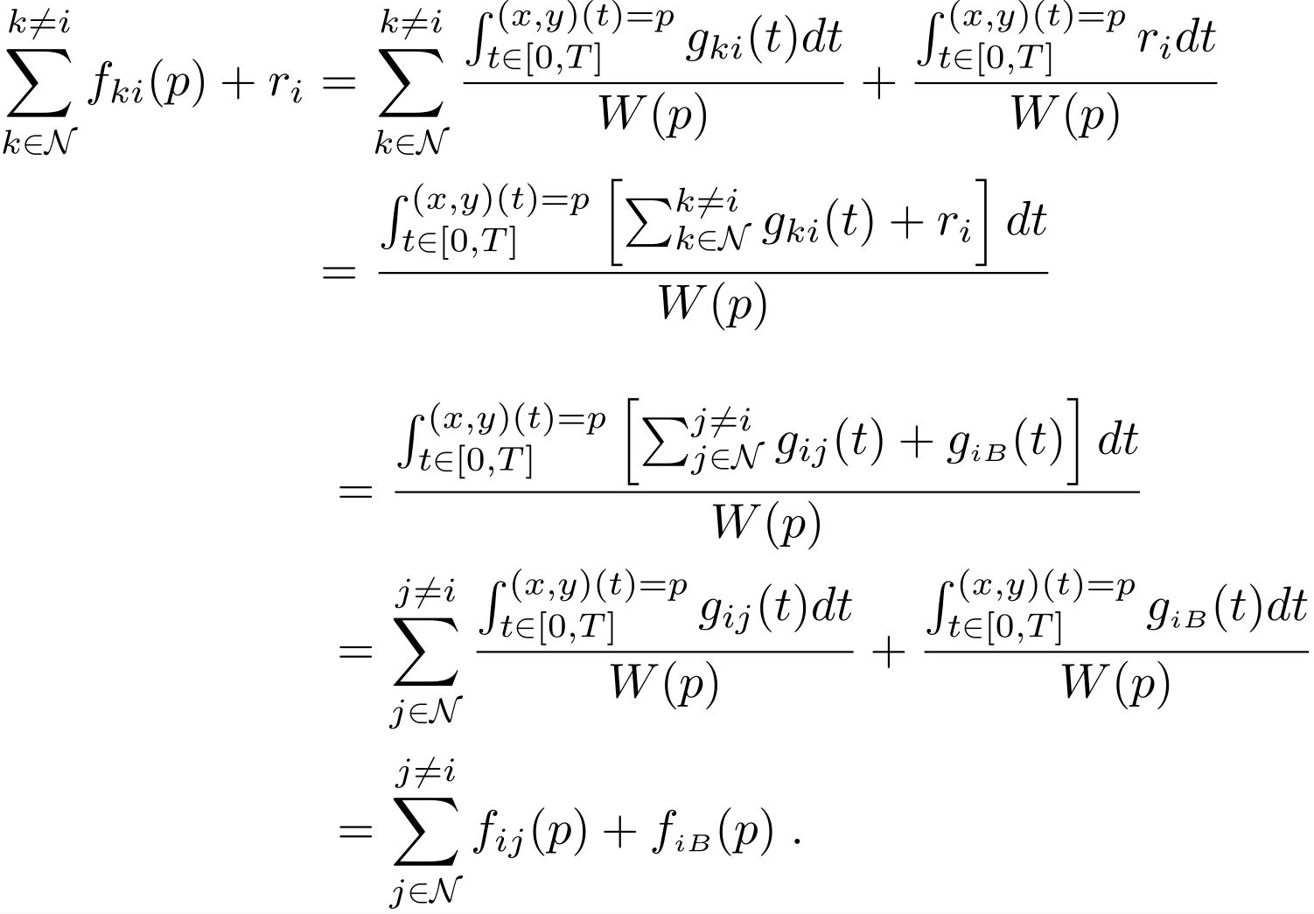
From time Domain to Space Domain (cont’d)
      If base station dwells at p at least once, then we have following flow conservation:
Notes:
The first equality holds by (9.2).
The third equality holds by the flow conservation in time-dependent solution $\varphi$.
The last equality holds by (9.2) and (9.3).

Slide 16
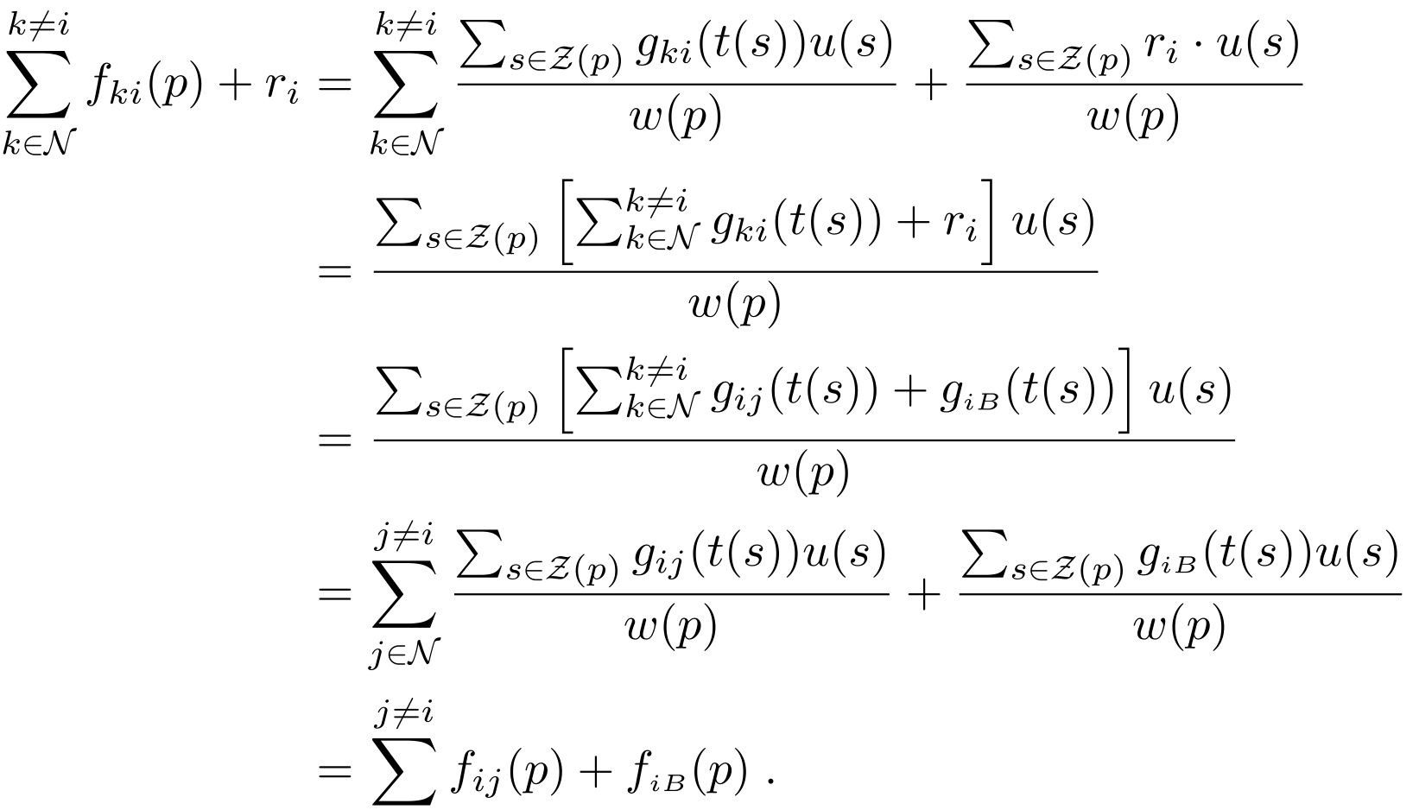
From time Domain to Space Domain (cont’d)
      If base station traverses (but never dwells at) p, then we have the following flow conservation:
Notes:
The first equality holds by (9.6) and definition of w(p).
The third equality holds by the flow conservation in the time-dependent solution $\varphi$.
The last equality holds by (9.6) and (9.7).

Slide 17
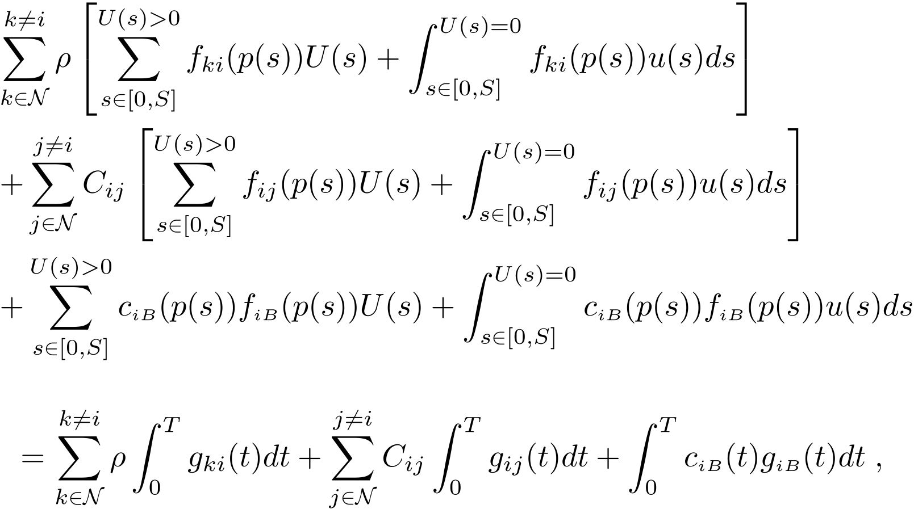
From time Domain to Space Domain (cont’d)
    We prove (ii) The energy consumption at each node in the construction solution is the same as that in the given time-dependent solution, i.e.,
Notes:
c_{iB}(p) is the energy cost from sensor i to the base station B when the base station is at point p

Slide 18
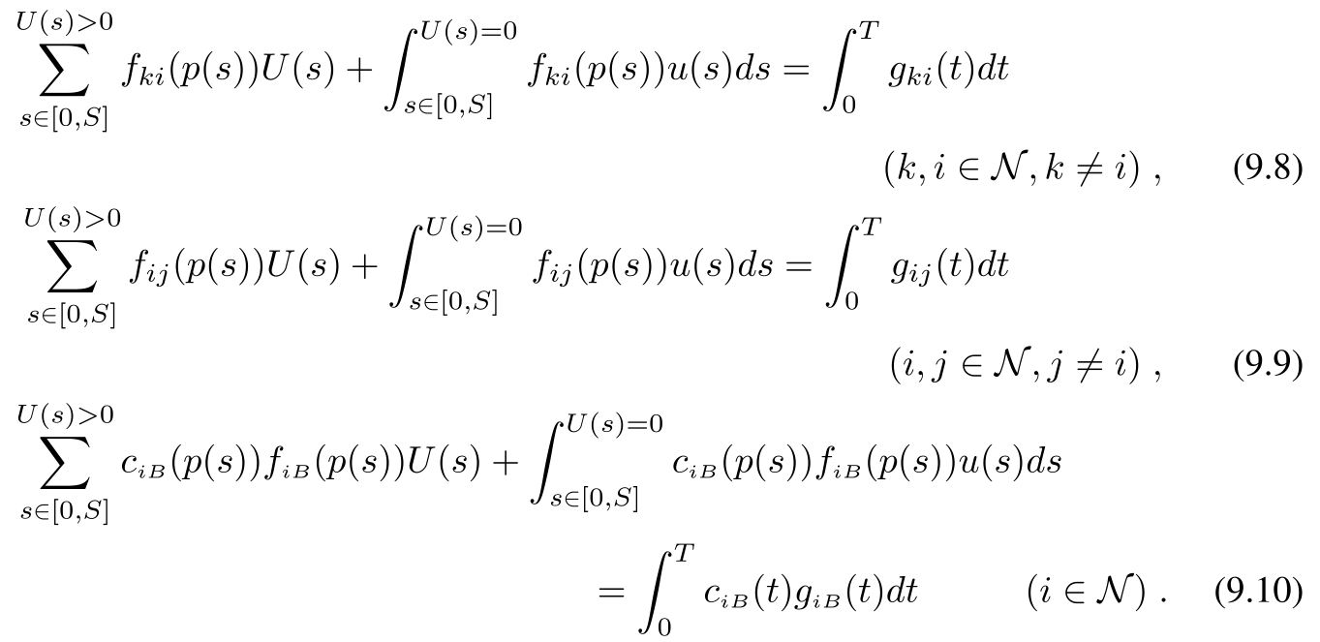
From time Domain to Space Domain (cont’d)
    To show the above three equalities, it is sufficient to show that the following three equalities hold
    We now prove (9.10). The proofs for (9.8) and (9.9) are similar.
Notes:
We leave the proof of (9.8) and (9.9) for homework.

Slide 19
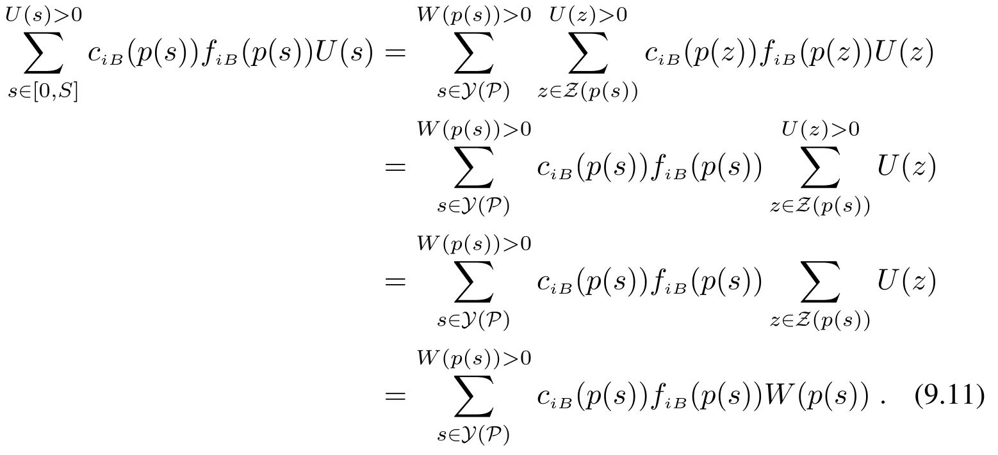
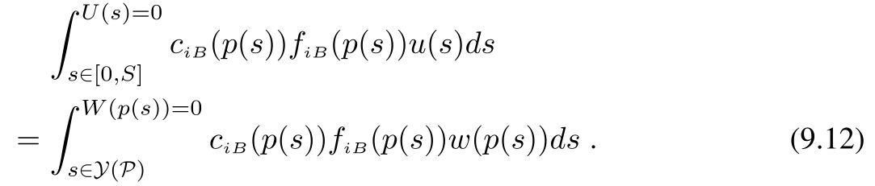
From time Domain to Space Domain (cont’d)
    For the summation (first term) on the LHS of (9.10), we have
    The integration (second term) on the LHS of (9.10) can be shown
Notes:
On the left-hand-side (LHS) of (9.10), we observe the summation and integration are over distances in [0, S].
For each s\in \mathcal Z(p), c_{iB}(p(s)) is the same since p(s) is the same point, then f_{iB}(p(s)) is also same for each s\in \mathcal Z(p).
Thus, for a point p, we can group these distances in \mathcal Z(p) together in the summation as well as integration on the left of (9.10).
We select one distance from each group \mathcal Z(p) to represents this group, in particular, we can select the smallest distance in \mathcal Z(p).
Denote \mathcal Y(\mathcal P) as the se t of these representatives for each \mathcal Z(p). Then \mathcal Y(\mathcal P) is a subset of [0, S].
From above, the first equality holds by grouping those distances corresponding to the same point p(s) that base station dwells.
The second equality holds by c_{iB}(z)=c_{iB}(s) and f_{iB}(p(z))= f_{iB}(p(s)) for each z\in \mathcal Z(p(s)).
The last equality holds by (9.1).

Slide 20
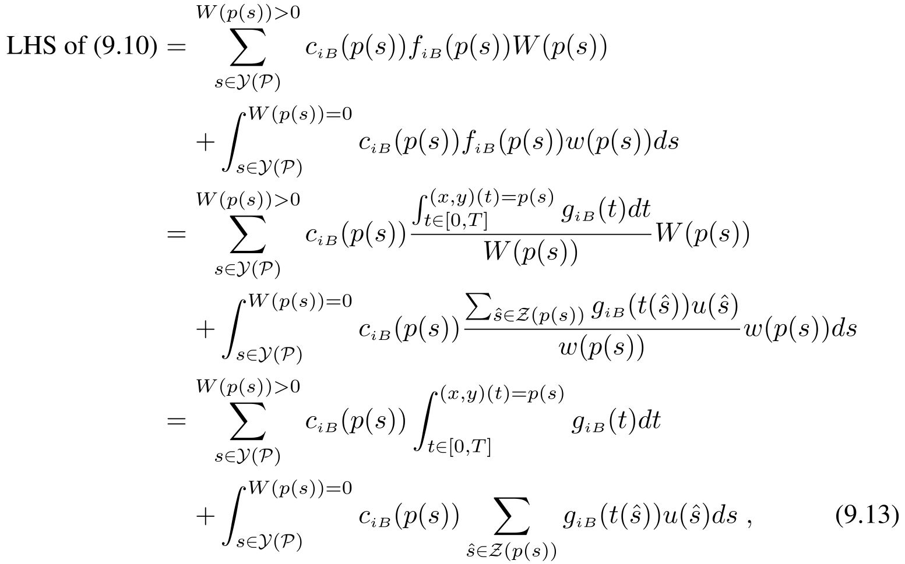
From time Domain to Space Domain (cont’d)
    Thus, by (9.11) and (9.12), we have
    For the RHS of (9.10), we have
Notes:
The second equality holds by (9.3) and (9.7)

Slide 21


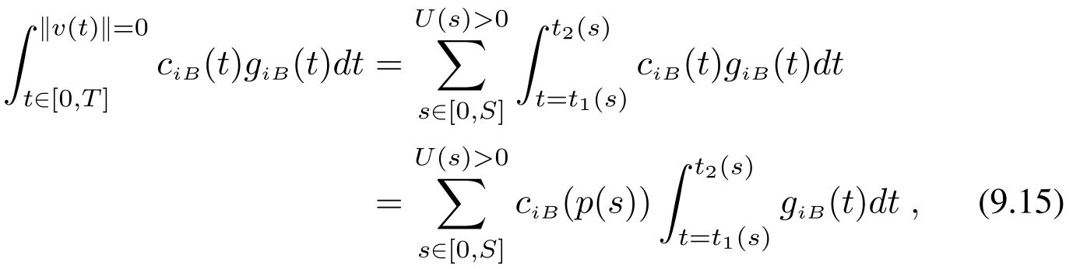

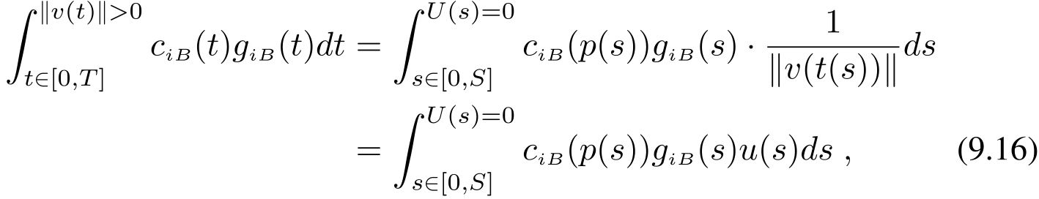
From time Domain to Space Domain (cont’d)
    We now transform each of above integrations from t-domain to s-domain
    For the case . For any time t during , the base station dwells. Thus,
    For the case , the base station is traversing at the current point. Thus
Notes:
For ||v(t)||=0: The first equality holds as the integration is limited to those dwelling periods, each corresponding to a distance s\in [0, S] with U(s)>0.
The second equality holds by c_{iB}(t)=c_{iB}(p(s)) for t\in [t_1(s), t_2(s)].
For ||v(t)||>0:
g_{iB} is the flow rate from sensor I to base station B when the base station is traversing at point p(s).
The first equality holds by ds=|||v(t(s))|=0 and the second equality holds by the definition of u(s).

Slide 22
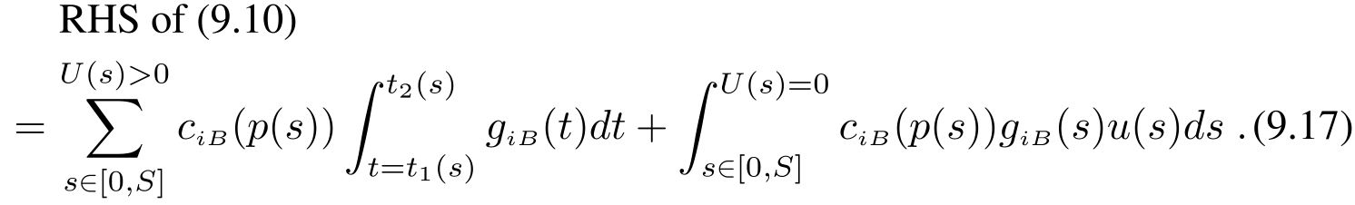
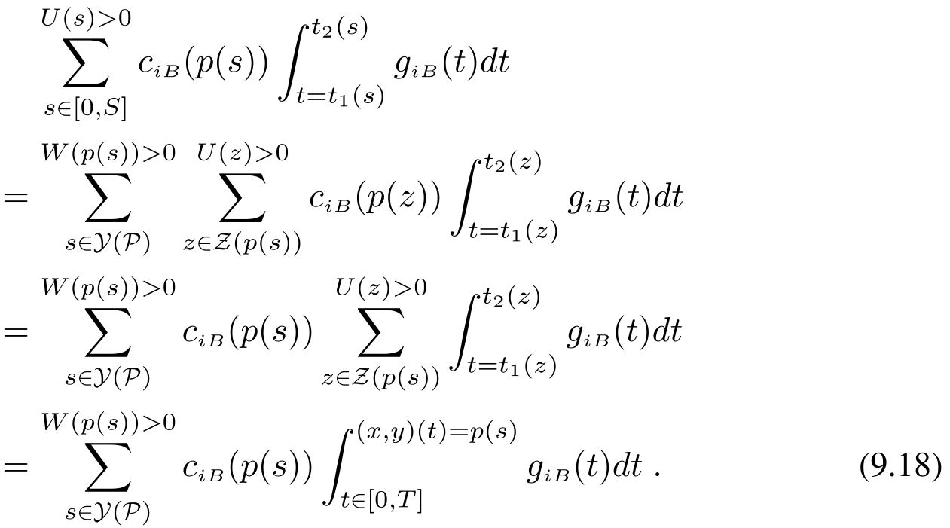
From time Domain to Space Domain (cont’d)
    Therefore, by (9.14), (9.15) and (9.16), we have
    For the summation (first term) on the RHS of (9.17), we have
Notes:
The first equality holds by grouping those distances corresponding to the same point p(s) that the base station dwells.
The second equality holds by c_{iB}(p(z))=c_{iB}(p(s)) for each z\in \mathcal Z(p(s)).

Slide 23
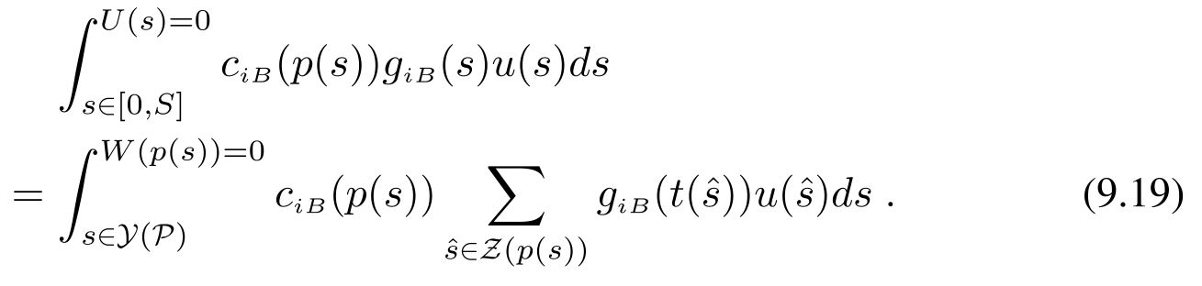
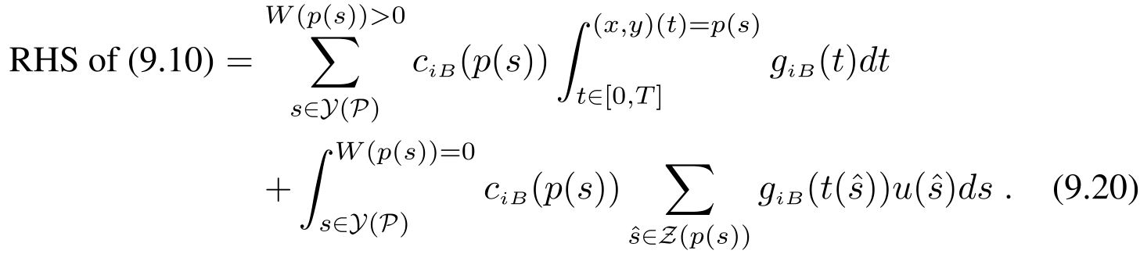
From time Domain to Space Domain (cont’d)
    For the same taken, for the integration (second term) on the RHS of (9.17), it can be shown that
    Therefore, by (9.17), (9.18), and (9.19), we have
    By (9.13) and (9.20), (9.10) is proved.

Slide 24

From time Domain to Space Domain (cont’d)
Lemma 9.2. Under a location-dependent solution, as long as W(p) (w(s)) at each point p remains the same, the network lifetime T will remain unchanged regardless of the ordering and frequency of the base station’s presence at each point.
Combine Lemmas 9.1 and 9.2, and considering the special case that is optimal, we have Theorem 9.1.
Notes:
Lemma 9.2 can be easily proved by analyzing the energy consumption behavior at each node over time T.
We leave its proof as a homework problem.
We conclude as far as network lifetime is concern, it is sufficient for us to study location-dependent solution

Slide 25

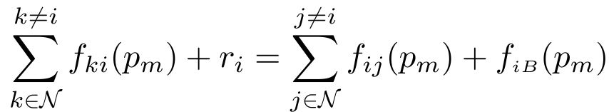
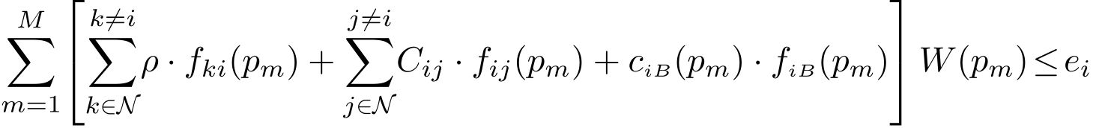
Constrained Mobile Base Station (C-MB)
The location of base station is limited to a finite of M location
When the base station is at point , the flow conservation for node is
The energy constraint for node at the end of network lifetime T is

Slide 26
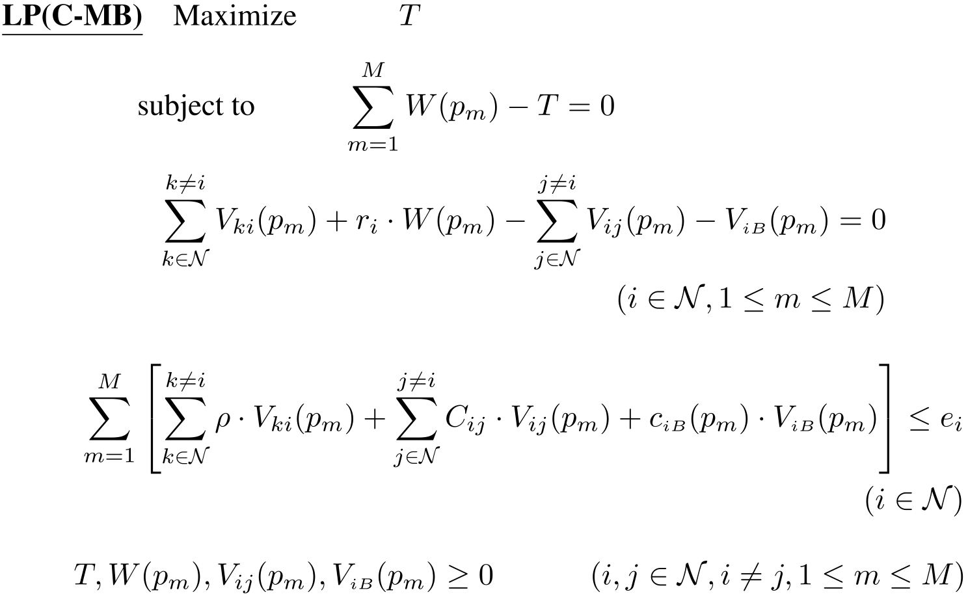
C-MB Formulation
Notes:
f_{ij}=V_{ij}(p_m)/W(p_m)
F_{iB}=V_{iB}(p_m)/W(p_m)
The C-MB problem can be solved via a single LP in polynomial

Slide 27

Unconstrained Mobile Base Station (U-MB)
Discrete transmission & cost with parameter
  Get a sequence of distance with a factor of
Divide SED into subareas
  Using a sequence of circles with radius at each sensor
Represent each subarea by a Fictitious Cost Point (FCP)
Compute the optimal sojourn time and flow routing for each FCP
D[h]
D[h]

Slide 28

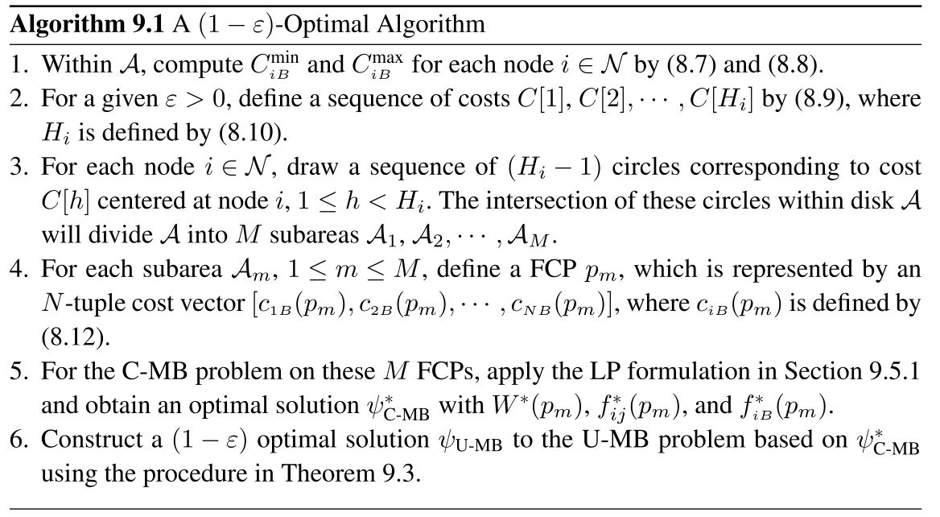
A -optimal Algorithm
Notes:
The procedure of Theorem 9.3 will be shown later.

Slide 29







Roadmap for Proof
Denote as an optimal solution to U-MB and as the maximum network lifetime
Denote as an optimal solution to the C-MB obtained by applying LP on the M FCP, and the corresponding network lifetime
We first prove
We further construct solution based on and show

Slide 30






Proof of optimality
Theorem 9.2. For a given , then we have
  To prove Theorem 9.2, we have the following lemma
Lemma 9.3. Given a feasible solution to U-MB with network lifetime , we can construct a solution with a lifetime
With Lemma 9.3, we are now ready to prove Theorem 9.2
Notes:
The details of the proof of lemma 9.3 are similar to the proof of Lemma 9.1, and are left in a homework problem.

Slide 31





Proof of optimality
Proof:
  Consider a given solution to U-MB is optimal with network lifetime
  By Lemma 9.3, we can transform it into a solution to the C-MB problem with a network lifetime at least
  As a result,
  However, a FCP may not be mapped to a physical point
  We shown the network lifetime for the constructed solution
Notes:
In the following theorem, we show how to construct a solution with each point being physically realizable.
Further, the network lifetime for this constructed solution is greater than or equal to the maximum network lifetime

Slide 32







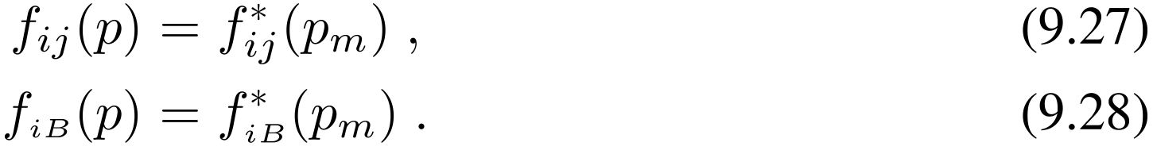
Proof of optimality
Theorem 9.3. For given , given an optimal solution on these M FCPs with and a network lifetime , a -optimal solution to the U-MB problem can be constructed by having the base station stay in for amount of time and by having a corresponding flow routing for any physical point as
Notes:
In Theorem 9.3, note that in the constructed solution to the U-MB problem, as long as the base station is within \mathca A_m (any point in this subarea), the flow routing is the same.

Slide 33


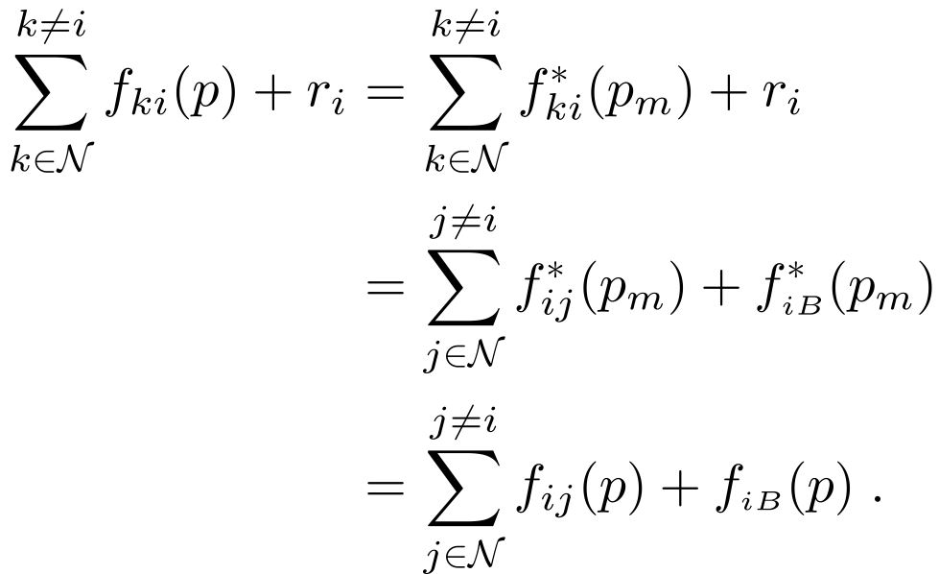
Proof of optimality
Proof:
  We show the constructed solution is feasible
  We first prove (i): Flow conservation holds at any point
    For flow conservation, when the base station location p is in , we have
Notes:
The first equality holds by (9.27).
The second equality holds by flow conservation in optimal solution for C-MB
The third equality holds by (9.27) and (9.28).
Thus, this constructed solution is feasible.

Slide 34





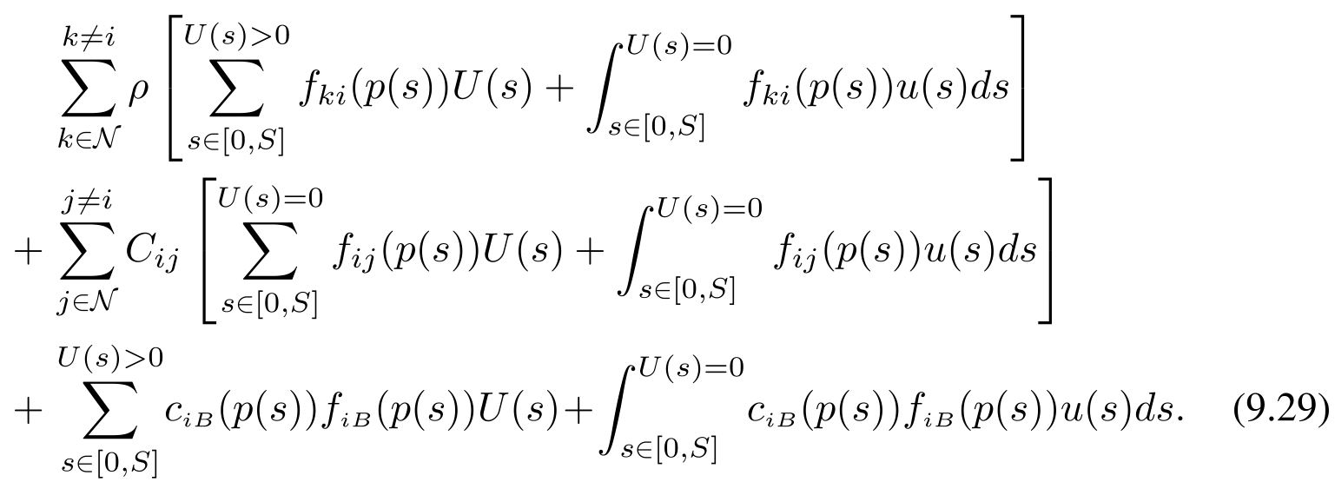
Proof of optimality
  We prove (ii): the network lifetime of is at least
    The total energy consumption at a node by time in solution is
  For the last two terms in (9.29), we have

Slide 35
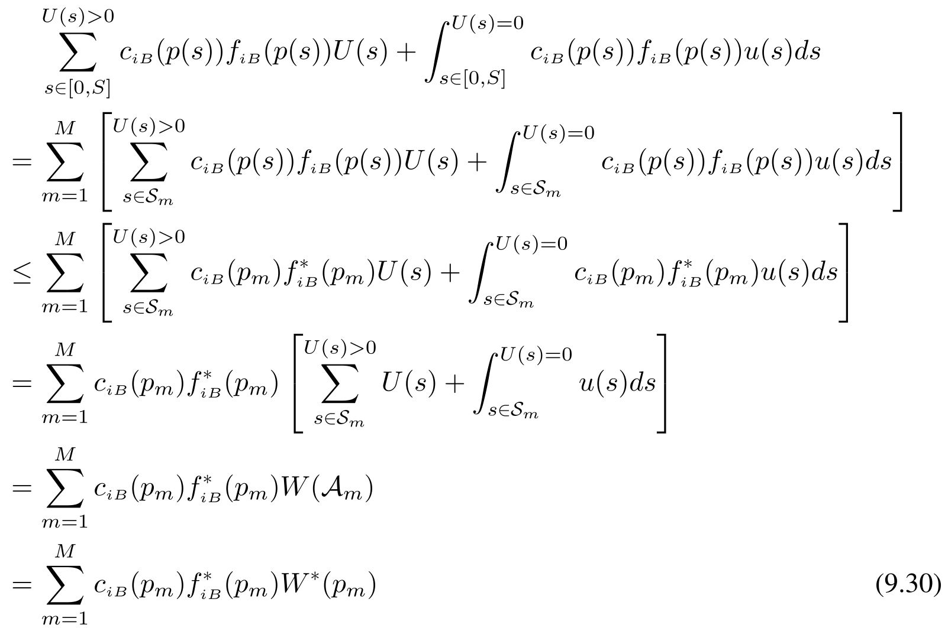
Proof of optimality
Notes:
The second inequality holds by c_{iB}(p(s)) <=c_{iB}(p_m) in Property 1 and (9.28).
The fourth equality holds by (9.25).
The last equality holds by (9.26)

Slide 36
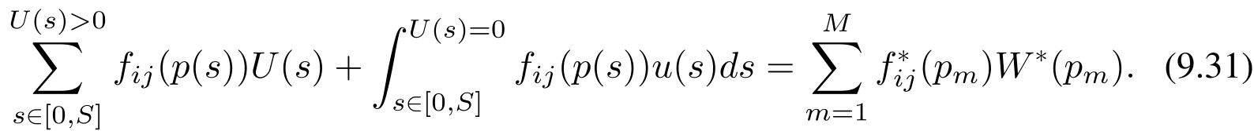

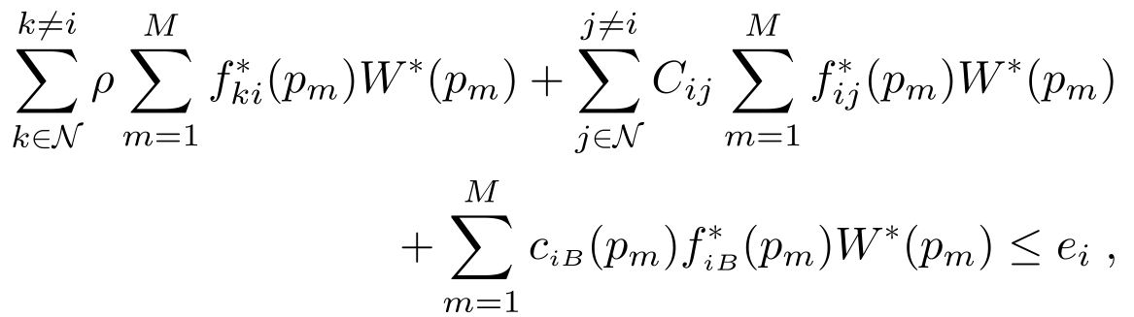

Proof of optimality
  Following the same taken, it can be shown that
  Thus, by (9.30) and (9.31), the total energy consumption at node by time , which is shown in (9.29) is no more than
  Thus, network lifetime of solution is at least
  This completes the proof.
Notes:
The inequality holds by the energy constraint in optimal C-MB solution.

Slide 37
Summary of Algorithm
  In Algorithm 9.1, Step 5 has the highest complexity among all steps
  Since the total number of subareas M obtained through the intersection of these circles is upper bounded by
  Thus, LP in Step 5 has polynomial size and the complexity of the overall algorithm is Polynomial

Slide 38
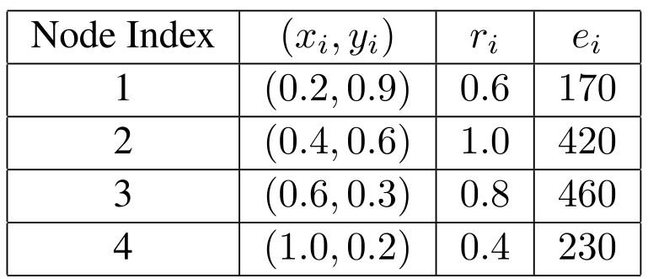




An Example – Network Setting
  Solve a 4-node WSN problem as an example
  The location, data rate, and initial energy for each sensor node are shown below
  We set , , and

Slide 39




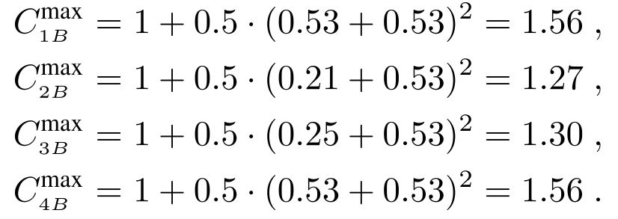
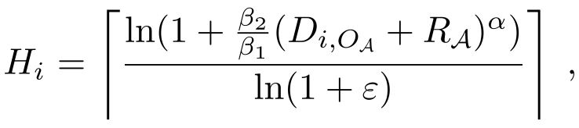
An Example – Details
  In Step 1, we identify SED with =(0.60, 0.55) and Radius =0.53
  Then we have and , then we have
  In Step 2, for , since

Slide 40
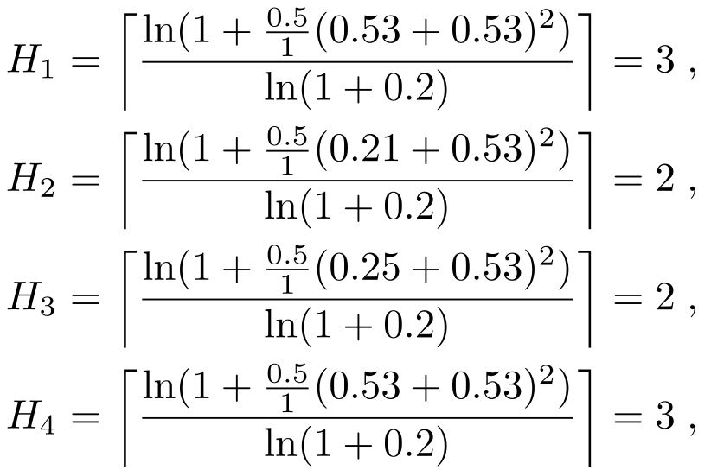
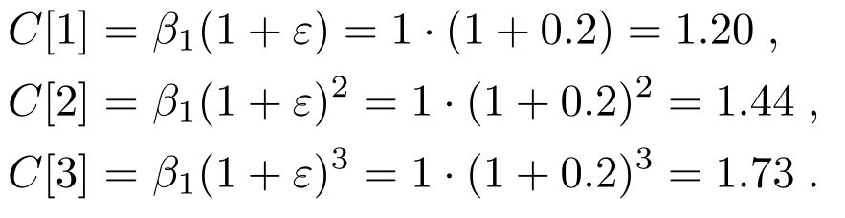
An Example – Details
  We have
  and

Slide 41

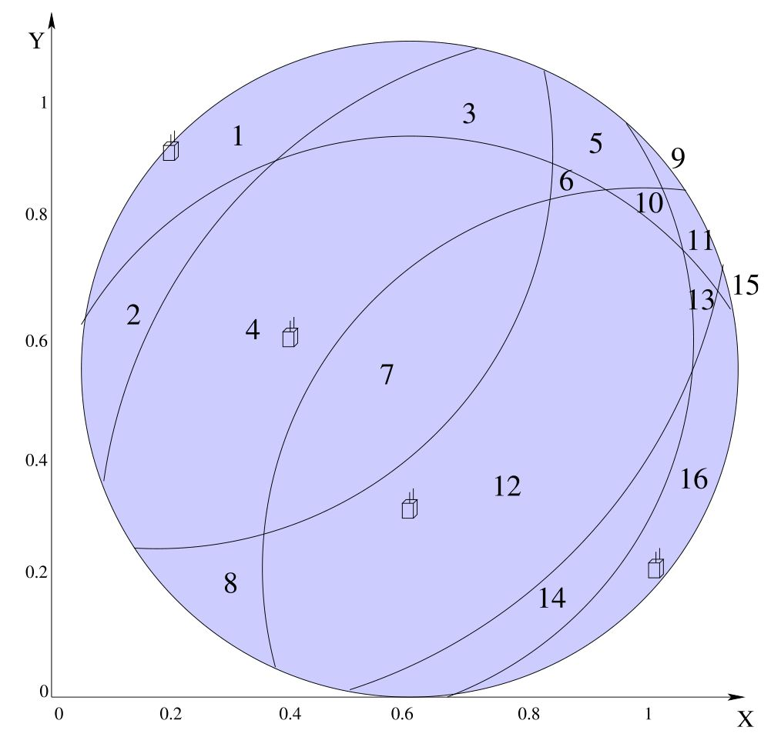
An Example – Details
  In Step 3, we draw a sequence of circles at each node with cost C[h] to divide the SED into 16 subareas

Slide 42











An example – Details
  In Step 4, we define FCP p_{m} for each subarea ,
    For example, for 4-tuple cost vector as
  In Step 5, we obtain an optimal solution to C-MB. We obtain network lifetime 247.76, 144.22 82.50, =21.06, and for all other 13 FCPs, we have .
    When base station is at FCP , the routing is
    When base station is at FCP , the routing is
    When base station is at FCP , the routing is
1≤m≤16

Slide 43





An Example – Details
  In Step 6, We obtain optimal solution to U-MB as follows,
    Let the base station stays at any point in subareas , and for 144.22, 82.50 and 21.04 unit of time, respectively
    The routing for base station at a point p in is
    The routing for base station at a point p in is
    The routing for base station at a point p in is
  The network lifetime for is greater than or equal to 247.76 and is optimal

Slide 44


Discussions
  For any path, as long as the total sojourn time at each subarea is , the achieved network lifetime is optimal
  All of these paths are equally good under network lifetime objective.
  It may be arguable that one path is better than another under some other objective, e.g., minimizing the total traveled distance
  However, such objective can be formulated as a separate problem and its discussion is beyond the scope of this chapter

Slide 45



Numerical Examples
  We consider four randomly generated networks
    Consisting of 10, 20, 50, and 100 nodes deployed over unit square
  The data rate and initial energy for each node are randomly generated between [0.1, 1] and [50, 500]
  The units of distance, rate and energy are all normalized appropriately
  Set , and

Slide 46
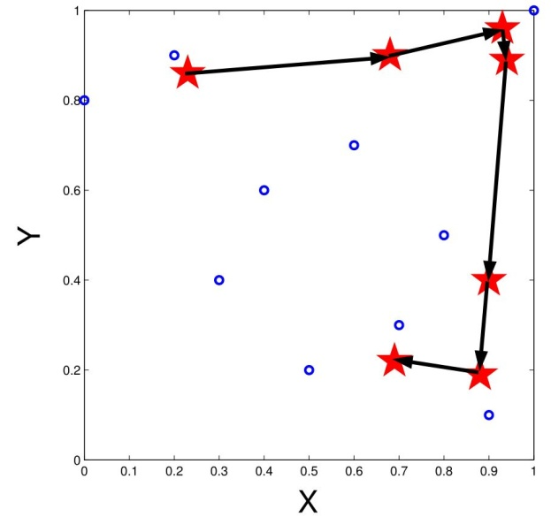
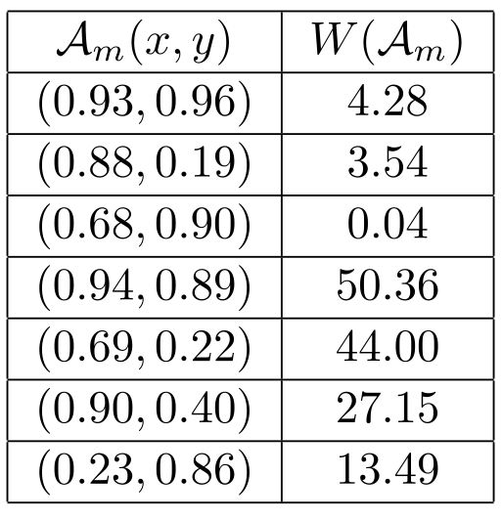
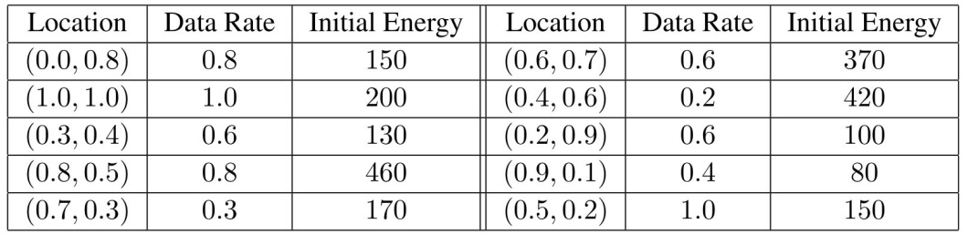
10-node Network
T_{ε}=142.86 guaranteed by 95% optimum
Notes:
The location, data rate, and initial energy for each node is shown in right side table (bottom).
The corresponding sojourn time for base station to stay in each of these 7 subareas is shown in right side table (top).
The subareas that will be visited by base station will are represented by star in the left figure, and a possible path is also shown in this figure

Slide 47
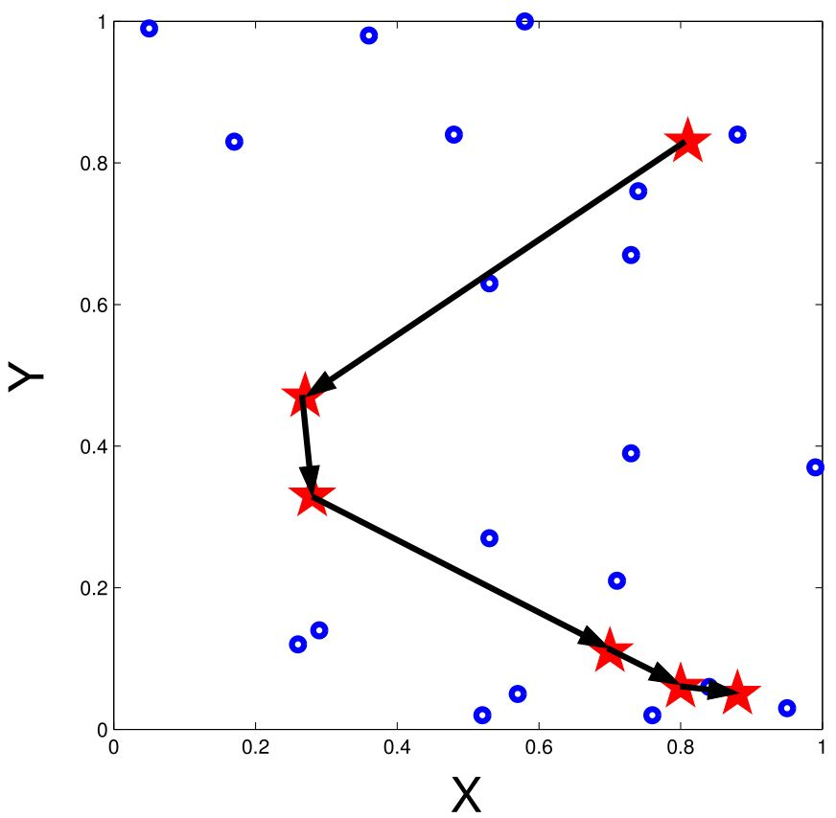
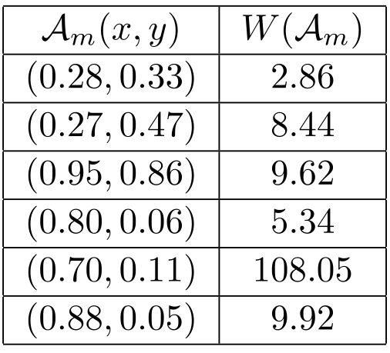
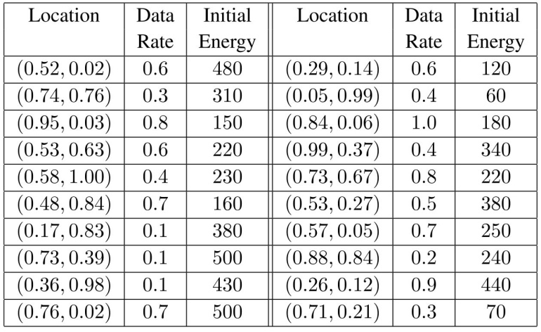
20-node Network
T_{ε}=144.23 guaranteed by 95% optimum
Notes:
The location, data rate, and initial energy for each node is shown in right side table (bottom).
The corresponding sojourn time for base station to stay in each of these 6 subareas is shown in right side table (top).
The subareas that will be visited by base station will are represented by star in the left figure, and a possible path is also shown in this figure

Slide 48
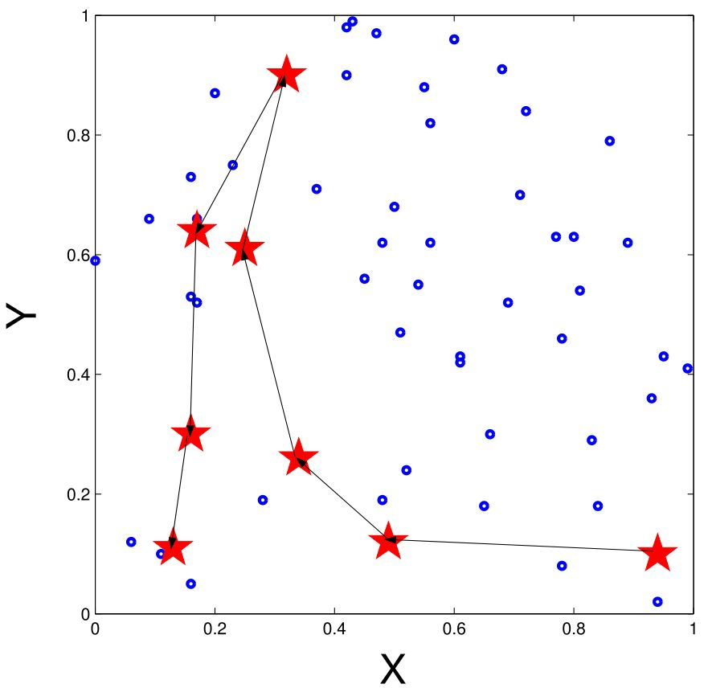
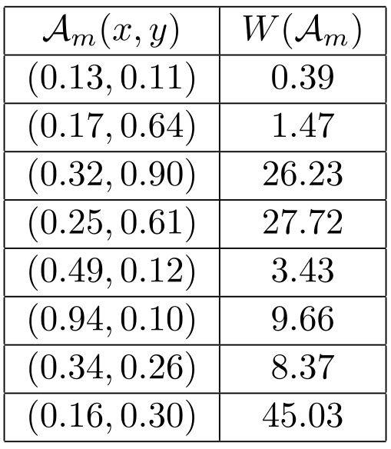
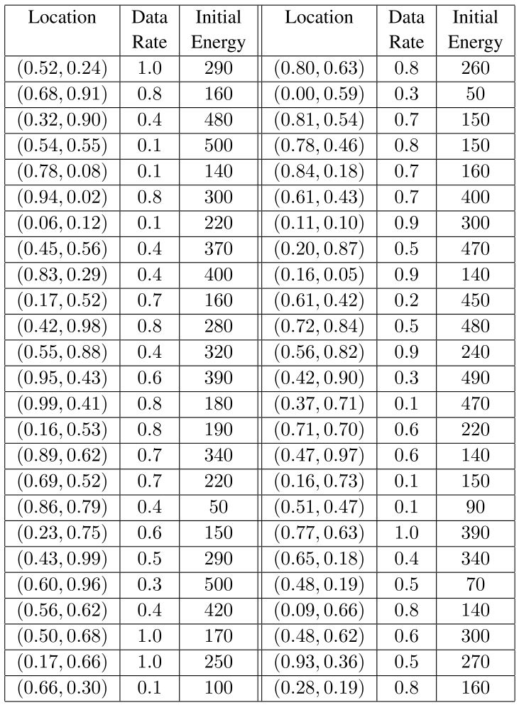
50-node Network
T_{ε}=122.30 guaranteed by 95% optimum
Notes:
The location, data rate, and initial energy for each node is shown in the middle table.
The corresponding sojourn time for base station to stay in each of these 8 subareas is shown in right side table
The subareas that will be visited by base station will are represented by star in the left figure, and a possible path is also shown in this figure

Slide 49
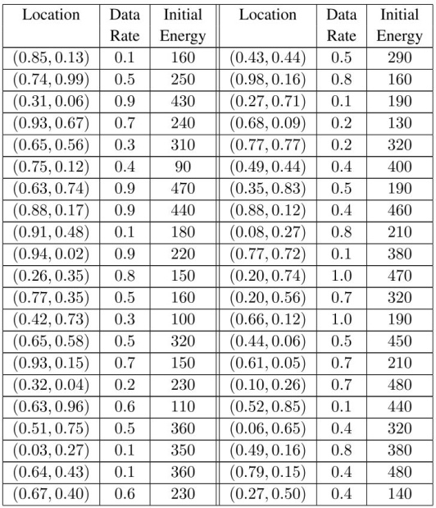
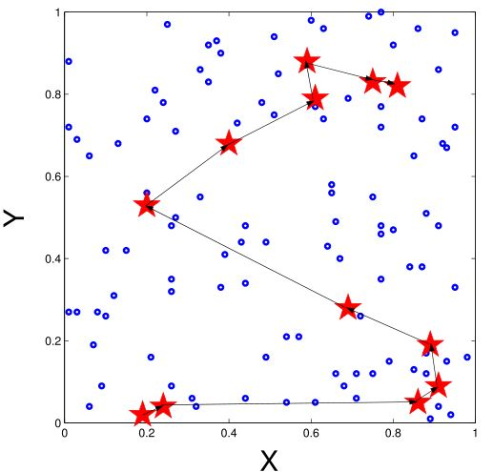


100-node Network
T_{ε}=149.45 guaranteed by 95% optimum
Notes:
The location, data rate, and initial energy for each node is shown in middle table
The corresponding sojourn time for base station to stay in each of these 12 subareas is shown in right side table
The subareas that will be visited by base station will are represented by star in the left figure, and a possible path is also shown in this figure

Slide 50
Summary
Mobile base station problem
  Transform from time domain to space domain
  Constrained base station problem
  Unconstrained base station problem
    Design a optimal algorithm
    An Example
  Numerical results

