Slide 1
Chapter 8
Approximation algorithm and its applications
Part 1

Slide 2
Review of Approximation Algorithm
Constant-factor approximation algorithm
  Maximization problem: Obtained feasible solution is
  at least cOPT
  Minimization problem: Obtained feasible solution is
  at most cOPT
(1-ε)-optimal (or (1+ε)-optimal) approximation algorithm
  Maximization problem: Obtained feasible solution is
  at least (1-ε)OPT
  Minimization problem: Obtained feasible solution is
  at most (1-ε)OPT
Notes:
Constant-factor approximation algorithm: OPT >0 (unknown) is the optimal objective value, c<1 and is a constant for a maximization problem (c>1 and is a constant for a minimization problem)
The complexity is polynomial time.
(1-epsilon)-optimal (or (1+epsilon)-optimal) approximation algorithm: OPT >0 (unknown) is the optimal objective value, 0<epsilon <<1 and epsilon can be arbitrarily small
The complexity is polynomial function of 1/epsilon

Slide 3
Case Study
Base Station Placement Problem

Slide 4
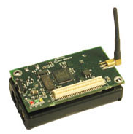
Network Setting
Sensor nodes
  Transmit data to the base station via multi-hop
  Have limited energy
Network lifetime
  Many definitions
    In this case study, network lifetime is defined as the time until any node uses up its energy

Slide 5
Base Station Placement (BSP) Problem
Motivation
  Fact: Base station location has a profound impact on network lifetime
Objective
  Determine the optimal base station location so as to maximize network lifetime
  Also optimize routing

Slide 6


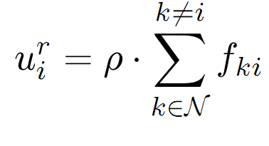
Energy Consumption Modeling
Communication power is the dominant part of energy consumption
Transmission power modeling
where
Receiving power modeling
Notes:
fij is data rate that node i transmits to node j.
Cij is the cost associated with link i -> j.
beta_1 and beta_2 are constant coefficients
Alpha is path loss index
dij is the physical distance between sensor node i and j
Rho is a constant coefficient

Slide 7
Impact of Base Station Location
Base station location has profound impact on energy consumption and network lifetime
We can determine the
maximum network lifetime
achieved on a location
Where to place base station
Notes:
From the energy consumption model, we can see that flow rate and distance influence energy consumption
The maximum network lifetime achieved on a location can be solved by a linear program (see next slide).

Slide 8
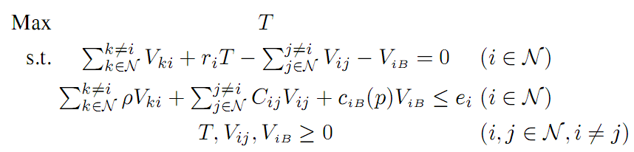


For A Given Base Station Location
Where and are constant.
Linear Programming
We can determine maximum network lifetime in polynomial-time

Slide 9
Naïve Approach
Determine the network lifetime for each possible location
Compare these network lifetimes and choose the maximum
Infinite search space !!!
Notes:
We can solve LP for each given location.
Search space is the set of all possible base station locations
However, this is unrealistic because the search space is infinite.

Slide 10
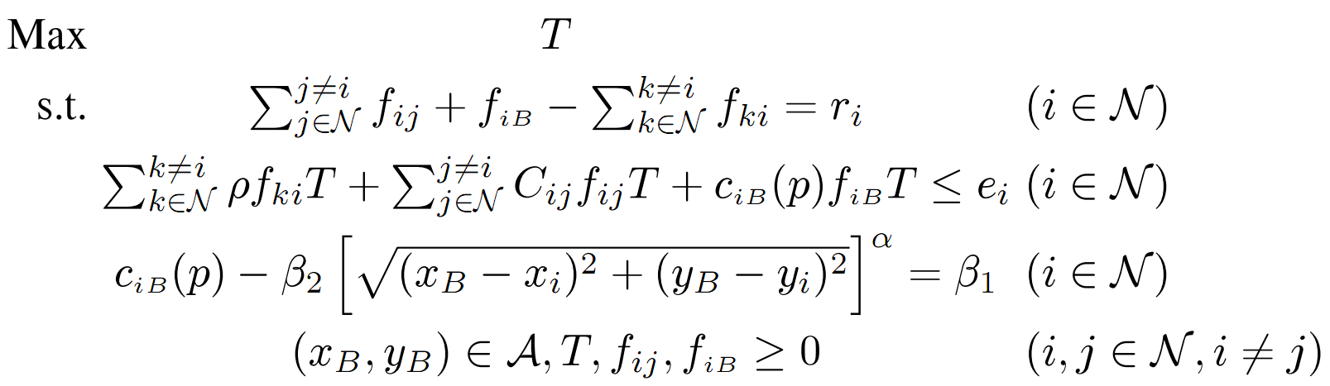


Formulation for BSP
  where is the base station location and
  is an area of base station location
Non-convex function
Non-convex Programming !!!
Notes:
First constraint is flow balance.
Second constraint is energy consumption, which joint consideration of base station location and multi-hop routing.
Third constraint is from transmission power modeling.
Non-convex programming is NP-hard in general.

Slide 11
Basic Idea of Our Approach
Sub-area division
  With tight bounds on transmission cost for any point in the subarea
Fictitious cost point (FCP) presentation
  Change infinite search space into finite search space
The best FCP provides (1-ε)-optimal solution

Slide 12
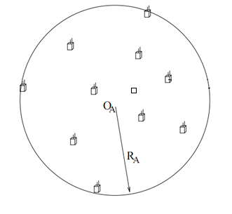
Smallest Enclosing Disk (SED)
To maximize network lifetime, the base station must be within SED
  Smallest disk that covers all sensor nodes
  Can be found in polynomial-time

Slide 13
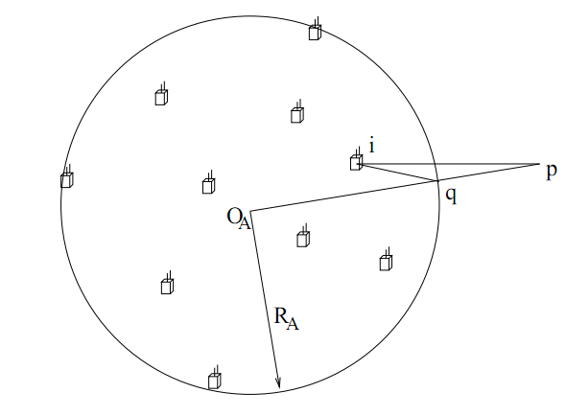
Proof
Based on contradiction
  Assume the optima base
  station location p is
  outside SED.
  For each sensor node ,
  we have d_{iq}<d_{ip}.
  Consequently, C_{iq}<C_{ip}.
  We can save energy on every sensor node by relocating p to q. The network lifetime will be increased.
  Thus, p cannot be optimal.
Notes:
Let q be the intersecting point between the line segment [p, O_{A}] and the circle of SED

Slide 14
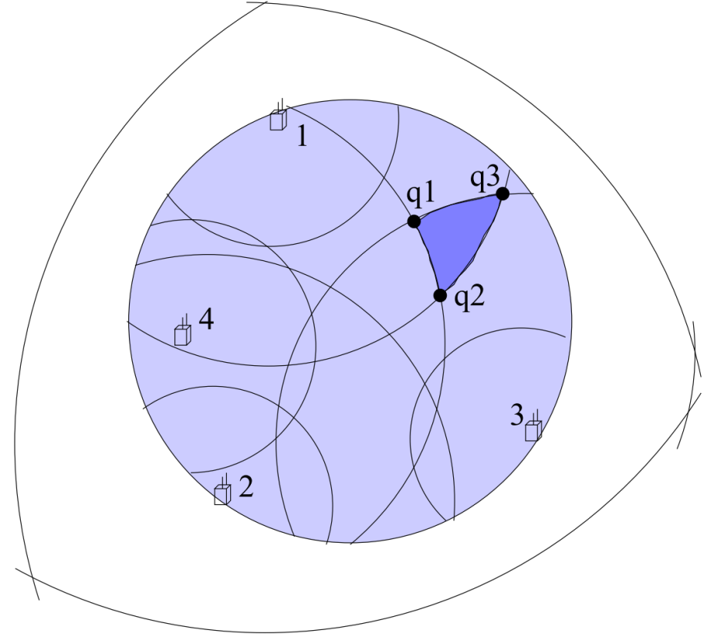
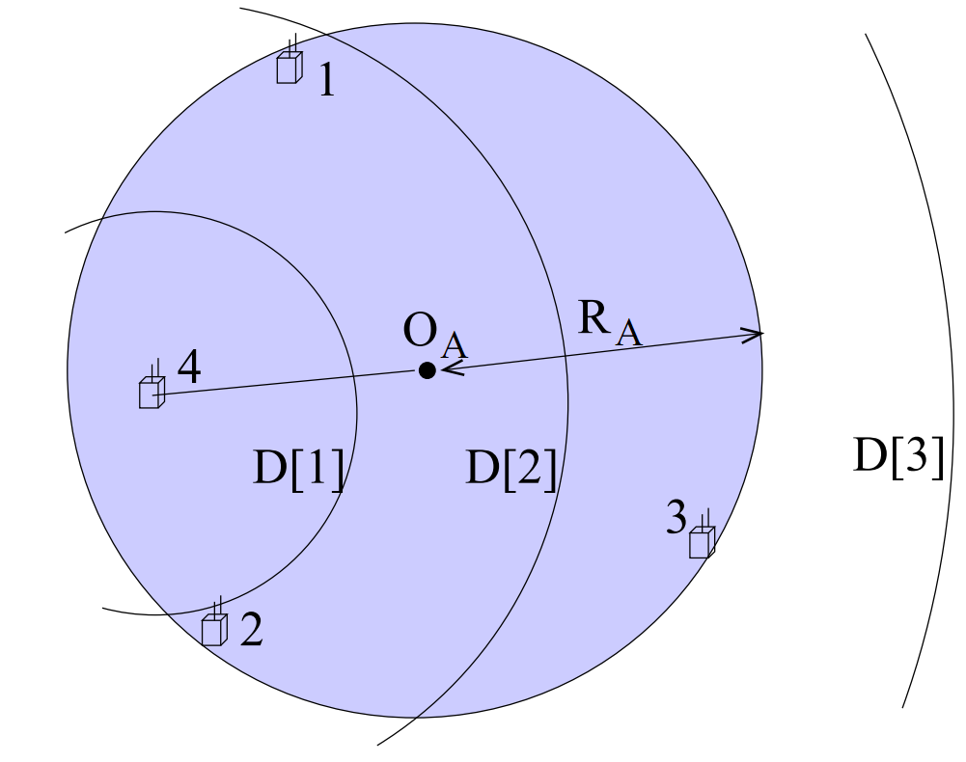
Sub-area Division
Divide SED by a sequence of circles with radius D[h] and center node
Notes:
The left SED is divided by a sequence of circles with center node 4.
The right SED is divided by sequence of circles at all nodes. This SED is divided into 28 irregular subareas.
D[h] will depend on next slide.

Slide 15



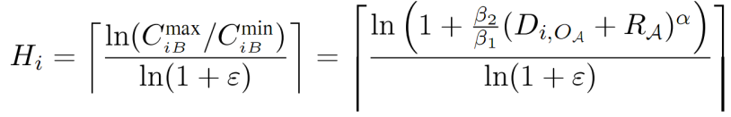
Determine
Denote , where is the maximum distances between sensor node and the base station B.
Denote and the minimum and maximum costs between sensor node and base station B. We have and
Define , h=0,1,2, …,
For each C[h], compute the corresponding distance D[h]

Slide 16



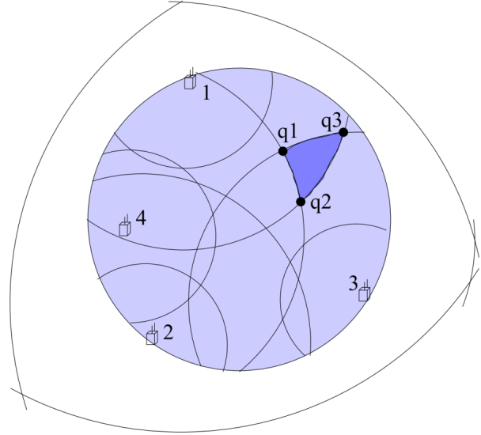


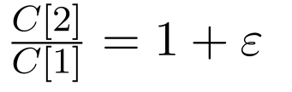
Property of A Sub-area
A subarea must be enclosed within some arc centered at sensor node
  Denote the index of this arc as
  For subarea (q₁, q₂, q₃) and sensor node 3, its h₃() is 2
For any point p in a sub-area and a sensor node , the transmission cost c_{iB}(p) can be tightly bounded
  and
  For subarea (q₁, q₂, q₃) and sensor
node 3, we have
and
Notes:
Arc(q₁,q₂) represents the arc between q₁ and q₂

Slide 17

Fictitious Cost Point (FCP)
Denote the FCP for subarea (m=1,2,…,M) as p_{m}
It is represented by an N-tuple vector
  The -th element being upper bound of cost for any point in subarea to the -th sensor node
  The N-tuple cost vector for FCP p_{m} is
with

Slide 18


Property of FCP
For any point and the corresponding FCP p_{m}, we have
Proof:
  From the definition of FCP p_{m}, we have
Notes:
The first equality is hold by definition of FCP
The second equality is hold by property of subarea
The inequality is hold by property of subarea

Slide 19
Locate the Base Station
  Solve an LP for each FCP to find maximum network lifetime
Find the best FCP with the largest network lifetime
Place the base station at any point in the corresponding sub-area

Slide 20
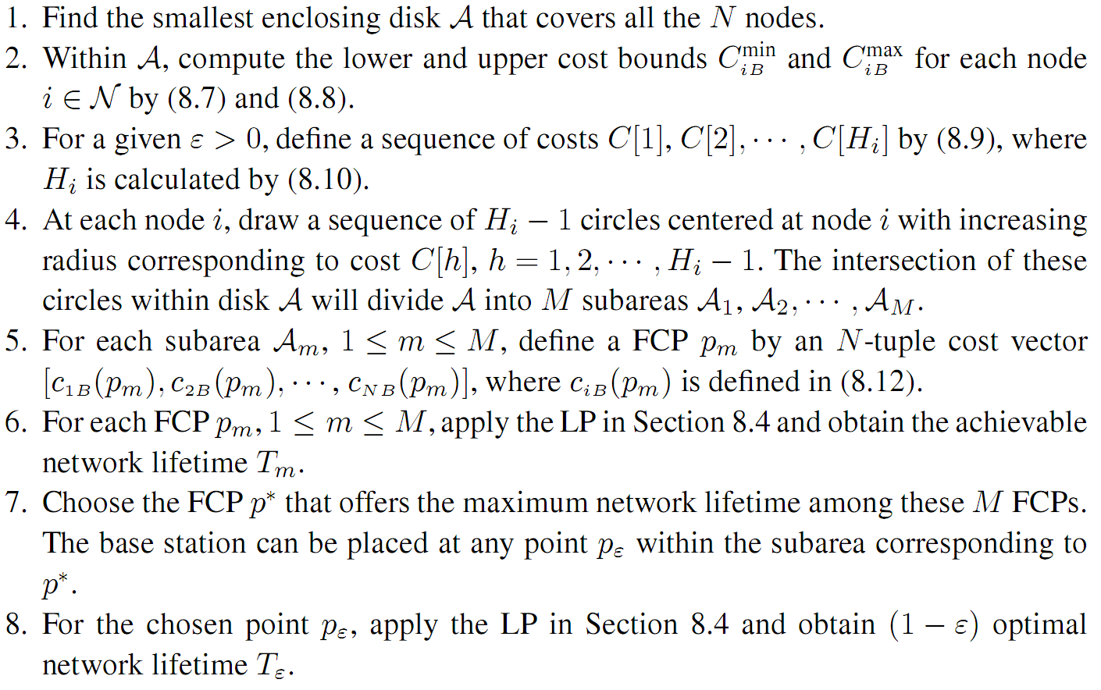
Summary:
A -optimal Approximation Algorithm

Slide 21
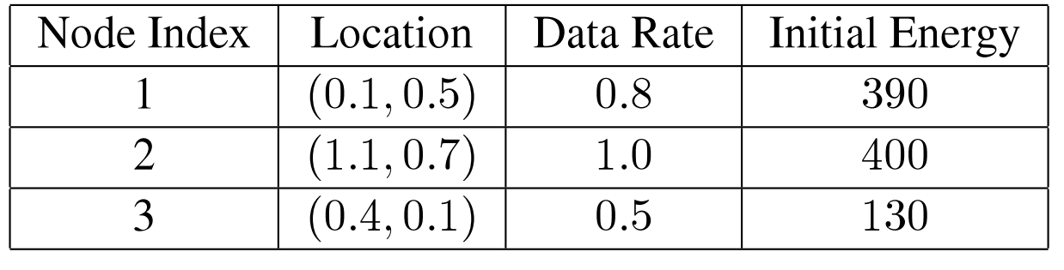
An Example – Network Setting
We set α=2, β₁=1, β₂=0.5, and ρ=1
For illustration, we set the error bound to ε=0.2
Notes:
We use a small 3-node network to illustrate the steps of the approximation algorithm.
The location, data rate, and initial energy for each sensor are shown in following table, where the units of distance, rate, and energy are all normalized.

Slide 22



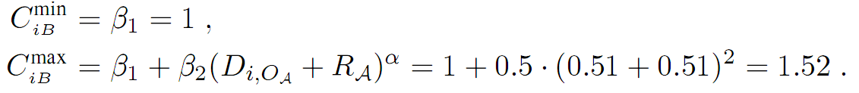
An Example – Algorithm Details
(1) We identify SED with origin = 0.61, 0.57 and radius =0.51
(2) We first have for each node . We then find the lower and upper bounds of c_{iB} for each node , as follows

Slide 23
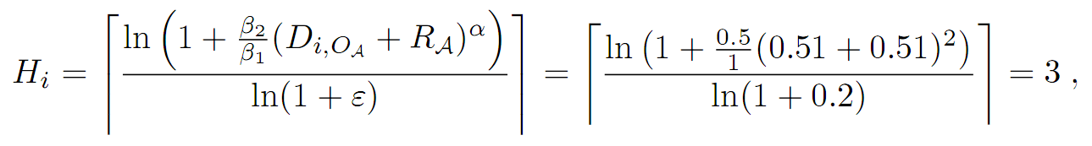
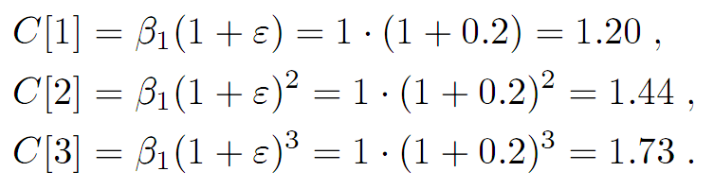
An Example – Algorithm Details (cont’d)
(3) For each node , we find
and

Slide 24
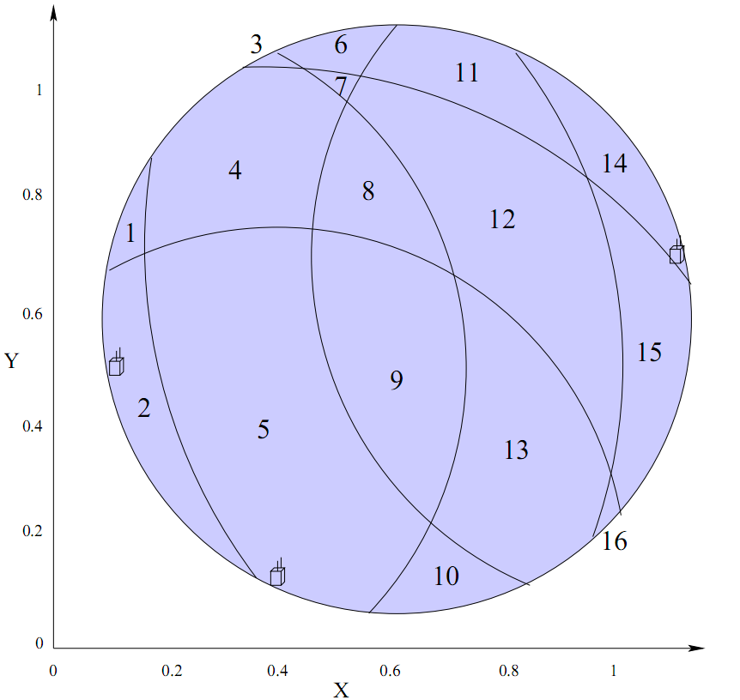


An Example – Algorithm Details (cont’d)
(4) We draw circles centered at
each node and with cost C[h],
1≤h≤H_{i}=3, to divide the whole
disk into 16 subareas
(5) We define a FCP p_{m} for each
subarea , 1≤m≤16
  For example, for FCP p₁, we define a 3-tuple cost vector as =

Slide 25

An Example – Algorithm Details (cont’d)
(6) We apply LP on these 16 FCPs and obtain the network lifetime for each FCP
(7) Since the FCP p₉ has the maximum achievable network lifetime 226.47 among all 16 FCPs, we can place the base station at any point in subarea ,
e.g., p_{ε}=(0.6, 0.6)
(8) We apply LP on p_{ε} and obtain (1-ε)-optimal network lifetime T_{ε}=227.07. This completes the algorithm.

Slide 26
Roadmap for Proof
Denote T_{opt} the maximum network lifetime under optimal base station placement p_{opt}
Denote T* the maximum network lifetime under the best FCP p*
Denote T_{ε} the network lifetime under a physical point p_{ε} in the subarea corresponding to the best FCP p*
We first prove that T* for the best FCP is with (1-ε) of the optimum, i.e., T*≥(1-ε)T_{opt}
Then we show that for the physical point p_{ε}, its corresponding network lifetime is T_{ε} no less than T* and thus also (1-ε) of the optimum, i.e., T_{ε}≥T*≥(1-ε)T_{opt}

Slide 27
Correctness Proof
For T*and T_{opt} as defined, we have T*≥(1-ε)T_{opt}
To prove this, we first prove the following result, which is a general case
For any given base station location p, corresponding optimal routing solution φ, and achievable network lifetime T, denote the subarea that contains p for a given ε. Then for the corresponding FCP p_{m}, its achievable network lifetime T_{m} is at least (1-ε) of T,
i.e., T_{m}≥(1-ε)T.

Slide 28

Correctness Proof (cont’d)
Proof:
  We use the same routing φ on p_{m}. Denote the network lifetime for FCP p_{m} under φ, we have .
  Then we only need to show .
  We compute the total consumed energy on node
  under φ at time (1-ε)T. We find that the consumed energy is no more than its initial energy
  Thus, the network lifetime under routing solution φ is at least (1-ε)T.
  As a result, We have . This completes the proof.
Notes:
Please see book chapter Lemma 8.2 for details.

Slide 29
Correctness Proof (cont’d)
For T_{ε} and T_{opt} as defined, we have T_{ε}≥(1-ε)T_{opt}.
Proof:
  Denote the network lifetime for point p_{ε} under the same routing solution φ* for FCP p*. Since φ* is a sub-optimal routing for p_{ε}, we have . We already proved
  Thus, to show T_{ε}≥(1-ε)T_{opt}, we only need to show
  We compute the total consumed energy on node
  under φ* for point p_{ε} at time T*. We find that the consumed energy is no more than its initial energy
  Thus, the network lifetime for location p_{ε} under φ* is at least T*. As a result, the maximum network lifetime T_{ε} for location p_{ε} is at least . This completes the proof.
Notes:
Now we prove next result

Slide 30

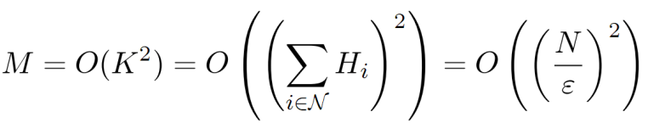
Complexity Analysis
The complexity is measured by the number of LPs, which equal to the total number of subareas
The maximum number of subareas is upper bounded by
  is total number of circles
Then

Slide 31
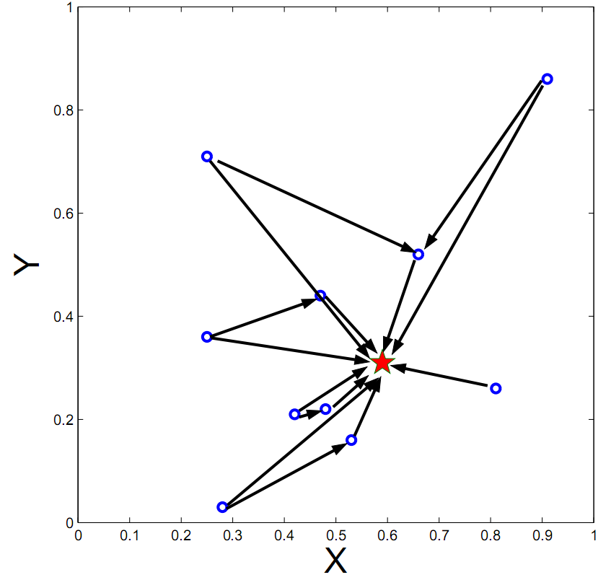
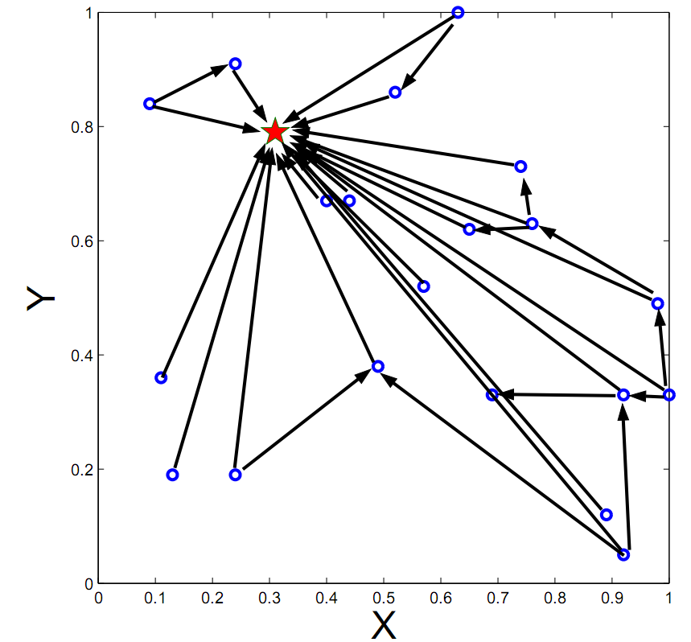
Numerical Results
10-node network
20-node network
T_{ε}=359.17 by (0.59, 0.31)
T_{ε}=82.91 by (0.31, 0.79)
Notes:
For 10-node network, we find that FCP with cost vector [1.05, 1.28, 1.05, 1.22, 1.16, 1.05, 1.05, 1.05, 1.41, 1.05] has maximum network lifetime T*=357.49, which is at least 95% of the optimal. By placing base station in the correspond subarea, e.g., at point (0.59,0.31), the network lifetime is 359.17>T*.
For 20-node network, we find that FCP with cost vector [1.55, 1.05, 1.16, 1.05, 1.41, 1.22, 1.41, 1.22, 1.41, 1.28, 1.63, 1.05, 1.16, 1.98, 1.71, 1.16, 1.28, 1.80, 1.05, 1.05] has maximum network lifetime T*=82.86 among all FCPs. We place base station in the correspond subarea, e.g., at point (0.31, 0.79). The network lifetime is 82.91>T*, which is also at least 95% of the optimum.

Slide 32
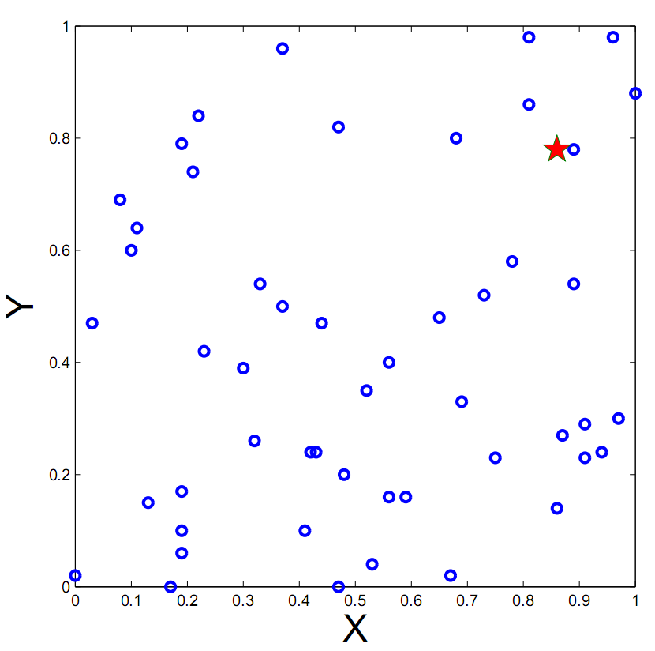
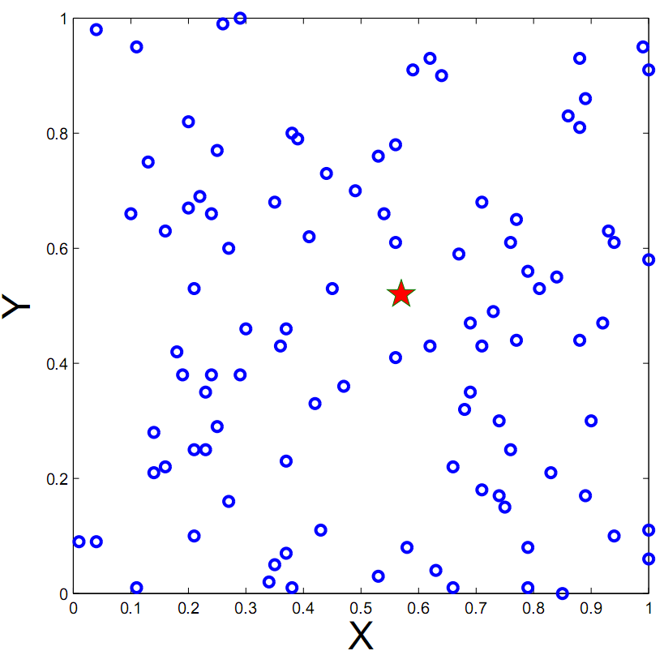
Numerical Results
50-node network
100-node network
T_{ε}=135.17 by (0.51, 0.68)
T_{ε}=61.73 by (0.57, 0.52)

Slide 33
Summary
Review of approximation algorithms
  Constant-factor approximation algorithm
  (1-ε)-optimal (or (1+ε)-optimal) approximation algorithm
Base station placement problem
  Change infinite search space into finite search space
  Represent each sub-area by a FCP
  The best FCP provides a (1-ε)-optimal solution

