Slide 1


Slide 2
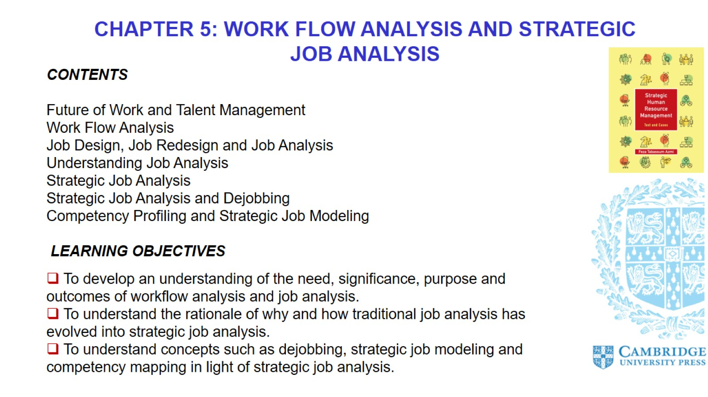

Slide 3
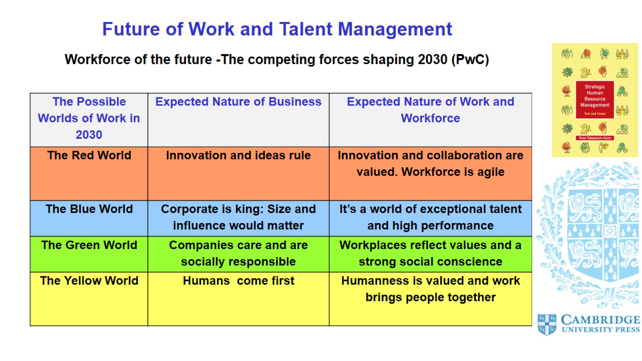
Future of Work and Talent Management

Slide 4
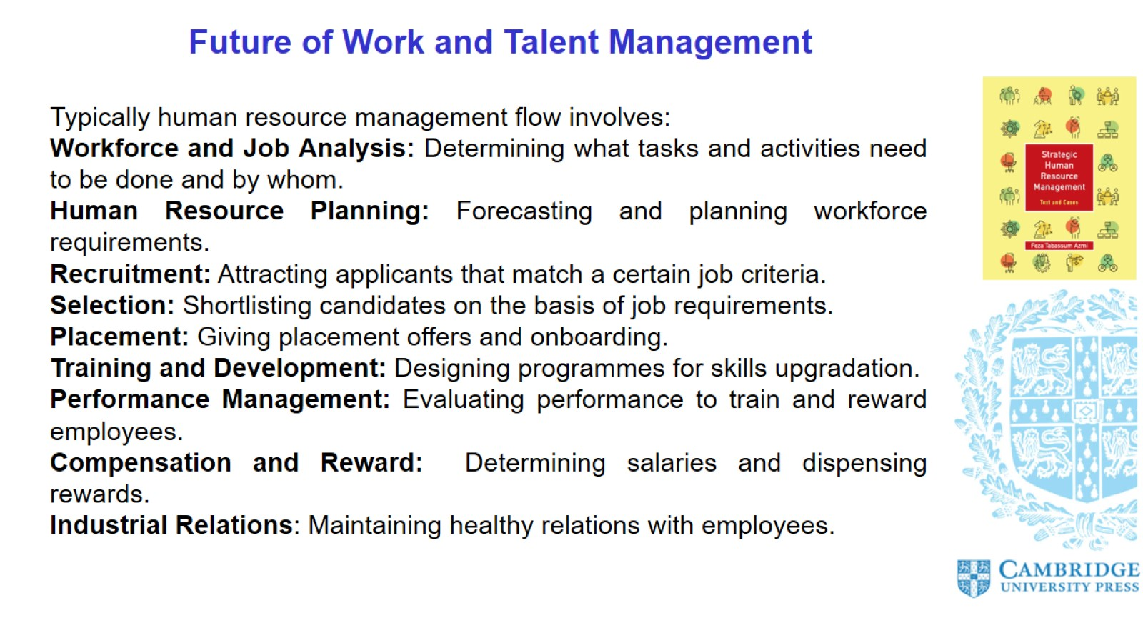
Future of Work and Talent Management

Slide 5
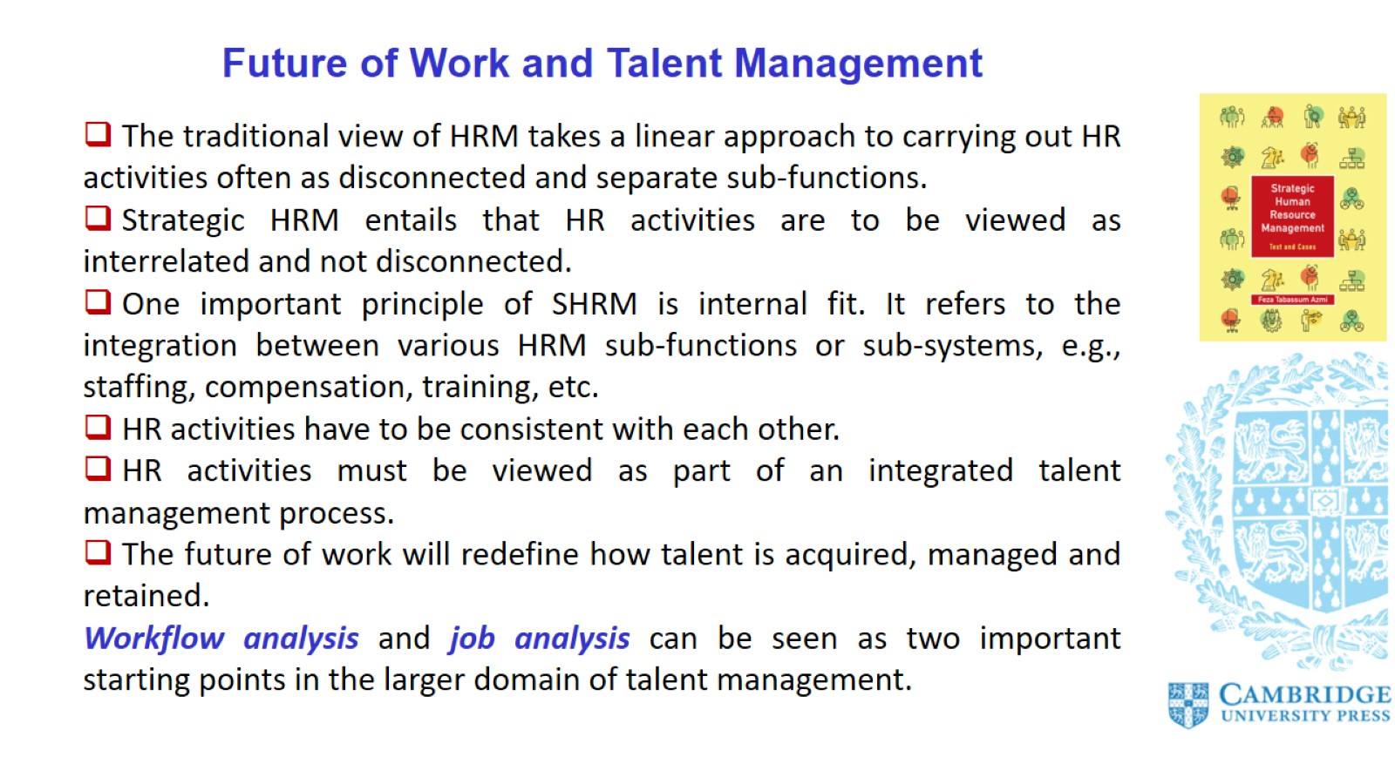
Future of Work and Talent Management

Slide 6
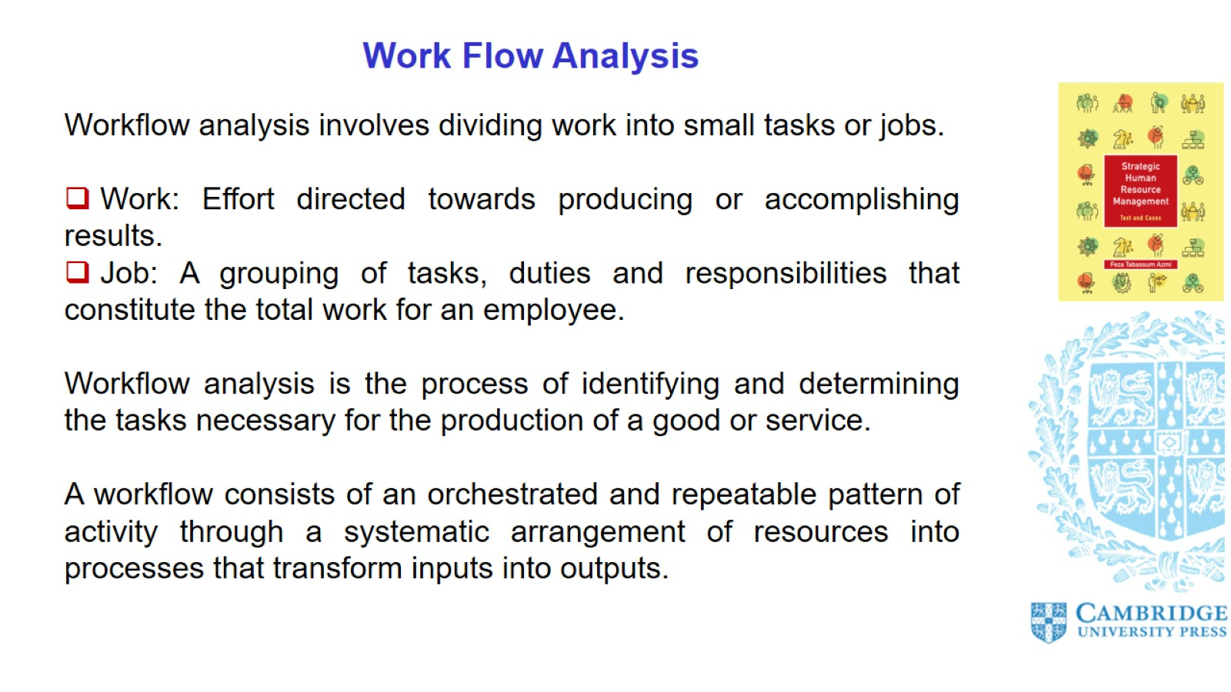
Work Flow Analysis

Slide 7
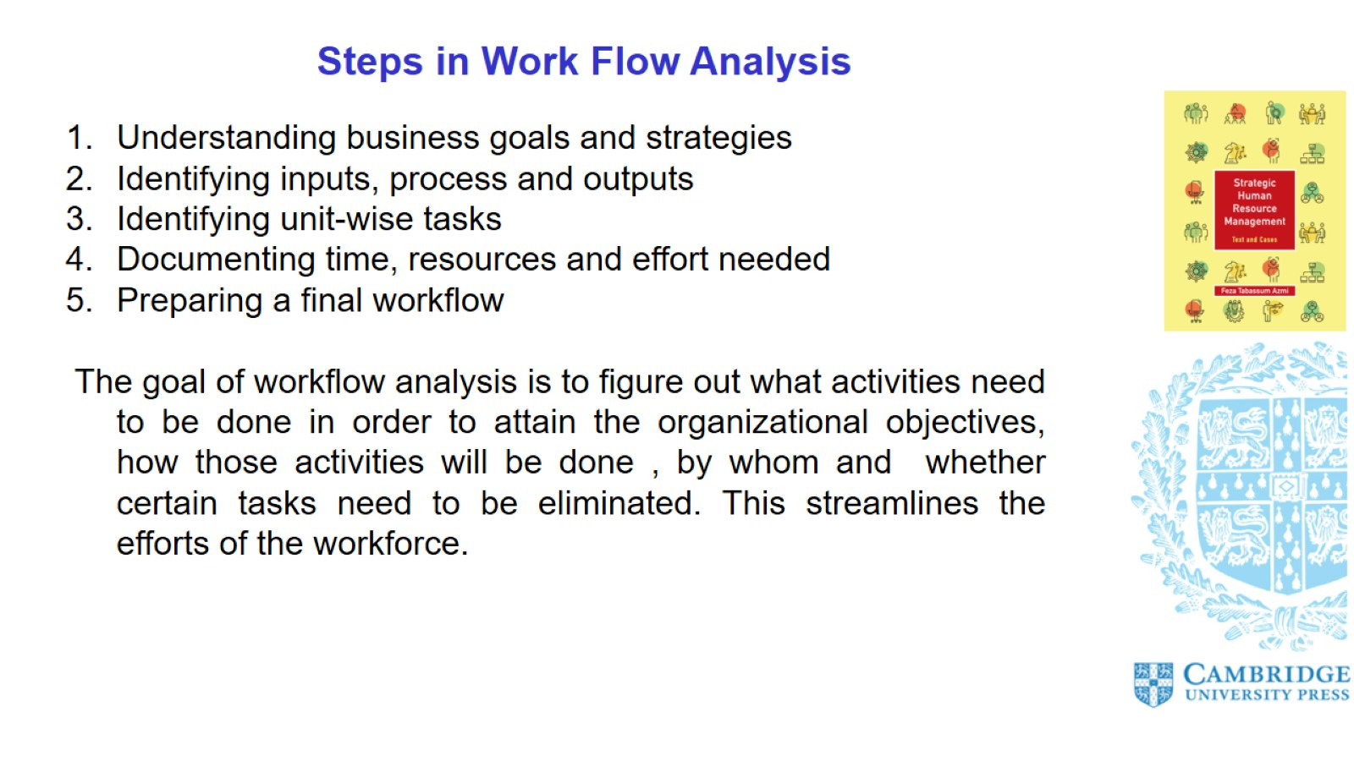
Steps in Work Flow Analysis

Slide 8
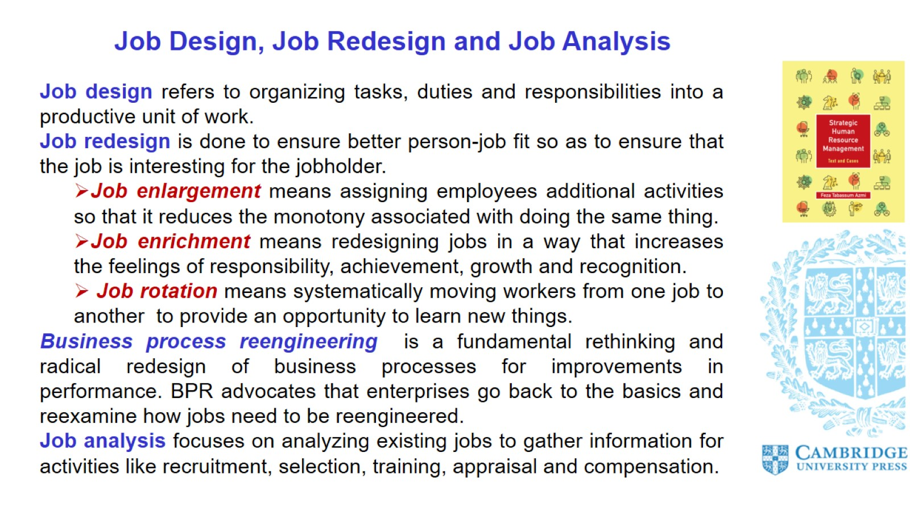
Job Design, Job Redesign and Job Analysis

Slide 9
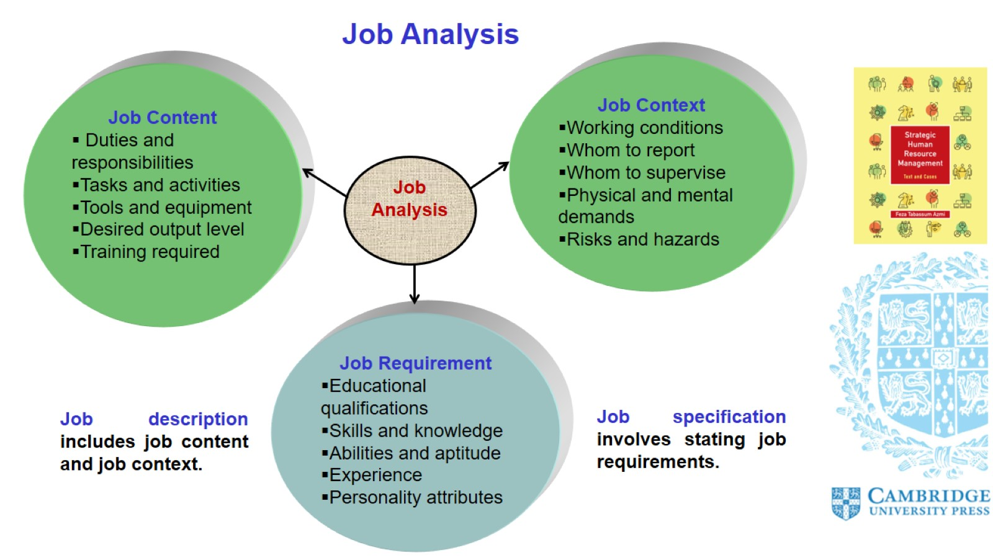
Job Analysis

Slide 10
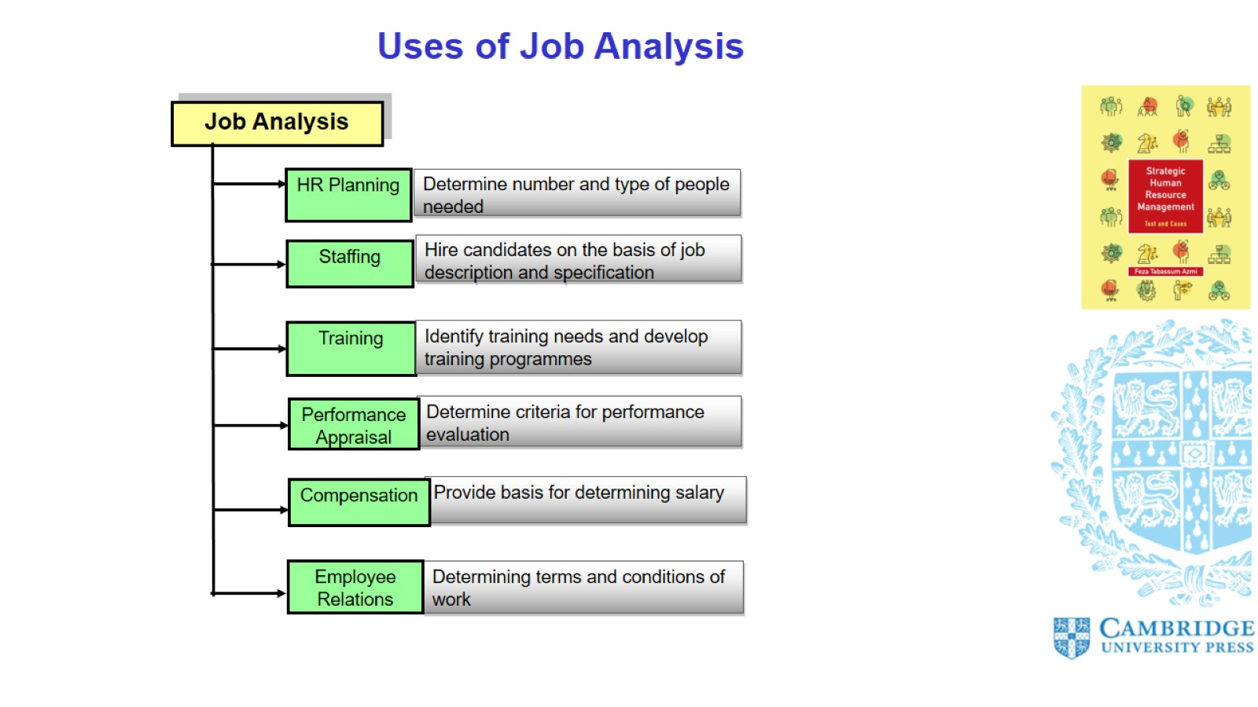

Slide 11
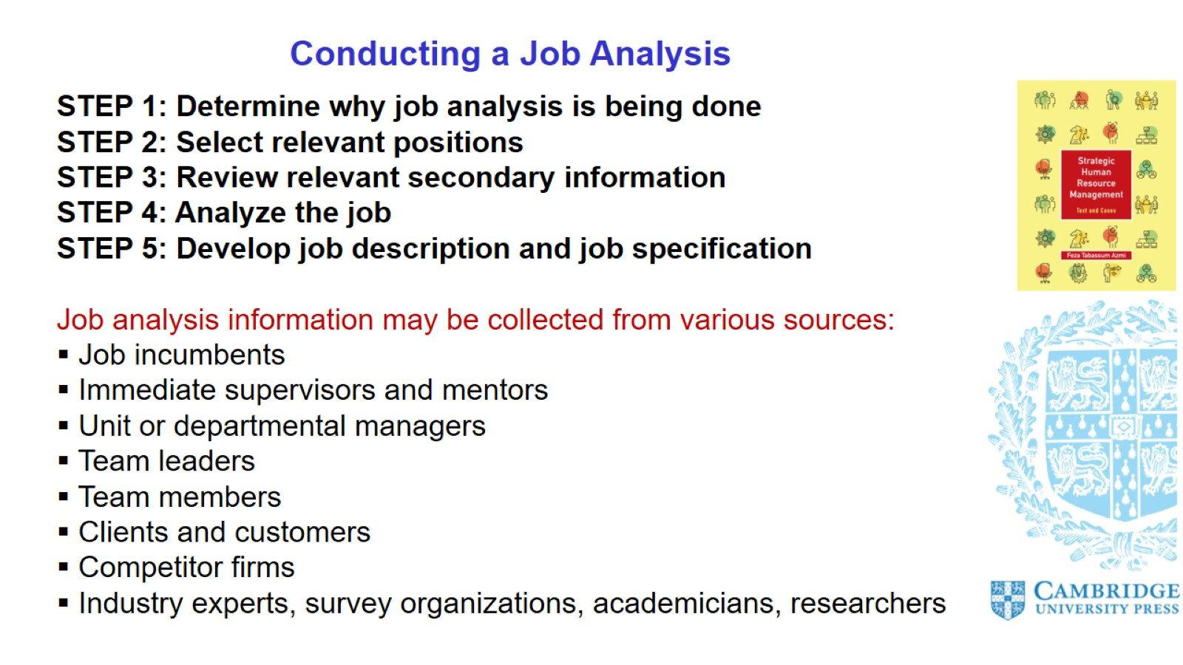
Conducting a Job Analysis

Slide 12
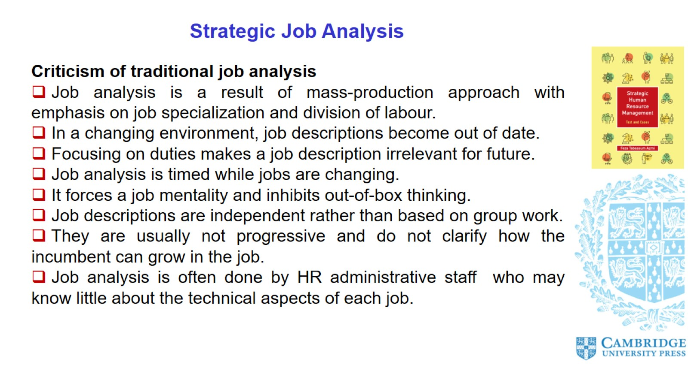
Strategic Job Analysis

Slide 13
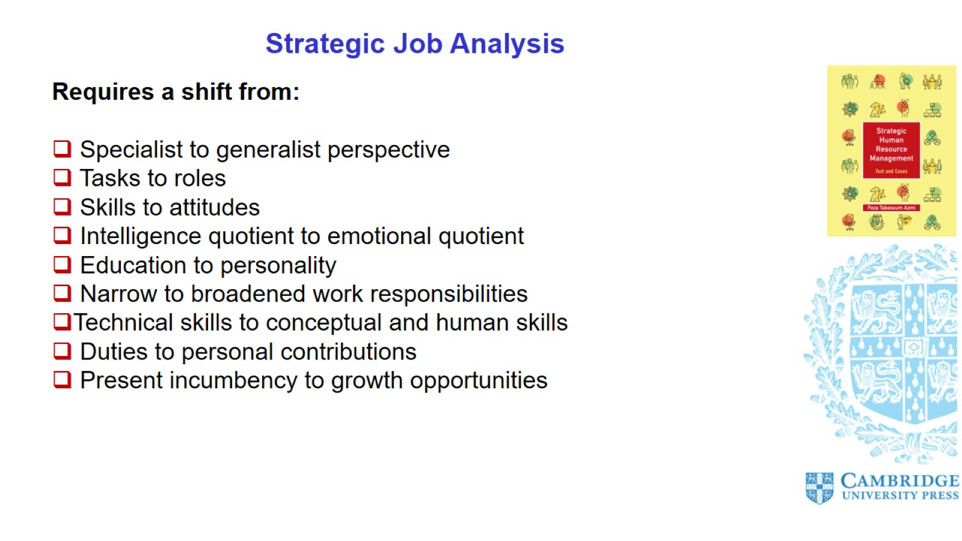
Strategic Job Analysis

Slide 14
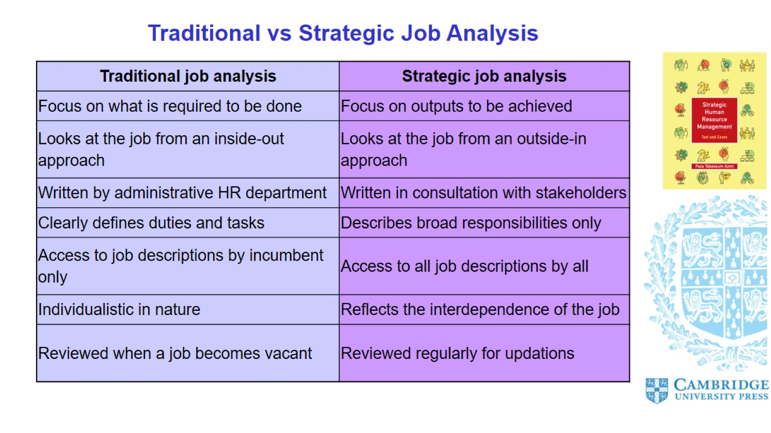

Slide 15
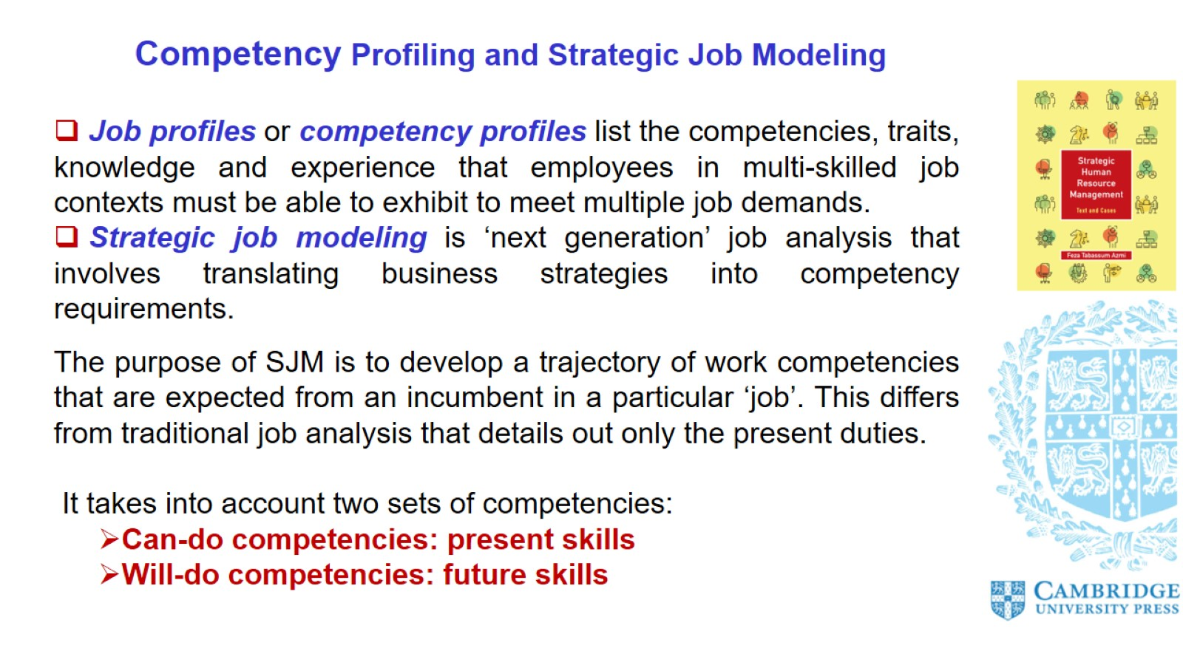
Competency Profiling and Strategic Job Modeling

Slide 16
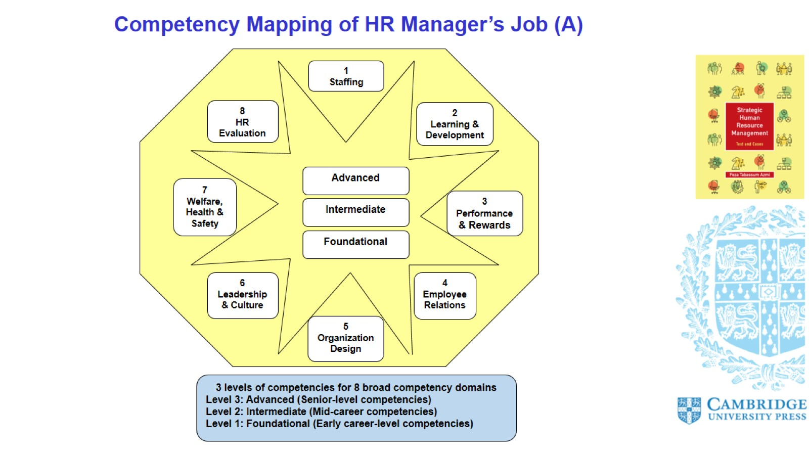
Competency Mapping of HR Manager’s Job (A)

Slide 17
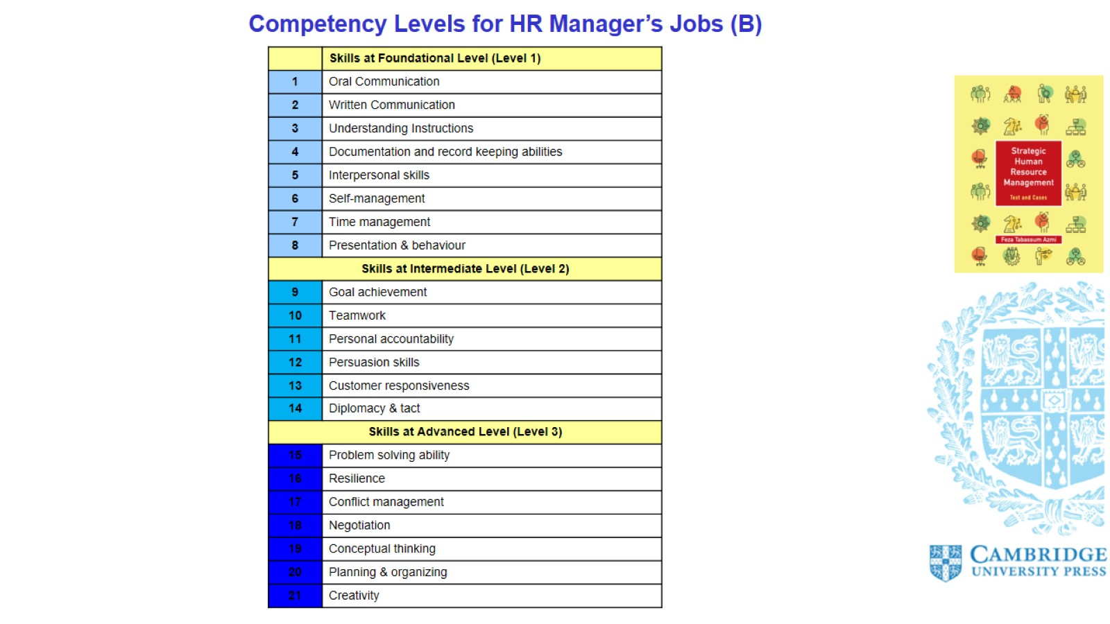
Competency Levels for HR Manager’s Jobs (B)

Slide 18
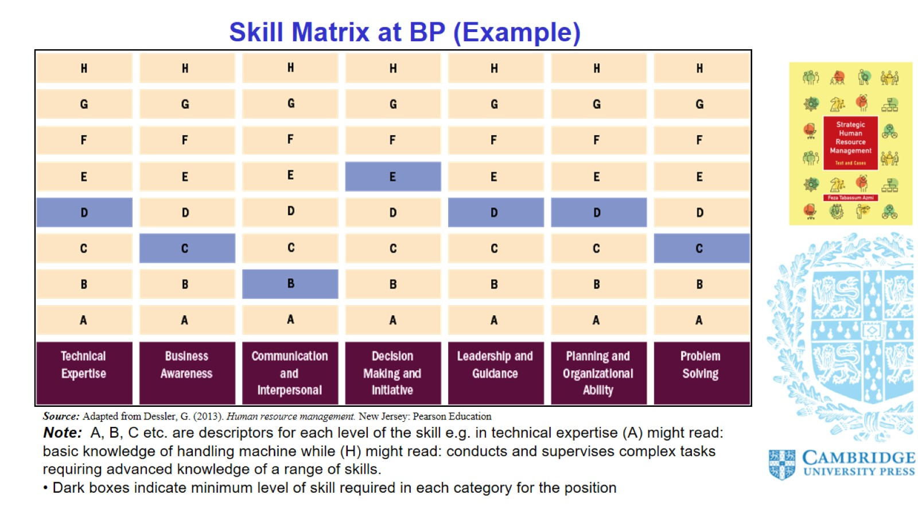

Slide 19
