Slide 1


Slide 2
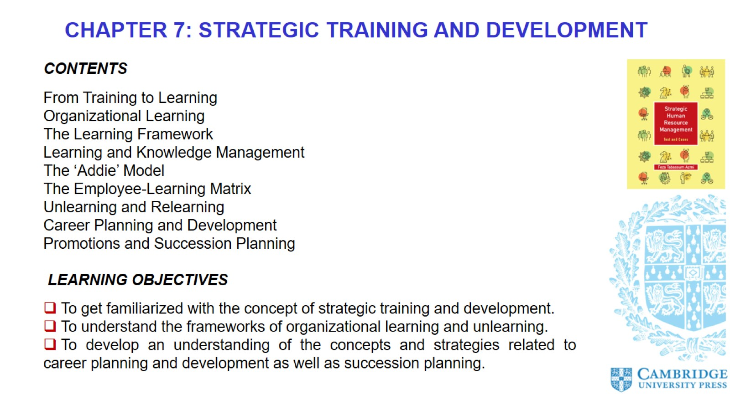

Slide 3
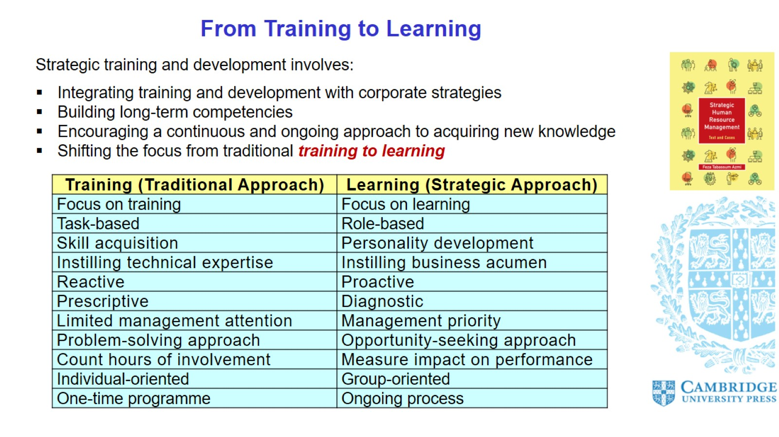
From Training to Learning

Slide 4
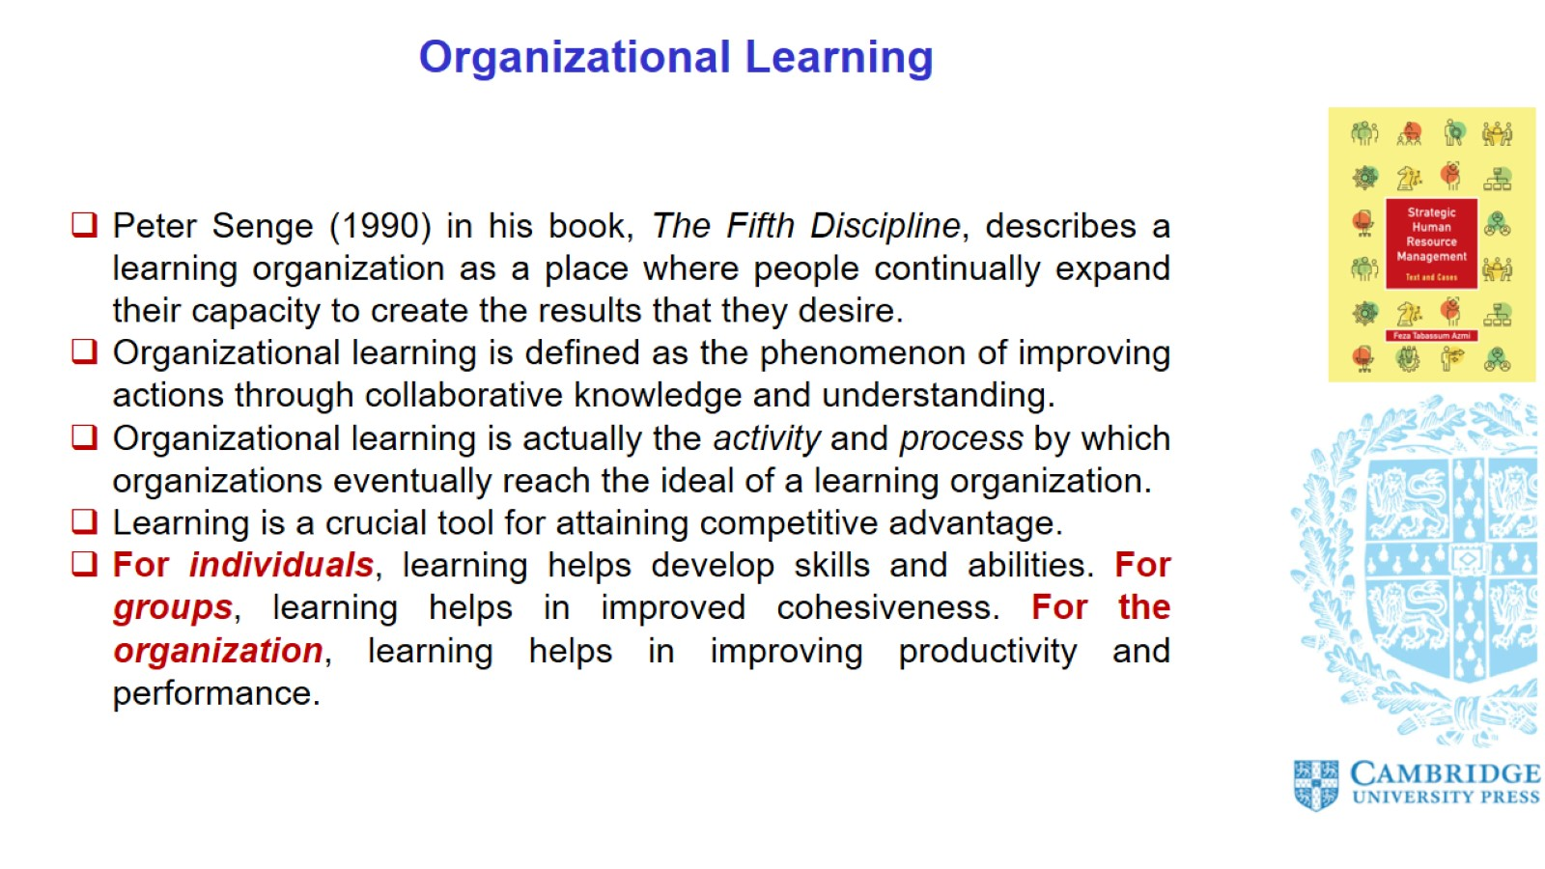
Organizational Learning

Slide 5
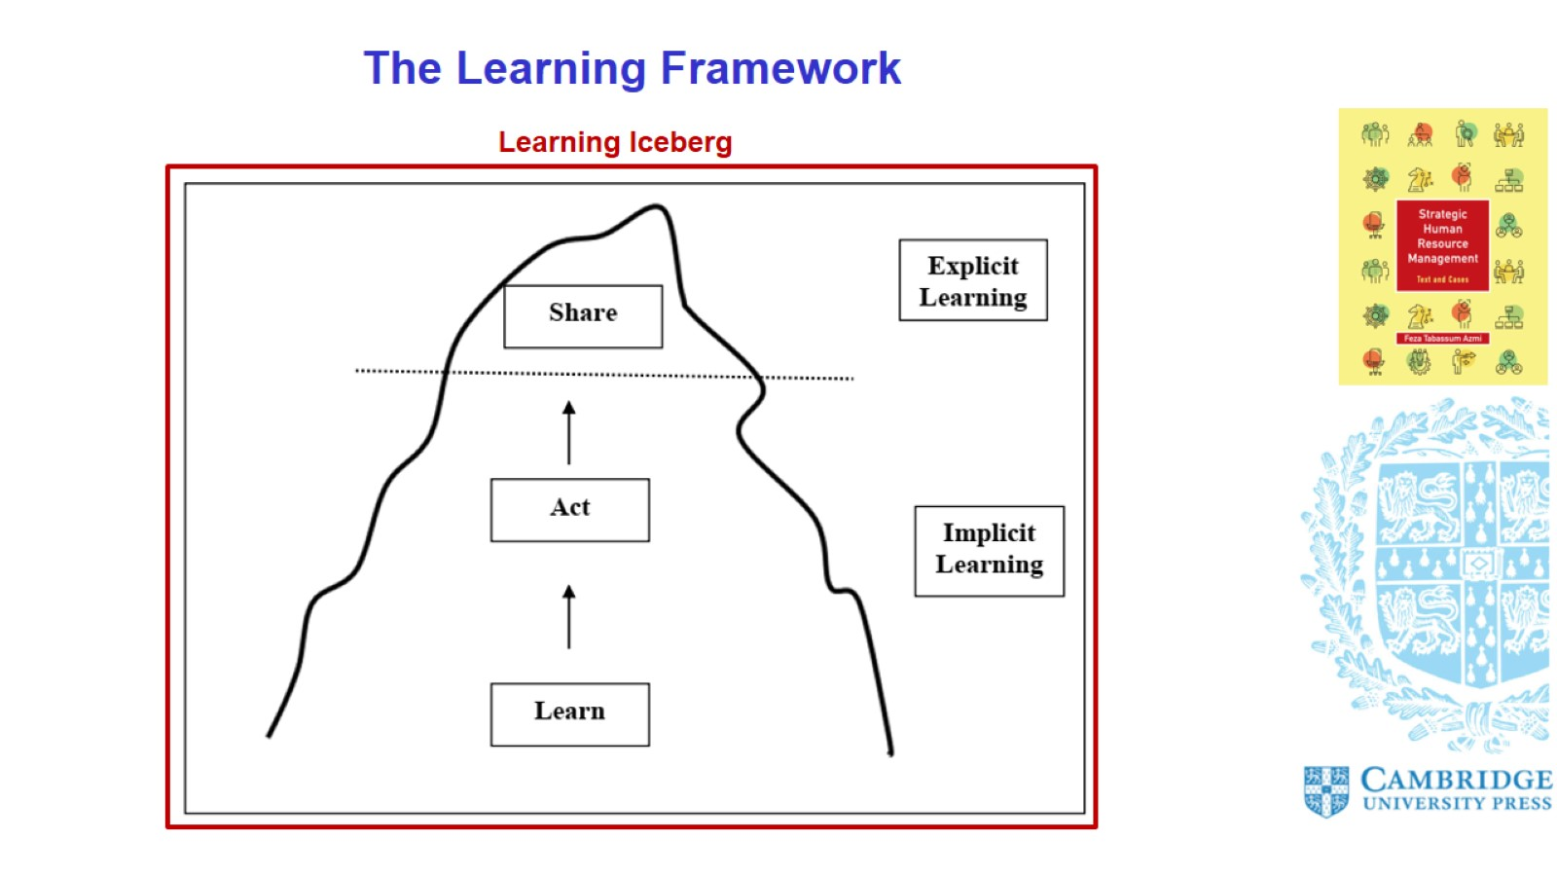
The Learning Framework

Slide 6
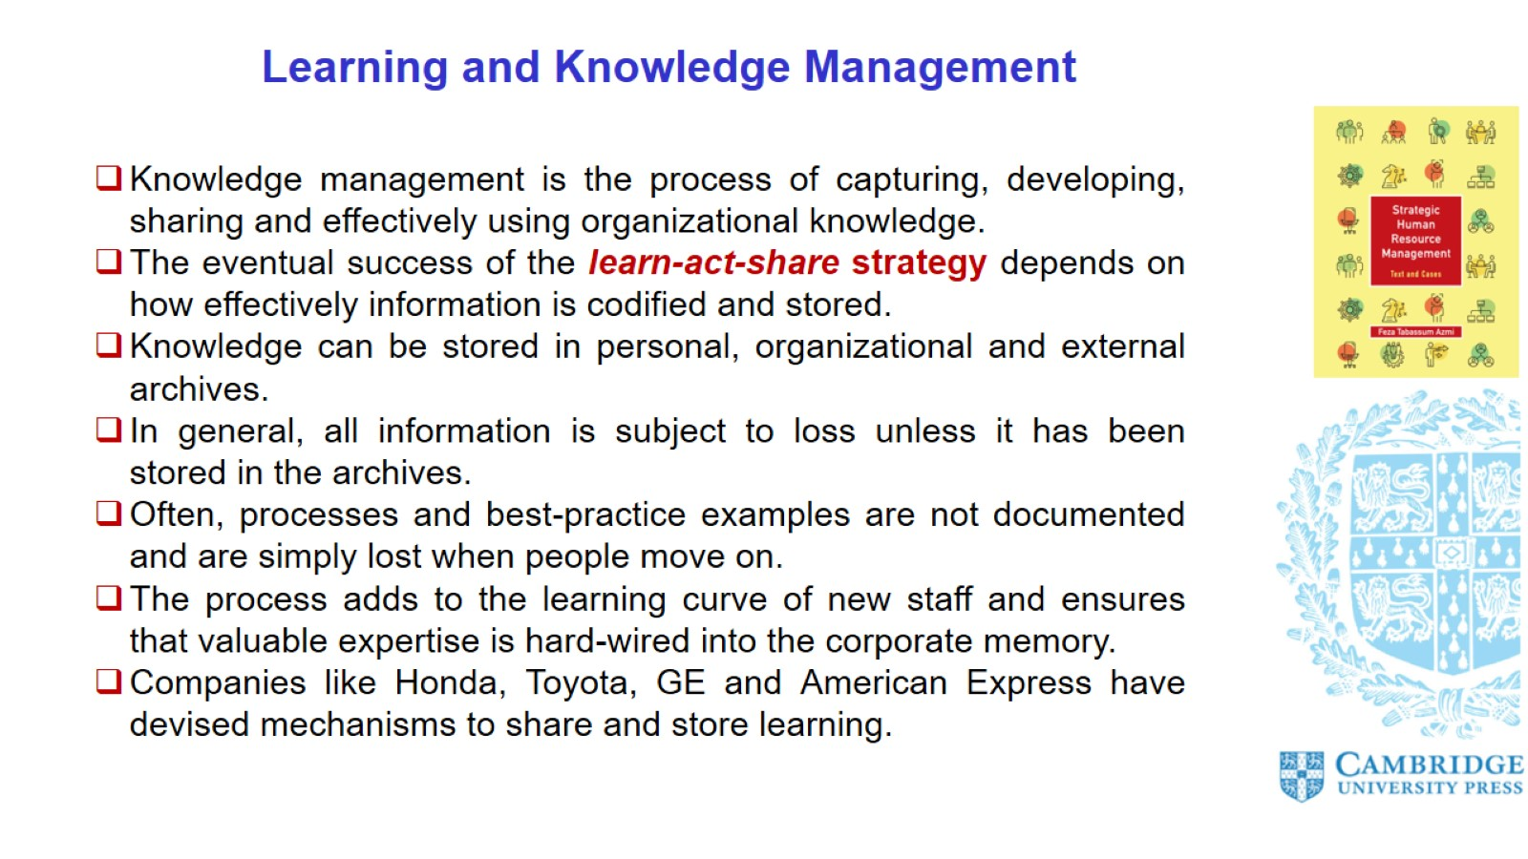
Learning and Knowledge Management

Slide 7
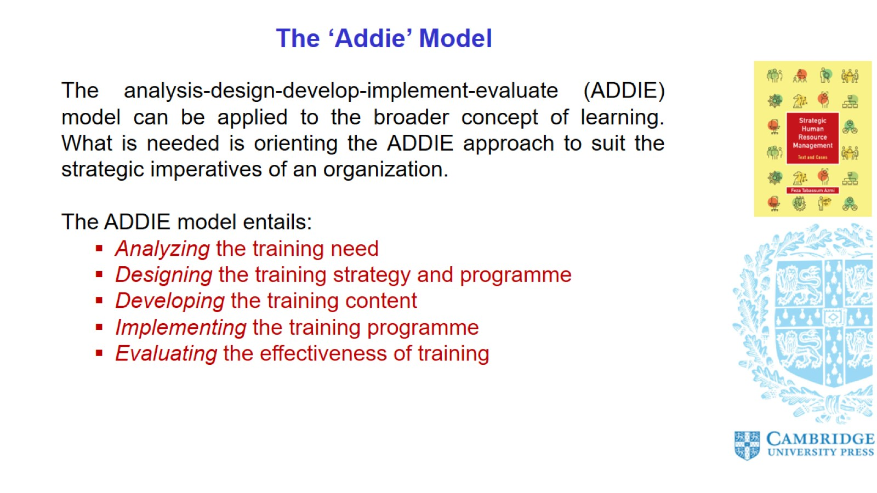
The ‘Addie’ Model

Slide 8
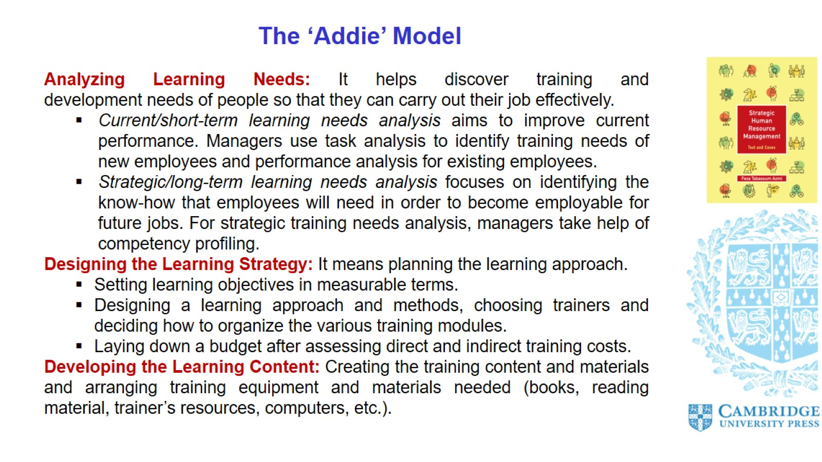
The ‘Addie’ Model

Slide 9
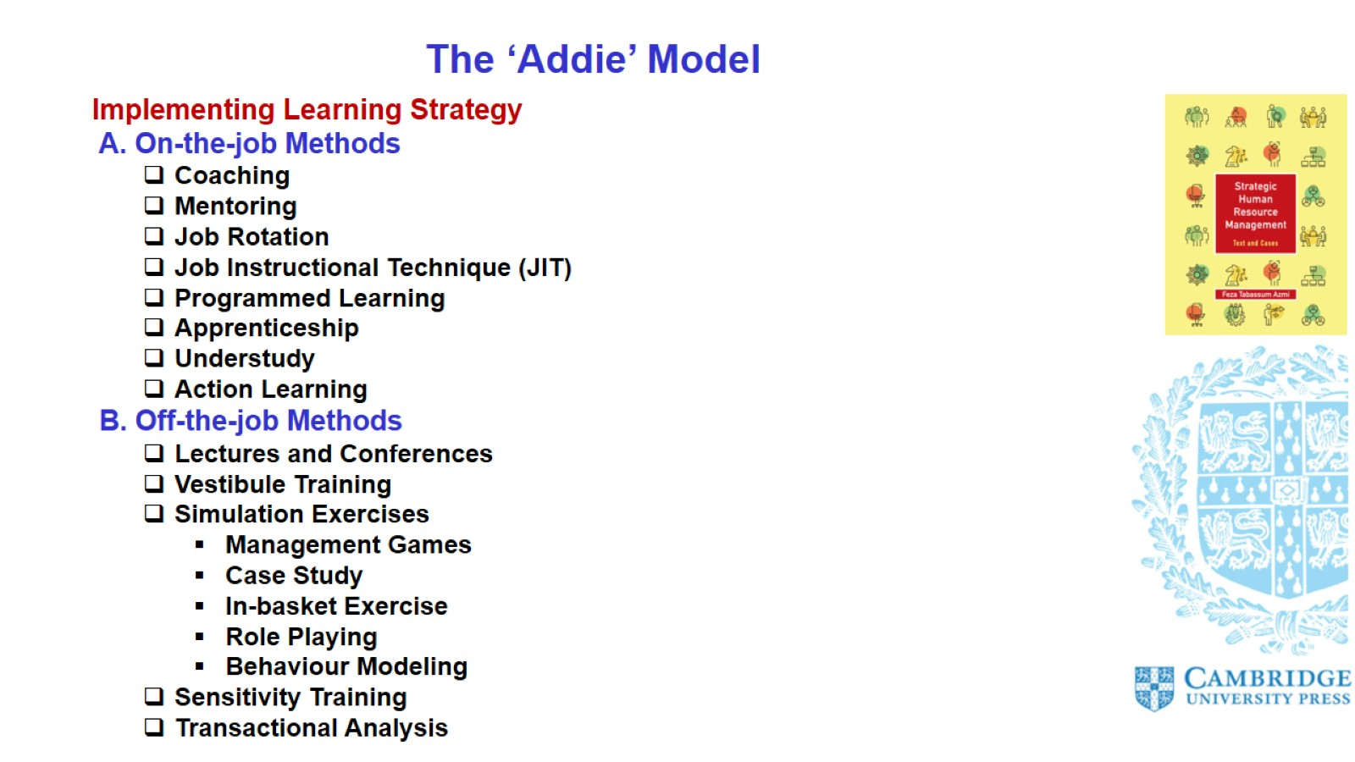
The ‘Addie’ Model

Slide 10
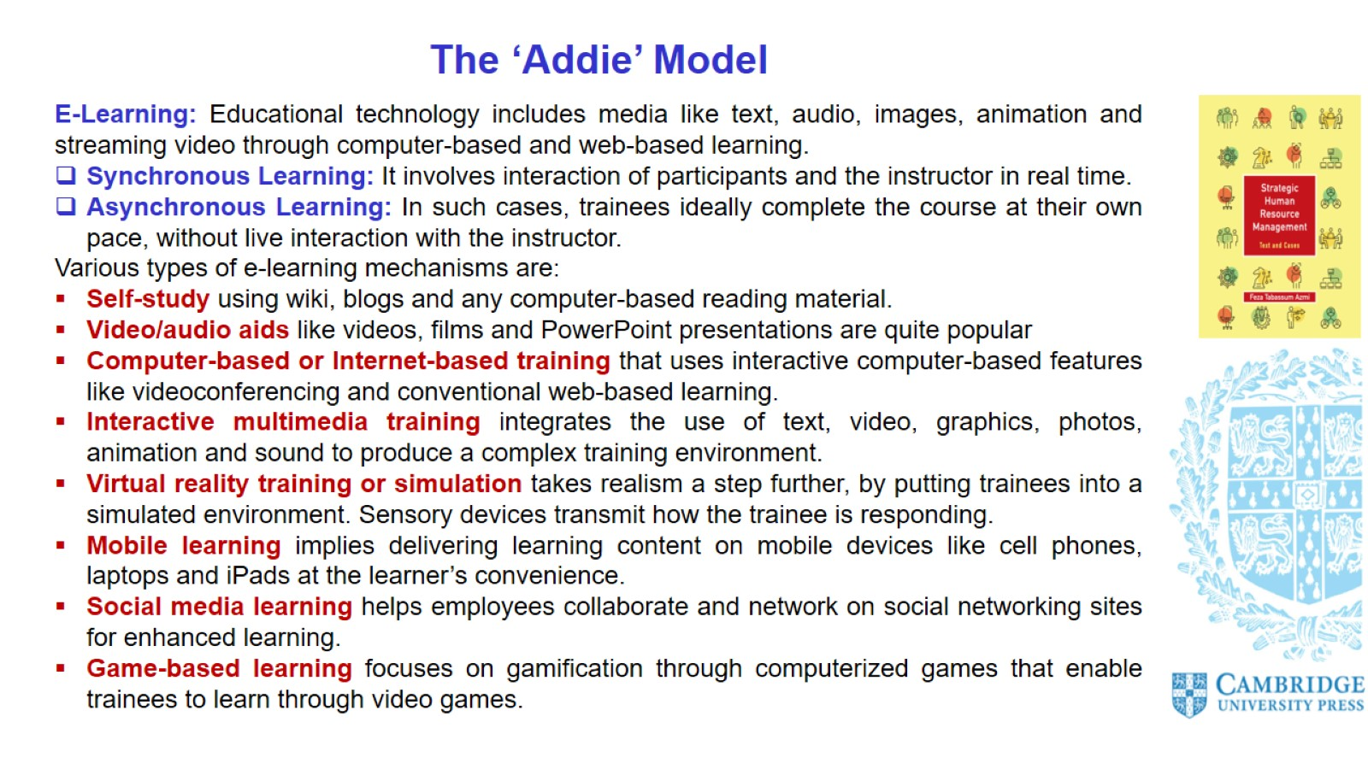
The ‘Addie’ Model

Slide 11
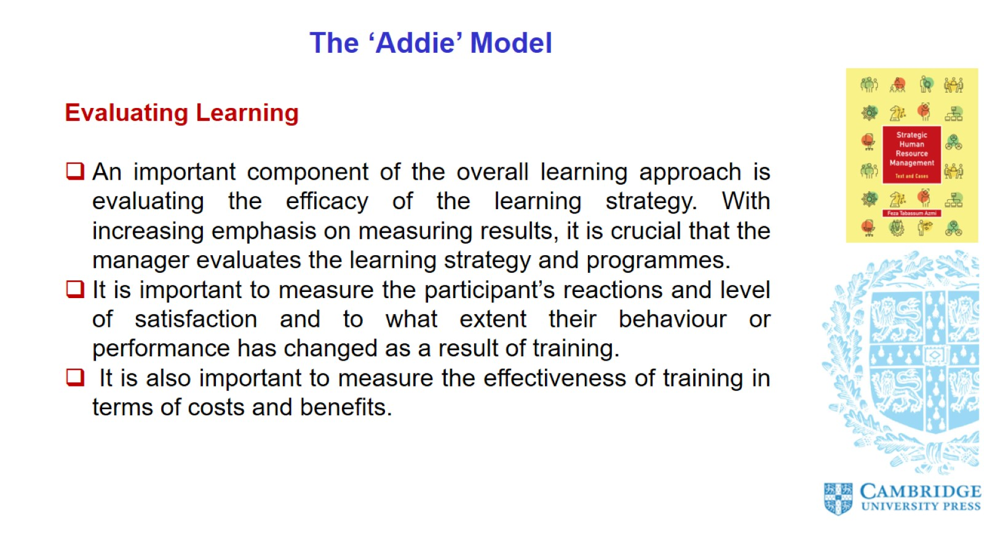
The ‘Addie’ Model

Slide 12
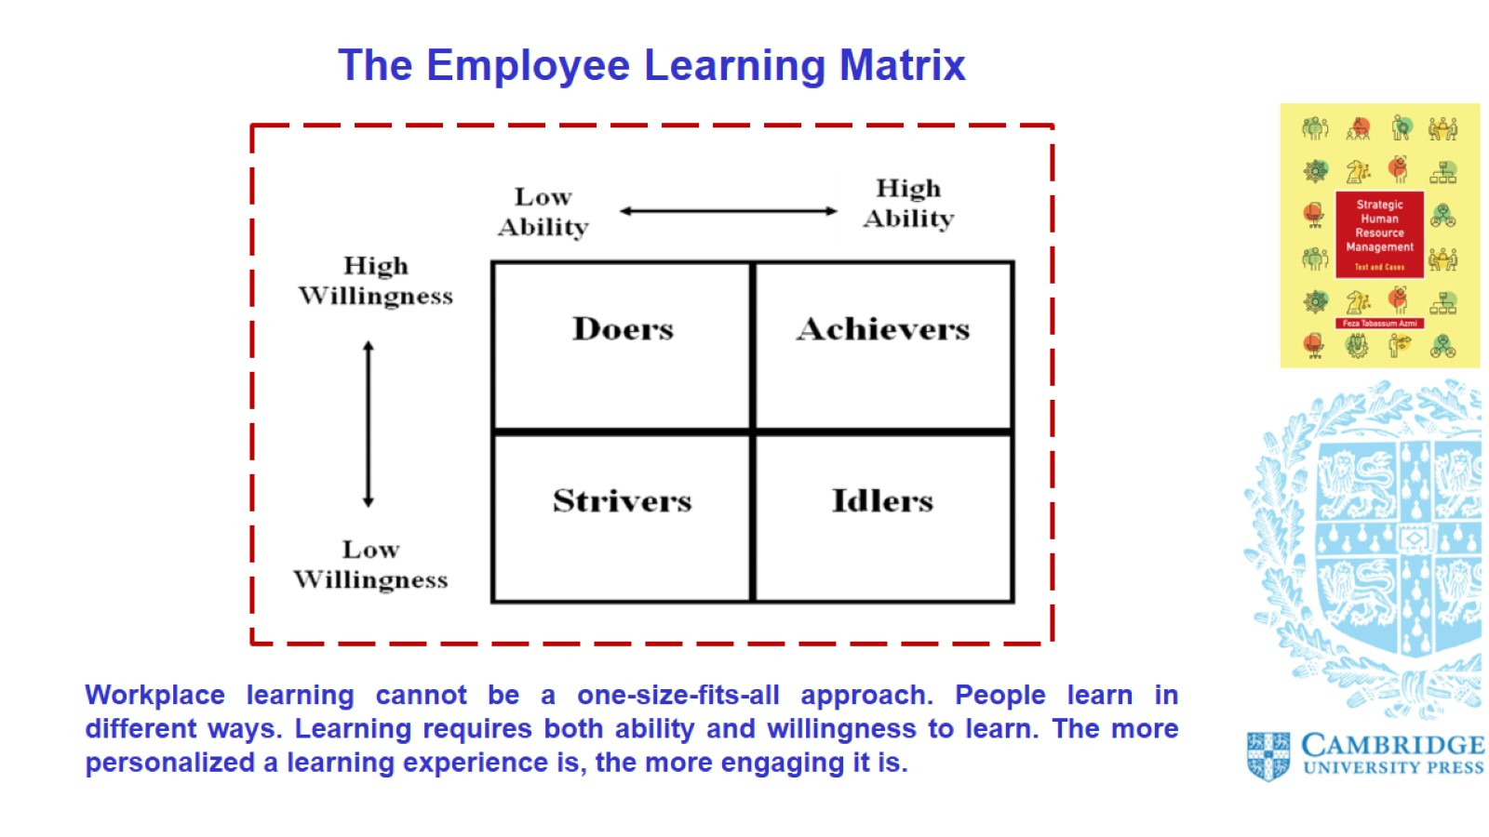
The Employee Learning Matrix

Slide 13
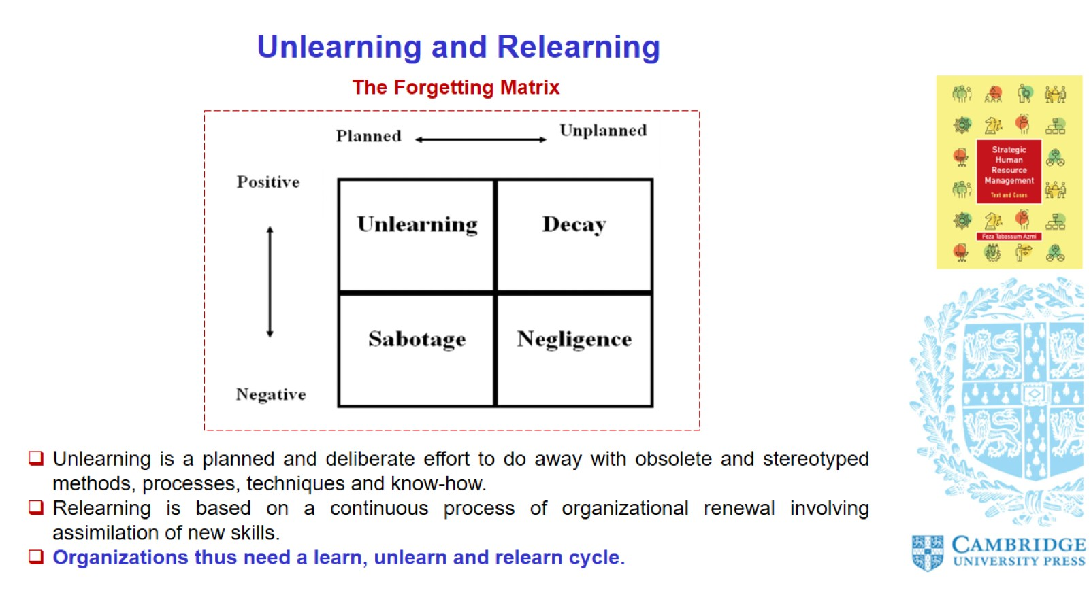
Unlearning and Relearning

Slide 14
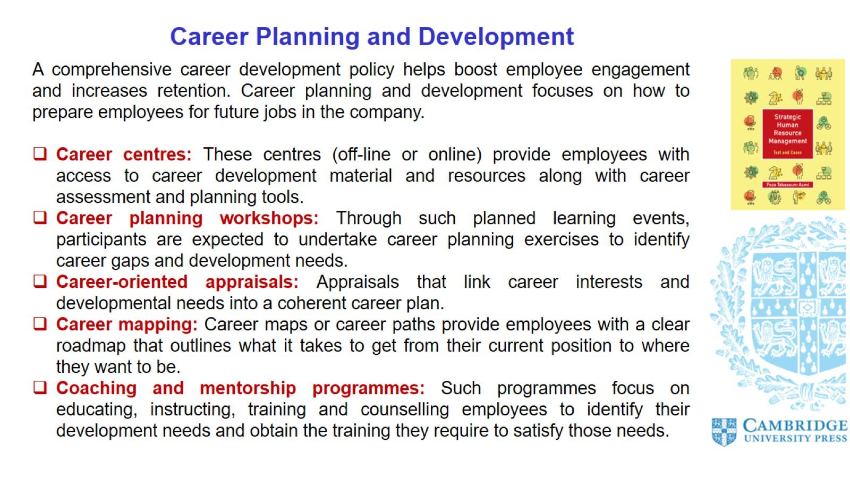
Career Planning and Development

Slide 15
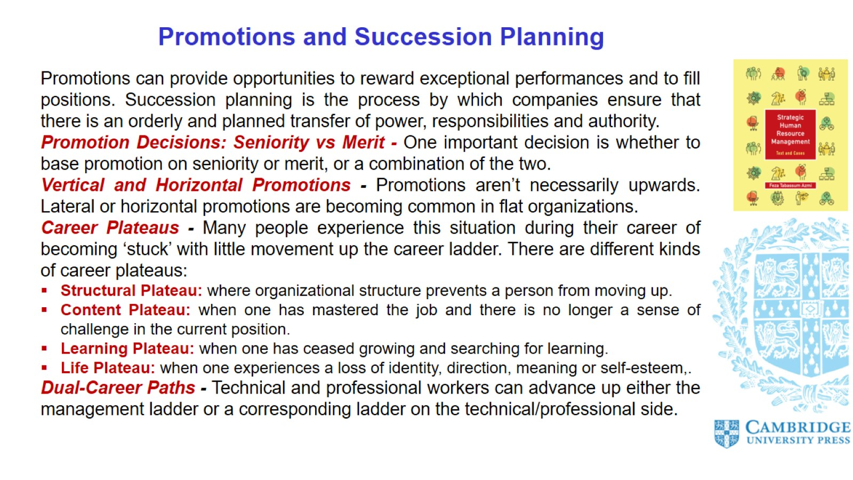
Promotions and Succession Planning

Slide 16
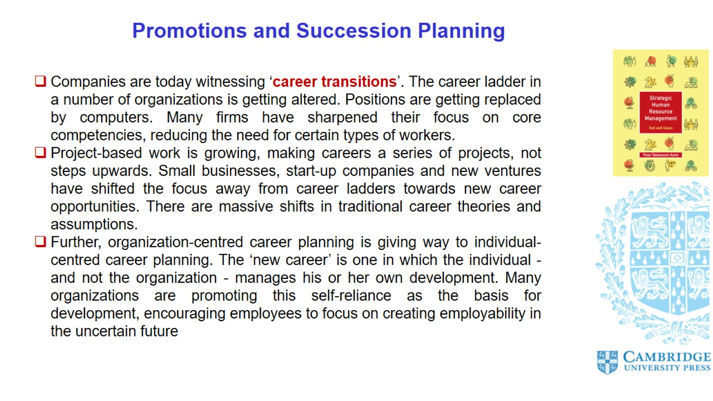
Promotions and Succession Planning

Slide 17
