Slide 1


Slide 2
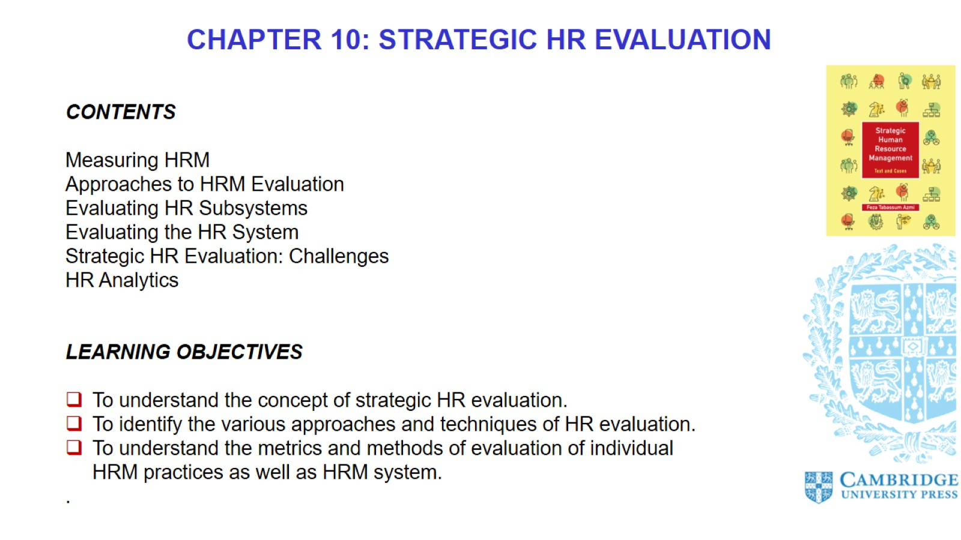

Slide 3
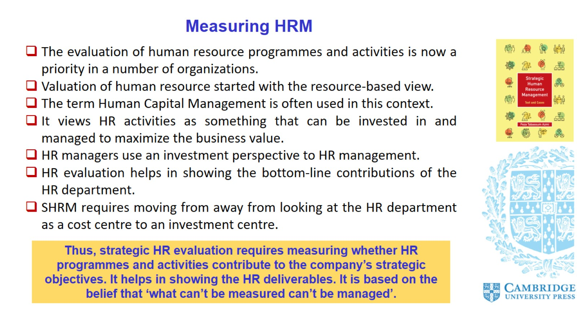
Measuring HRM

Slide 4
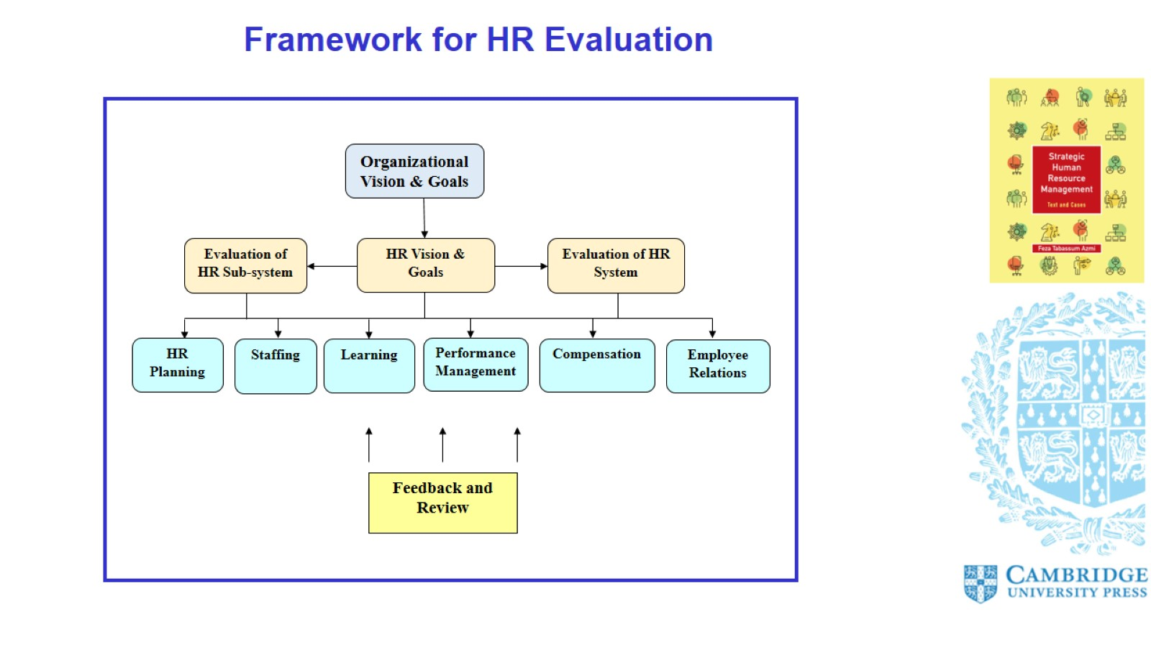

Slide 5
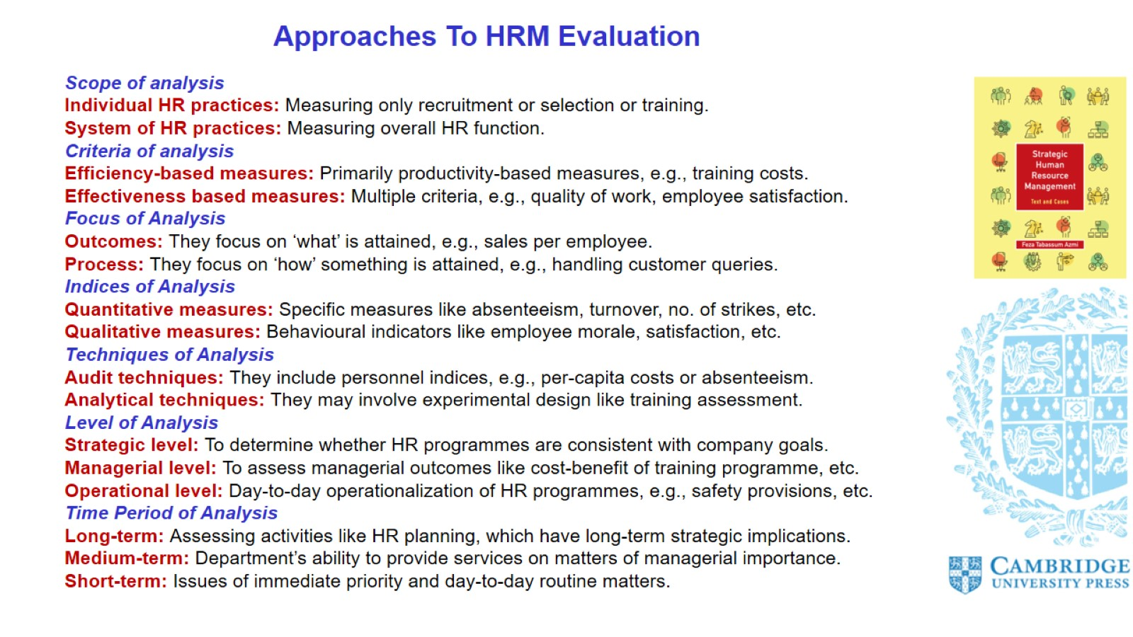
Approaches To HRM Evaluation

Slide 6
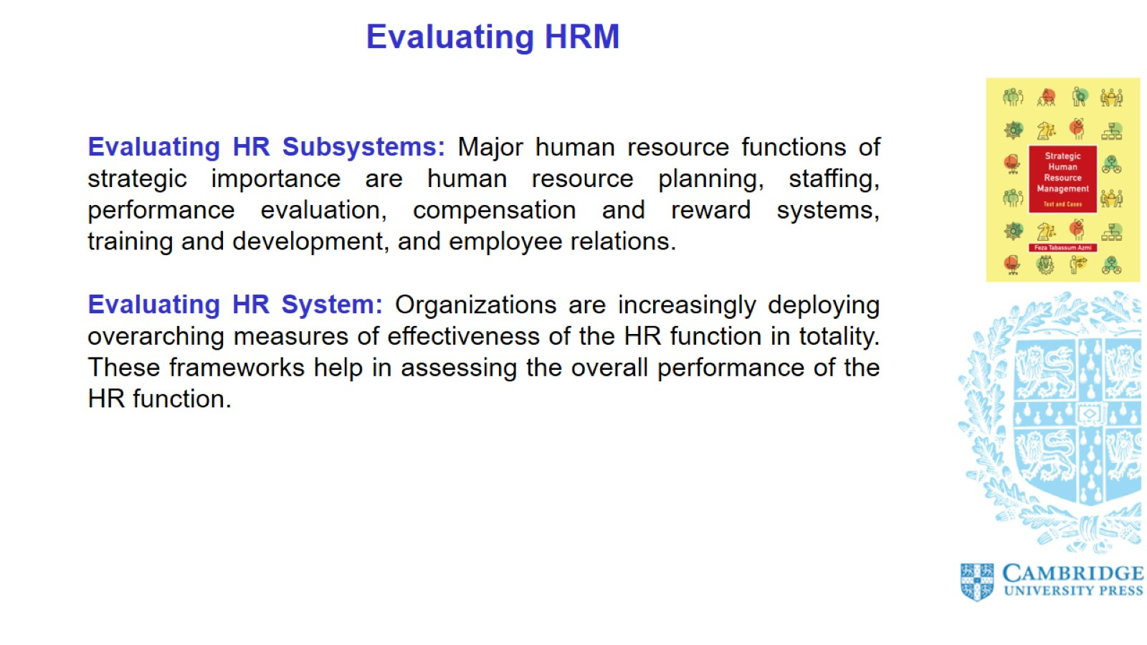
Evaluating HRM

Slide 7
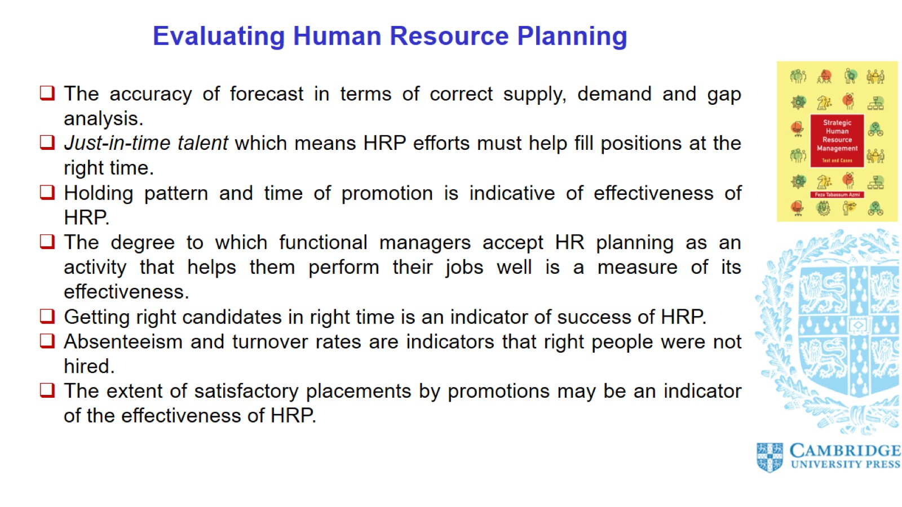
Evaluating Human Resource Planning

Slide 8
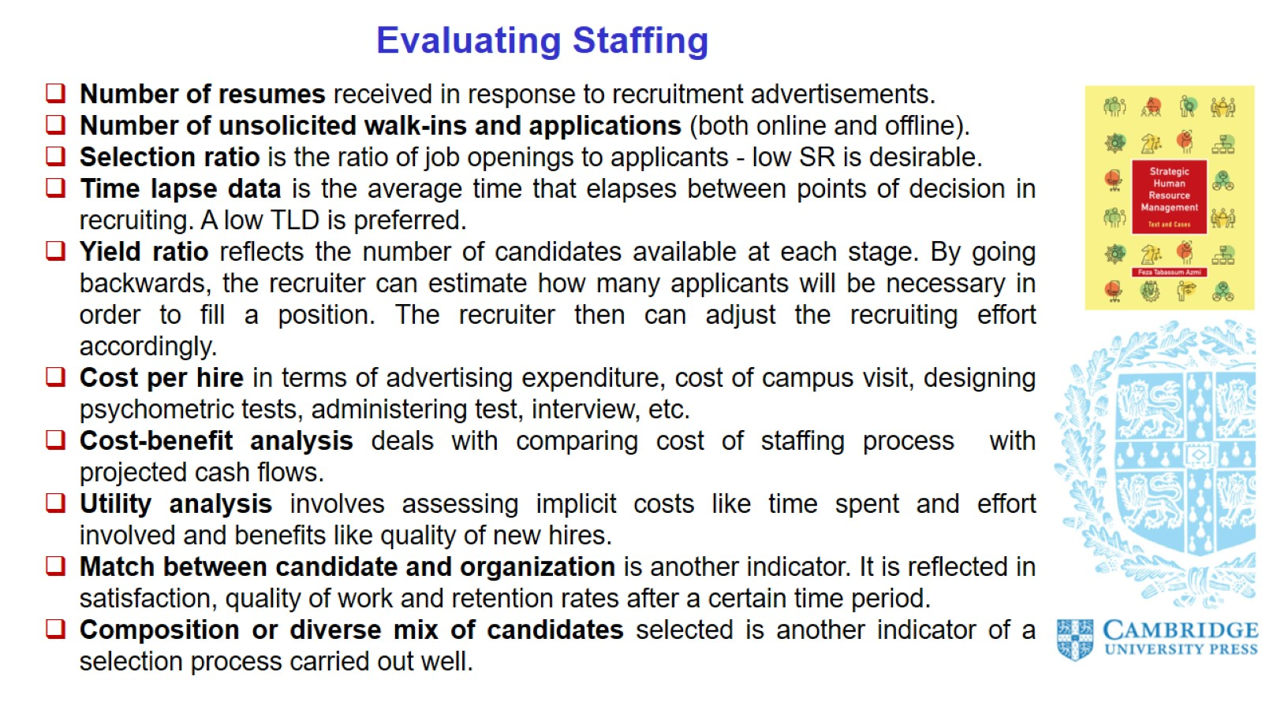
Evaluating Staffing

Slide 9
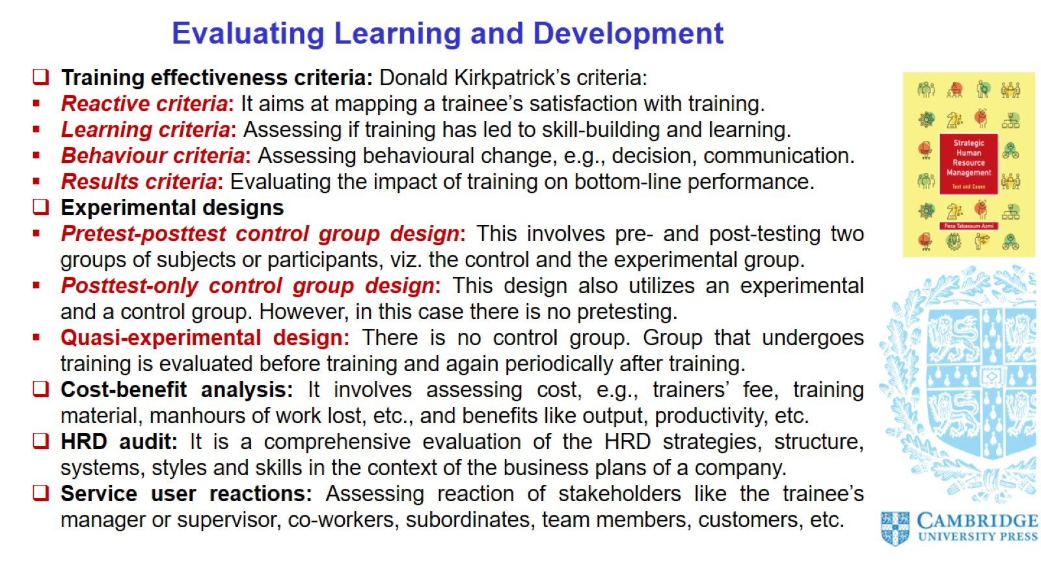
Evaluating Learning and Development

Slide 10
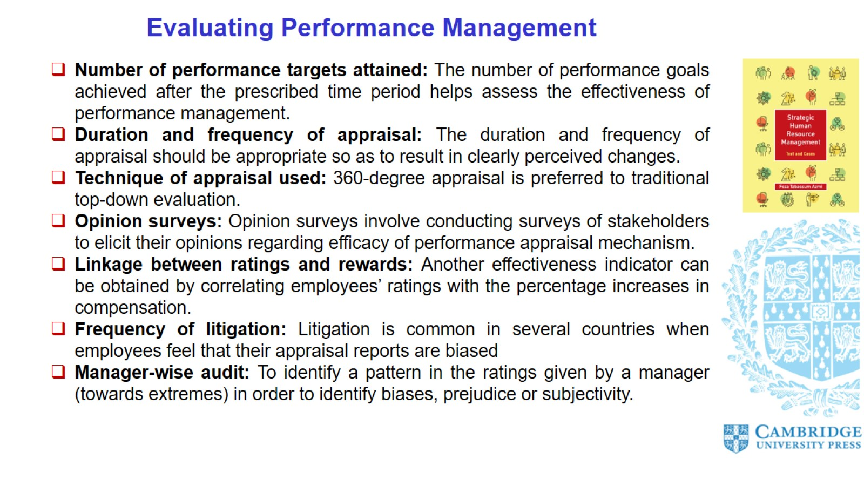
Evaluating Performance Management

Slide 11
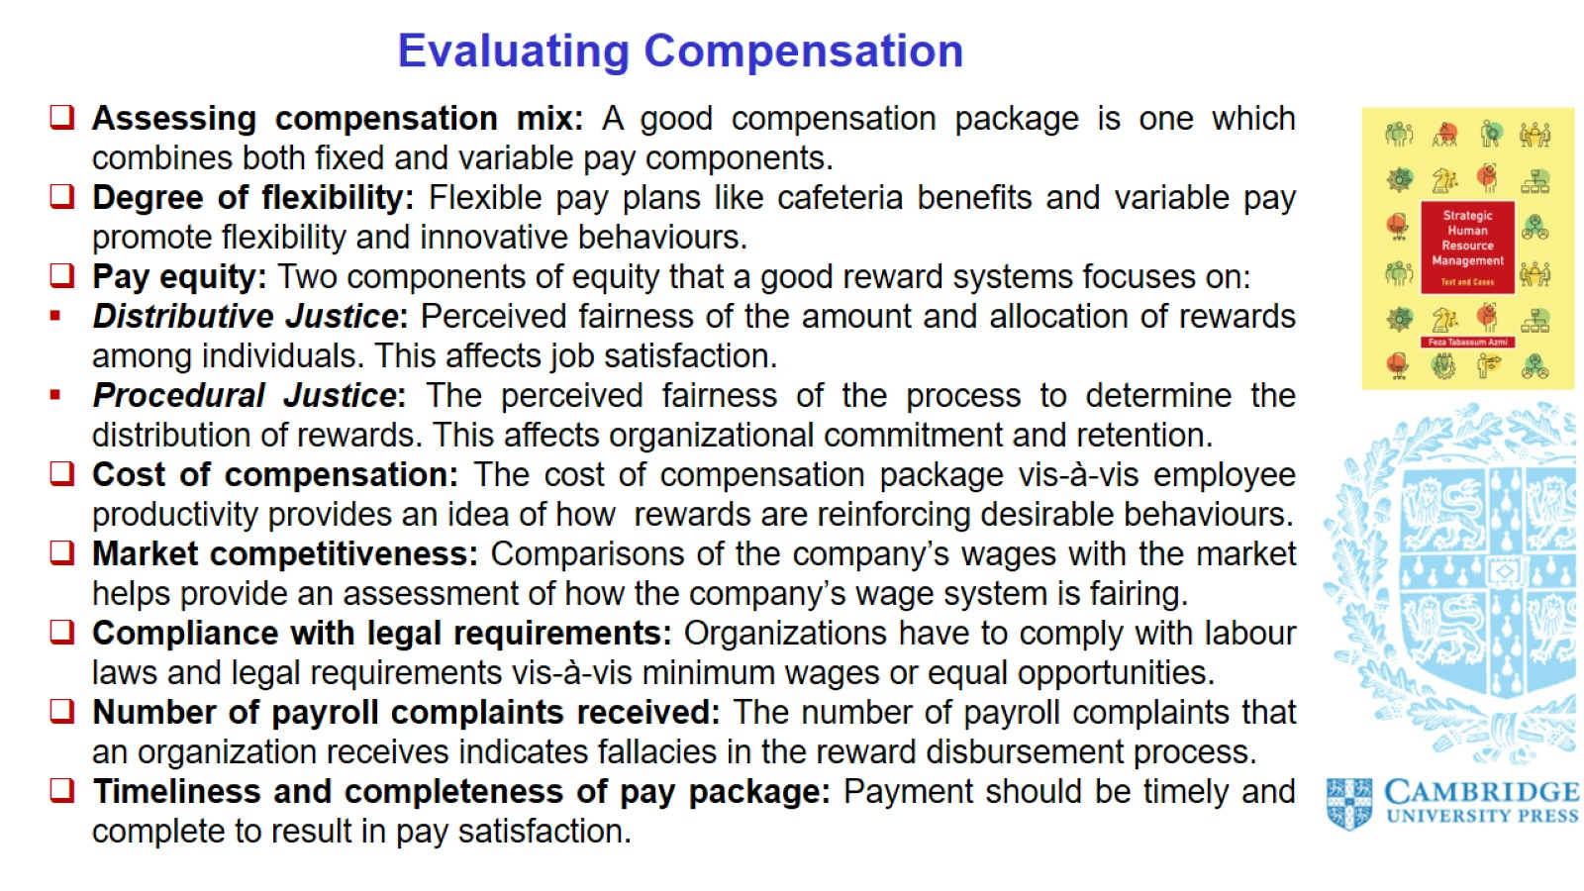
Evaluating Compensation

Slide 12
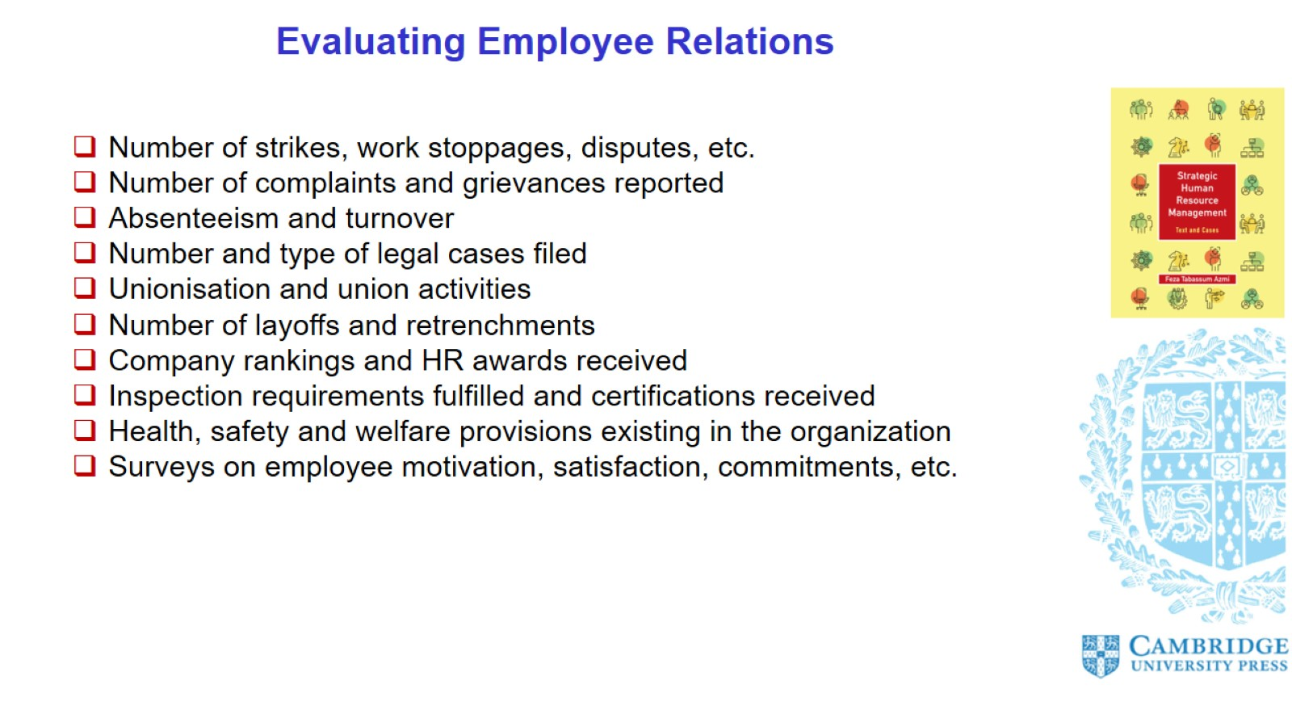
Evaluating Employee Relations

Slide 13
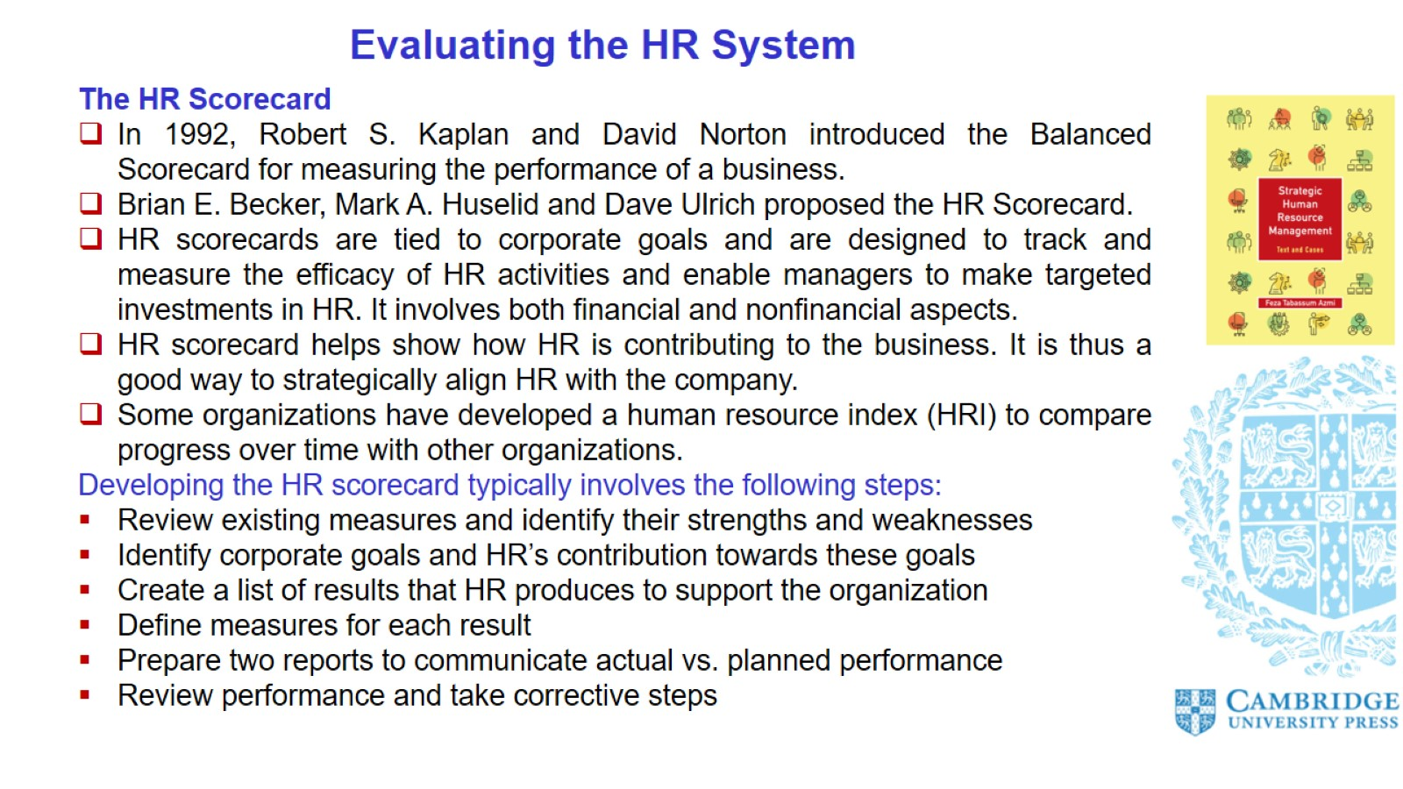
Evaluating the HR System

Slide 14
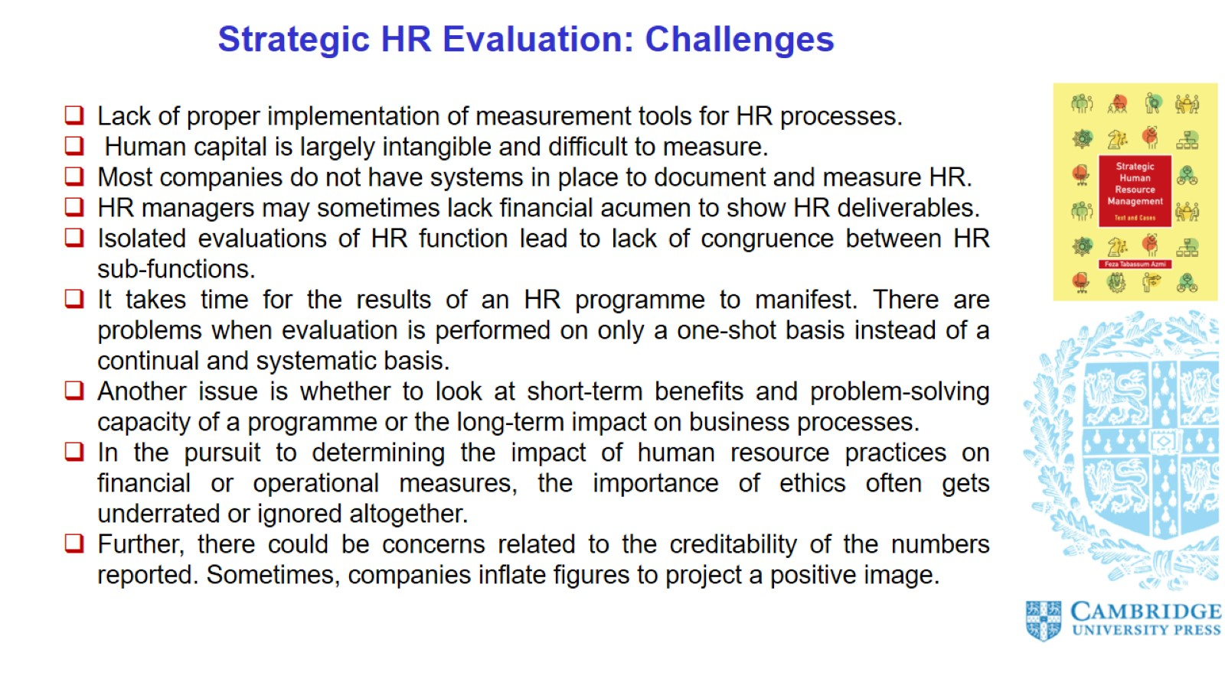
Strategic HR Evaluation: Challenges

Slide 15
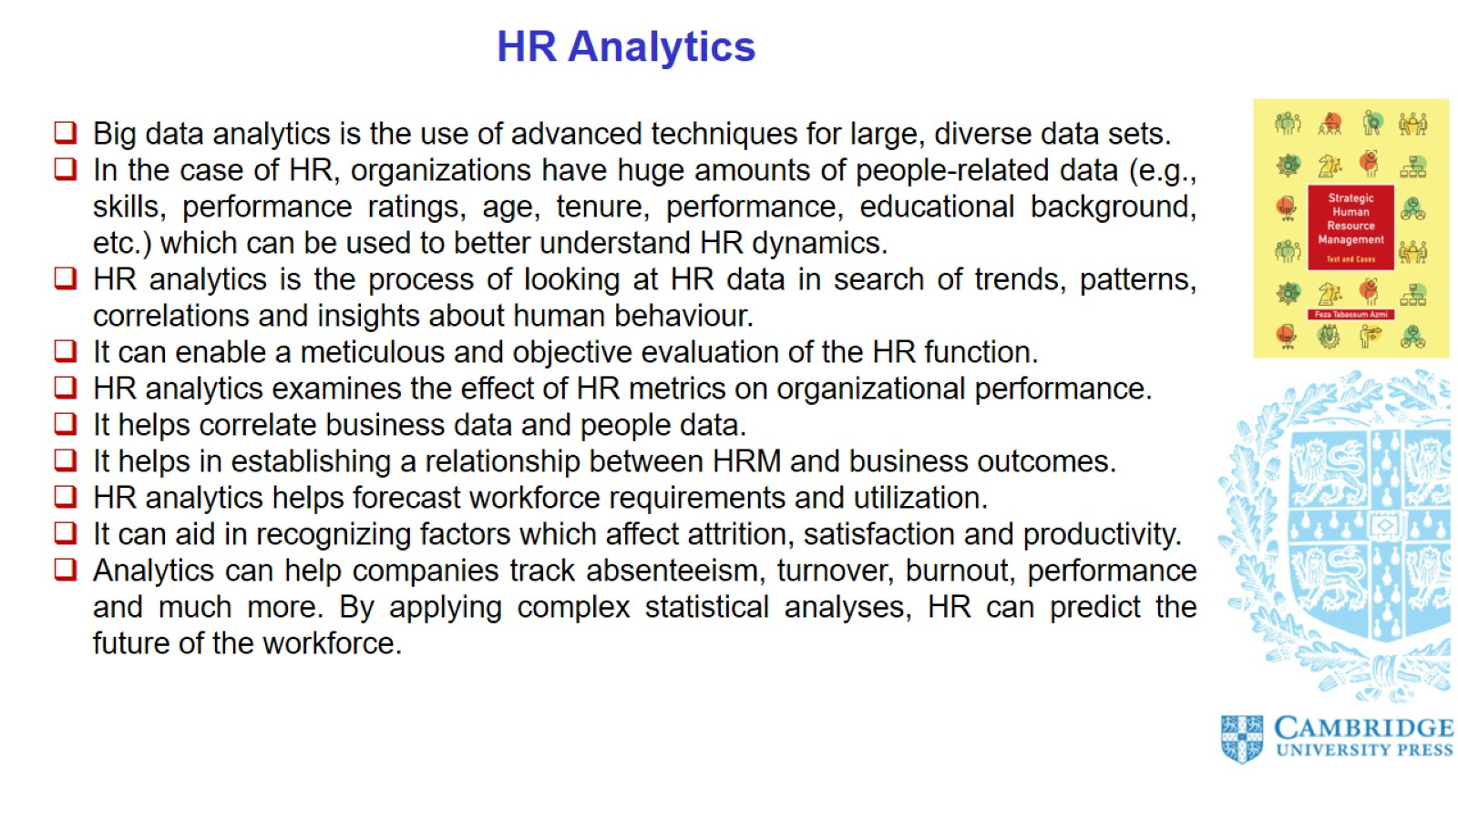
HR Analytics

Slide 16
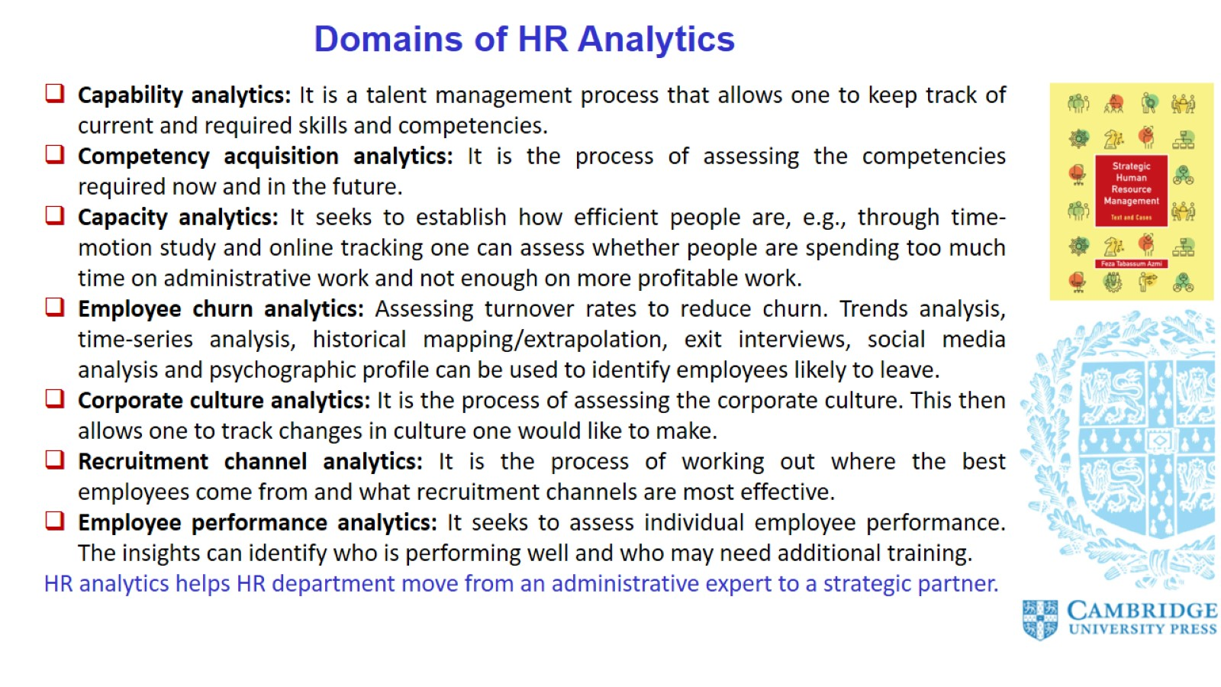
Domains of HR Analytics

Slide 17
