Slide 1


Slide 2
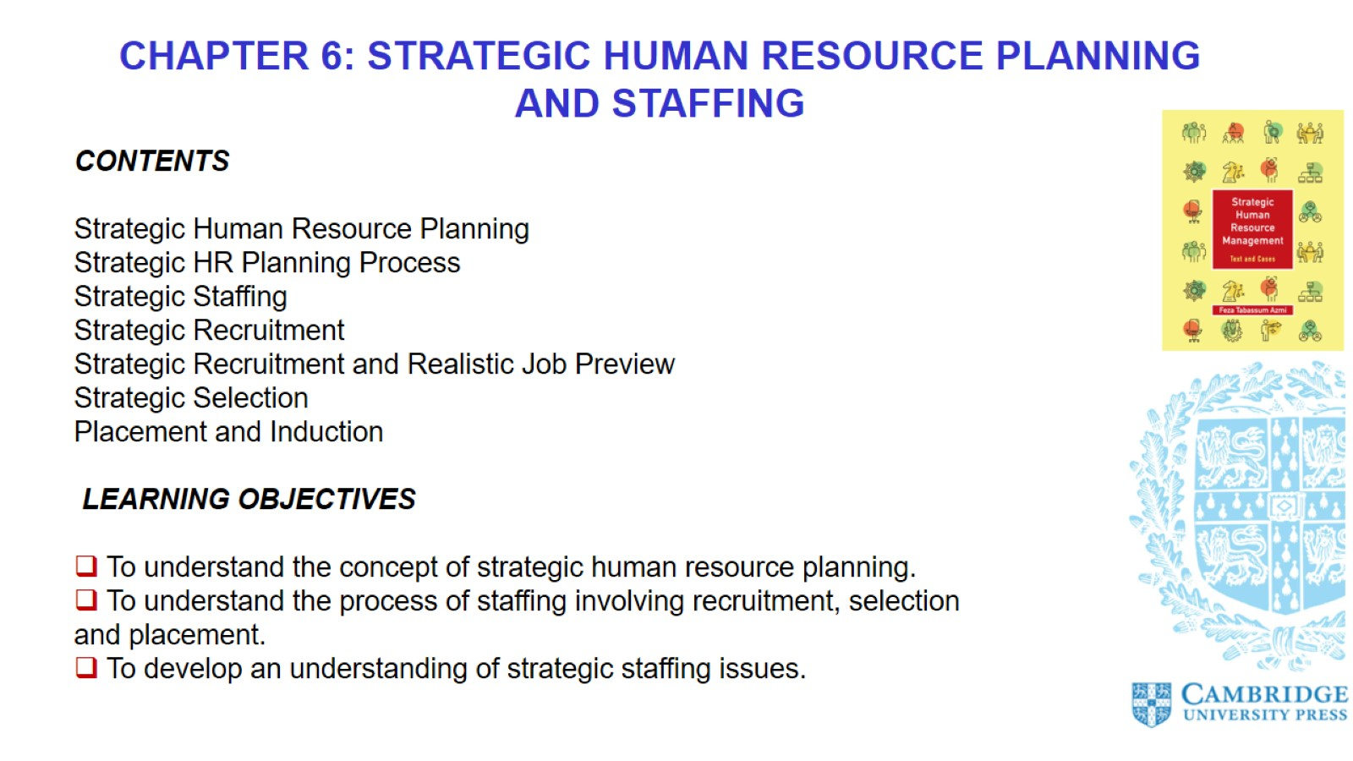

Slide 3
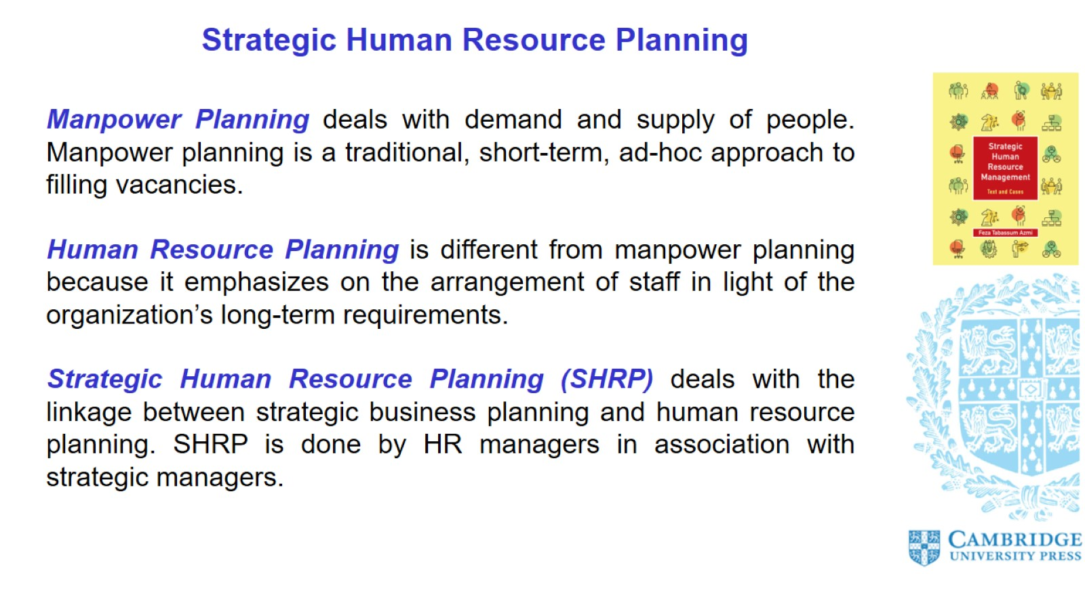
Strategic Human Resource Planning

Slide 4
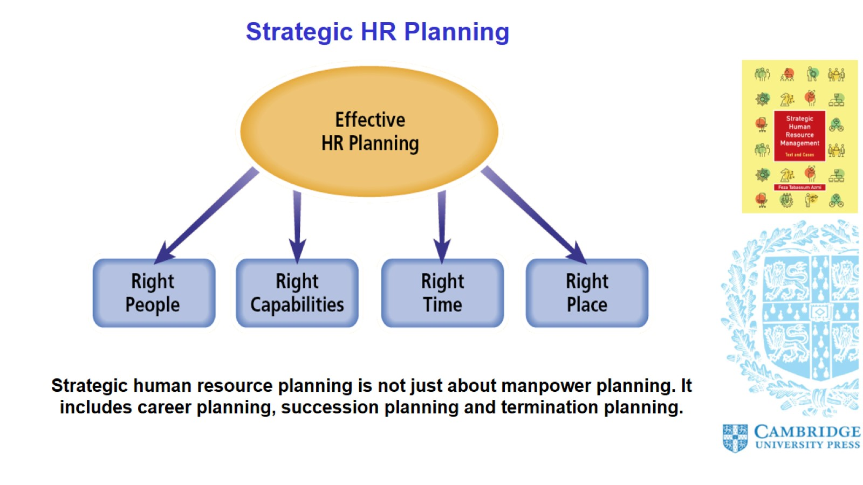
Strategic HR Planning

Slide 5
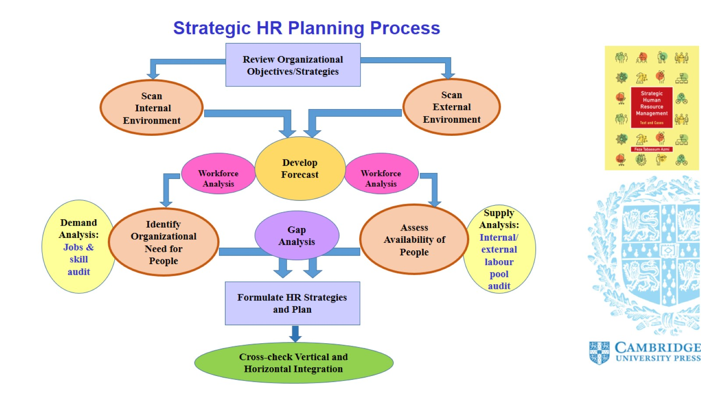
Strategic HR Planning Process

Slide 6
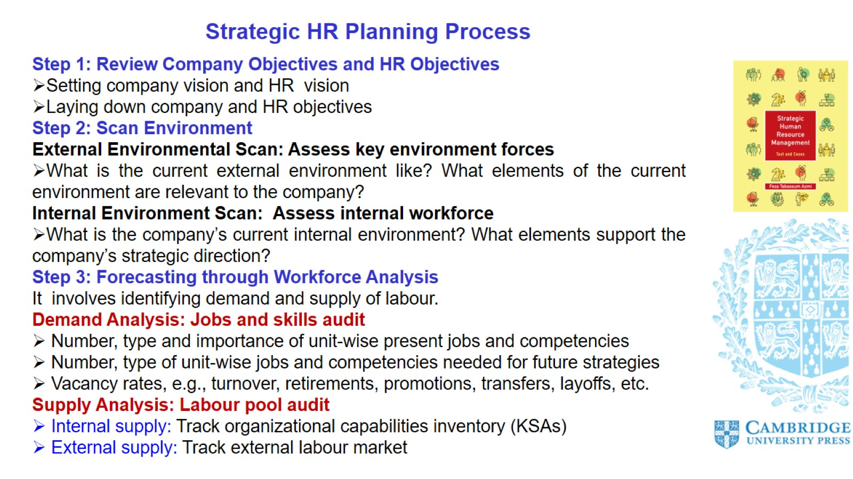
Strategic HR Planning Process

Slide 7
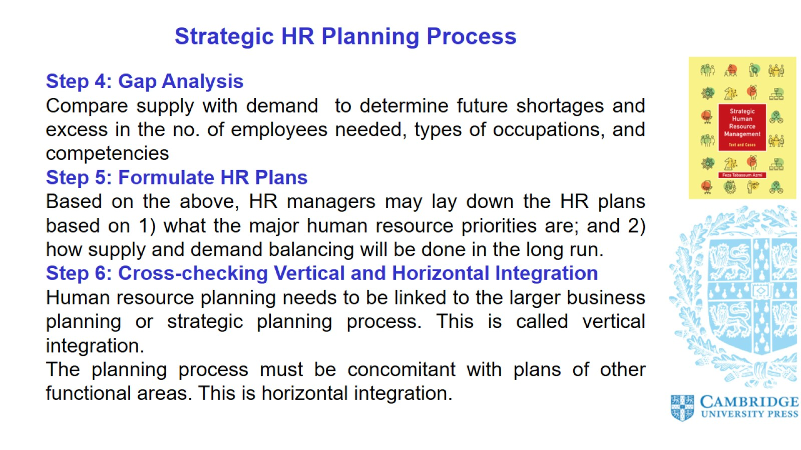
Strategic HR Planning Process

Slide 8
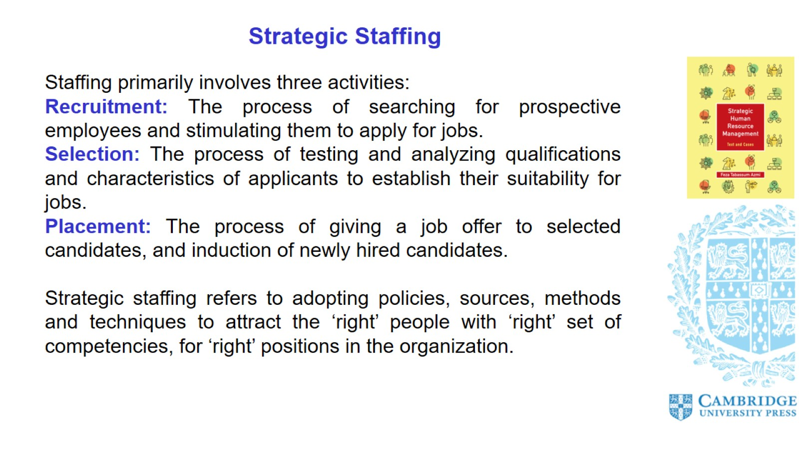
Strategic Staffing

Slide 9
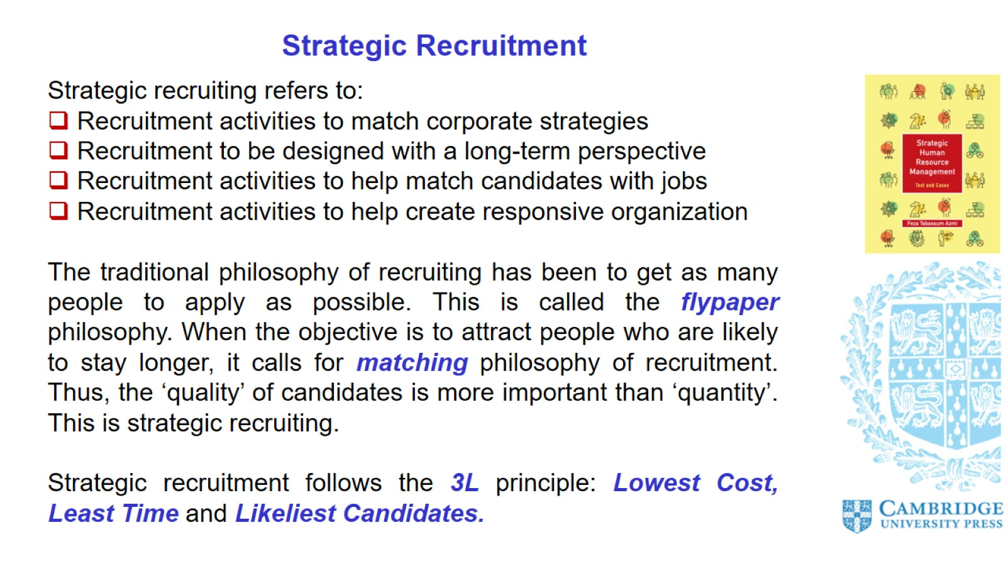
Strategic Recruitment

Slide 10
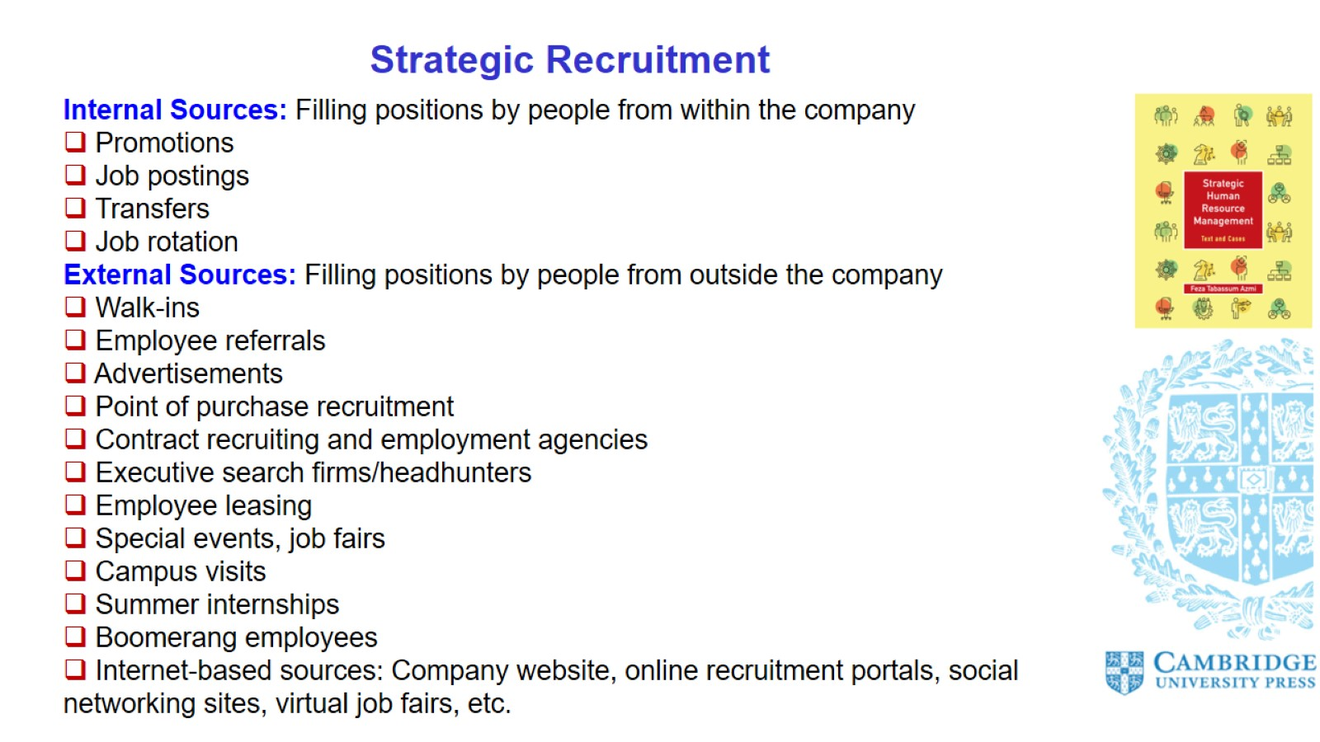
Strategic Recruitment

Slide 11
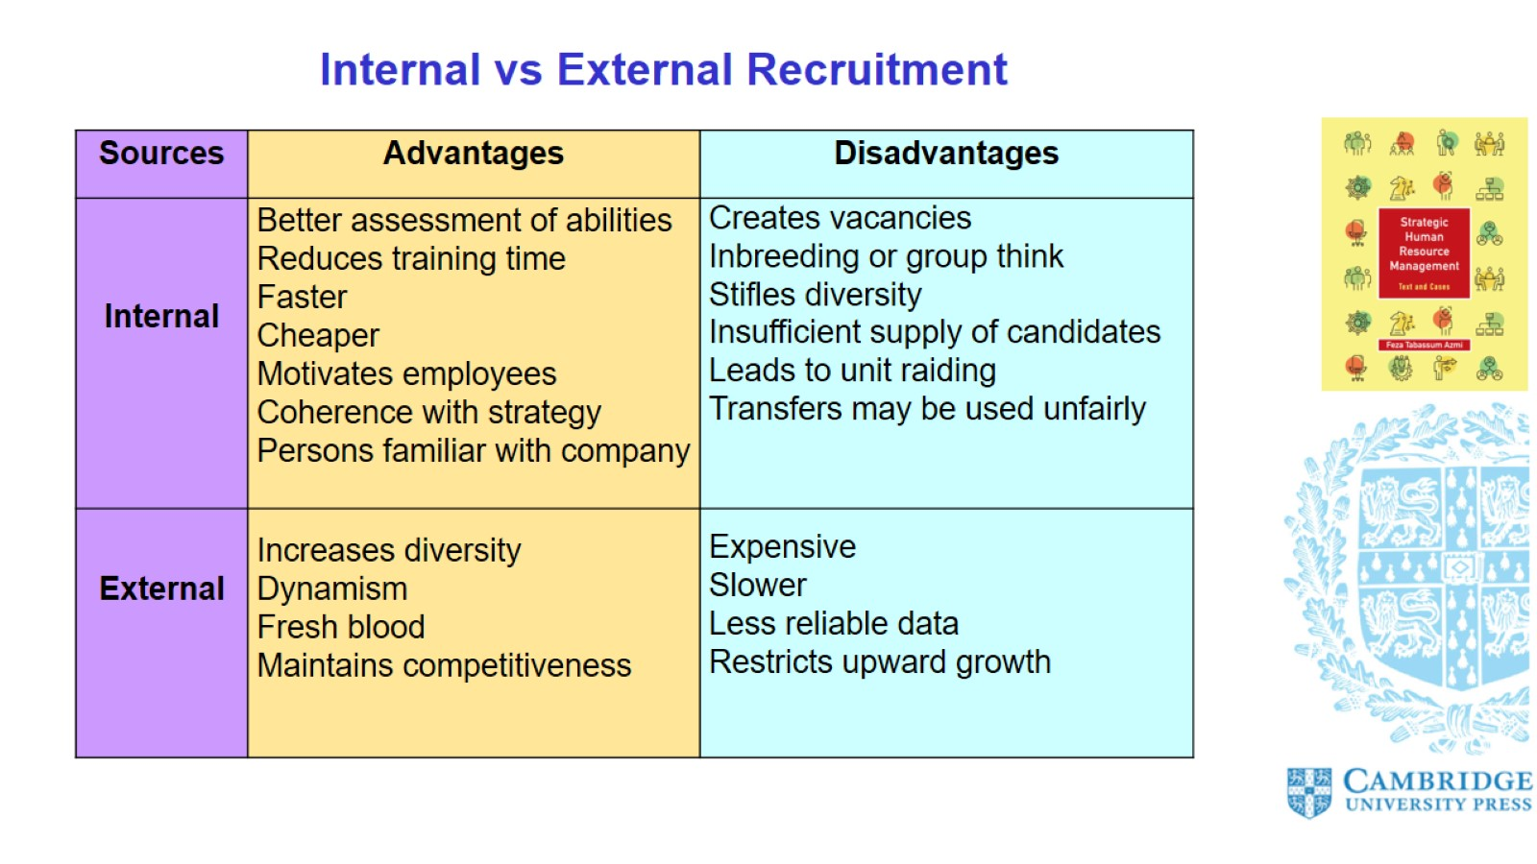
Internal vs External Recruitment

Slide 12
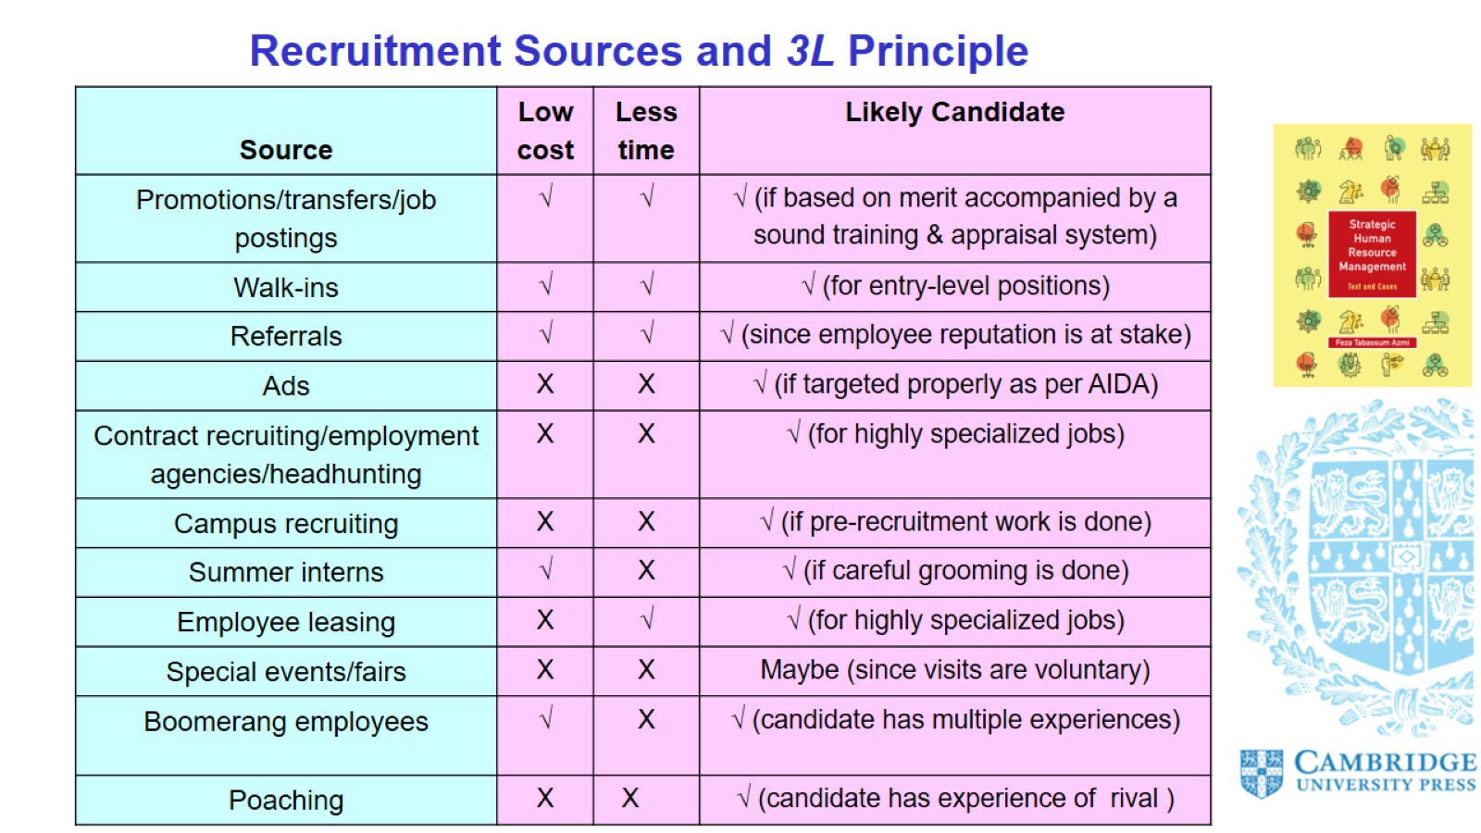
Recruitment Sources and 3L Principle

Slide 13
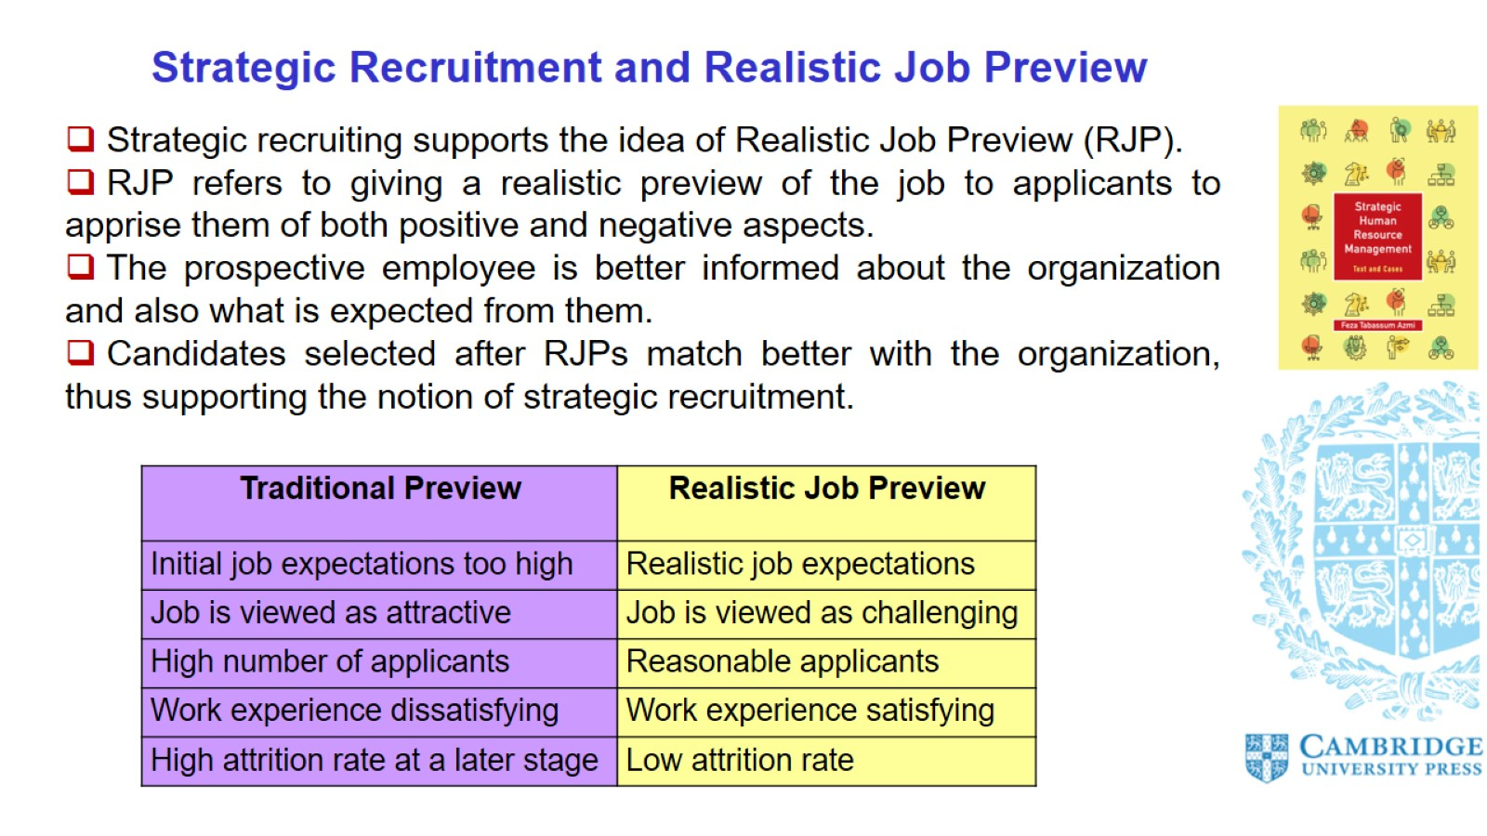
Strategic Recruitment and Realistic Job Preview

Slide 14
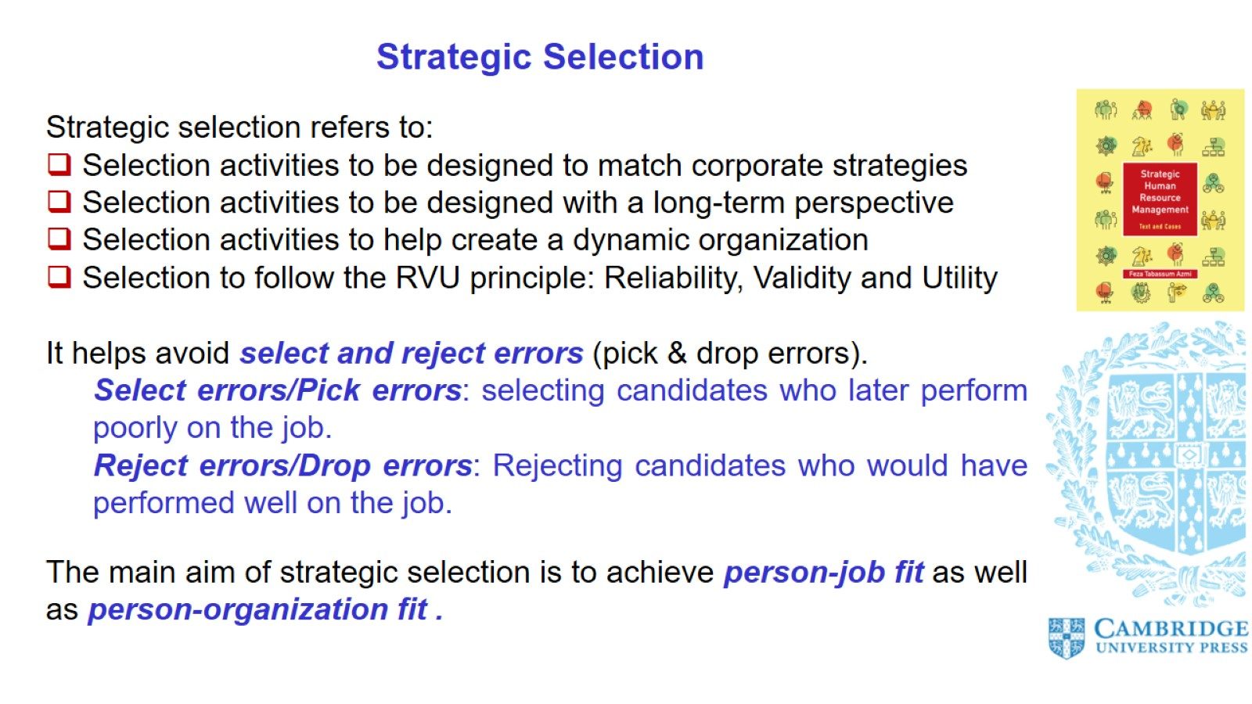
Strategic Selection

Slide 15
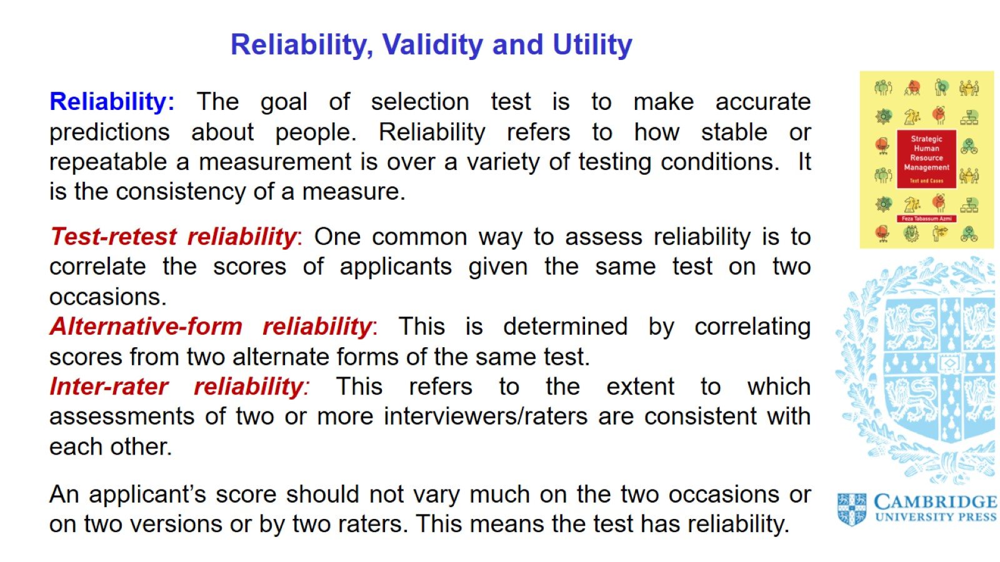
Reliability, Validity and Utility

Slide 16
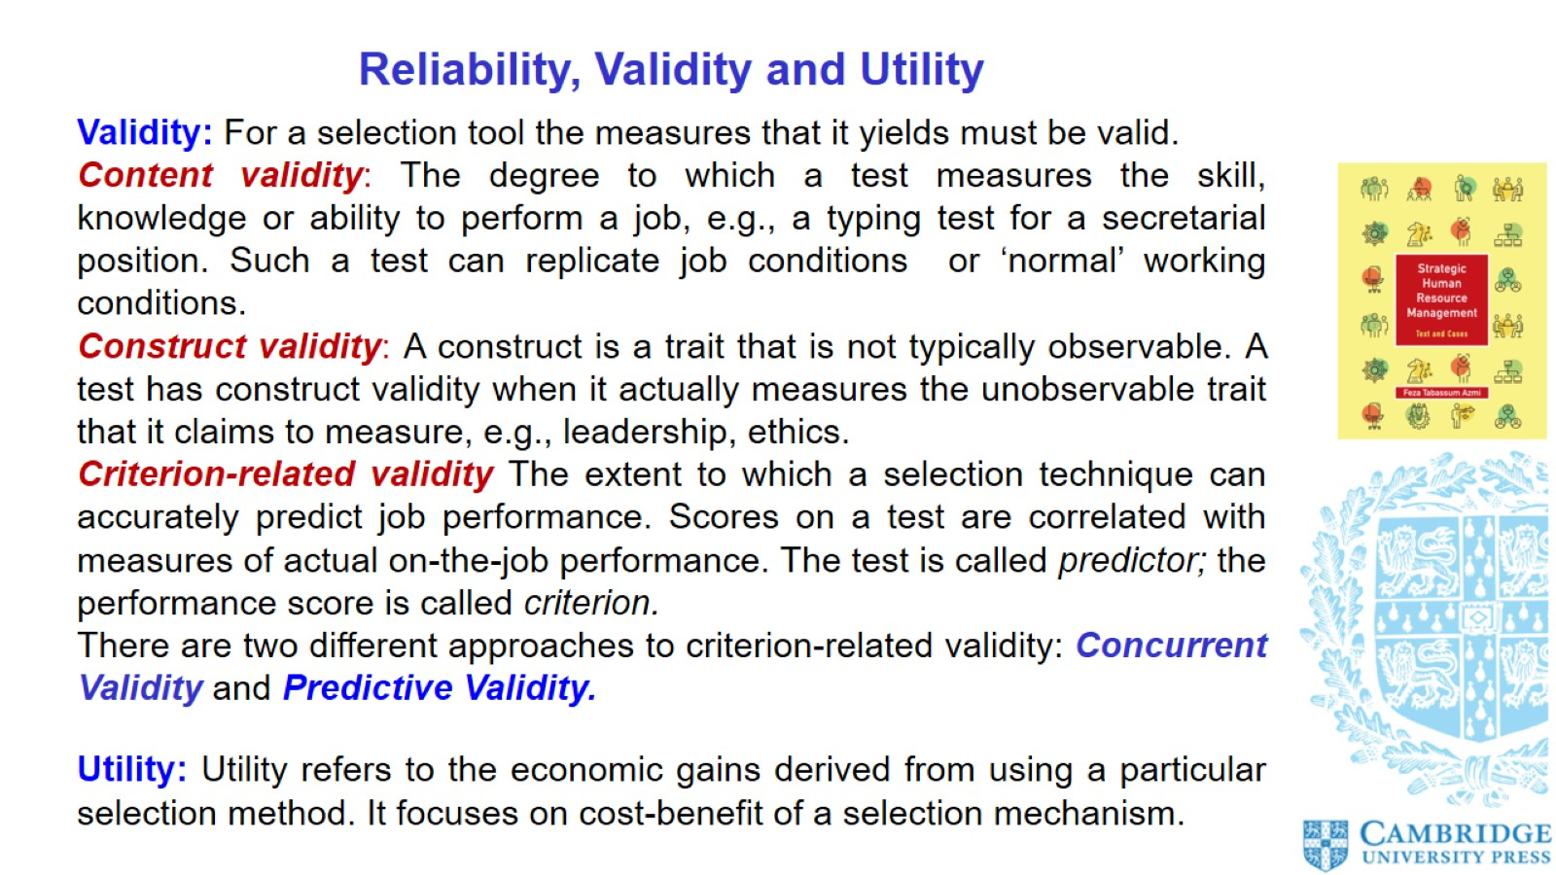
Reliability, Validity and Utility

Slide 17
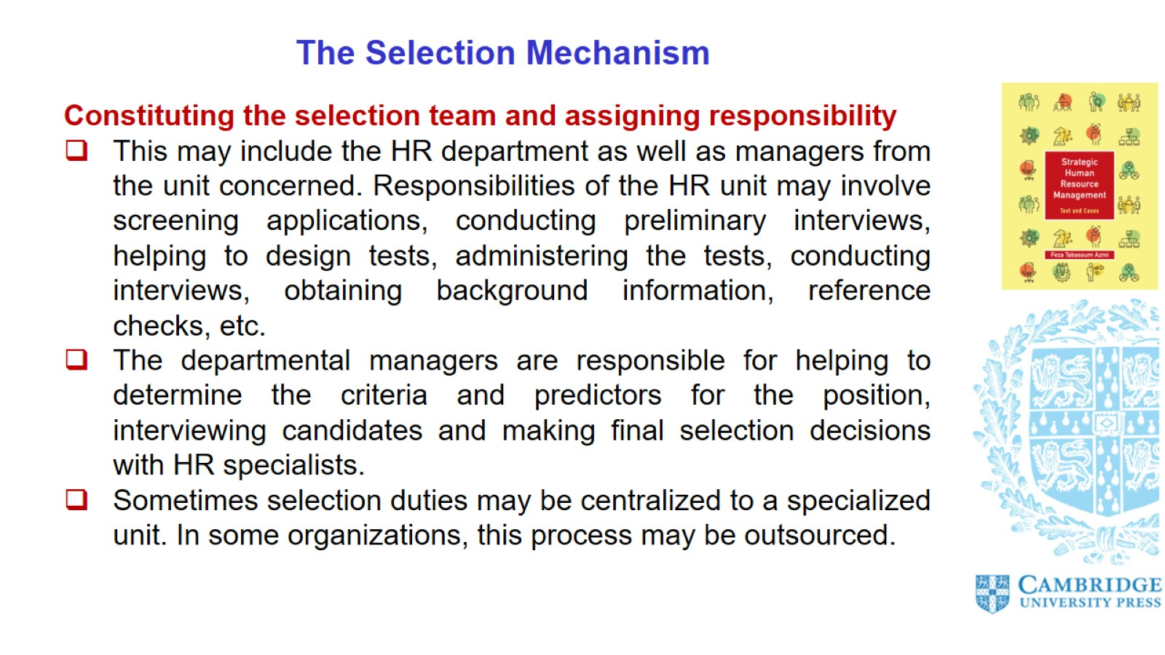
The Selection Mechanism

Slide 18
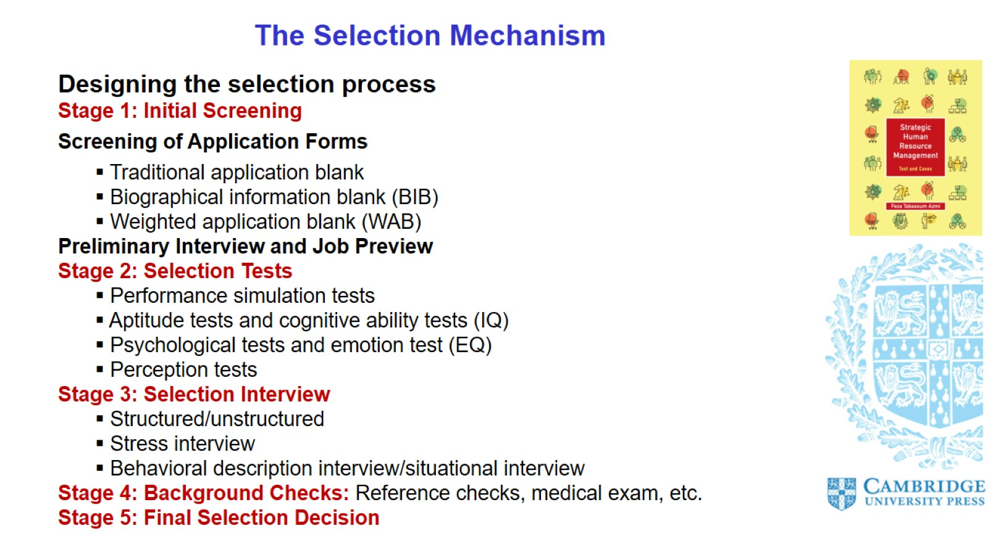
The Selection Mechanism

Slide 19
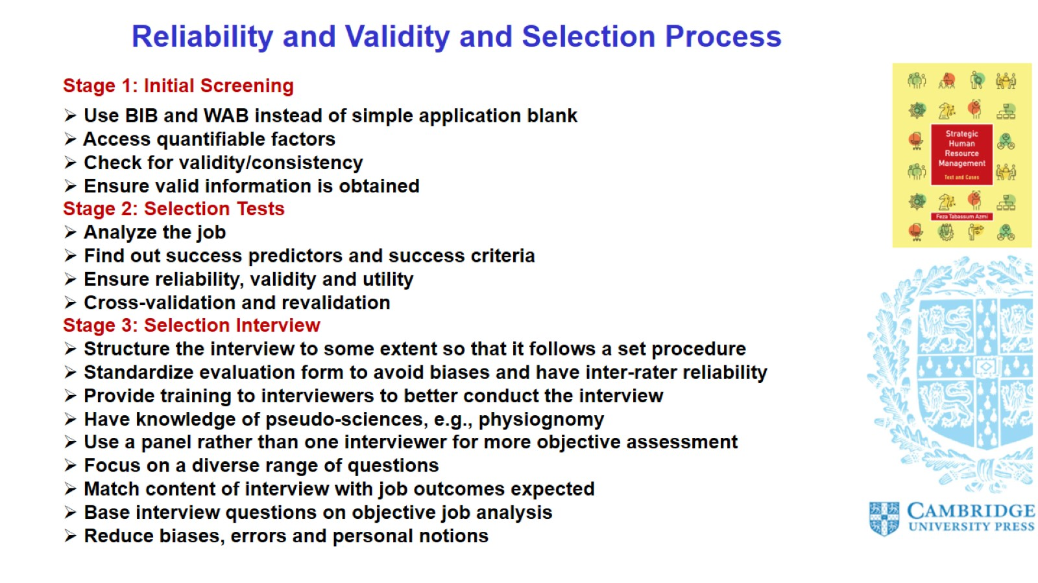
Reliability and Validity and Selection Process

Slide 20
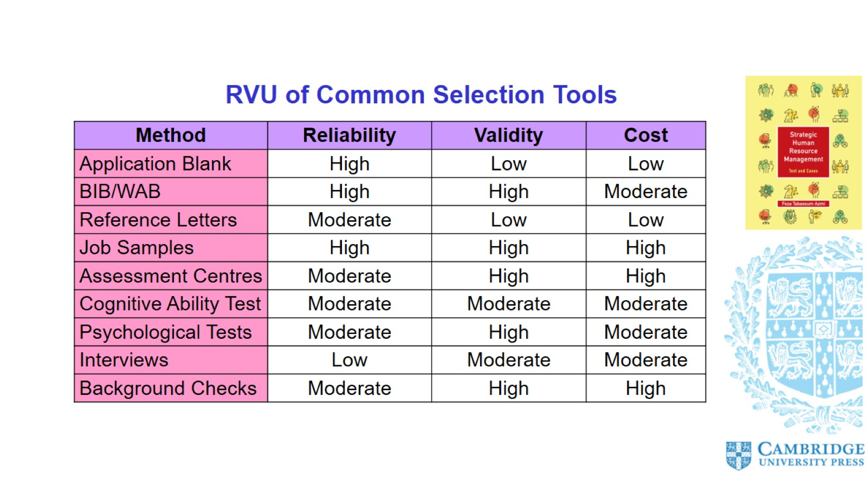

Slide 21
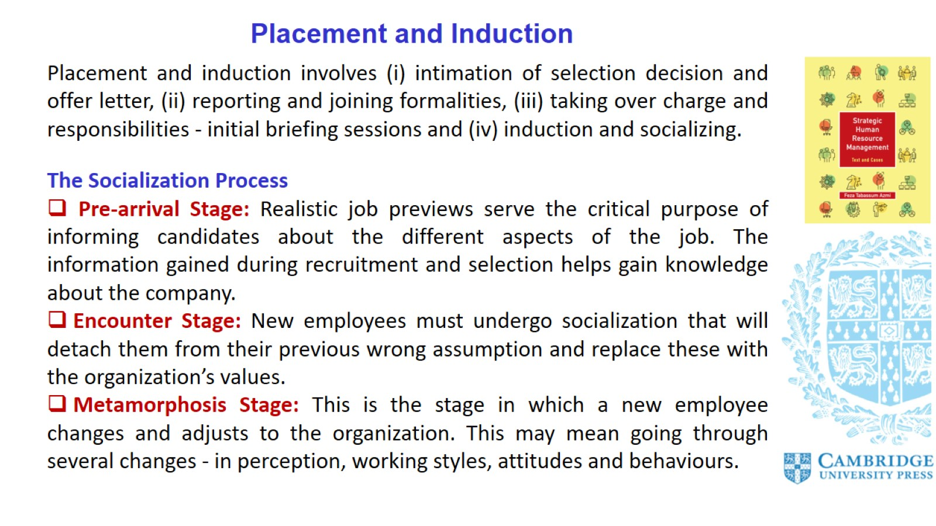
Placement and Induction

Slide 22
