Slide 1


Slide 2
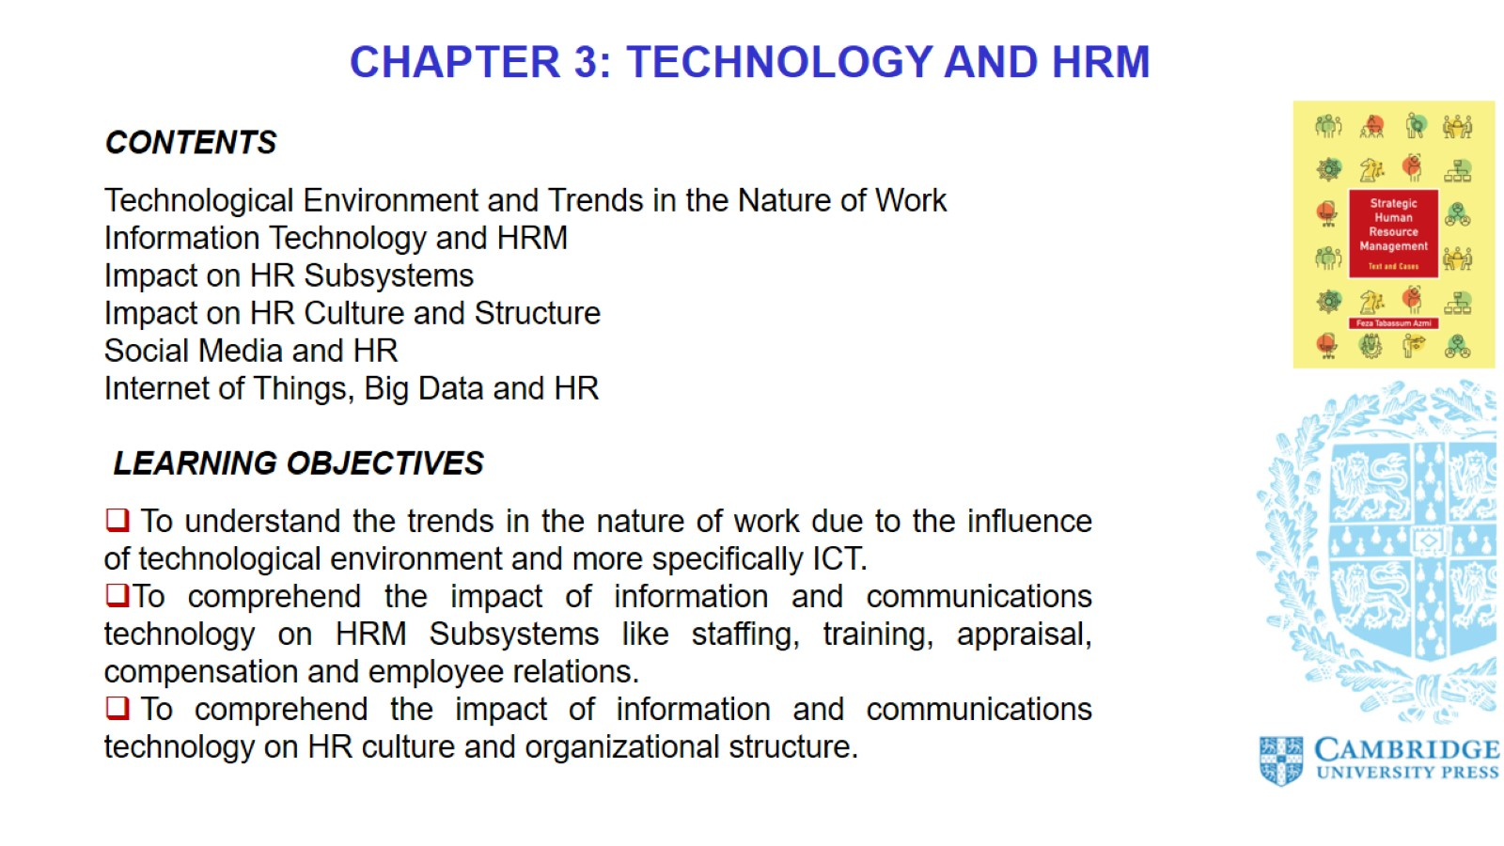

Slide 3
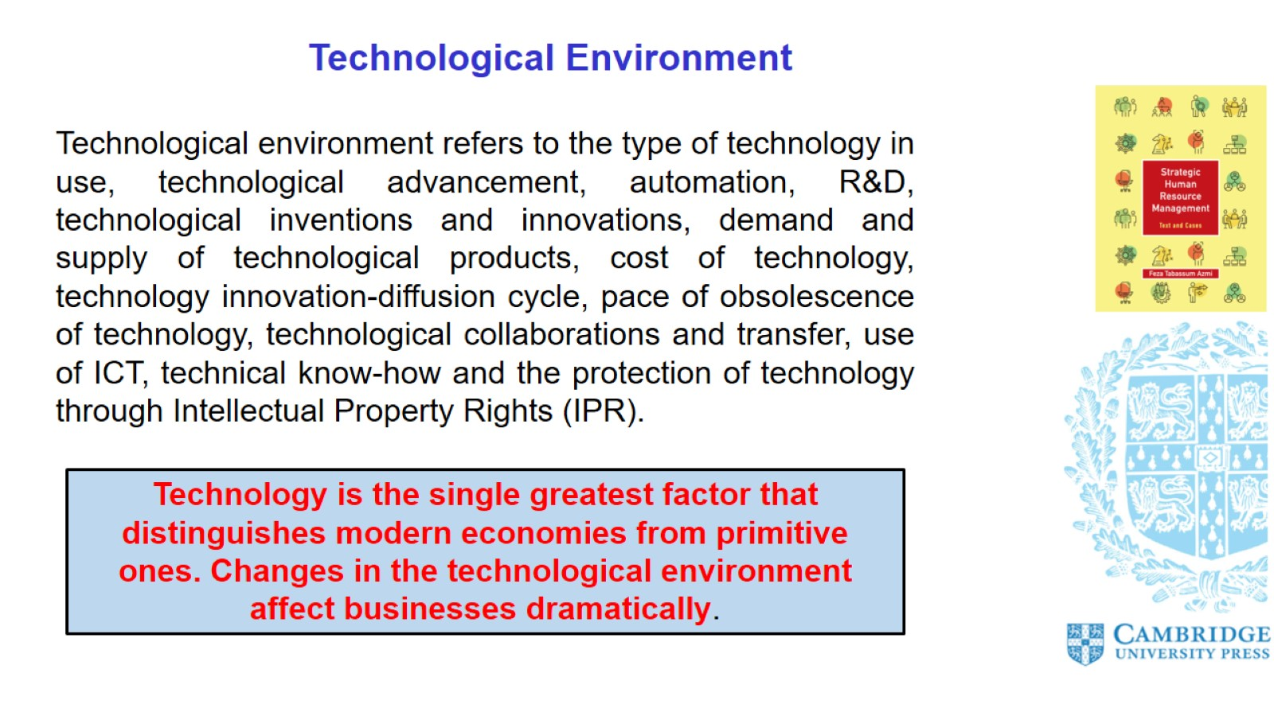
Technological Environment

Slide 4
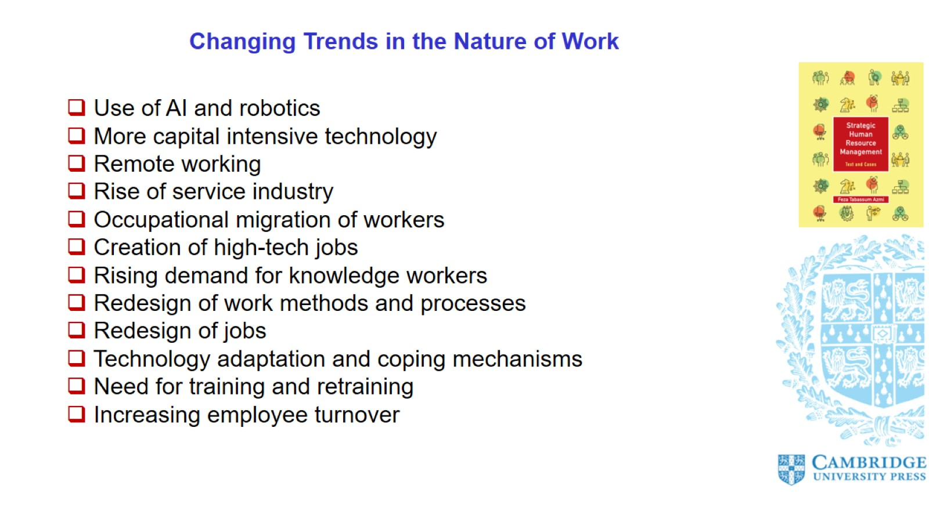
Changing Trends in the Nature of Work

Slide 5
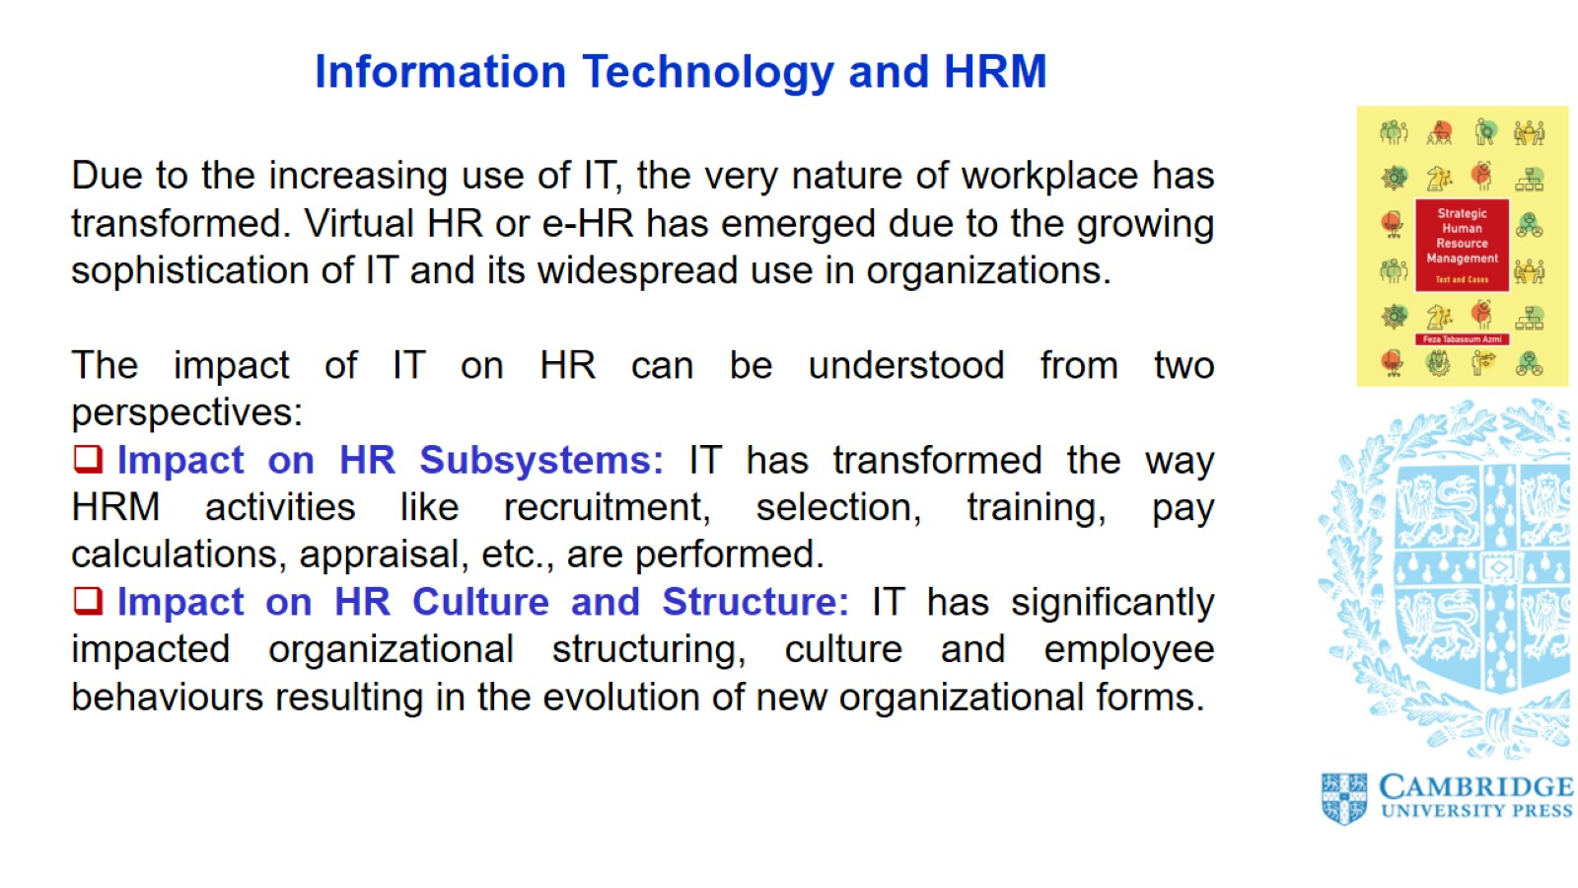
Information Technology and HRM

Slide 6
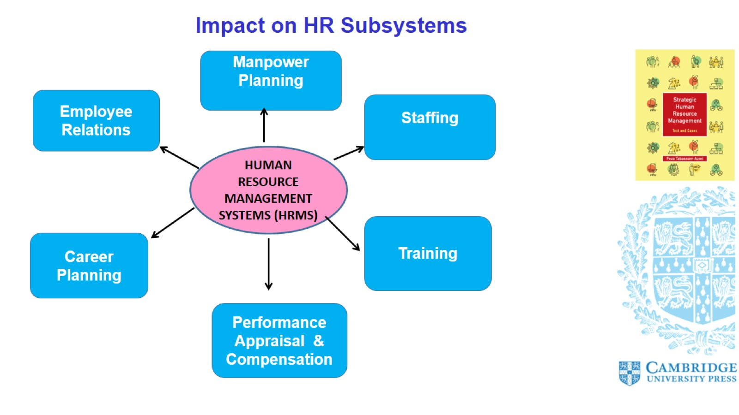
Impact on HR Subsystems

Slide 7
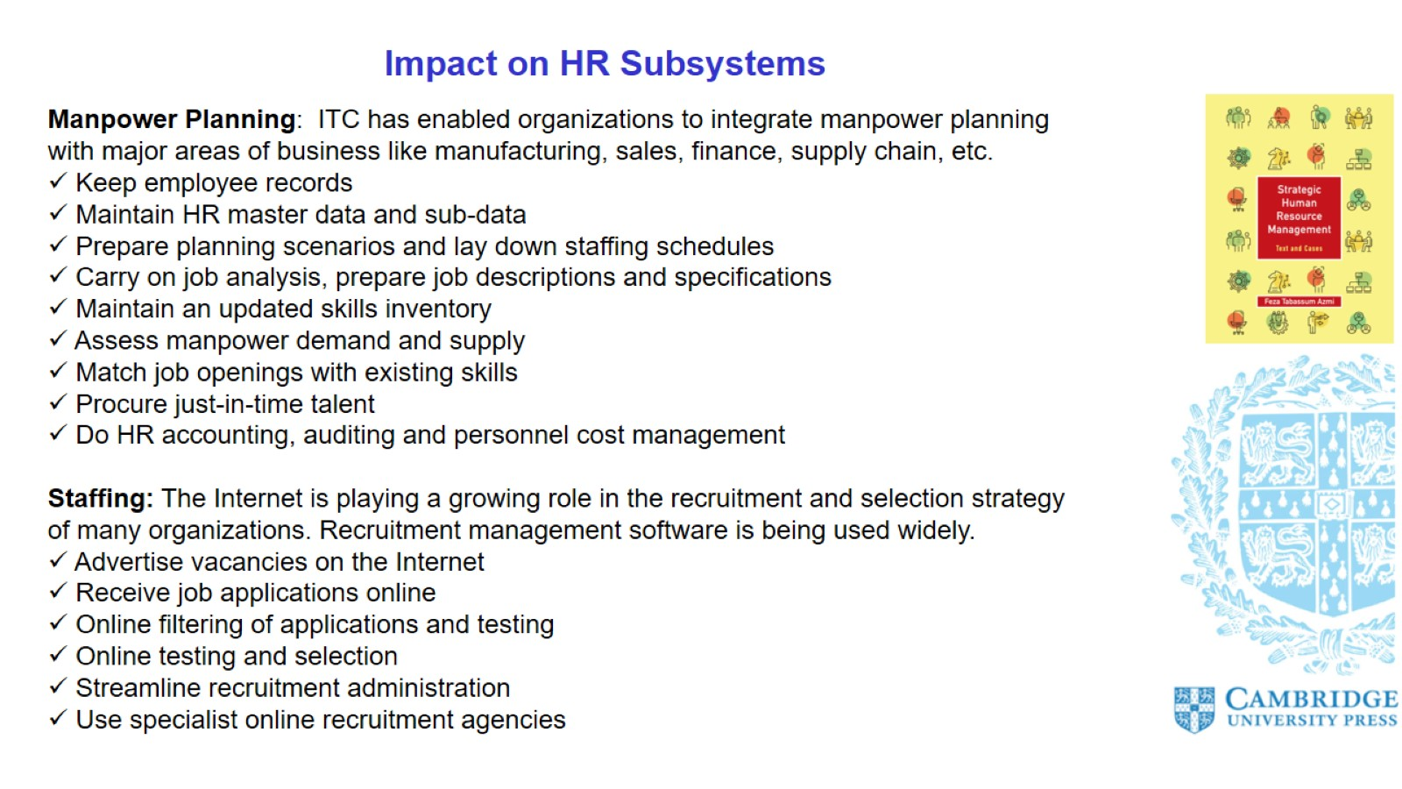
Impact on HR Subsystems

Slide 8
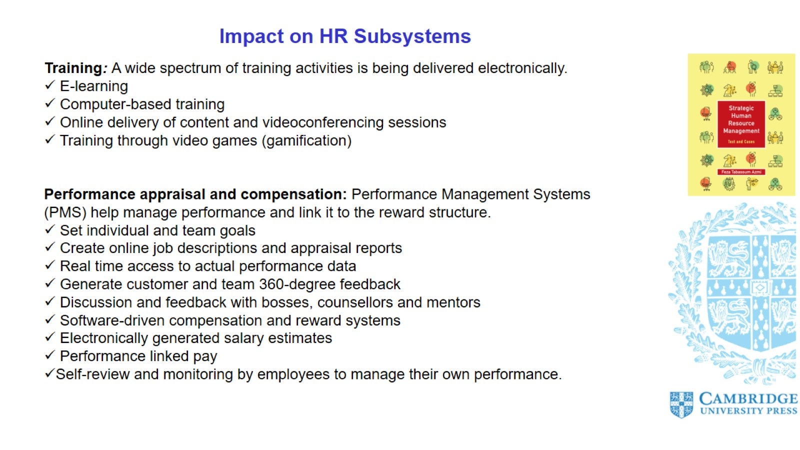
Impact on HR Subsystems

Slide 9
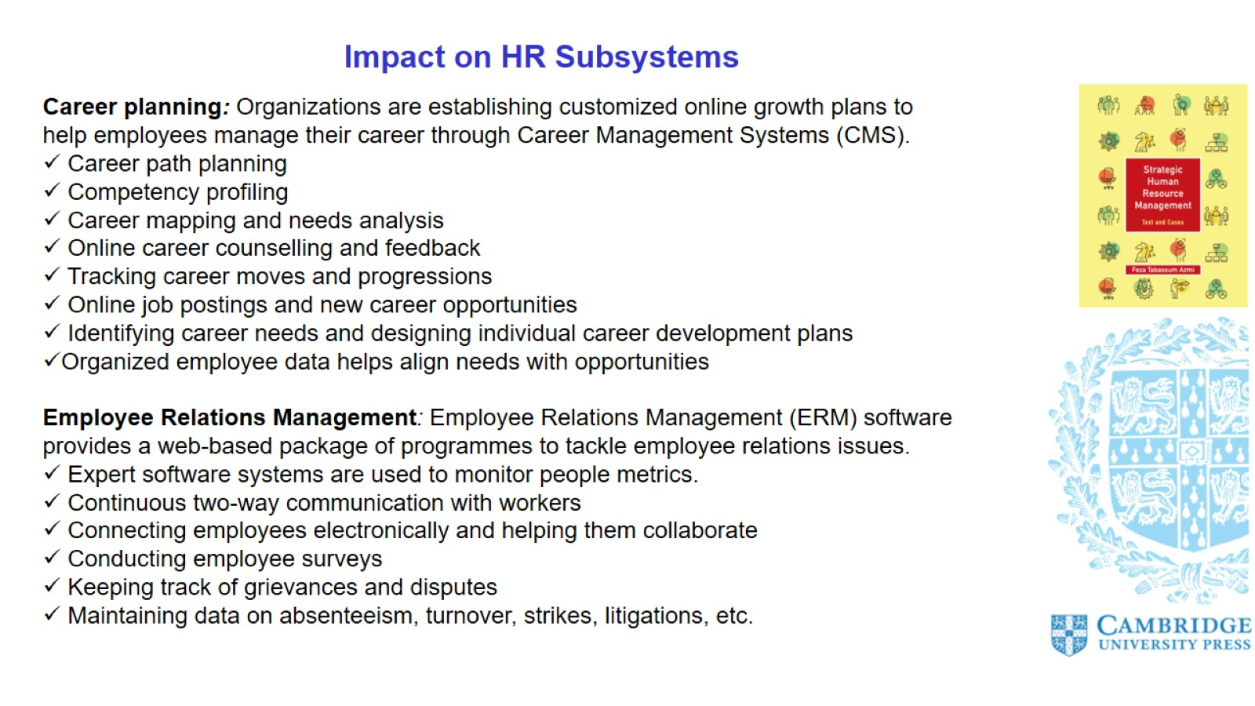
Impact on HR Subsystems

Slide 10
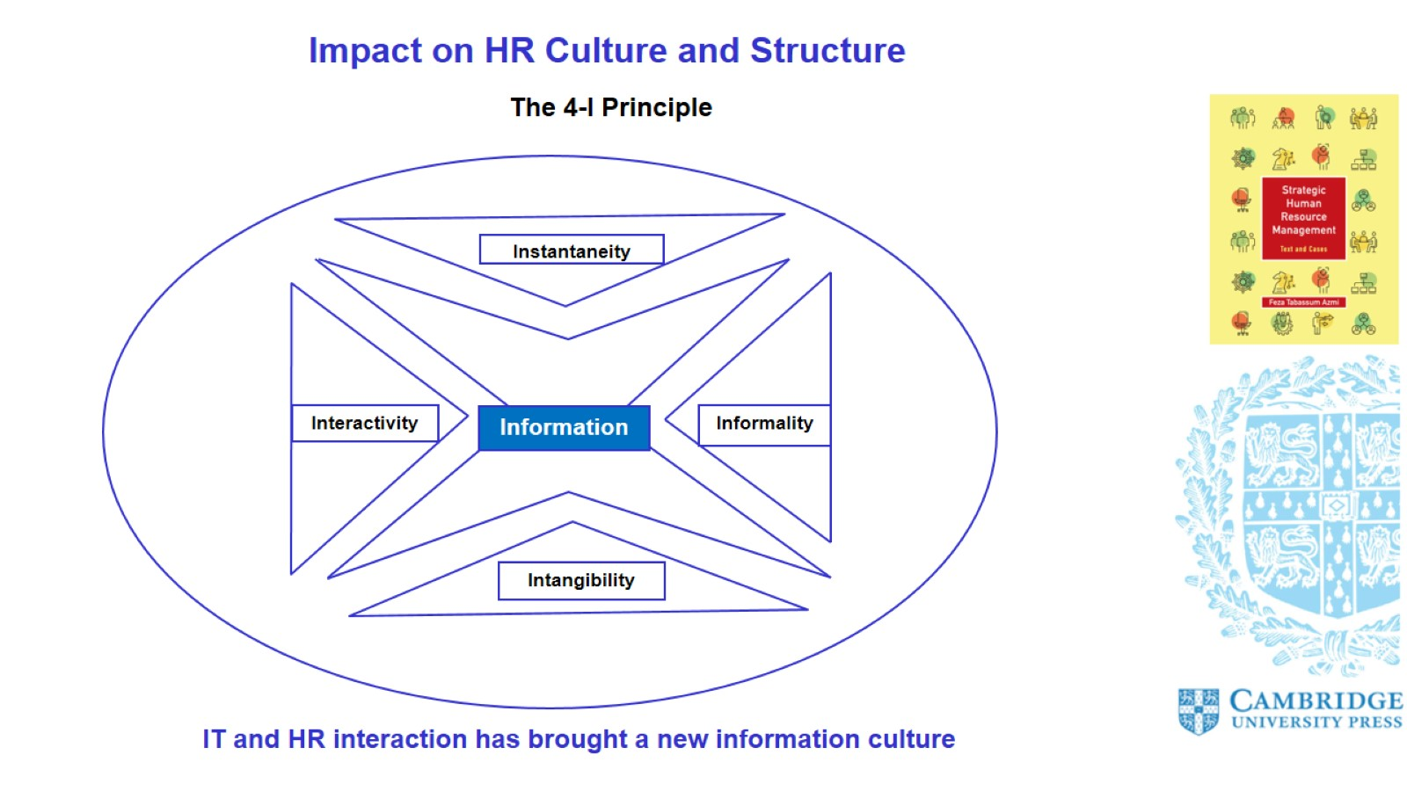
Impact on HR Culture and Structure

Slide 11
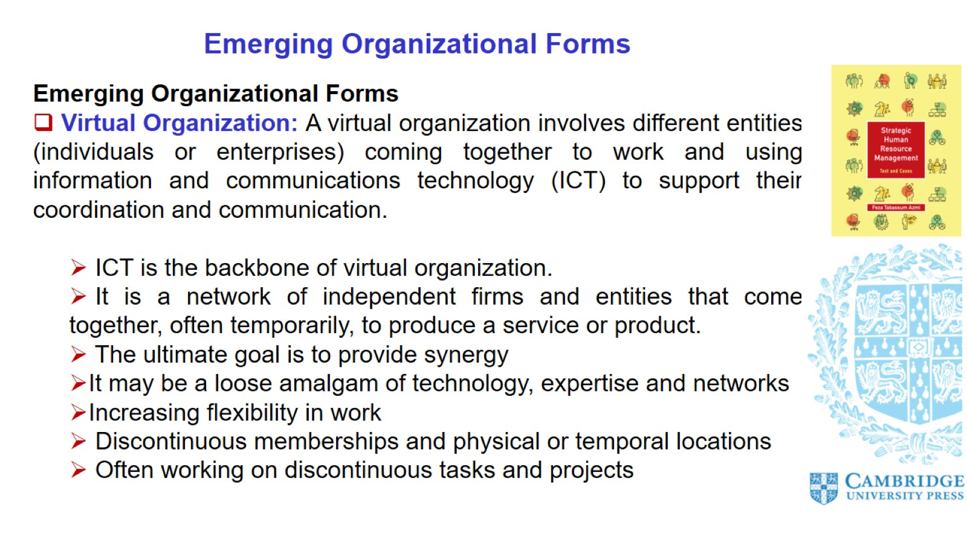
Emerging Organizational Forms

Slide 12
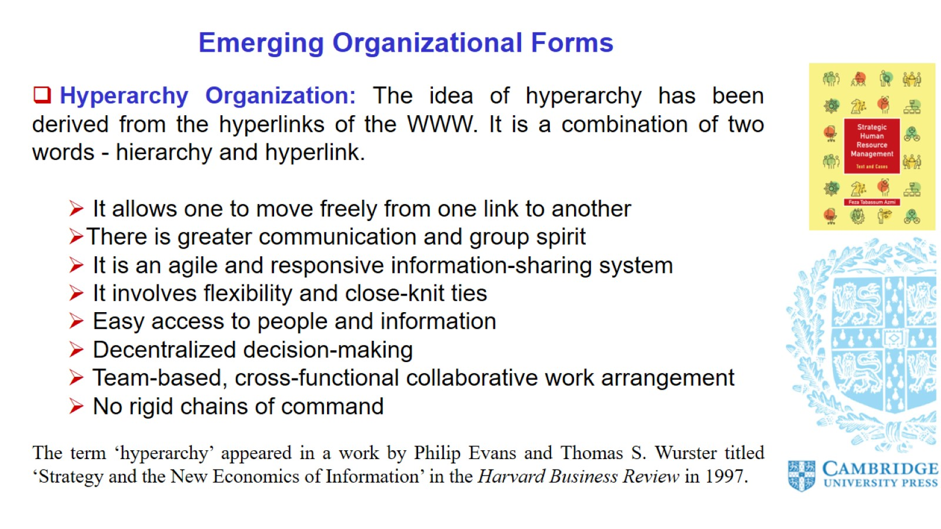

Slide 13
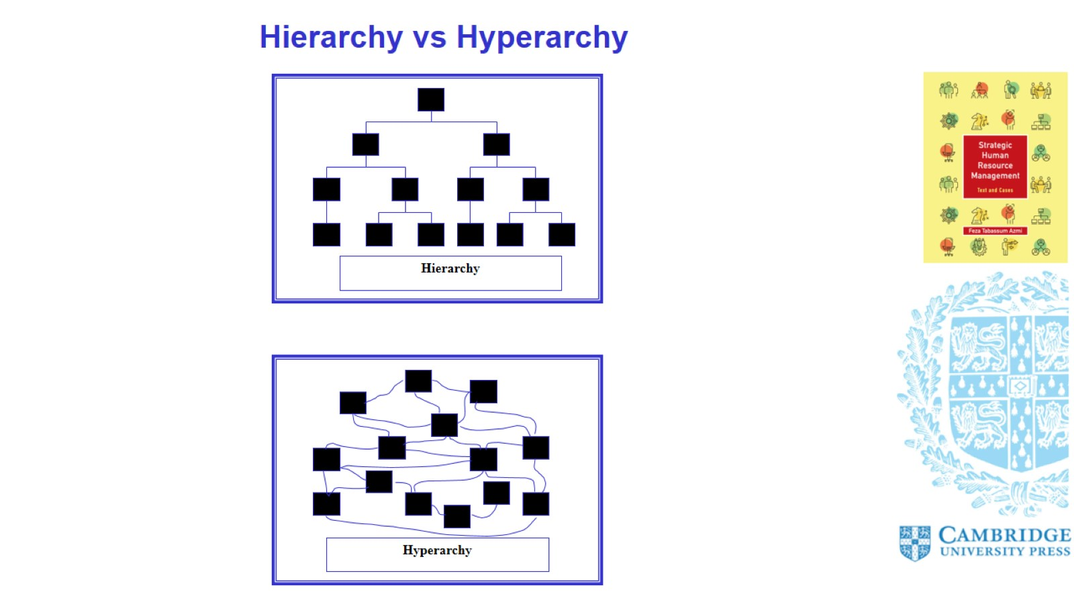

Slide 14
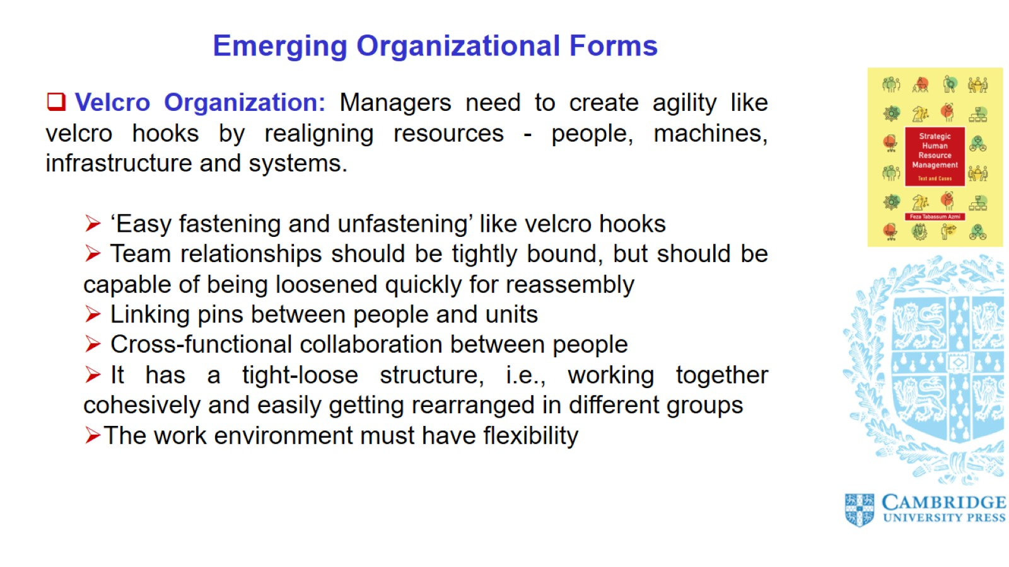
Emerging Organizational Forms

Slide 15
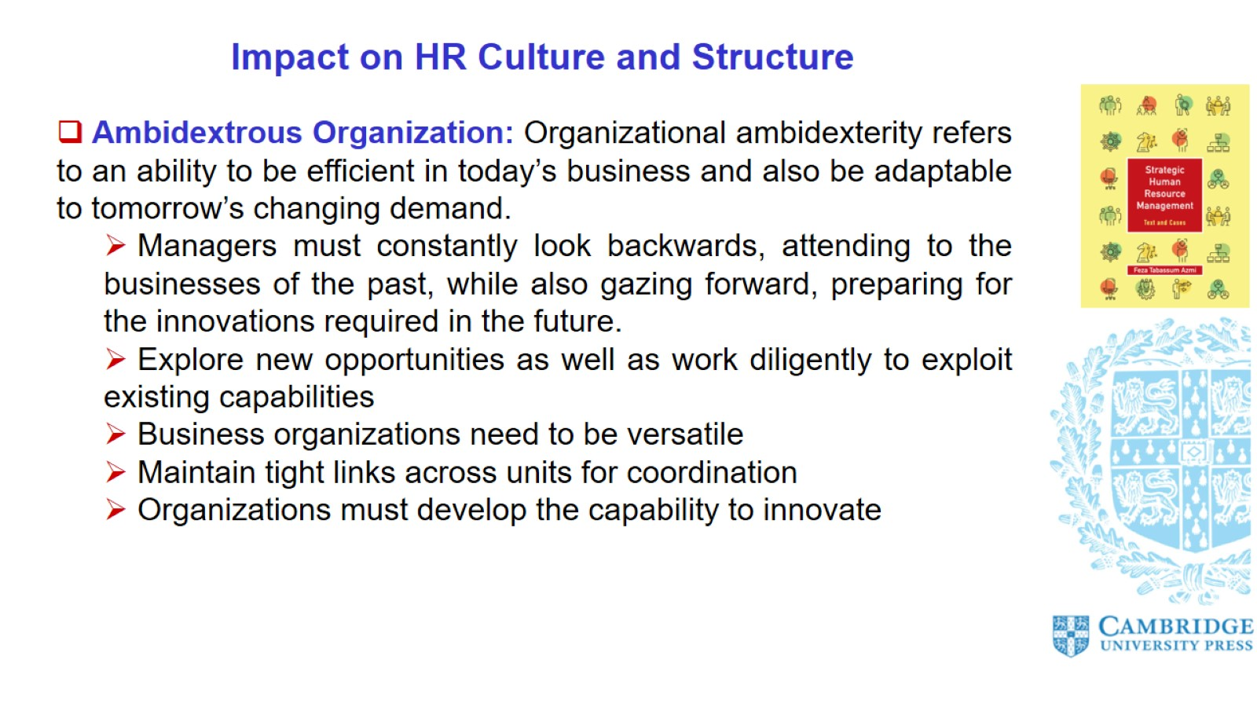
Impact on HR Culture and Structure

Slide 16
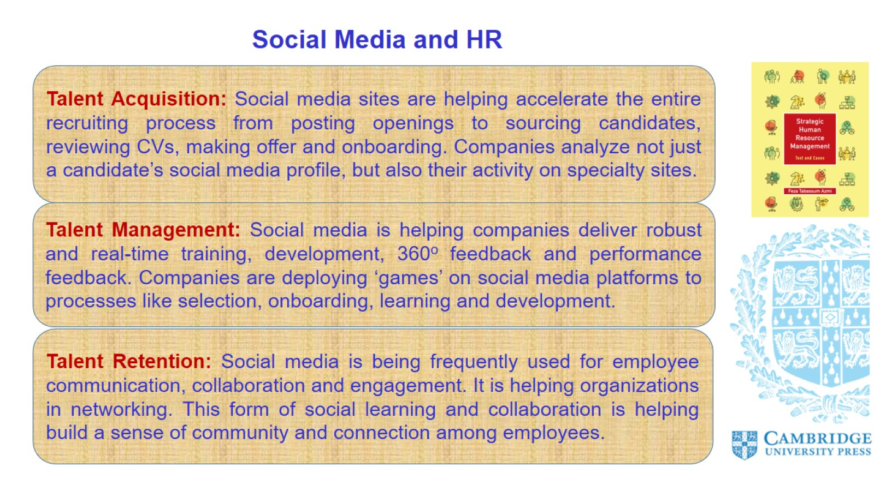
Social Media and HR

Slide 17
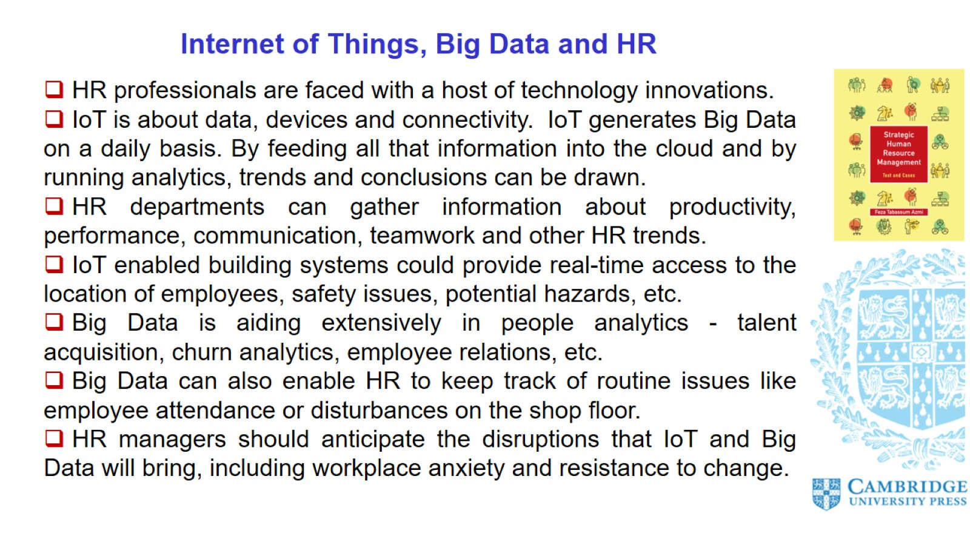
Internet of Things, Big Data and HR

Slide 18
