Slide 1
Chapter 5
Branch-and-bound Framework and Its Applications

Slide 2
Outline
Review of branch-and-bound framework
A case study
  Cross-layer optimization for cognitive radio networks

Slide 3


Basic Idea
Branch-and-bound
  A form of divide-and-conquer technique
  Aim to obtain -optimal solution for a small given
For a minimization problem
  1st iteration, we find upper and lower bounds for the problem
  Done if the lower bound and the upper bound are close enough

Slide 4
Basic Idea (cont’d)
  Otherwise, we divide a problem into two sub-problems
    We find upper and lower bounds for each sub-problem
    The global upper and lower bounds get tighter
  The procedure terminates when the lower and upper bounds for the original problem are close enough

Slide 5
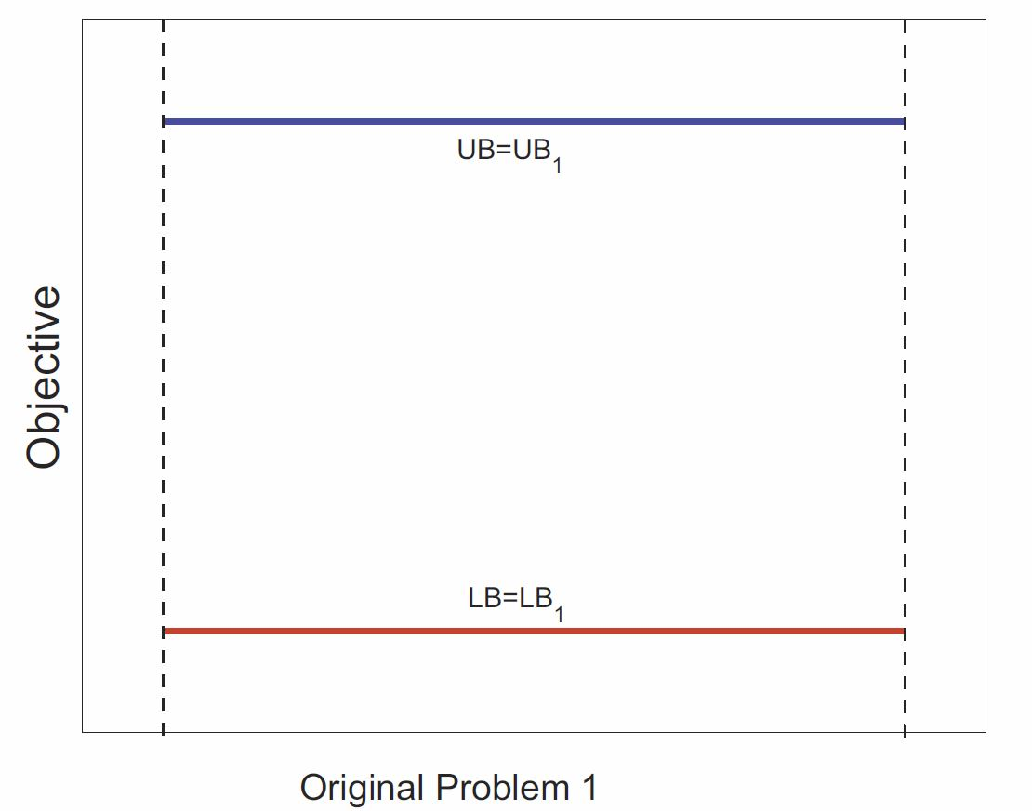

Branch-and-Bound Framework
Iteration 1
LB₁ obtained via relaxation
UB₁ obtained via a local search algorithm based on solution to lower bound
Global lower bound LB = LB₁
Global upper bound UB = UB₂
Done if
5

Slide 6
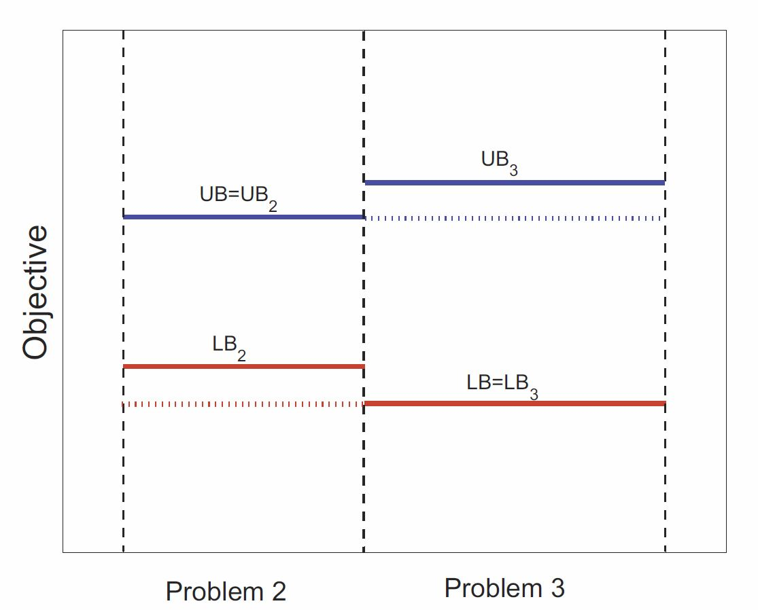
Branch-and-Bound Framework (cont’d)
Iteration 2
Problem 1 is divided into problem 2 and problem 3
min{LB₂,LB₃}≥LB₁
min{UB₂,UB₃}≥UB₁
LB = min{LB₂,LB₃}
UB = min{UB₂,UB₃}
Done if
6

Slide 7
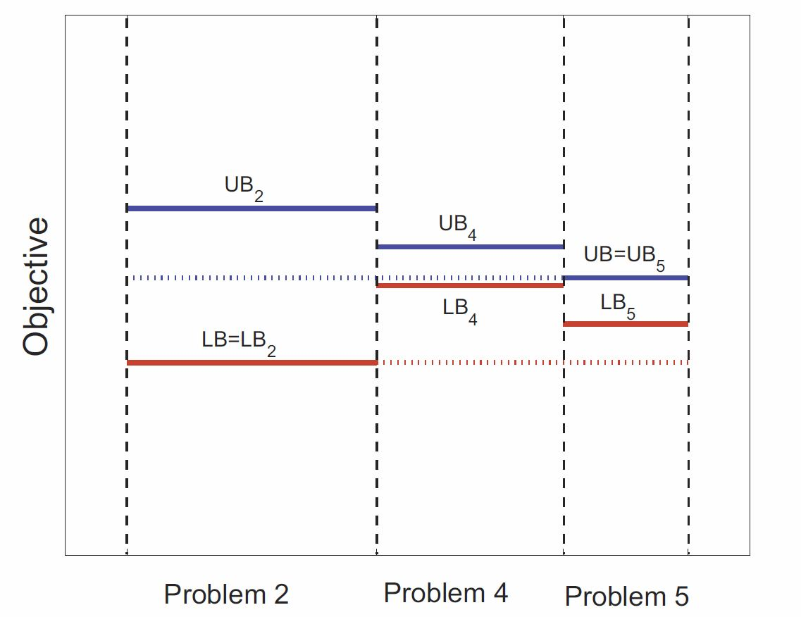
Branch-and-Bound Framework (cont’d)
Iteration 3
Select problem 3 since it has a loose lower bound
Problem 3 is divided into problem 4 and problem 5
LB=min{LB₂,LB₄,LB₅}
UB=min{UB₂,UB₄,UB₅}
Done if
7

Slide 8
Branch-and-Bound Framework (cont’d)
  When the procedure terminates, the feasible solution is -optimal
Complexity
  Branch-and-bound is not a brute force algorithm
    A number of sub-problems can be removed before solving it completely
  The actual running time could be fast when all partition variables are integers
  Worst case complexity is exponential
8

Slide 9
Outline
Review of branch-and-bound framework
A case study
  Cross-layer optimization for cognitive radio networks

Slide 10

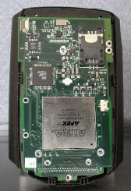

Cognitive Radio Networks
Traditional radio
  Hardware-based
    modulation and signal processing implemented in hardware, not flexible
  Each radio operates on a given frequency band, inefficient use of spectrum
Cognitive radio – A revolution in radio technology
  Most functions are software-based, can be modified if desired
  Capable of sensing available spectrum
  Capable of reconfiguring RF on the fly
  Capable of switching to selected frequency bands
10

Slide 11
Problem To Be Solved
Problem setting
  A multi-hop CR network
  Available frequency bands at each node may be different
  A set of communication sessions each with a rate requirement
Study the per-node power control problem for a multi-hop CR network
Objective: Minimize resource to support the set of communication sessions
11
Notes:
Many similar problems can also be asked and solved along the same line

Slide 12
Outline of Case Study
Mathematical Modeling and Problem Formulation
A Solution Procedure
Numerical Results

Slide 13



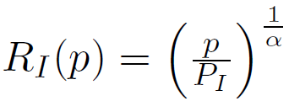
Transmission and Interference Ranges with Power Control
Transmission range is determined by
  Transmission power p
  Minimum receiving power threshold
  Propagation gain model, e.g.,
Transmission range is
Interference range is
13

Slide 14
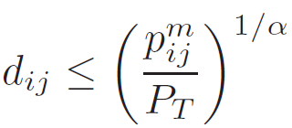
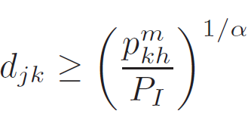
Necessary and Sufficient Condition for Successful Transmission
The receiving node j should be in the transmission range of the transmitting node i
  (C-1)
The receiving node j should not be in the interference range of any other transmitting node k
  (C-2)
14

Slide 15
An Example
What if link 3→4 is active?
Node 3 uses the maximum
transmission power
Node 3 uses a smaller
transmission power
15
Notes:
The figure shows a network with three links (1 → 2, 3 → 4, and 5 → 6).
For each transmitting node (1, 3, and 5), the inner circle (dashed) represents transmission range and the outer circle (solid) represents interference range.
Clearly, each receiving node falls in the transmission range of its respective transmitting node.
Further, we can see that both receiving nodes 2 and 6 fall in the interference range of node 3.
Thus, when link 3 → 4 is using a frequency band m for transmission, link 1 → 2 and link 5 → 6 should not use the same band.
It should also be noted that when link 3 → 4 is not using a frequency band m, both link 1 → 2 and link 5 → 6 may use band m.
This is because that receiving node 2 does not fall in node 5’s interference range and receiving node 6 does not fall in node 1’s interference range.
Now consider that each node can adjust its transmission power.
In this setting, nodes 1, 3, and 5 can reduce their transmission powers while still maintaining data transmission to the corresponding receiving nodes.
Then receiving nodes 2 and 6 are no longer in node 3’s interference range. As a result, both transmitting nodes 1 and 5 can also transmit on band m as node 3 does.

Slide 16
Challenge
With power control, interference relationship is not fixed
  Need a model to formulate both scheduling and power control
Both transmission and interference ranges are non-linear functions of power
  Non-linear problem?
16

Slide 17
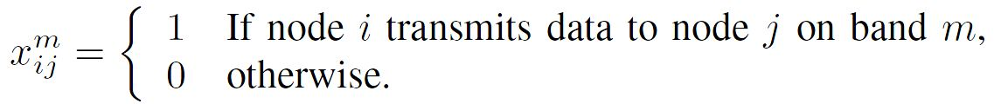
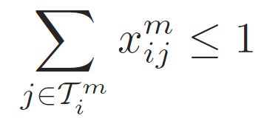

Per-Node Based Power Control and Scheduling
Scheduling is performed on bands
Denote
On the same band, a node can transmit to only one node
  (C-3) ,
where is the set of nodes to which node i can transmit
on band m under full power P.
17

Slide 18




Per-Node Based Power Control and Scheduling (cont’d)
Denote the maximum transmission range under the maximum transmission power P
To ensure that the receiving power from node i to node j is at least , we have
or
  or (C-1’)
18

Slide 19

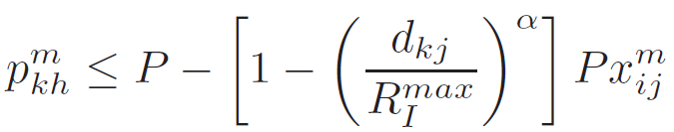
Per-Node Based Power Control and Scheduling (cont’d)
Denote the maximum interference range under the full transmission power P
To ensure that the interference power from node k to node j is at most β, we have
  (C-2’)
All the above constraints are linear!
19

Slide 20

Per-Node Based Power Control and Scheduling (cont’d)
For successful scheduling in frequency domain, the following two constraints must also hold:
  (C-4) For a band that is available at node j, this band cannot be used for both transmission and receiving.
  (C-5) Similar to constraint (C-3) on transmission, node j cannot use the same band to receive from two different nodes.
20

Slide 21
Per-Node Based Power Control and Scheduling (cont’d)
(C-4) and (C-5) are embedded in (C-1’) and (C-2’)
Lemma
  If transmission powers on every transmission link and interference link satisfy (C-1’) and (C-2’) in the network, then (C-4) and (C-5) are also satisfied.
It is sufficient to consider constraints (C-1’), (C-2’) and (C-3) for scheduling and power control
21

Slide 22
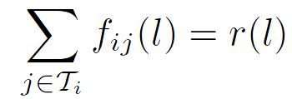
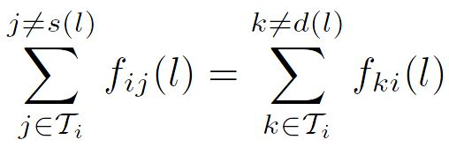
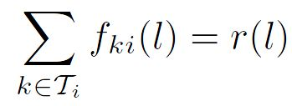
Flow Routing
For maximum flexibility (and optimality), we allow flow splitting (multi-path routing)
Flow balance constraint
  For session l
    If node i is the source node, then (5.5)
    For a relay node, we have (5.6)
    If node i is the destination node, then (5.7)
  Once (5.5) and (5.6) are satisfied, (5.7) must also be satisfied
22

Slide 23
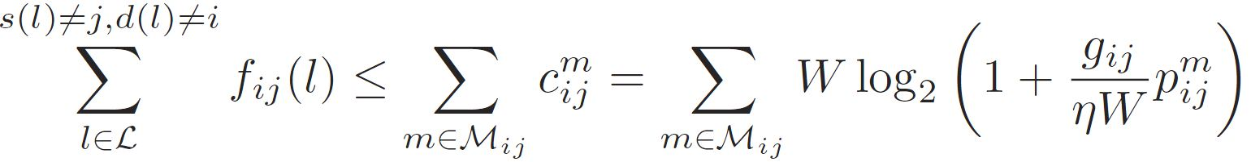
Link Capacity Constraint
Aggregate flow on link (i, j) cannot exceed link capacity
23

Slide 24

Objective Function
A critical resource in CR networks is spectrum
Spectrum is occupied at a specific region (footprint) around the transmission node
We use bandwidth-footprint-product (BFP) to measure resource
  Under the uniform propagation gain model, the footprint is
Our objective: The total used BFP for given communication sessions
24

Slide 25


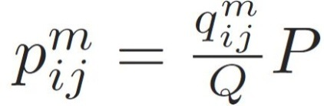
Discretization of Transmission Powers
Assume power control on Q levels
  The transmission power can be
Denote the power level at link (i, j) on band m, i.e.,
25

Slide 26
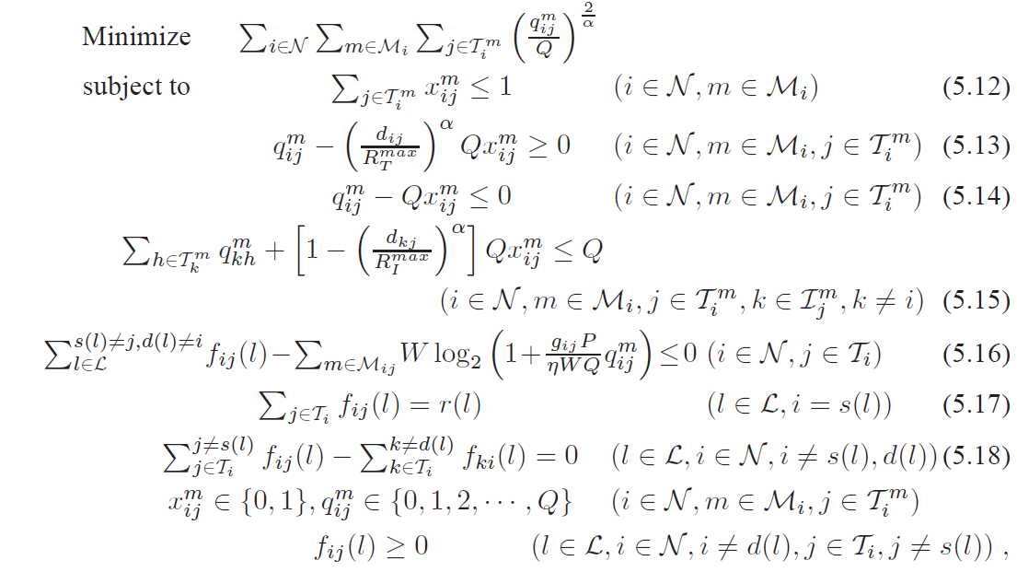
Problem Formulation
A mixed-integer non-linear program (MINLP)
26

Slide 27
Outline of Case Study
Mathematical Modeling and Problem Formulation
A Solution Procedure
Numerical Results

Slide 28
Basic Idea
Branch-and-bound
  A form of divide-and-conquer technique
During each iteration, we find upper and lower bounds for each sub-problem
  Lower bound obtained via convex hull relaxation
  Upper bound obtained via a local search algorithm based on solution to lower bound

Slide 29

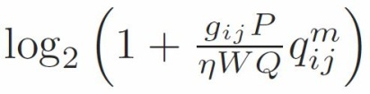
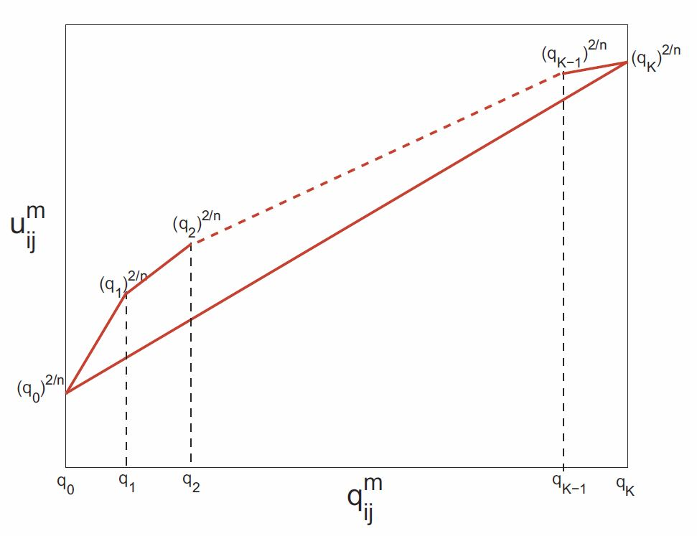

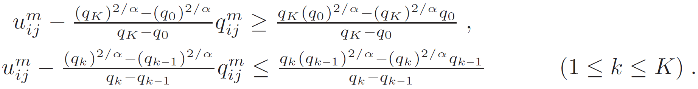
Linear Relaxation
We need linear relaxation for each non-linear term
and
Suppose
For the non-linear discrete term , we have a convex hull relaxation.
29

Slide 30
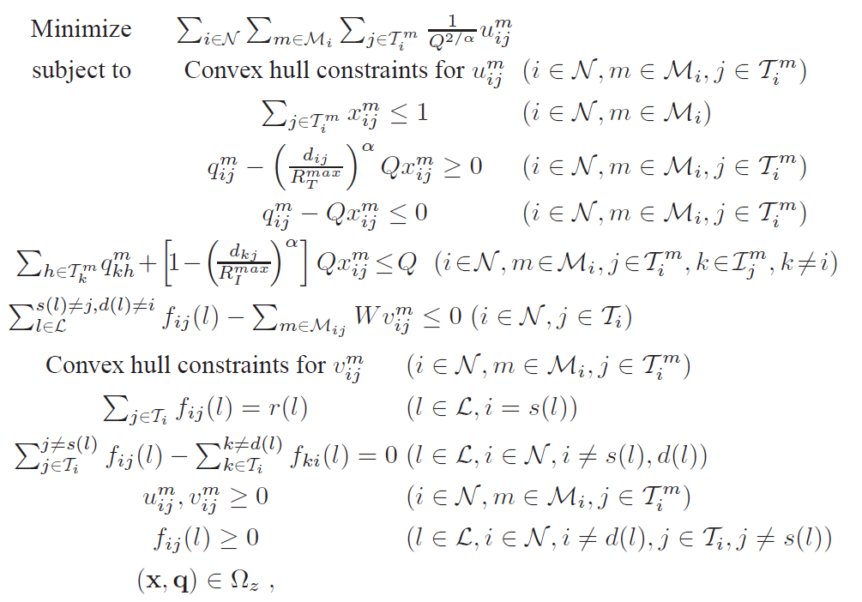
An LP to Find Lower Bound
Can be solved in
polynomial time.

Slide 31
Local Search Algorithm: Basic Idea
Motivation: In the solution to lower bound, both x and q variables may not be an integer
  Not feasible to the original problem
A local search algorithm finds a feasible solution based on solution to lower bound
This feasible solution provides an upper bound on the total BFP

Slide 32

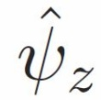
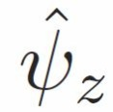
Local Search Algorithm: Details
To the original problem, a feasible solution includes (f, x, q)
Denote the relaxation solution as
  may not be feasible to the original problem
Construct a feasible solution based on
  should satisfy all constraints in the original problem

Slide 33
Original Problem

Slide 34
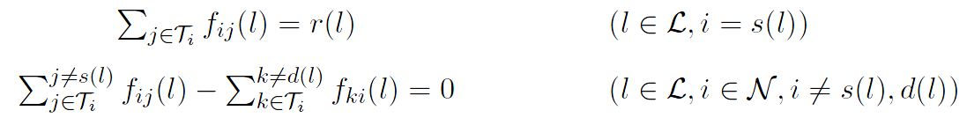


Verifying Flow Routing Constraint
  Preserve the flow routing, i.e.
Since satisfies flow balance constraints (5.17) and (5.18)
Constraints (5.17) and (5.18) also hold by f
(5.17)
(5.18)

Slide 35
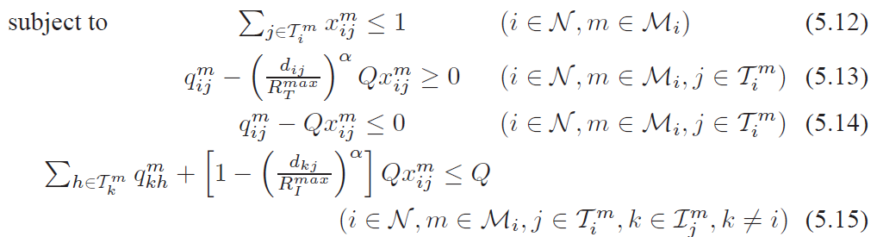

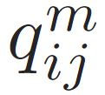
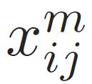
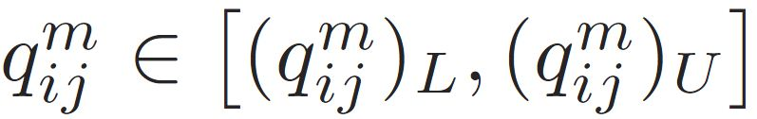
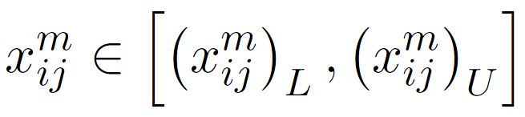
Satisfying Power Control and Scheduling Constraints
Each and has its value set, i.e.

Slide 36


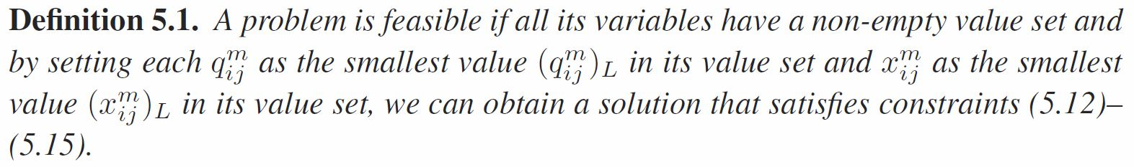
Verifying Power Control and Scheduling Constraints (cont’d)
Initially, we set and
The original problem 1 is feasible
  The initial x=0 and q=0 satisfy constraints (5.12)-(5.15)
When we partition the problem, we only keep feasible problems

Slide 37


Verifying Link Capacity Constraint
(5.16)
Capacity requirement on link i->j (fixed)
Current capacity
(tunable)
By increasing
If constraints (5.16) are satisfied, is a feasible solution
Otherwise, increase under its value set limitation to satisfy (5.16)

Slide 38


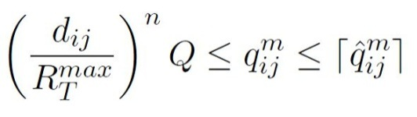


Satisfying Rate Requirement: Step 1
Three steps
  Increase among currently used bands in the non-increasing order of and under the limitation that
  Use an available but currently unused band in the non-increasing order of . For the selected band m, increase under the constraint
    When is changed, we need to adjust other variables to keep (5.12)-(5.15) satisfied
Notes:
A band m is available on link i → j if for any transmitting node k using this band, node j is not in its interference range

Slide 39
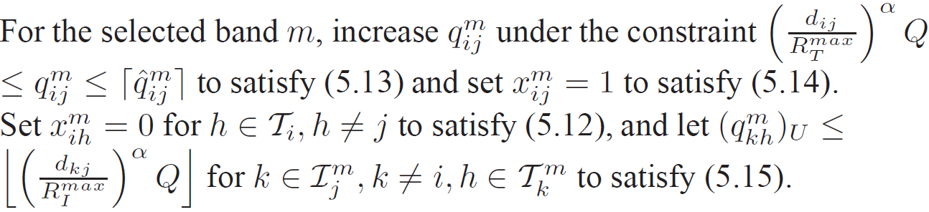

Verifying Link Capacity Constraint (cont’d)
  Variables adjustments
  Increase among currently used bands in non-increasing order of and under the constraint
Homework question: Do we need to adjust other variables at step 1 or 3?

Slide 40
Termination of Local Search Algorithm
If the rate requirement can be satisfied, then the local search algorithm terminates
  We have a feasible solution
  Set the objective value of this feasible solution
Otherwise, a feasible solution cannot be found
  Set the objective value to ∞

Slide 41
Selection of Partition Variables
What if the gap between the lower and upper bound is large?
  Generate two new sub-problems to narrow down the gap
Identification of a partition variable
  Based on its relaxation error
  Consider x variables first
  After all x variables are determined, consider q variables
Notes:
The partition variables include all x and q variables.
For our problem, we find that x variables are more important than q variables, in terms of their impact on the objective value.
The x variables are link-layer binary variables which determines whether or not a link is activated.
The q variables are physical-layer integer variables which determines the power level of a link.
Thus, instead of identifying a partition variable based on its relaxation error only, it makes sense to consider x variables before q variables.

Slide 42


Selection of X Variables
The relaxation error for is
Choose the with the largest relaxation error
Example
  Three variables: x₁=0.8, x₂=0.6, x₃=0.3
  The relaxation errors: 0.2, 0.4, 0.3
  Choose x₂=0.6

Slide 43


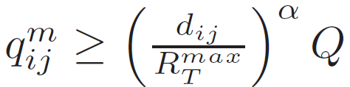
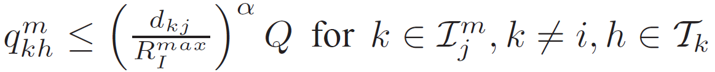
Problem Partition on X Variables
Problem z
=0
=1
Problem z₁
Problem z₂
Set =0 to satisfy constraints (5.14)
(5.12), (5.13) and (5.15) remain to hold
Set to satisfy constraints (5.12)
to satisfy constraints (5.13)
to satisfy (5.15)

Slide 44
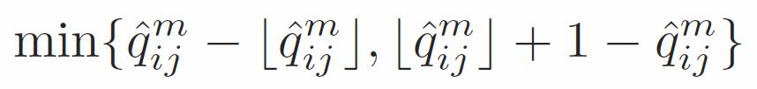
Selection of q Variables
After all x variables are determined
The relaxation error for is
Choose the with the largest relaxation error
Example
  Three variables: q₁=10.8, q₂=5.6, x₃=3.3
  The relaxation errors: 0.2, 0.4, 0.3
  Choose q₂=5.6
Notes:
How to partition problems using q variables and how to adjust other variables is a homework problem.

Slide 45
Outline of Case Study
Mathematical Modeling and Problem Formulation
A Solution Procedure
Numerical Results

Slide 46
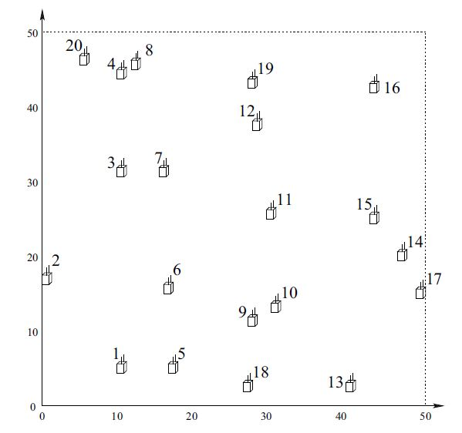
Simulation Setting
20 nodes
50 x 50 area
5 communication sessions with rates in [10, 100]
  Node 7 ->16
  Node 8 ->5
  Node 15 ->13
  Node 2 ->18
  Node 9-> 11
10 bands with the same bandwidth of 50
  A subset of these 10 bands is available at each node
Network topology of a 20-node network

Slide 47
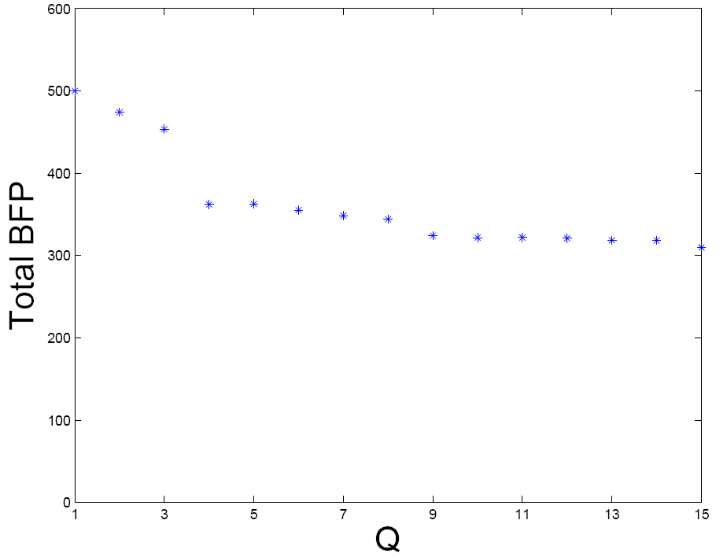
Impact of Power Control Granularity on BFP
No power control
Power control can decrease BFP
Q=10 is sufficient for this network
47
Notes:
Note that Q = 1 corresponds to the case that there is no power control, i.e., a node always uses its peak power P for transmission.
When Q is sufficiently large, power control approaches continuous.
we note that the granularity of power control has a significant impact on objective value.
Comparing the case when there is no power control (Q = 1) and the case of Q = 15, we find that there is nearly a 40% reduction in
the objective value.
2) Although the objective value is a non-increasing function of Q, when Q becomes sufficiently large (e.g., 10 in this network setting), further increase
in Q will not have much reduction in the objective value.
This suggests that for practical purpose, the number of required power control levels does not need to be a large number.

Slide 48
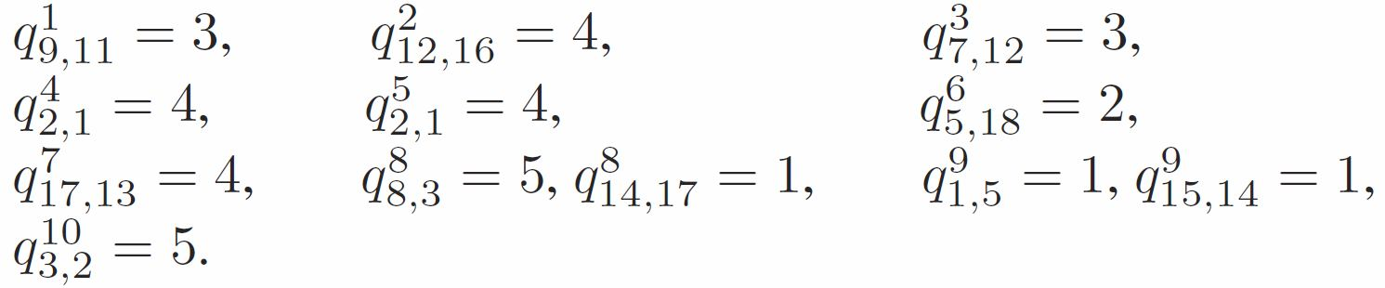
Results of Transmission Power
When Q=10,
Transmission power at each node can be smaller than the full power.
With power control, the objective function (BFP) can be smaller.

Slide 49
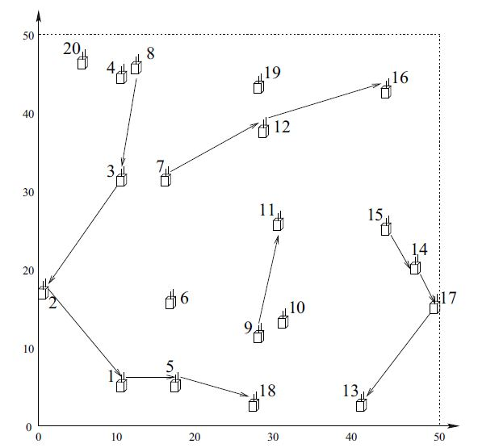
Flow Routing
Active on band 8
A shorter path is not used to avoid interference
Also active on band 8
Flow routing when Q=10
Notes:
The following observations on the numerical results show the close coupling relationships between per-node power control and upper layers.
1) In one observation (scheduling), we can see that, links 8 → 3 and 14 → 17 are active on the same band 8.
This is feasible because the interference range at node 14 is 22.49 under q⁸_{4,17} = 1, which is smaller than 38.35 (the distance between nodes 3 and 14).
We note that if there is no power control, i.e., node 14 use the peak transmission power, then node 3 will be in the interference range of node 14,
which is R^{max}_{I} = 40, and will lead to a scheduling conflict.
2) In another observation (routing), we see that, for session 2 (from node 8 to node 5), the routing path is 8 → 3 → 2 → 1 → 5.
Here, a shorter path 8 → 3 → 6 → 5 is not used.
This is because path 8 → 3 → 6 → 5 is interfered by transmissions on other paths.
The optimal solution tends to choose paths that are not close to each other.
3) Finally, for session 3 (form node 15 to node 13), the routing path is 15 → 14 → 17 → 13, while a shorter path 15 → 17 → 13 is not used.
This is because that node 15 can use a smaller transmission power to transmit to a closer neighboring node 14 with a smaller interference footprint.
This will allow link 1 → 5 to be active on the same band 9 with link 15 → 14.

Slide 50
Summary
Review of branch-and-bound framework
A case study
  Cross-layer optimization for cognitive radio networks
  Developed a linear formulation for scheduling with power control
  Formulated a cross-layer optimization problem
  Designed a formal solution procedure based on branch-and-bound and convex hull relaxation
50

