Slide 1
Chapter 11
Metaheuristic methods

Slide 2
Outline
Review of metaheuristic methods
Case study
  Routing for multiple description video over wireless ad hoc networks

Slide 3
Review of Metaheuristic Methods
Basic idea
  Taking user-given solutions as starting points
  Improving them to obtain a much better solution
Well known metaheuristic method
  Iterative improvement
  Simulated annealing
  Tabu search
  Genetic algorithm

Slide 4
Iterative Improvement
Start with a feasible solution
In each iteration, search the neighborhood of the current solution to find a better solution
Terminates when a better solution cannot be found
A fundamental problem: Likely to get trapped in a local optimum
  May be far from the global optimum

Slide 5
Simulated Annealing (SA)
Inspired by a thermal process in physical science
Starts at an initial solution
Search neighborhood of the current solution to generate a new solution
Accept a better solution or accept a worse solution with certain probability
    Avoid being trapped in a local optimum
Cooling process guarantees convergence
  Decreases diversification as time pass
  Gradually converges to a simple iterative improvement algorithm
Notes:
Physical science: When a metal in a melted state is cooled down, the metal atoms try to stabilize to low energy state to form a pure crystal. If the cooling process is slow, possibly the metal can reach the state of minimum energy; otherwise, it may reach a state with higher energy.
Analogous to the metal annealing, the basic idea of SA is to find an optimal solution for an optimization problem (corresponding to the minimum energy) by a series of improving moves (corresponding to the cooling process).
The performance of SA is sensitive to the initial solution and the neighborhood structure.

Slide 6
Tabu Search (TS)
A memory metaheuristic approach
  Explicitly uses the history of the search
Maintain a list of solutions declared as “tabu”
  Exclude recoded solutions from the neighbors of current solution
  Prevent cycling and revisiting
  Escape from local optima
Both simulated annealing and Tabu search are single-point-search metaheuristic

Slide 7
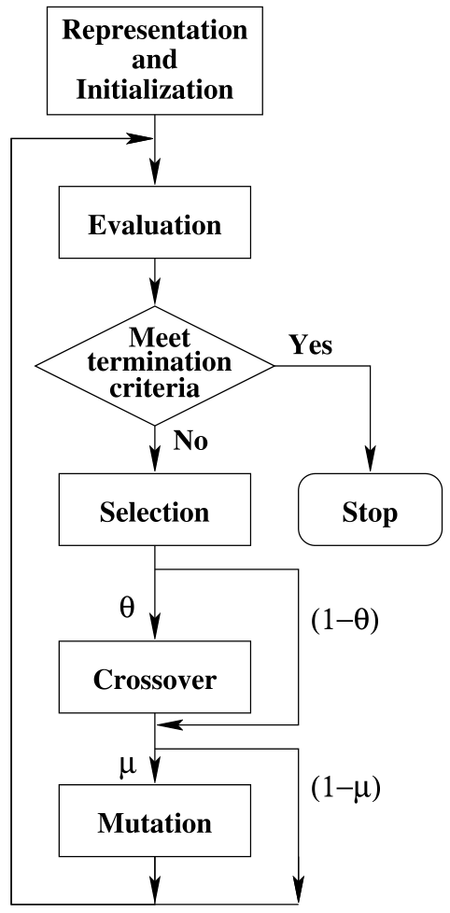
Genetic Algorithm (GA)
Inspired by natural evolution
  The survival-of-the-fittest principle
A population-based algorithm
  Deal with a set of solutions (or individuals) at each generation
Main idea
  Evaluates each individual by a fitness function
  Select “good” individuals
  Generate offspring via genetic operations
    Crossover
    Mutation
Notes:
The survival-of-the-fittest principle ensures that the overall quality of the population increases as the algorithm progresses from on generation to the next.
After evaluation, if current individuals meet some terminating condition, then we can terminate and return the best individual as the final solution.

Slide 8
GA -- Details
Fitness function
  Related with the objective function of an optimization problem
Crossover
  Recombines two or more selected individuals to produce new individuals
Mutation
  Achieve a randomized self-adaption of individuals

Slide 9
Outline
Review of metaheuristic algorithm
Case study
  Routing for multiple description video over wireless ad hoc networks

Slide 10
Synopsis
Motivation
  Multiple description (MD) video has its potential in ad hoc network
Objective
  Optimal multipath routing for double description (DD) video in wireless ad hoc networks
Question to be answered
  Model video distortion and routing behavior
  Efficient solution procedure
  Achievable performance
Notes:
Multiple description coding has become a popular coding technique for media streaming.
With MD coding, multiple streams (or description) are generated for a video source and any received subset of these streams can be used to reconstruct the original video.
Further, the quality of received video commensurate with the number of received descriptions.
Therefore,…
Routing is one of these most important factor that affects the video quality.
We study the problem of multipath routing for double description video in wireless ad hoc network.

Slide 11
Problem Description
Network model
  Model ad hoc network as stochastic directed graph
  A graph of vertices and edges
  Edge: Determined by transmission range
Link metrics
  Available bandwidth
  Packet loss probability
  Average loss burst length
Internet
Notes:
We assume that the nodes are reliable during the video session, but links may fail with certain probabilities.
The orthogonal channel are used among the links so that interference among links can be effectively management by proper channel assignment.

Slide 12
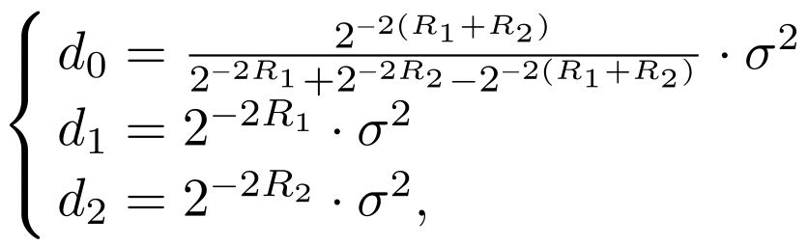
Video Rate-Distortion Model
Using more descriptions and paths
  Increase robustness to packet loss and path failure
  Increase the video bit for the same video quality
  Increase from one to two can achieve the most significant performance gain
  Two descriptions are more effectively achieve performance gain
Relationship between distortion and bit rate
Notes:
Denote d_h as the achieved distortion when only h description is receivedm h=1,2, and d_0 the distortion when both description are received.
Denote R_h as the rate in bits/pixel of description h, h=1,2.

Slide 13




Video Rate-Distortion Model (cont’d)
The average distortion of the received video can be approximated as:
where is the probability of receiving both descriptions,
is the probability of receiving description 1 only,
is the probability of receiving description 2 only,
and is the probability of losing both descriptions.
Notes:
Our formulation does not depend on any specific distortion-rate function.
A more accurate distortion-rate function for MD video could be incorporated into our formulation and it should be available in the furture.

Slide 14



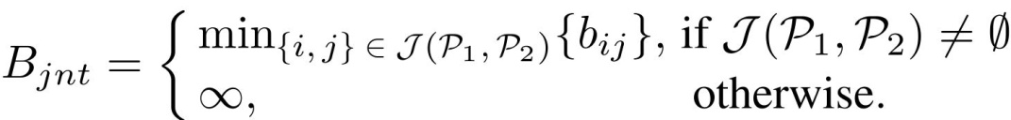


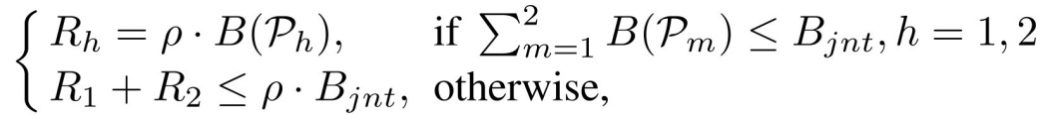


Description Rates
Denote as the set consisting of disjoint links on paths and , the minimum bandwidth of is:
The rates of two video streams, and are:
where and is constant determined by the video format and frame rate
Notes:
For a video with coding rate f frames/s and a resolution of W *V pixels/frame, we have \rho=1/(\kappa*W*V*f), where \kappa is a constant determined by the chroma sub-sampling scheme.
The first case for the rates is for when the joint links are not bottleneck of the paths.
The second case is when one of the links is the bottleneck of both paths.
In the latter case, we assign the bandwidth to the paths by splitting the bandwidth of the shared bottleneck link in proportion to the mean success probabilities of the two paths, while an alternative approach is to split the bandwidth evenly for balanced description.

Slide 15
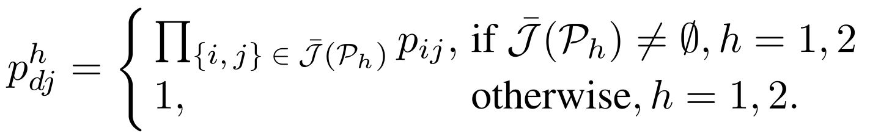
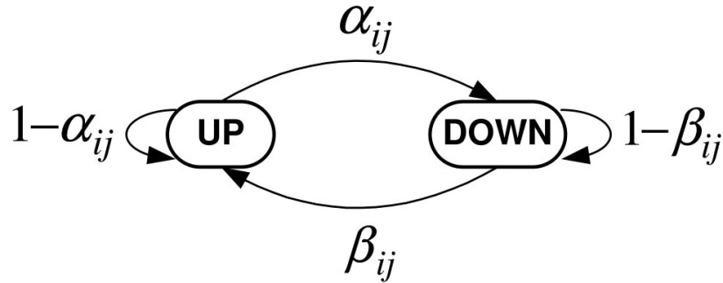


Computing Success Probabilities
Success probability on the disjoint portions of the two paths is:
Joint probabilities of receiving the description
  Correlated losses: Aggregate the shared links and model them as an on-off Markov process
Transition probabilities
Notes:
There is no packet loss when the link is in the “up” state; all packets are drooped when the link is in the “down” state.

Slide 16
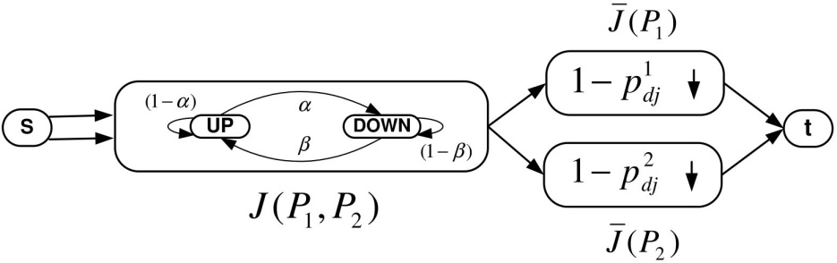
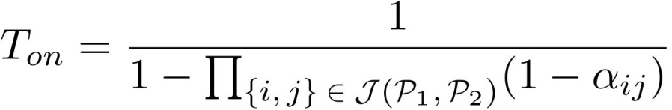
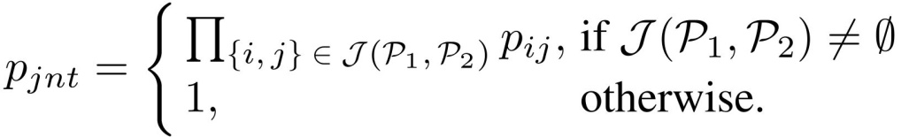
Computing Success Probabilities(cont’d)
  Independent losses: Aggregate the disjoint links of each path and model them as a Bernolli process
  The average length of the “up” period is
  If the joint link set is not empty, the probability of a successful delivery on the joint links can be written as
Notes:
For K shared links, the aggregate failure process of these links is a Markov process with 2^K states.
In order to simply the computation, we follow the well-know Fitchman modl to model the aggregate process as an on-off process.

Slide 17
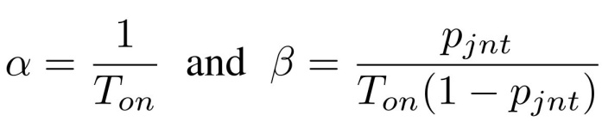
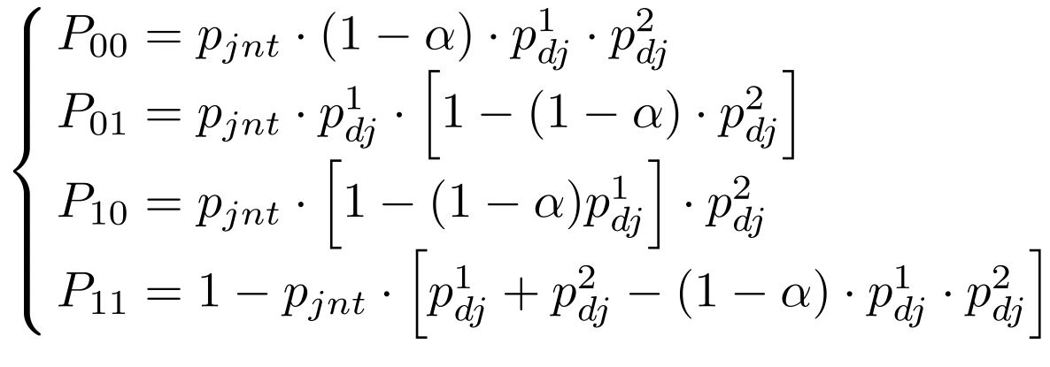
Computing Success Probabilities(cont’d)
  Finally, the transition probabilities of the aggregate on-off process are
  With the consolidated path model, the joint probabilities of receiving the descriptions are:

Slide 18
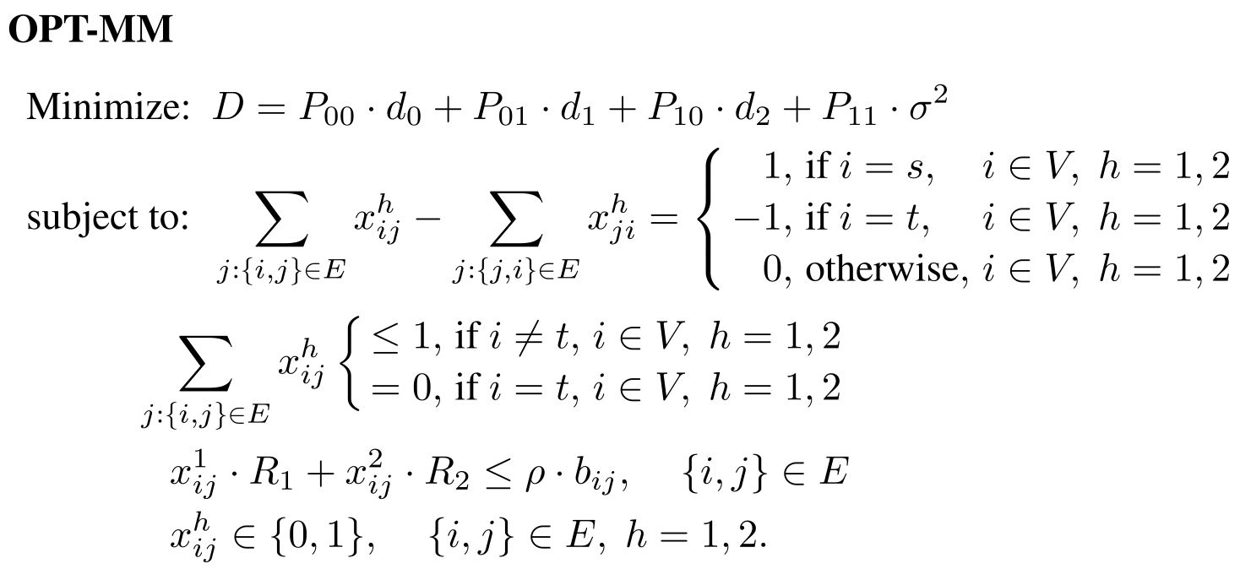
The optimal Multipath Routing Problem
Minimize the average distortion of the received video
Ensure the links are stable
Ensure the paths are loop-free
Notes:
x^h_{ij}=1 if {i, j} \in \mathcal P_h; =0; otherwise
x^h_{ij} are binary optimization variables.
For a given pair of paths, the average video distortion D is determined by the end-to-end statistics and correlation of the paths.
Different statistics of a given pair of path lead to different video distortion.
Specifically, the larger the end-to-end bandwidth is, the higher the video rate is, and the smaller distortion is with a lower end-to-end loss rate, fewer video framers will be corrupted.
The objective function is a highly complex ratio of high-order exponentials of the x-variables.
The objective evaluation of a pair of paths involves identifying the joint and disjoint portions, which is only possible when both paths are completely determined.
[Sherali1998], Sherali et al. considered a problem that seeks a pair of disjoint paths in a network such that the total travel time over the paths is minimized, where the travel time on a link might be either a constant, or a non-decreasing (or unstructured) function of the
time spent on the previous links traversed. Even for a simple special case where all the links except one have a constant travel time (and hence linear objective terms), this problem is shown to be NP-hard. Our problem has much more complex relationships pertaining to the contribution of each individual link to the objective function, which depends in general on the other links that are included in a fashion that has no particular

Slide 19
A GA-based Method
Approach
  Propose a solution procedure that produces a pair of feasible and near-optimal paths
Why GA
  Identifying promising search region
  Less likely to be trapped at a local optimum
  GA is a parallel algorithm
    Naturally handling complexity due to the interaction among concurrent sessions
Notes:
GA are population-based metaheuristic inspired by the survival-of-the-fittest principle.
The survival-of-the-fittest principle ensures that the overall quality of the population improves as the algorithm progresses from one generation to the next.
It has the intrinsic strength of dealing with a set of solutions at each step, rather than working with a single, current solution.

Slide 20
Representation and Initialization
Representation
  Define a node as a gene
  Define a route as a sequence of gene (chromosome)
  Define a solution (individual) as a set of routes, each route assigned to a session
  Define a population as a group of solutions (individuals)
Initialization
  Produce an initial population of solution
Notes:
A simple approach generating feasible solution as initial solution would be to randomly append feasible elements to a partial solution.

Slide 21
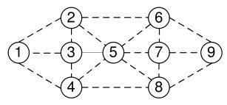
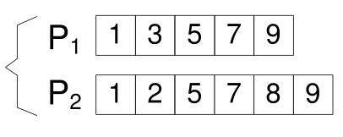
An Example
An example ad hoc network
A feasible solution
Notes:
Dashed lines in the left figure represent the wireless links

Slide 22


Evaluation and Selection
Evaluation
  Define an individual
  The fitness function is defined as the inverse of the distortion value:
Selection
  An individual with higher values of fitness function is likely to be selected
Notes:
The fitness function of an individual should be closely related to its objective function value (the total distortion D).
Since the objective function is to minimize the average distortion, we have adopted a fitness function that is defined as the inverse of the distortion value.
For selection, we can use the popular Tournament selection scheme, which randomly chooses some individuals from the population each time, then selects the best of these individuals in terms of their fitness values.

Slide 23
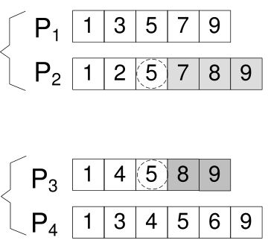
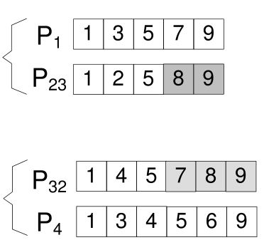
Crossover
Mimics the genetic mechanism of reproduction in the natural world
Genes from parents are recombined and passed to offspring
Parent 1
Offspring 1
Parent 2
Offspring 2
Notes:
Crossover mimics the genetic mechanism of reproduction in the natural world, in which genes from parents are recombined and passed to offspring.
In this example, two parent individuals x_1=[P1, P2] and x_2=[P3, P4,], we could randomly pick a session, say session 2 (P2 in x_1 and P3 in x_2).
We select the first common node exist in P2, node 5 (not source or destination node).
We can then concatenate the nodes {1, 2, 5} from P2 with the nodes {8, 9} in P3 to produce a new path P23. Likewise, we can concatenate the nodes {1, 4, 5} from P3 with the nodes {7, 8, 9} in P2 to produce a new path P32.

Slide 24




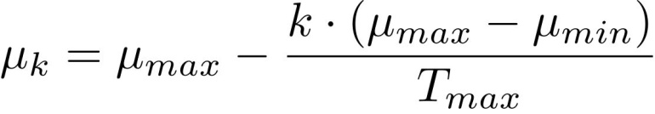
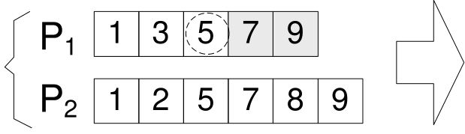
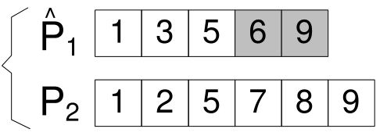
Mutation
We propose a schedule to vary the mutation rate within
  The mutation rate is first initialized to
  Then as generation number increases, the mutation rate gradually decreases to , i.e.,
An example
Original individual
New individual
Notes:
The objective of the mutation operation is to diversity the genes of the current population, which helps prevent the solution from being trapped in a local optimum.

Slide 25



Numerical Example
Ad hoc network randomly generated within a rectangular region
The failure probability for each link is uniformly chosen from [0.01, 0.3]
The available bandwidth is uniformly chosen from [100, 400] kb/s, with 50 KB/s steps,
The mean burst length is uniformly chosen from [2, 6]
The population size is 15; ; is varied from 0.3 to 0.1; =1
Notes:
The GA is terminated after a predefined number of generations or after a prespecified computation time.

Slide 26
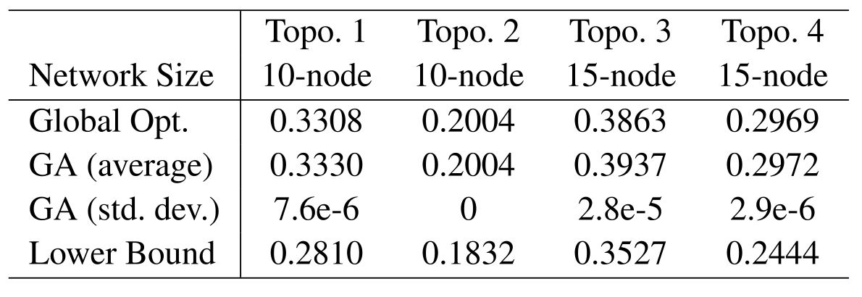
Performance Bounds
Average distortion values found by the algorithm
Notes:
We compare the GA solutions to the global optimal solutions computed by exhaustive search (Global Opt), for small networks.
The solution found by GA are very close to the global optimum in all cases.
In addition, the standard deviation of the 30 GA results for the small network is very small.
The average computation time for GA is 0.29s for the 10-node network (about 60 generations) and 0.39s for the 15-node network (about 70 generation)
For exhaustive search, the average computational time is 58.7s for 10-node case and 1877s for the 15-node case.

Slide 27
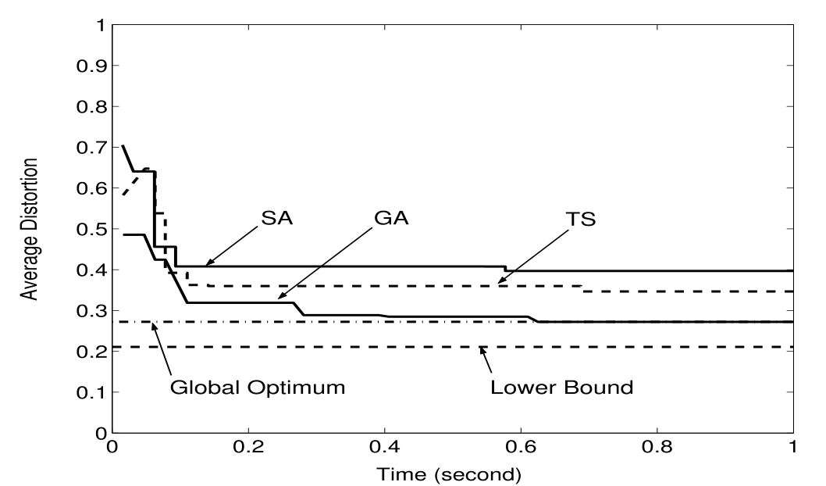
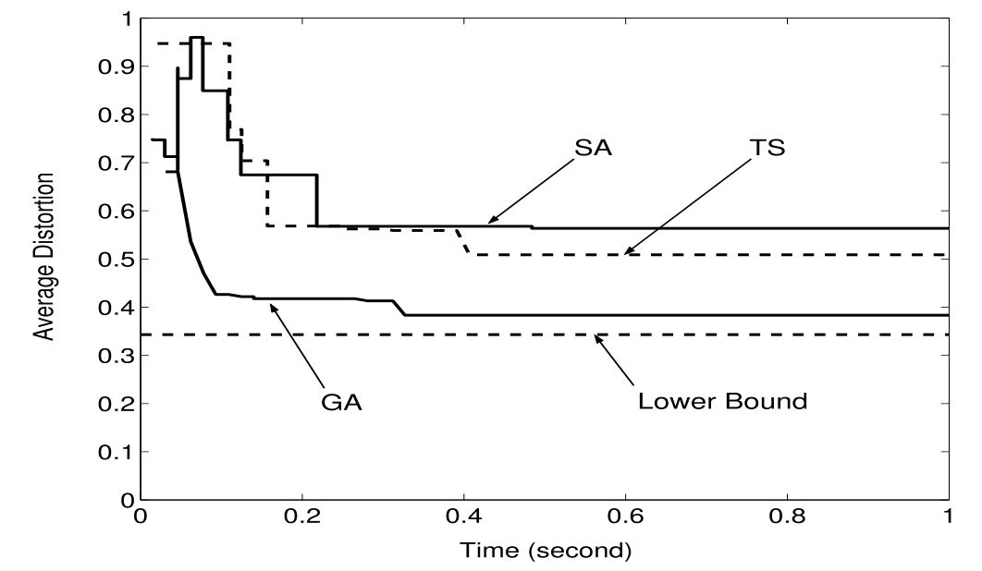
GA versus Trajectory Methods
Distortion evolution for a 10-node network
Distortion evolution for a 50-node network
Notes:
We implement two representative trajectory metaheuristic methods, namely, SA and TS.
The geometric cooling schedule for the SA implementation with a decay coefficient 0.99.
For TS implementation, we choose a tabu list of 5 for small network and 10 for large network.
Upon termination, GA has evolved 210 generations in left figure and 75 generation in the right figure;
SA ran for 1500 iterations in left figure and 700 generation in the right figure;
TS ran for 1050 iterations in left figure and 550 generation in the right figure.
In both network, GA quickly converges to the global optimal in 10-node network, while SA and TS are trapped at local optima.
In addition to providing better solution, another strength of GA over trajectory methods is that multiple “good” solution can be found after a s
The initial temperature T in SA to 1 and the temperature decaying ratio r to 0.5.
The tabu tenure for the TS implementation is chosen to be 5-units
The decoding deadline is set to 0.1s for the 11-node network simulations and 0.5s for the 50-node network simulations.

Slide 28
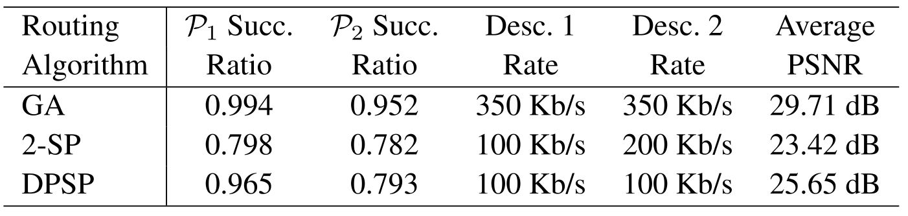
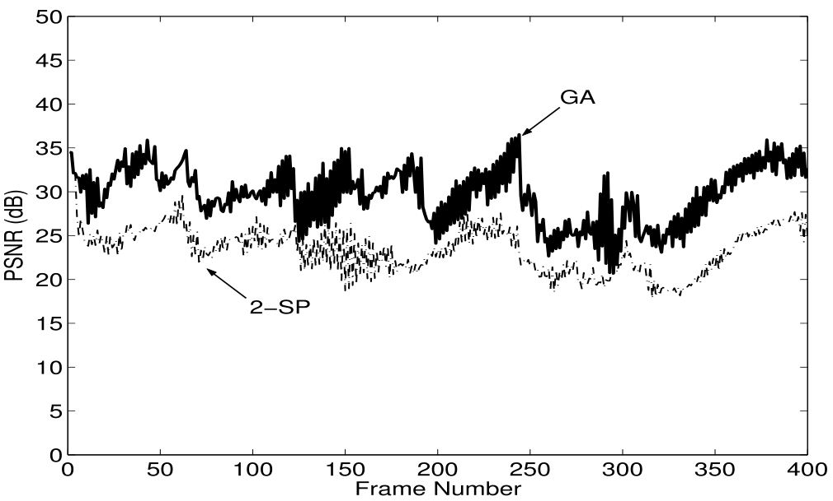
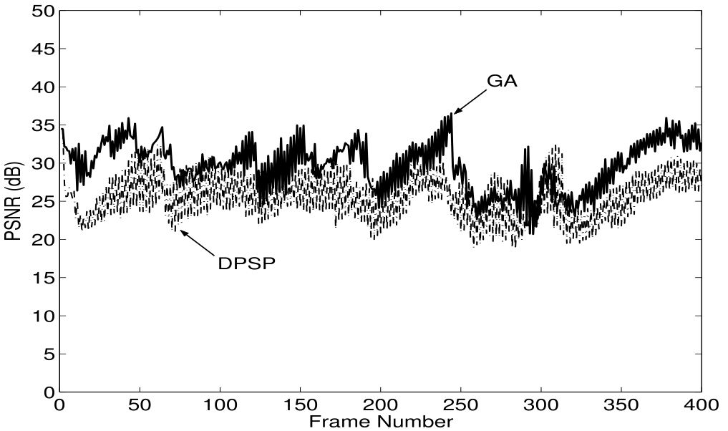
GA-based Routing versus Network-centric Routing
GA-based algorithm versus 2-SP
GA-based algorithm versus DPSP
Notes:
We implement two popular network-centric multipath routing algorithm, namely k-shortest path routing (with k=2 or 2-SP) and disjoint path routing, Disjoint Pathset Selection Protocol (DPSP).
The quality of the paths found by these three algorithms are present in the Table.
The 2-SP algorithm has the worst performance in terms of oath success probabilities.
DPSP algorithm has an improved success probability performance since it uses link success probabilities in routing. However it may sacrifice path bandwidth while pursing low loss paths.
Our GA-based routing yields paths with much higher end-to-end success probabilities and end-to-end bandwidths, resulting in greatly improved video quality.
The PNSR curves of the received video frames are shown in these two figures.
The PNSR cure obtained by GA is well above those obtained by the aforementioned network-centric routing approaches

Slide 29
Summary
Review of metaheuristic methods
  Iterative improvement, simulated annealing, Tabu search, genetic algorithm
Case study: Routing for multiple description video over wireless ad hoc networks
  Developed a GA-based methods
  Used extensive simulation to demonstrate the performance of GA

