Slide 1


Slide 2
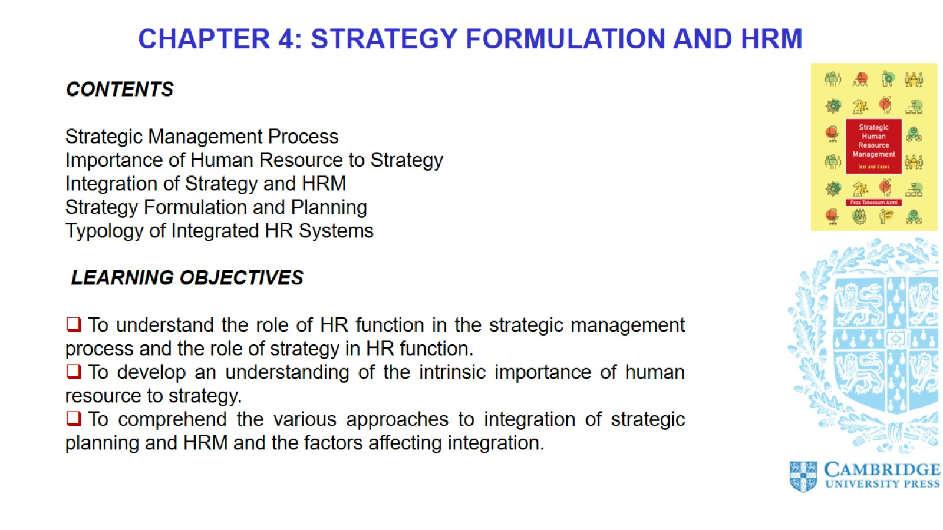

Slide 3
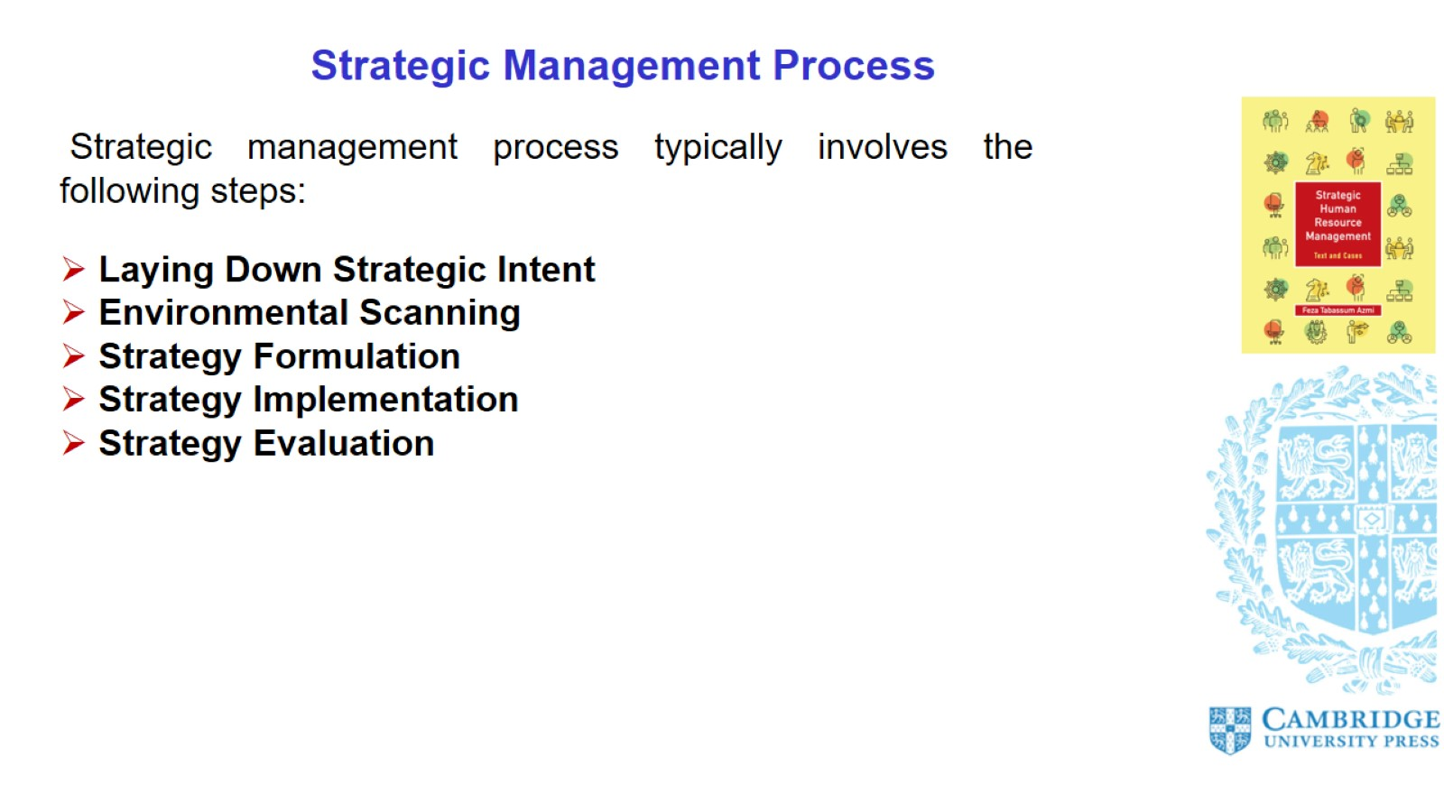
Strategic Management Process

Slide 4
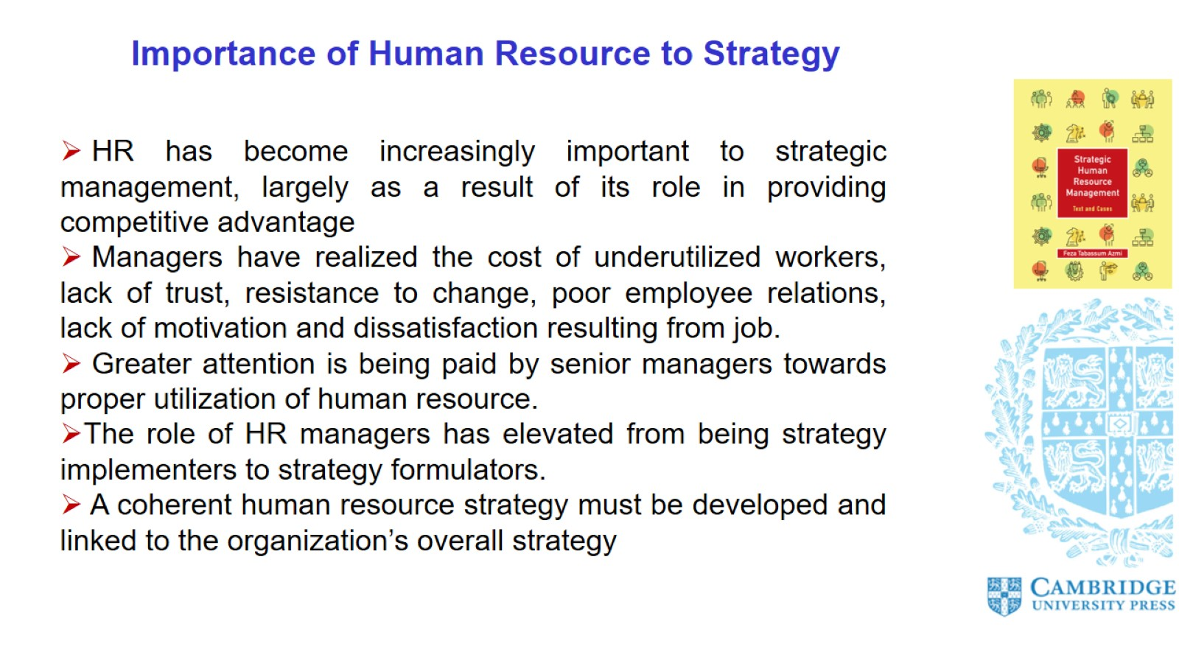
Importance of Human Resource to Strategy

Slide 5
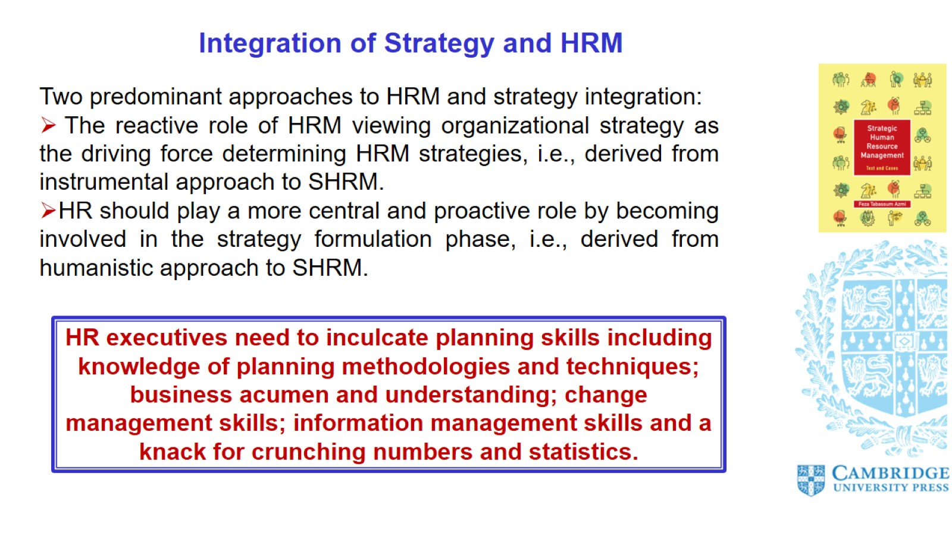
Integration of Strategy and HRM

Slide 6
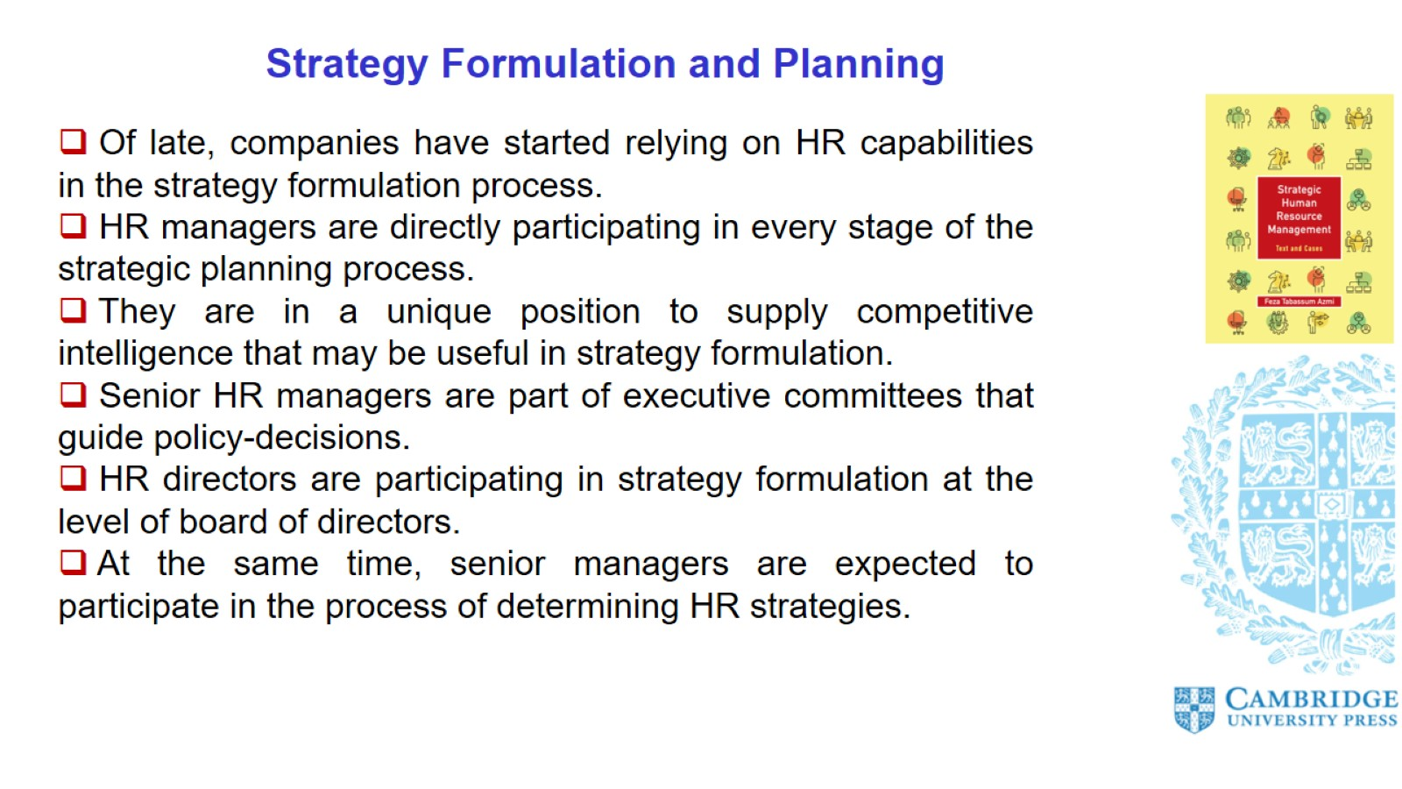
Strategy Formulation and Planning

Slide 7
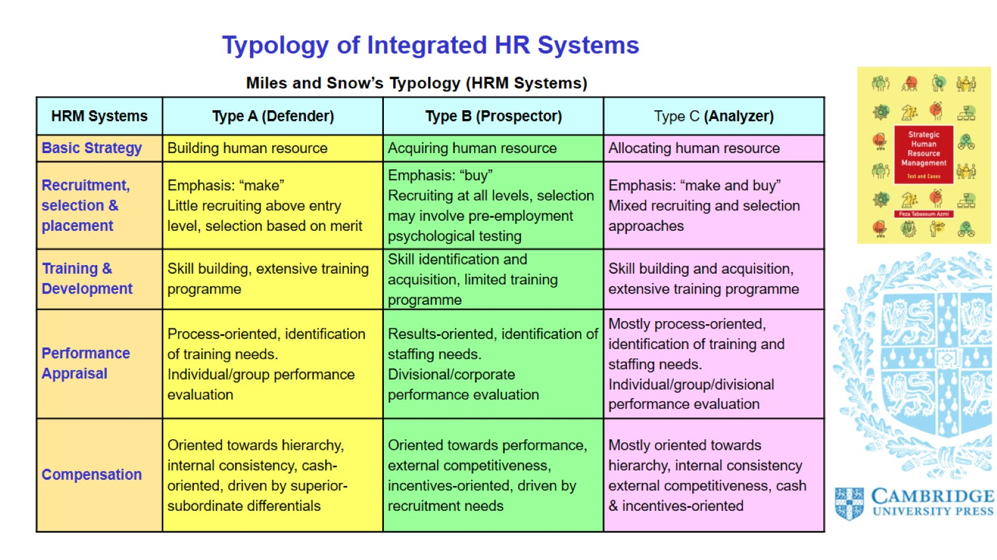
Typology of Integrated HR Systems

Slide 8
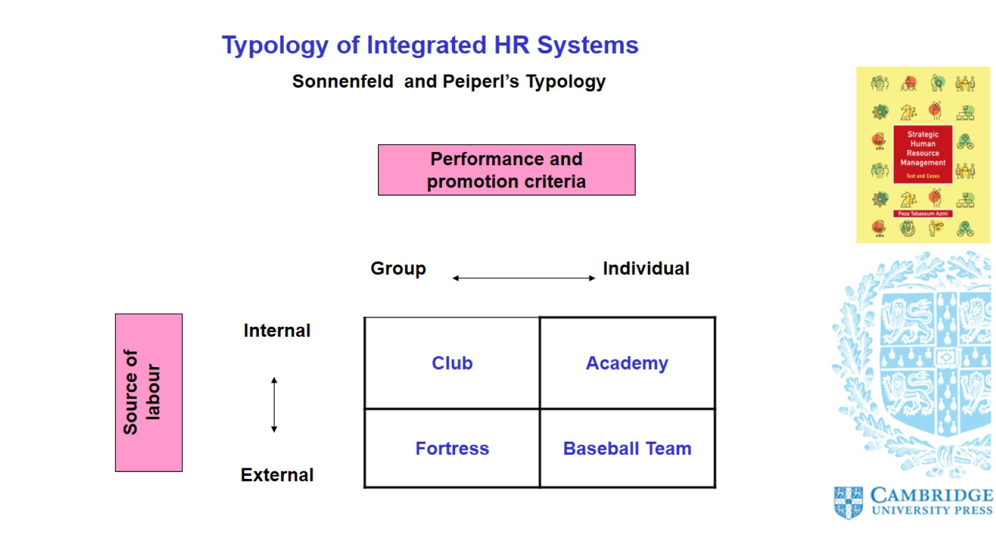
Typology of Integrated HR Systems

Slide 9
